Slide 1
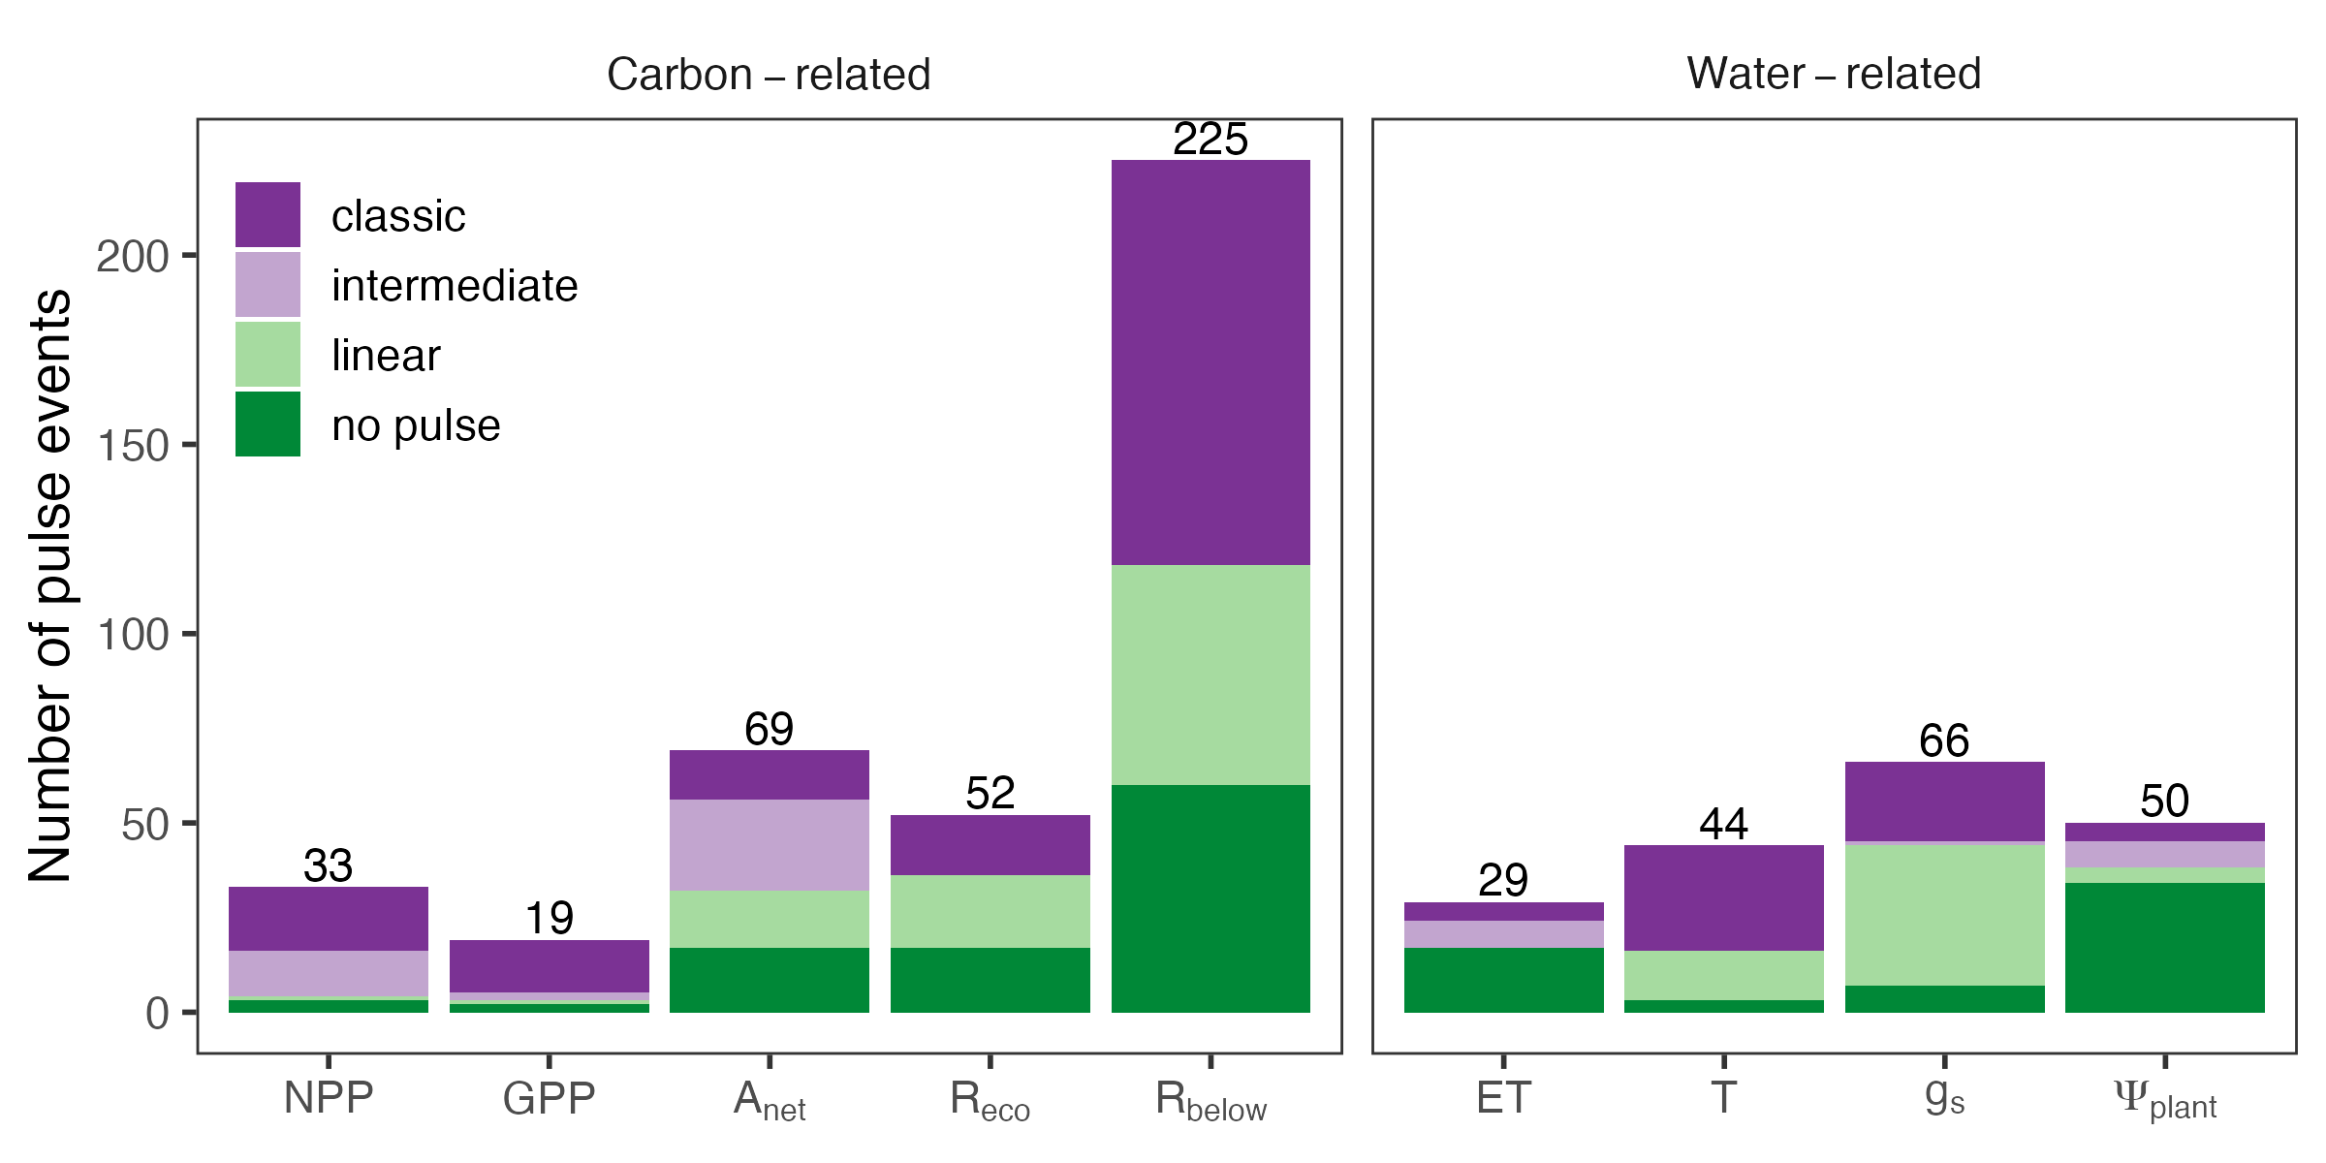
(A)
(B)

Slide 2
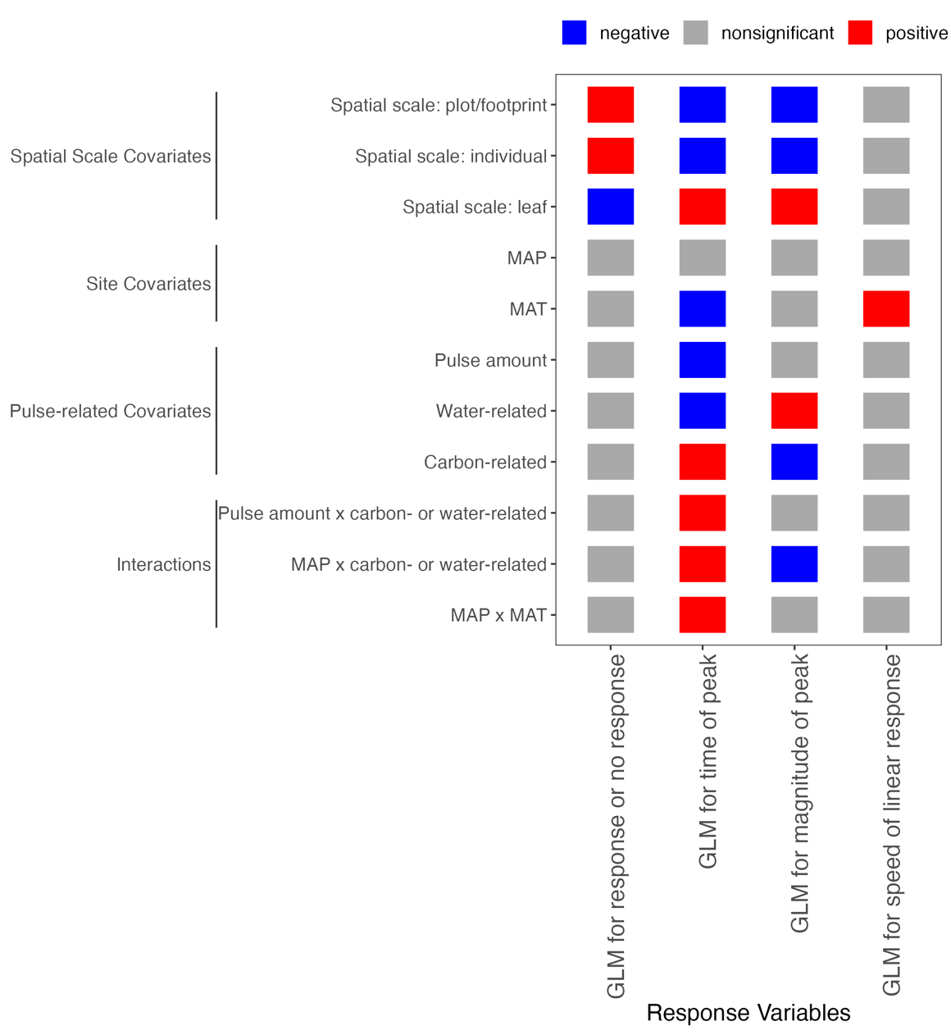
Plot/footprint
Individual
Leaf
MAP
Covariates
MAT
Pulse amount
Water-related
Carbon-related
Pulse amount × water- or carbon- related
MAP × water- or carbon- related
MAP × MAT
Negative
Speed (linear response slope)
Time of peak
Nonsignificant
Response or no response
Magnitude of peak
Positive
Response Variables
Notes:
Pulse-level covariates

