Slide 1
Statistics
Group of Horribly Optimistic STatisticians
Jędrzej Ogrodowski

Slide 2
Statistics is extremely broad subject. In our course we we will talk only about key aspects with as less theory as possible. I recommend read about these topics. For understanding of statistics, it is necessary to know some topics from Probabilistic Methods. (2nd semester on AI and CS)
For self study, recommend StatQuest on Youtube.

Slide 3
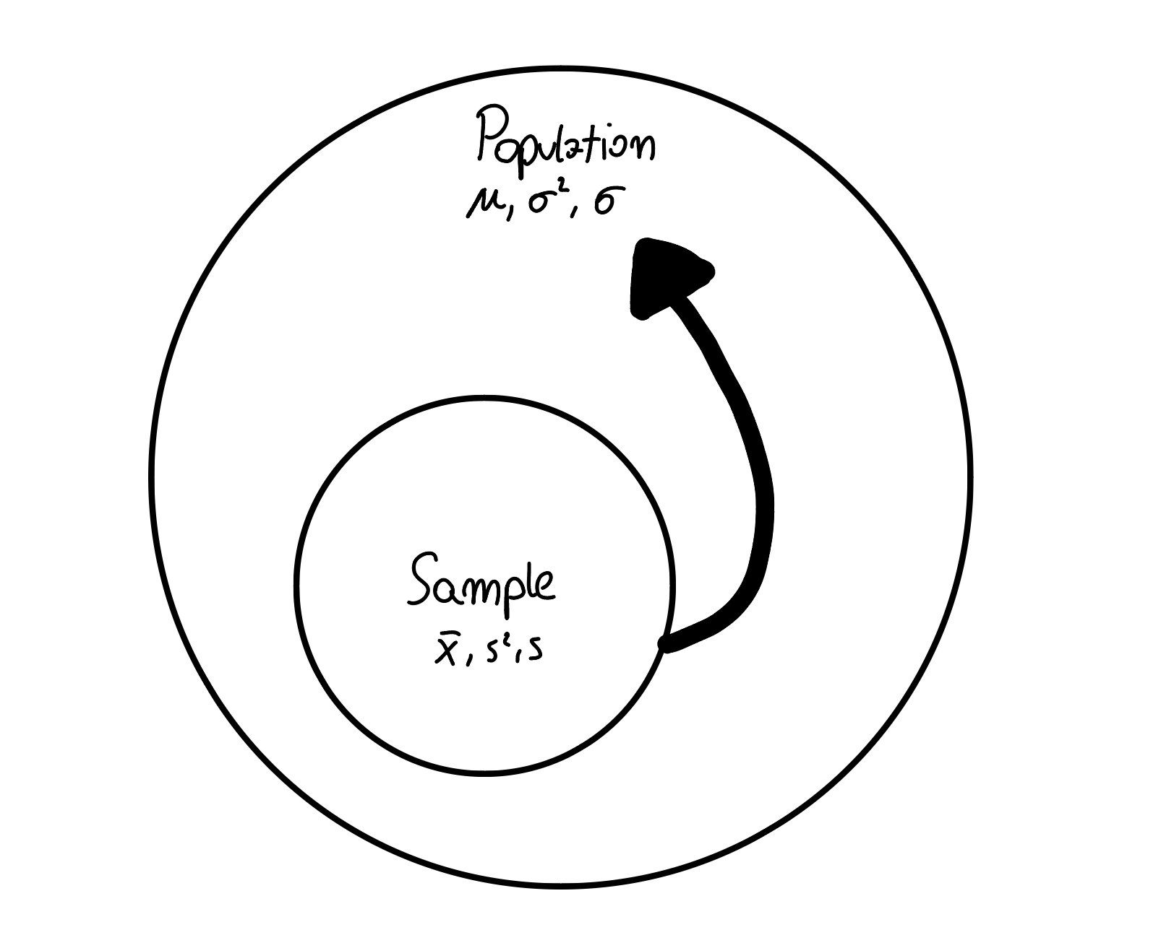

Slide 4
We will focus on dependency between parameters and working with sample data and decide if our sample result is likely in whole population.

Slide 5
Random variables

Slide 6
A random variable is a numerical value that represents the outcome of a random event or experiment. It’s called "random" because its value depends on the outcome, which isn’t certain until we observe it.
A random variable is closely related to a distribution, which describes all the possible values the random variable can take and the probabilities associated with each of these values. The distribution gives us a "picture" of the behavior of the random variable by showing how often we can expect each outcome.

Slide 7
Normal Distribution

Slide 8
It is fundamental concept in statistics. It's a probability distribution that is symmetric about the mean, meaning that data points closer to the mean are more frequent than those farther away.

Slide 9
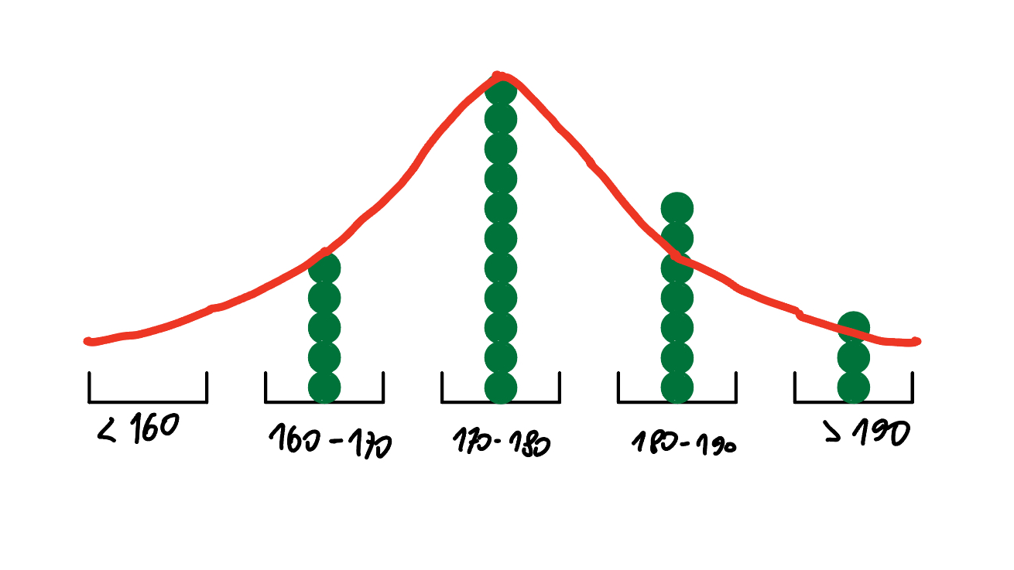

Slide 10
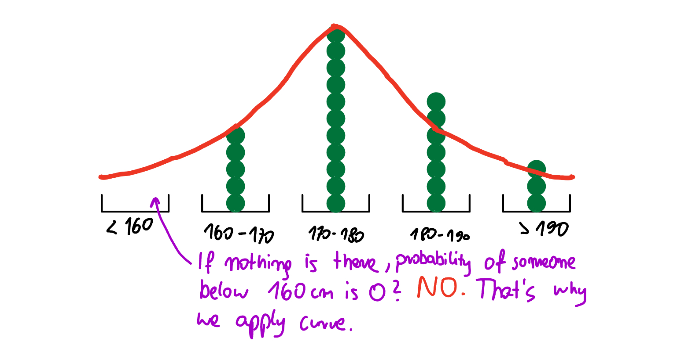

Slide 11
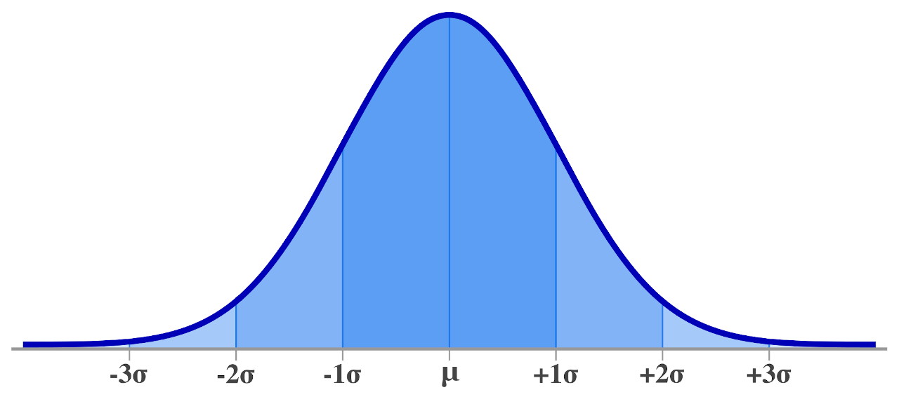

Slide 12
Ubiquity in Nature: Many natural phenomena follow a normal distribution.
Central Limit Theorem: This theorem states that the distribution of sample means approaches a normal distribution as the sample size increases, regardless of the underlying population distribution.
Foundation for Statistical Tests: Many statistical tests, like t-tests and ANOVA, assume that the data is normally distributed.

Slide 13
Central Limit Theorem

Slide 14
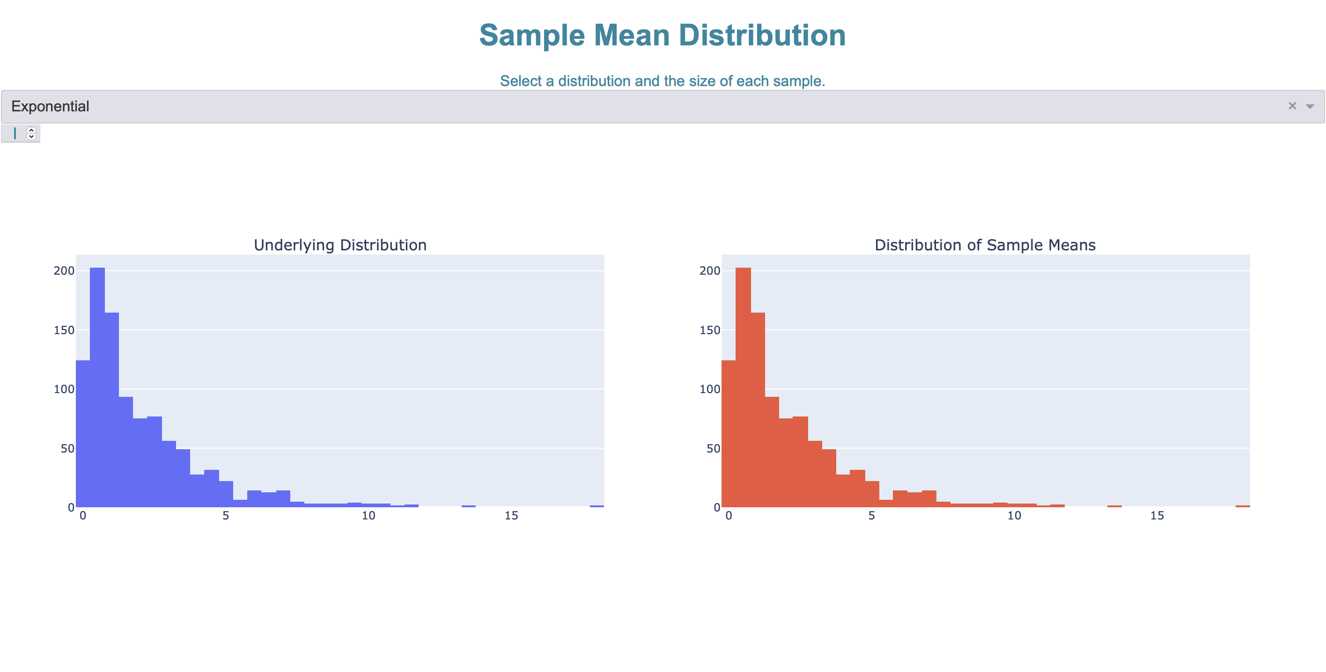
https://cltapp.fly.dev/

Slide 15
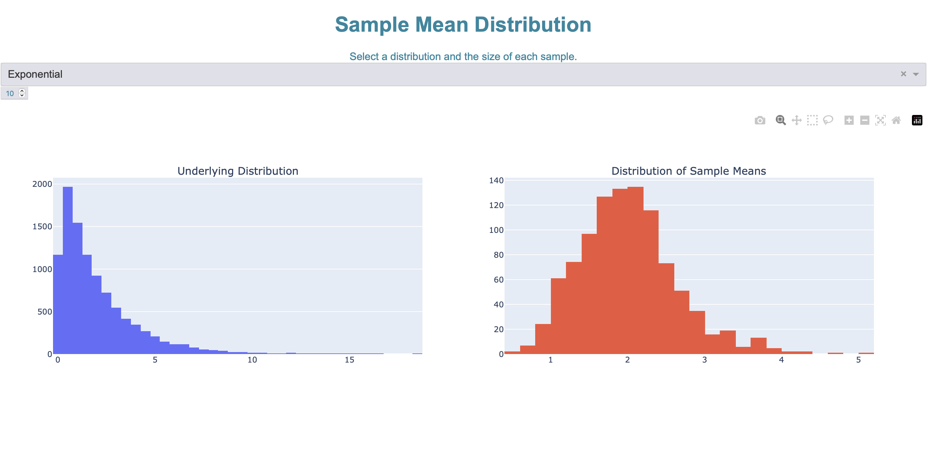
https://cltapp.fly.dev/

Slide 16
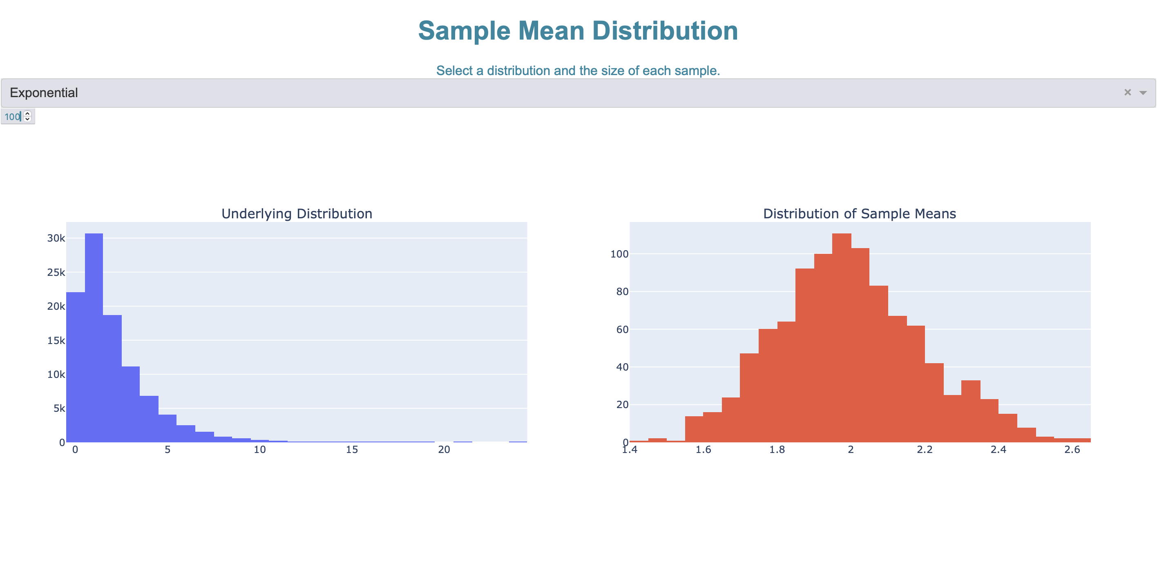
https://cltapp.fly.dev/

Slide 17
Law of Large Numbers

Slide 18
As the number of trials of a random experiment increases, the average of the results obtained will converge to the expected value.
The larger the sample size, the closer the sample mean will be to the population parameter.

Slide 19
Imagine flipping a coin.

Slide 20
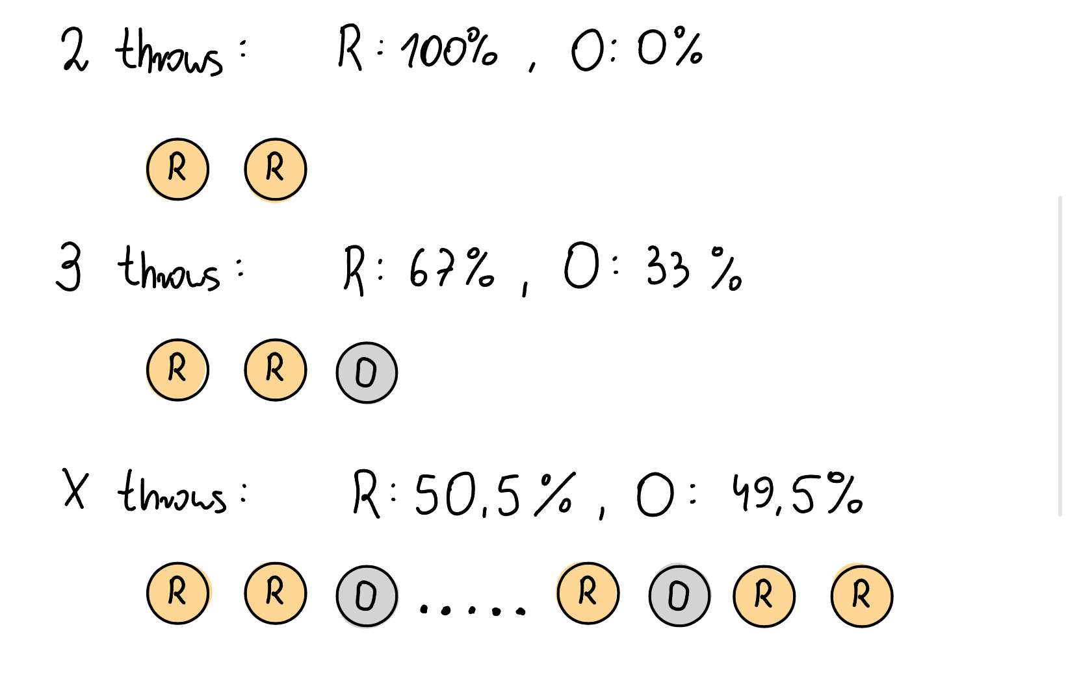

Slide 21
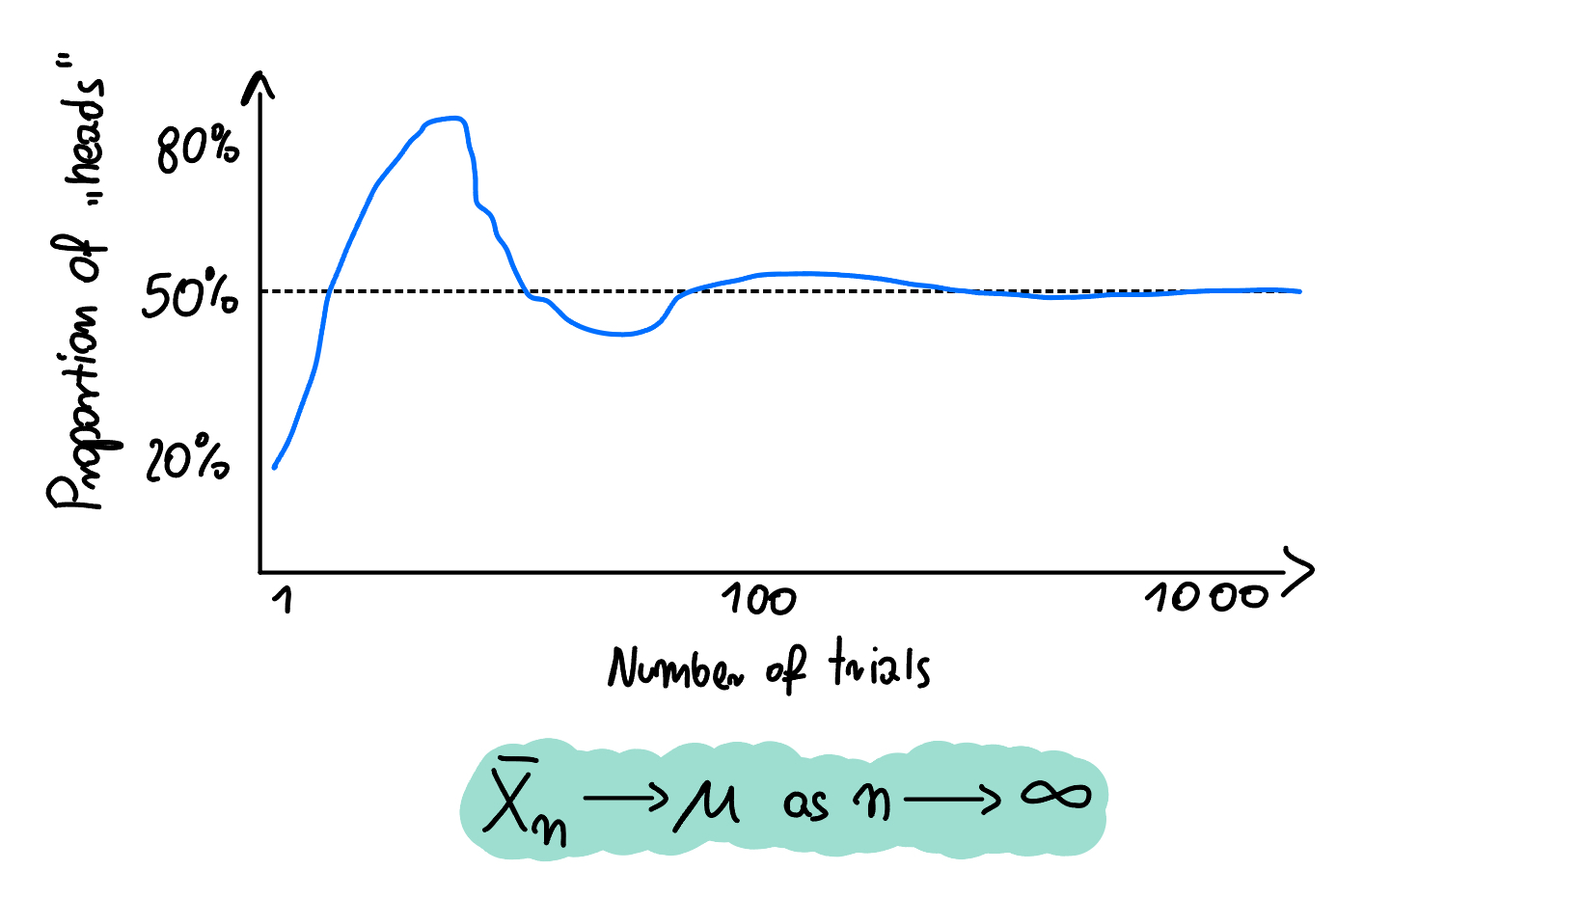

Slide 22
Sampling

Slide 23
Operating on whole population is either non possible or very exstensive. Thus, we need to extract samples. Our goal is to make unbiased samples which represent population parameters well.

Slide 24
HOW?

Slide 25
Random Sampling
Systematic Sampling
Stratified Sampling
Cluster Sampling
Convenience Sampling
Snowball Sampling

Slide 26

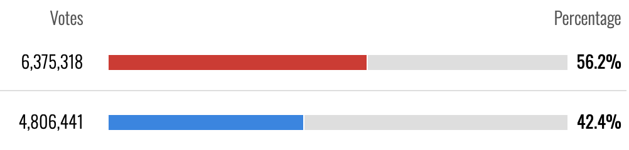

Slide 27
The greater the accuracy required for the results, the larger the sample size should be.
The higher the confidence level, the larger the sample.
If the population is very diverse, a larger sample is needed to account for all this diversity.
Time, budget, and data availability often limit sample size.

Slide 28
Random and systematic sampling implementations on GitHub.

Slide 29
Resampling

Slide 30
Resampling methods are useful when training models on limited datasets. These techniques involve repeatedly drawing samples from the original data to create multiple training sets, helping to improve model performance and reduce overfitting.

Slide 31
Bootstraping

Slide 32
Bootstrapping is a resampling technique where multiple samples are drawn with replacement from the original dataset. Each resample is the same size as the original dataset. The statistic of interest is calculated for each resample, and the distribution of these calculated statistics is used to estimate the sampling distribution of the original statistic.

Slide 33
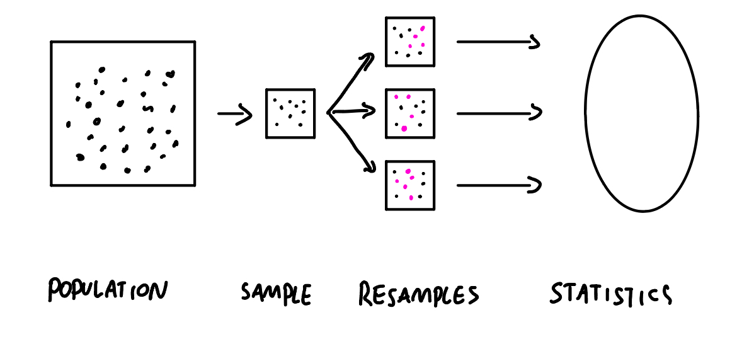

Slide 34
Cross Validation

Slide 35
Cross-validation is a method for evaluating machine learning models. By dividing the dataset into multiple folds, we can train and test the model on different subsets of data. This helps mitigate overfitting and provides a more reliable estimate of the model's generalization performance.

Slide 36
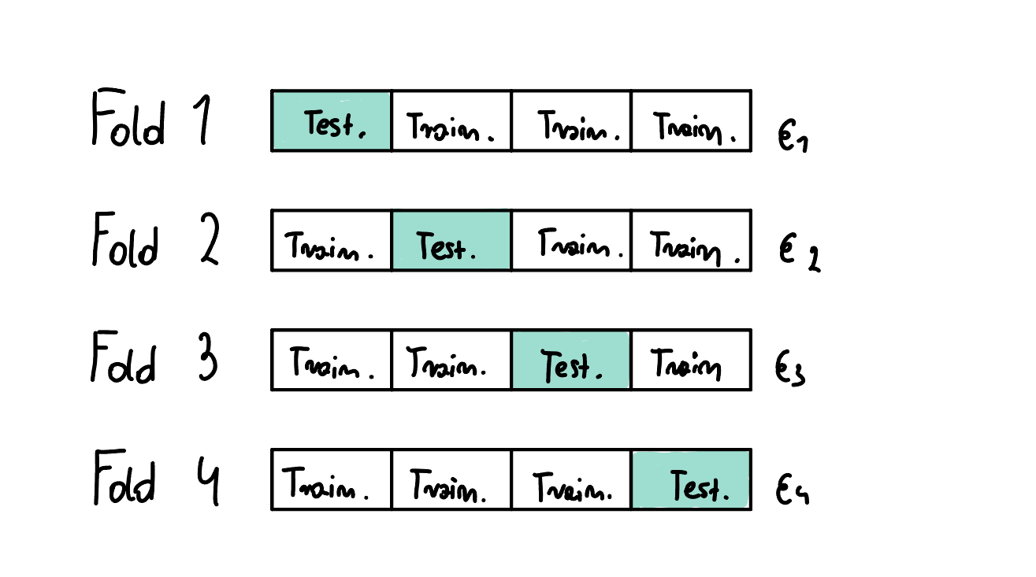

Slide 37
Outliers
to drop or not to drop

Slide 38
An outlier is data that deviates from the rest significantly. Many statistics (e.g. mean) are very sensitive for outstanding data. Thus, as Data Scientists, we have to take care of it to prevent inaccuracy. But remember, removing outliers is legitimate only for specific reasons.

Slide 39
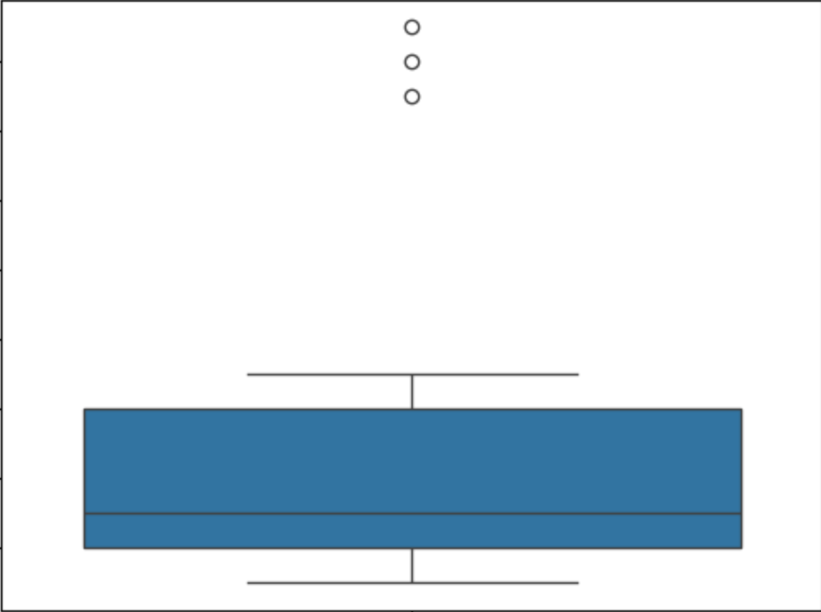

Slide 40
If the outlier is

Slide 41
… a natural part of the population you are studying, you should not remove it.

Slide 42
… a measurement error or data entry error, correct the error if possible. If you can’t fix it, remove that observation because you know it’s incorrect.

Slide 43
… not a part of the population you are studying (i.e., unusual properties or conditions), you can legitimately remove the outlier.

Slide 44
Industry knowledge can be very useful

Slide 45
Hypothesis testing

Slide 46
Statistical significance is a concept used in data analysis and statistics to determine whether observed results are likely due to chance or reflect a real relationship between variables. Simply put, statistical significance helps us assess how confident we can be that an effect observed in a sample also exists in the broader population.

Slide 47
Null hypothesis (H₀) – assumes that there is no difference or relationship between the variables
Alternative hypothesis (H₁) – assumes that there is a real difference or relationship between the variables.
Significance level (α) – this is the threshold set by the researcher before analysis, usually at 0.05 (5%). It means that if the probability of the result happening by chance is less than 5%, we reject the null hypothesis and consider the result statistically significant.
p-value – this is a measure that tells us how likely it is that the observed result could have occurred by chance.

Slide 48
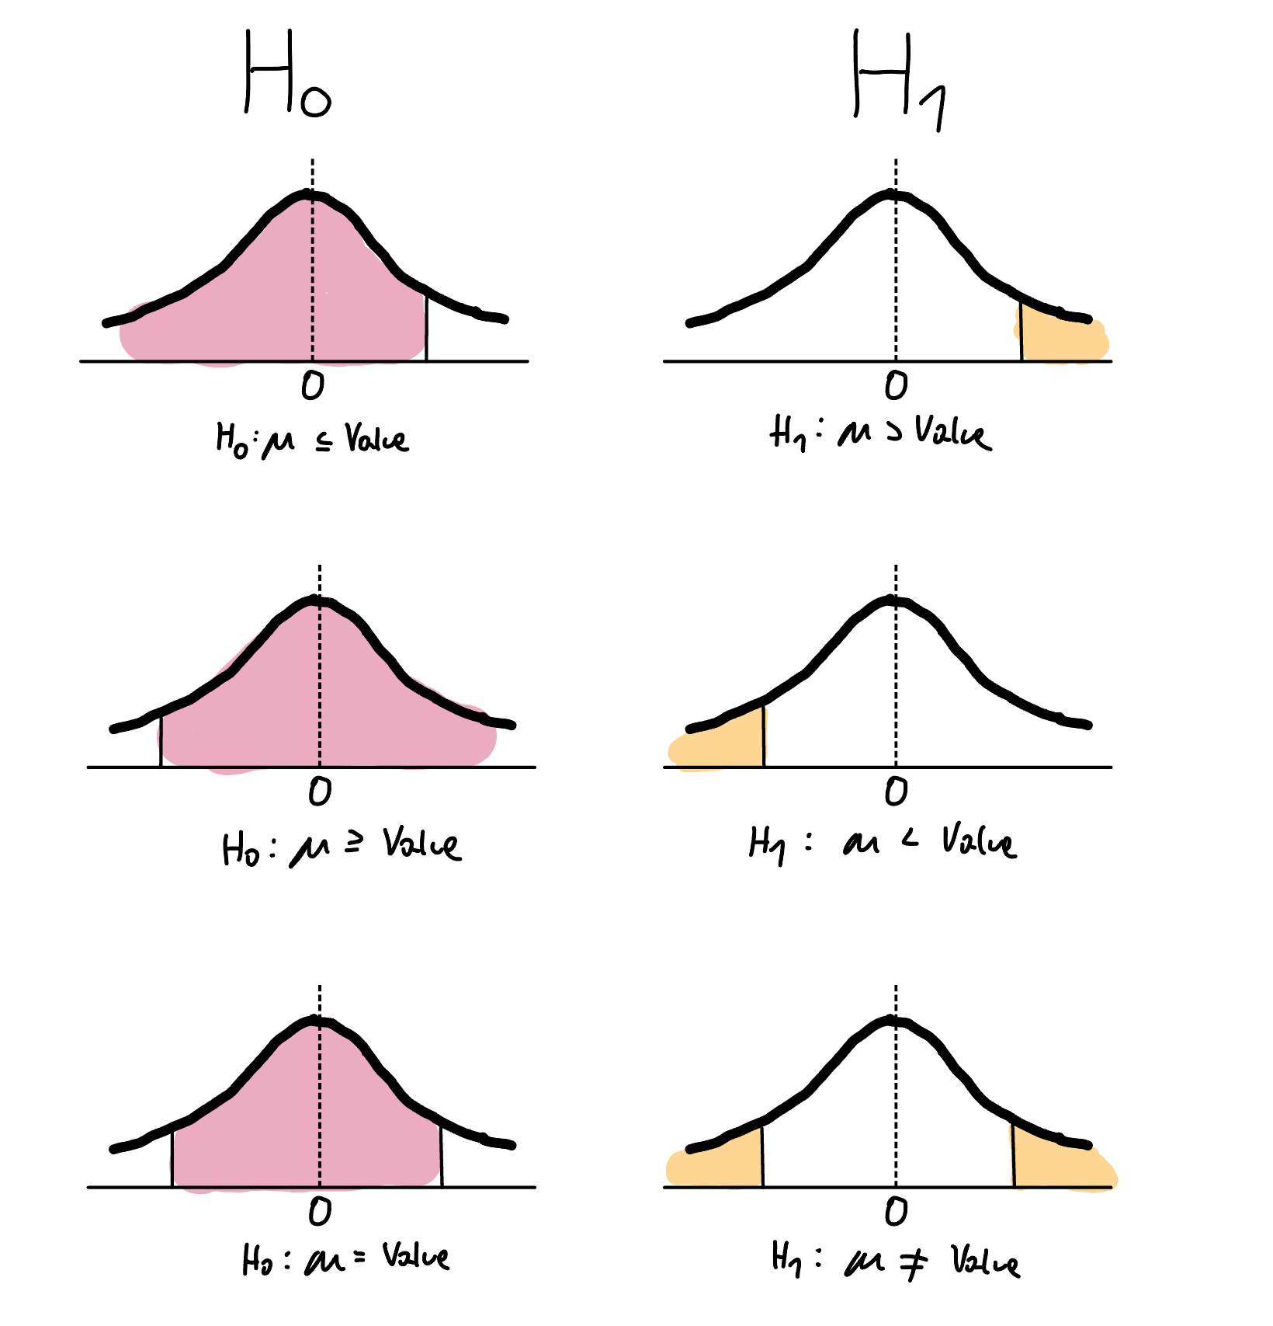

Slide 49
Example (The data are examples and not true)
Null hypothesis (H₀) - no difference between employment on Universities
Alternative hypothesis (H₁) – there is difference between employment on Universities
Significance level (α) – 0.05

Slide 50
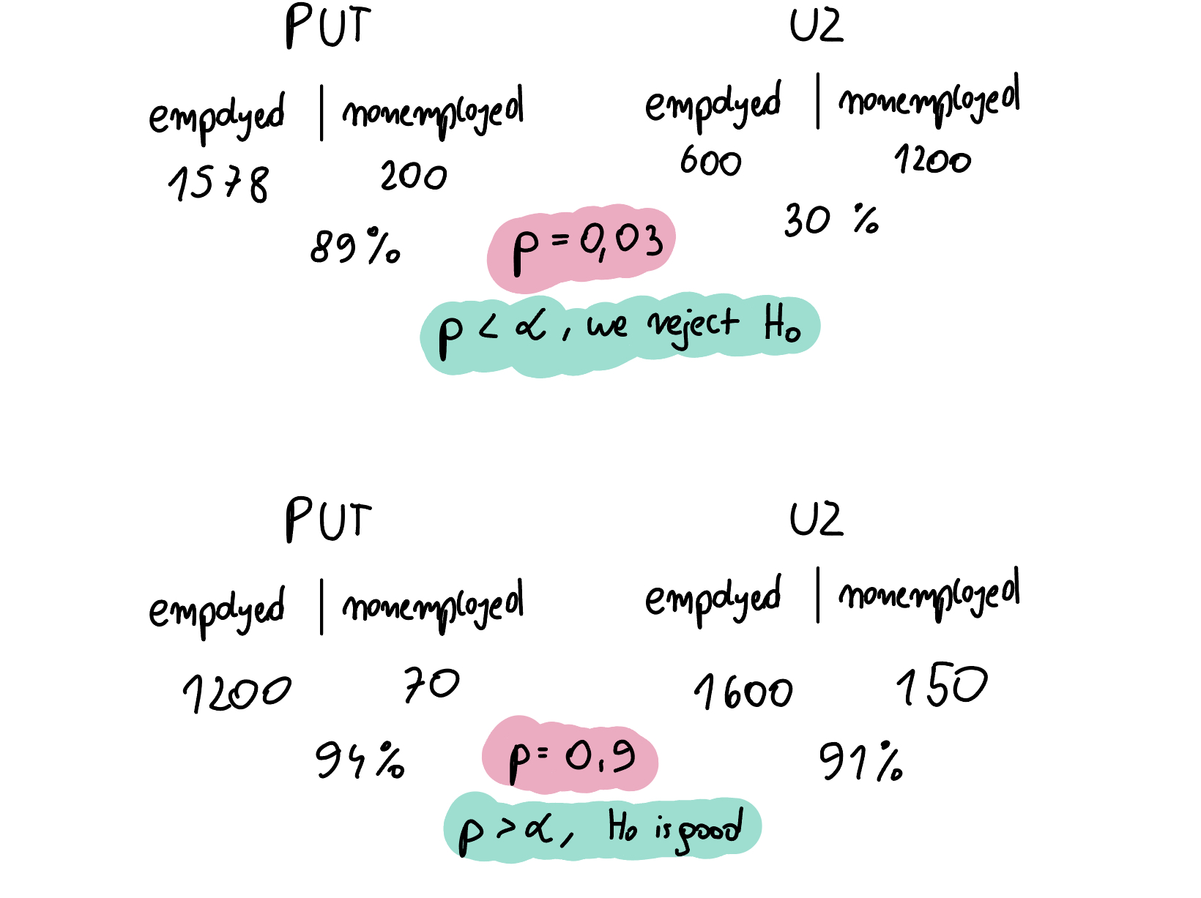

Slide 51
Standard verification procedure:
Formulate the null hypothesis and the alternative hypothesis
Select the appropriate test statistic
Set the significance level
Determine the critical region
Calculate the test
Make decision

Slide 52
Correlation

Slide 53
Correlation is a statistical measure that expresses the extent to which two variables are linearly related (meaning they change together at a constant rate)

Slide 54
Standard Deviation

Slide 55
Measure that quantifies the amount of variation or dispersion in a set of data values. It indicates how much the individual data points deviate from the mean (average) value of the dataset

Slide 56
Parametric tests

Slide 57
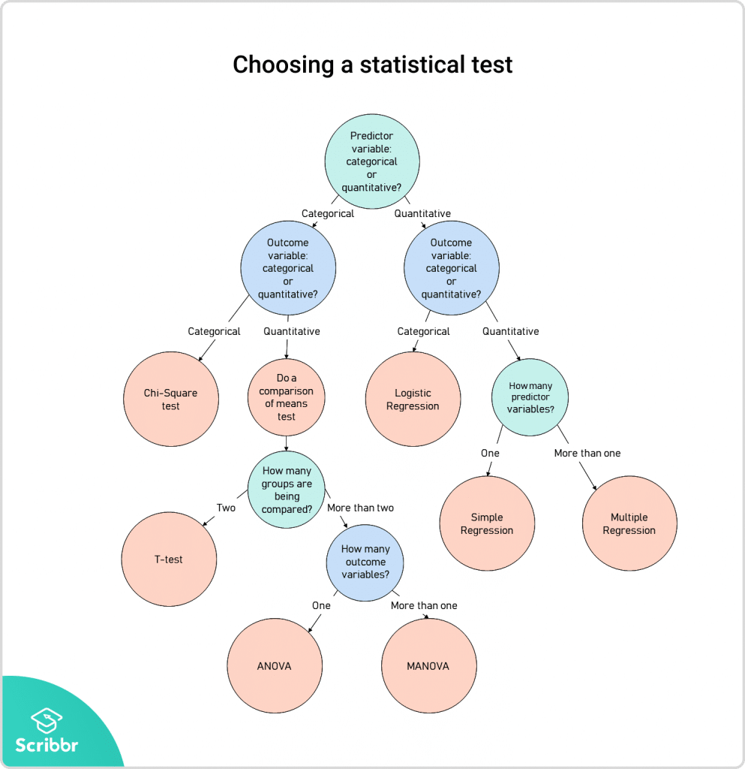
https://www.scribbr.com/statistics/statistical-tests/

Slide 58
Normality test - Shapiro-Wilk

Slide 59
Normality tests are statistical procedures used to assess whether a data set is well-modeled by a normal distribution and to evaluate how likely it is that the underlying random variable follows a normal distribution. These tests are important because many statistical methods, assume that the data are normally distributed.

Slide 60
T test

Slide 61
Used when we want to compare a sample mean with a population mean. A one-sample t-test examines whether the mean of a sample is statistically different from a known or hypothesized population mean

Slide 62
ANOVA, MANOVA

Slide 63
ANOVA is a powerful statistical method used to assess whether there are significant differences between the means of various groups. It is particularly useful when analyzing data across multiple populations influenced by one or more factors simultaneously. By examining variance within and between groups, ANOVA isolates sources of variability and identifies whether specific factors contribute to observed differences among group means.

Slide 64
TYPE | NUM. OF DEPENDENT VARIABLES | NUM. OF INDEPENDENT VARIABLES | INDEPENDENT/ CORRELATED SAMPLES
ONE - WAY ANOVA | ONE | ONE | INDEPENDENT
TWO WAY ANOVA | ONE | MORE THAN ONE | INDEPENDENT
MANOVA | MORE THAN ONE | ONE | CORRELATED
REPEATED MEASURE ANOVA | ONE | MORE THAN ONE | INDEPENDENT

Slide 65
Nonparametric tests

Slide 66
Chi-Square

Slide 67
The Chi-square test is a non-parametric test used to determine if there is a significant difference between observed and expected frequencies in categorical data. It is commonly applied in hypothesis testing to see if the distribution of data aligns with expectations under the null hypothesis. By comparing observed values against expected values, the test quantifies the discrepancies and helps evaluate whether they are due to random variation or if they suggest a meaningful association or pattern.

Slide 68
And a lot more…

Slide 69
Live coding!

