Slide 1
Delivery Monkey App
The online shopping database management

Slide 2
Grocery - Hopping
This database design is a method for people that can’t go shopping because no free time from their schedule is always busy, it helps them to manage time for study and work, the supermarket supply online orders, the concept creates a small job for agent-delivery but require supermarket employees approval.

Slide 3
Grocery - Diagram
Customer
Employee
Approval-agent
Order
Delivery-Order
Agent
Approval-Delivery
payment

Slide 4
Employees
The employee have two responsibility
When customer registered it’s require to choice any employee because if you have any issues of products that you order contact he/she.
Agent require employee approval for he/she to be granted delivery any orders.

Slide 5
Entities of the employee
Employee: new register
Address: enable for multiple keep the old address
Two department entities: Current-department and Department, related ability to change department also keep the old
Education: the employee education record
Medical: check all health of the employees every three months
Attendance: presented in office
Bank: account details for payment
Salary: keep the record of monthly payment
Holiday-Leave: any leave require record
Loan: Education improvement
Loan-return: record the loan-return

Slide 6
Customer’s
The customer register before order any product after the pay for the product then it can be delivery by the agent.

Slide 7
Entities of the customer’s
Customer: new register
Address: enable for multiple keep the old address
Order: items in pending status
Product: the collection items
Category: set of classes product in sequence
Product-Price: items price
Order-Detail: information of the order product
Order-detail-delivery: the product will be collected by the customer
Payment: Items it’s being payed

Slide 8
Agents
The register for delivery any product that is order by the customer’s before then it most be approval by the employee.
The active status pending waiting for approval.

Slide 9
Entities of the agents
Agent: new register
Address: enable for multiple keep the old address
Agent-approval: employee grant permit
Delivery: daily detail record
Payment: After delivered you receive payment

Slide 10
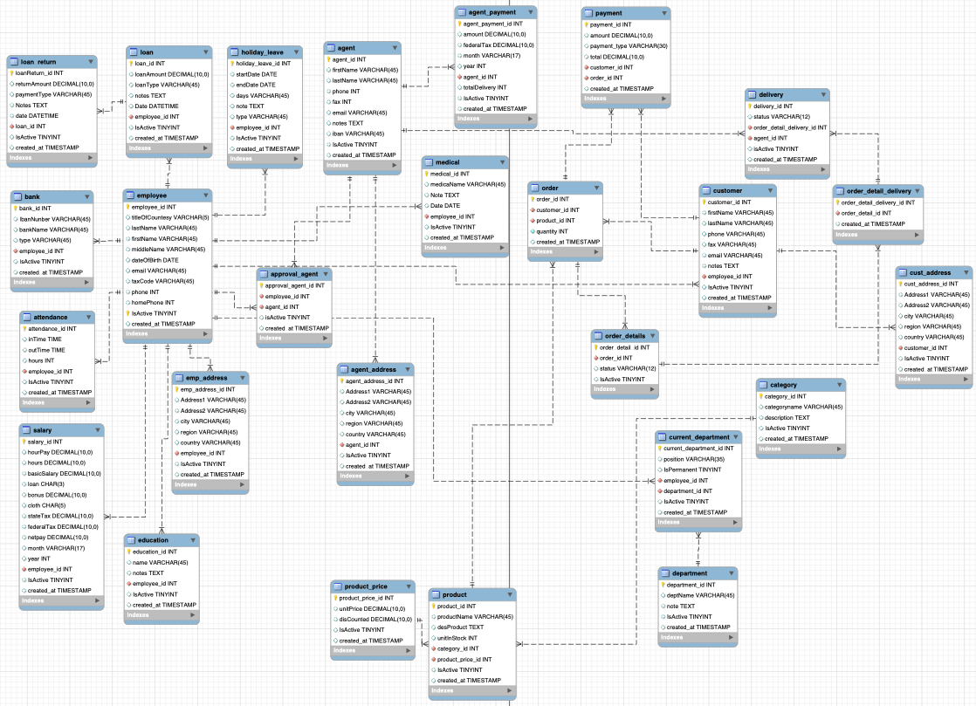
EER-Diagram

