Slide 1

Statistical Analysis of Stock Prices for Microsoft, Apple and Tesla. OGTIP Data Science Batch 2023 Project 1
OGUNTOLA IBRAHIM

Slide 2



CONTENT
INTRODUCTION TO THE GOAL OF THE ANALYSIS.
COMPARATIVE DESCRIPTIVE STATISTICS ON THE DATA.
ANALYSIS ON THE MEASURE OF RISKINESS OF EACH STOCK (WITH THE ASSISTANCE OF S&P500 STOCK MARKET INDEX).
ANALYSIS ON EFECTIVENESS OF REGRESSION ON PREDICTING FUTURE STOCK PRICE.

Slide 3



INTRODUCTION
We conduct a comparative analysis of the real-time adjusted stock prices for three prominent companies: Microsoft (MSFT), Apple, and Tesla
These stock price data are sourced from Yahoo Finance and cover daily trading activity spanning from February 2018 to January 31, 2023.

Slide 4

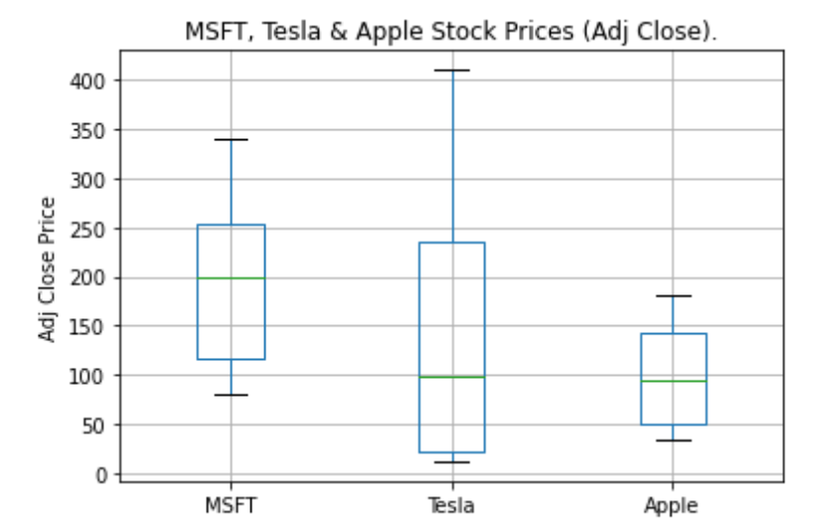
2. COMPARATIVE DESCRIPTIVE ANALYSIS
The table presents the average (mean), median, mode, and a range of distribution metrics for the adjusted closing price of the three stocks.
The boxplot illustrates the median, interquartile range (IQR), overall range, and variability for each stock. It serves to compare the central tendency and distribution spread between the different stocks.
 | MSFT | Tesla | Apple
Mean | 190.8268 | 131.7903 | 97.38823
Standard Error | 2.103222 | 3.272219 | 1.30262
Median | 198.8247 | 97.64 | 94.14835
Mode | 89.88315 | 23.62067 | 41.24635
Standard Deviation | 75.18836 | 116.979 | 46.56754
Sample Variance | 5653.29 | 13684.08 | 2168.536
Kurtosis | -1.31057 | -1.26037 | -1.58064
Skewness | 0.140261 | 0.468792 | 0.123055
Range | 259.8696 | 398.0387 | 146.6501
Minimum | 80.05519 | 11.93133 | 34.30959
Maximum | 339.9248 | 409.97 | 180.9597
Sum | 243876.6 | 168428 | 124462.2
Count | 1278 | 1278 | 1278

Slide 5
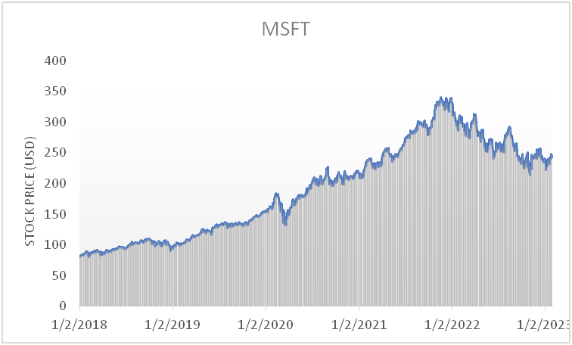
ADJ. CLOSING PRICE TRENDS FOR EACH COMPANY STOCKS

Slide 6
COMPARATIVE DESCRIPTIVE ANALYSIS
Mean Comparison: Microsoft had the highest average stock price ($190.83), followed by Tesla ($131.79), and then Apple ($97.39).
Volatility Comparison: Tesla exhibited the highest volatility in stock prices (standard deviation of approximately 116.98), followed by Microsoft (standard deviation of about 75.19), and Apple had the lowest volatility (standard deviation of roughly 46.57).
Skewness Comparison: All three stocks displayed slight to moderate right - skewness in their price distributions.
Kurtosis Comparison: The kurtosis values for all three stocks indicated thinner tails compared to a normal distribution, with Apple having the lowest kurtosis.
In summary, Microsoft had the highest average stock price but moderate volatility. Tesla had a lower average stock price but was highly volatile. Apple had the lowest average stock price and relatively lower volatility. All three stocks had right-skewed distributions with thinner tails compared to a normal distribution. The choice between these stocks depends on an investor's risk tolerance and investment objectives.

Slide 7
3. ANALYSIS OF RISKINESS WITH THE ASSISTANCE OF S&P500 STOCK MARKET INDEX
We conducted an analysis that includes the performance of the three companies alongside the S&P 500 index over the same period. The S&P 500 is a stock market index that tracks the performance of 500 large companies listed on stock exchanges in the USA.
In line with the Capital Asset Pricing Model, we calculated the slope coefficient Beta in a simple regression of the excess return on each stock (e.g., Apple%chng) against the stock return on the market (S&P%chng). This Beta value serves as a measure of the relative risk associated with each stock. Higher Beta values indicate higher levels of risk, suggesting that these stocks are more likely to experience greater returns in the market.

Slide 8
ANALYSIS OF RISKINESS WITH THE ASSISTANCE OF S&P500 STOCK MARKET INDEX
 | Slope: Beta | Relative Risk
SP%chng | -1.9E-07 | 1
MS%chng | -1.5E-06 | 8.00
Tesl%chng | -1.1E-06 | 5.64
App%chng | -7E-07 | 3.69
The Beta values provide valuable insights into the relative risk profiles of these stocks in comparison to the S&P 500. Microsoft and Tesla stand out as relatively riskier stocks, characterized by their higher Beta values, indicating a greater susceptibility to volatility and responsiveness to market fluctuations. On the contrary, Apple, while still carrying a higher level of risk compared to the market, demonstrates a lower Beta when compared to Microsoft and Tesla. This suggests a relatively more moderate level of risk associated with Apple. The S&P 500, with a Beta of 1, serves as the benchmark for average market risk against which these stocks are assessed.

Slide 9
4. ANALYSIS ON EFECTIVENESS OF REGRESSION ON PREDICTING FUTURE STOCK PRICE.
After converting the dates into sequential numeric values, we conducted regression analysis on various company stocks to derive a regression equation. This equation was subsequently employed to forecast stock prices from February 1, 2023 to October 31, 2023.
We collected the real stock prices from Yahoo Finance and proceeded to compare them. To assess the effectiveness of our regression-based prediction, we employed performance metrics including Mean Absolute Error (MAE) and Root Mean Squared Error (RMSE).

Slide 10
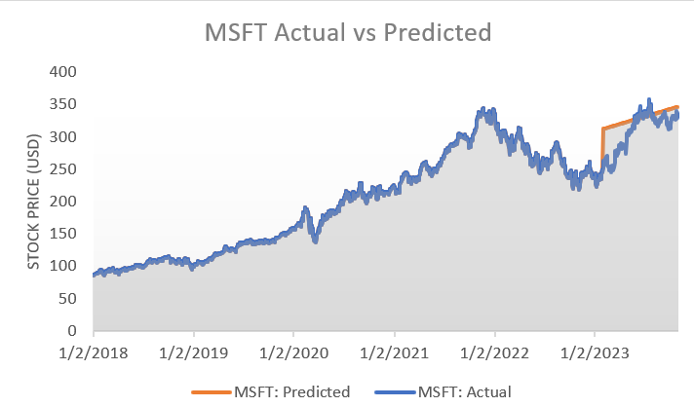
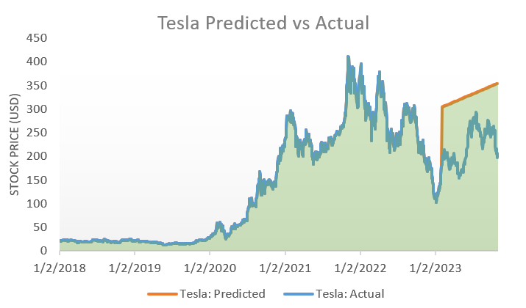
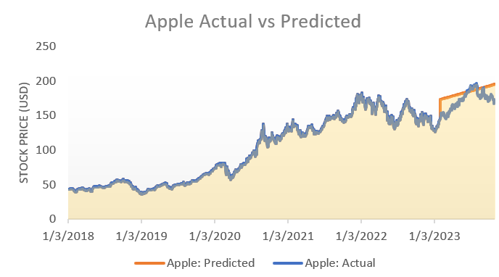
ACTUAL VS. PREDICTED STOCK PRICE DIFFERENCES (2/1/2023 - 10/31/2023)
MSFT
Stock price = 0.1840 + 76.7965 * Day
MAE = 23.46844
RMSE = 30.30717
TESLA
Stock price = 0.2692 – 40.3187 * Day
MAE = 107.3539
RMSE = 111.3511
APPLE
Stock price = 0.1168 + 23.8719 * Day
MAE = 13.41215
RMSE = 15.49847
Note: Day in the regression equations represents the sequential numeric values of the dates with 1 representing 1/2/2018.

Slide 11
Insights from the Prediction Evaluation
The current performance is not very good considering the high MAE and RMSE. However, there are specialized approaches for predicting time series data. These approaches include statistical methods like ARIMA (Autoregressive Integrated Moving Average) and Exponential Smoothing.
One can also explore Machine Learning and Deep Learning methods for better results. I recommend exploring my journal paper mentioned below, where we explored advanced deep learning models like Attention-based CNN-LSTM, Attention-based ConvLSTM and an ensemble of both models using Support Vector Regression to forecast future demand in the context of a supply chain network. Reference: Oguntola, I. O., Ülkü, M. A., Saif, A., & Engau, A. (2023). On the value of shipment consolidation and machine learning techniques for the optimal design of a multimodal logistics network. INFOR: Information Systems and Operational Research, 1-52.

Slide 12

1. Stock Price Volatility and Averages: - Microsoft (MSFT) displays moderate volatility with the highest average stock price. - Tesla, marked by high volatility, has a lower average price. - Apple shows the least volatility and lowest average price. - All exhibit right-skewed distributions, indicating different levels of investment risk. 2. Beta Analysis: - Each stock shows distinct market risk degrees relative to the S&P 500. - Microsoft and Tesla demonstrate higher volatility than Apple. - This analysis is vital for crafting informed investment strategies. 3. Forecasting Limitations: - Regression methods in forecasting time-series data have limitations. - Seeking more advanced approaches can enhance forecasting accuracy.
CONCLUSION

Slide 13


Thank You

