Slide 1
Clean Architecture
Notes:
Cover example with no photo
To update the text, just click on the text
To get more slides with this layout just copy this slide and paste

Slide 2
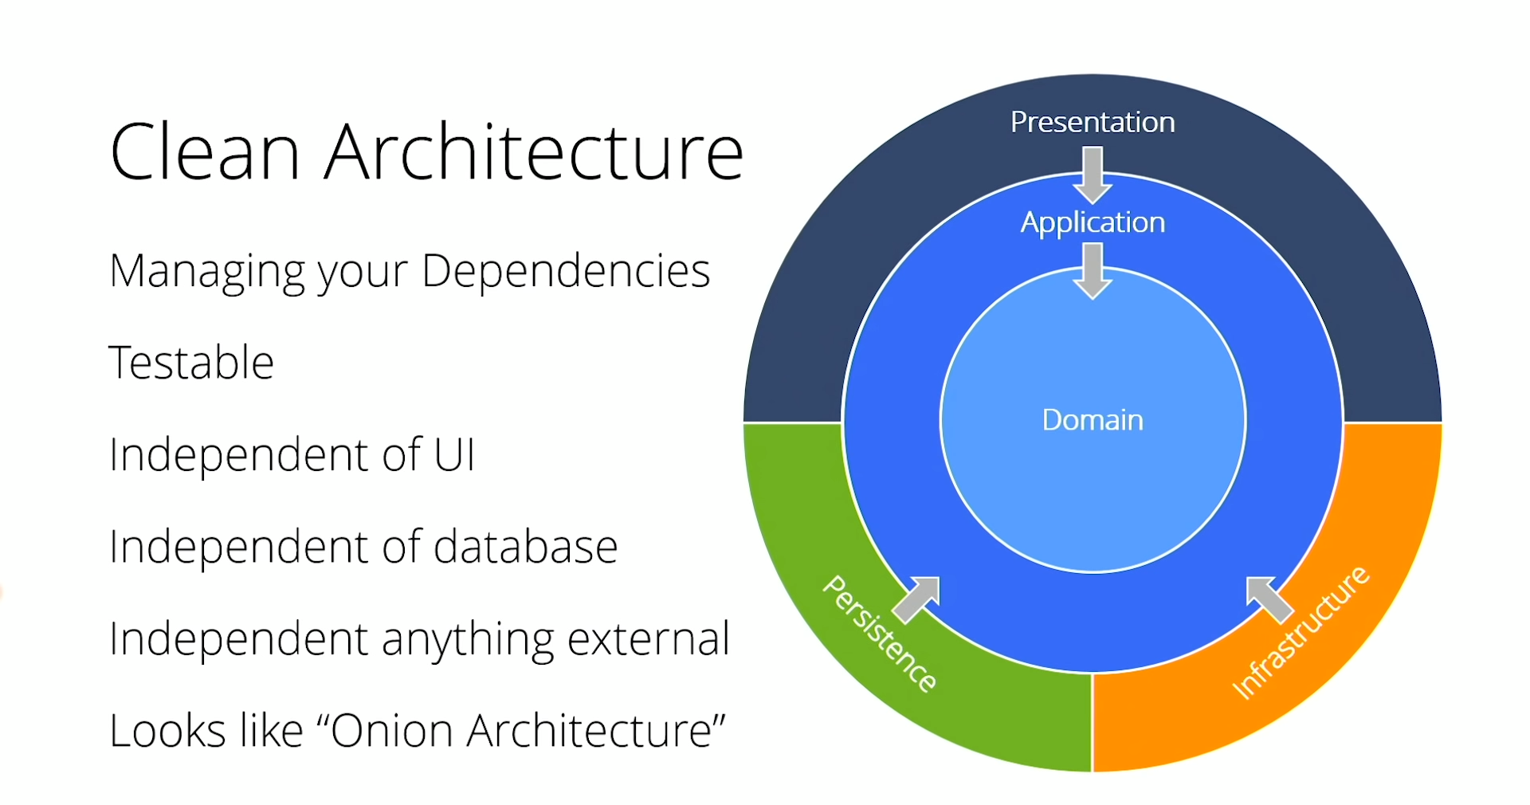

Slide 3
Key Points
 Domain contains enterprise-wide logic and types
 Application contains business-logic and types
 Infrastructure(including Persistence) contains all external concerns
 Presentation and infrastructure depend only on Application
 Infrastructure and Presentation components can be replaced with minimal effort

Slide 4
Low Cohesion High Cohesion Tight coupling Loose coupling
Cohesion is the indication of the relationship within a module.
Coupling is the indication of the relationships between modules.

Slide 5
CQRS
Command Query responsiblity segregation
Separate reads(queries) from writes(commands)
Single Responsibility Principle
Easy to add new features, just add a new query or command
Easy to maintain, changes only affect one command or query
Can be used with repositories

Slide 6
CustomerService
void MakeCustomerPreferred(CustomerId) Customer GetCustomer(CustomerId) CustomerSet GetCustomersWithName(Name) CustomerSet GetPreferredCustomers() void ChangeCustomerLocale(CustomerId, NewLocale) void CreateCustomer(Customer) void EditCustomerDetails(CustomerDetails)
CustomerWriteService
void MakeCustomerPreferred(CustomerId) void ChangeCustomerLocale(CustomerId, NewLocale) void CreateCustomer(Customer) void EditCustomerDetails(CustomerDetails)
CustomerReadService
Customer GetCustomer(CustomerId) CustomerSet GetCustomersWithName(Name) CustomerSet GetPreferredCustomers()

Slide 7

MediatR
MediatR is essentially a library that allows in process messaging – which in turn allows you to follow the Mediator Pattern!

Slide 8
MediatR + CQRS = ♥
Define commands and queries as requests
Application layer is just as series of request / response objects
Ability to attach additional beavior before and / or after each request, e.g logging, validation, caching, authorisation and so on

Slide 9
Key Points
 Using CQRS + MediatR simplifes your overall design
 Fluent Validation is usefull for all validation scenarios
 MediatR simplifies cross cutting concerns

