Slide 1

MintTrack
By Jeff Titus
Christopher C. Wilkins
Stephen Krach
Pablo BajoLaso

Slide 2
User Menus
MintTrack will sport a custom 4-tab interface
Add, edit, and delete income, expense, and transfer transactions through the entry menu
Query these transactions through the audit menu in the application.
View a grand total of how much money they have made or lost on the home menu
Use a handful of specially designed tools such as YATC (Yet Another Tip Calculator), export data, or view data as graphs in the tool menu

Slide 3
Functional Requirement
Functionality for the Normal User
A normal user will be able to use all the basic functionality such as enter, review, and edit income, expense, and transfer transactions
They are expected to be able to access the preferences and help menus from the bottom pop-up bar on the phone
Be able to export data and use the YATC in the tools menu
Functionality for the Advanced User
An advanced user will enjoy all of the same functionality as the “normal user”
Have the ability to create and edit accounts and categories of income and expenses
Advanced users will find it easy to query transactions based on a date range, category, account, etcetera to create an informative list of transactions or informative graphs

Slide 4
Nonfunctional Requirements
Usability:
Users must be able to navigate through tabbed menus in order to add transactions, review data, and access tools
Reliability:
A force close in the application should not delete data entered by the user after that data is saved to the database
When a force close happens, the user should be given the opportunity to restart the application.
Performance:
While a user is entering or viewing data, there should be no lagging caused by the application.
When a user goes to query information in the database, the response time of the system should be minimal and preferably unnoticeable.

Slide 5
Nonfunctional Requirement (Cont.)
Supportability:
As of right now we do not have a plan of issuing updates to users.
Implementation:
Any user who installs the application to their mobile device running an Android operating system, version 1.5 or higher, should have complete access to it at all times in which the application will be completely functional.
Interface:
The MintTrack application will run on Android operating systems, API 1.5 and higher. This is the general population of Android users.
Packaging:
The application will be delivered through download directly to the mobile device as an APK file, where it will be installed

Slide 6
Systems models: Examples of Scenarios
Name: addIncomeTransaction
Actors: User
Flow of Events:
User accesses transaction screen through transaction tab
User selects the income button; text fields and buttons appear for income transaction
User fills income transaction form (date, amount, account, notes)
Save button pressed; transaction added to database
The rest Transactions very similar.

Slide 7
Name: deleteTransaction
Actors: User
Flow of Events:
User accesses the audit screen through the audit tab
User selects a transaction
Drop-down menu appears; user selects “Delete”
Transaction removed from database; total fields updated
Name: queryByCategory
Actors: User
Flow of Events:
User accesses query screen through query tab
User chooses category(-ies) from spinner(s)
Query button pressed; Data displayed

Slide 8
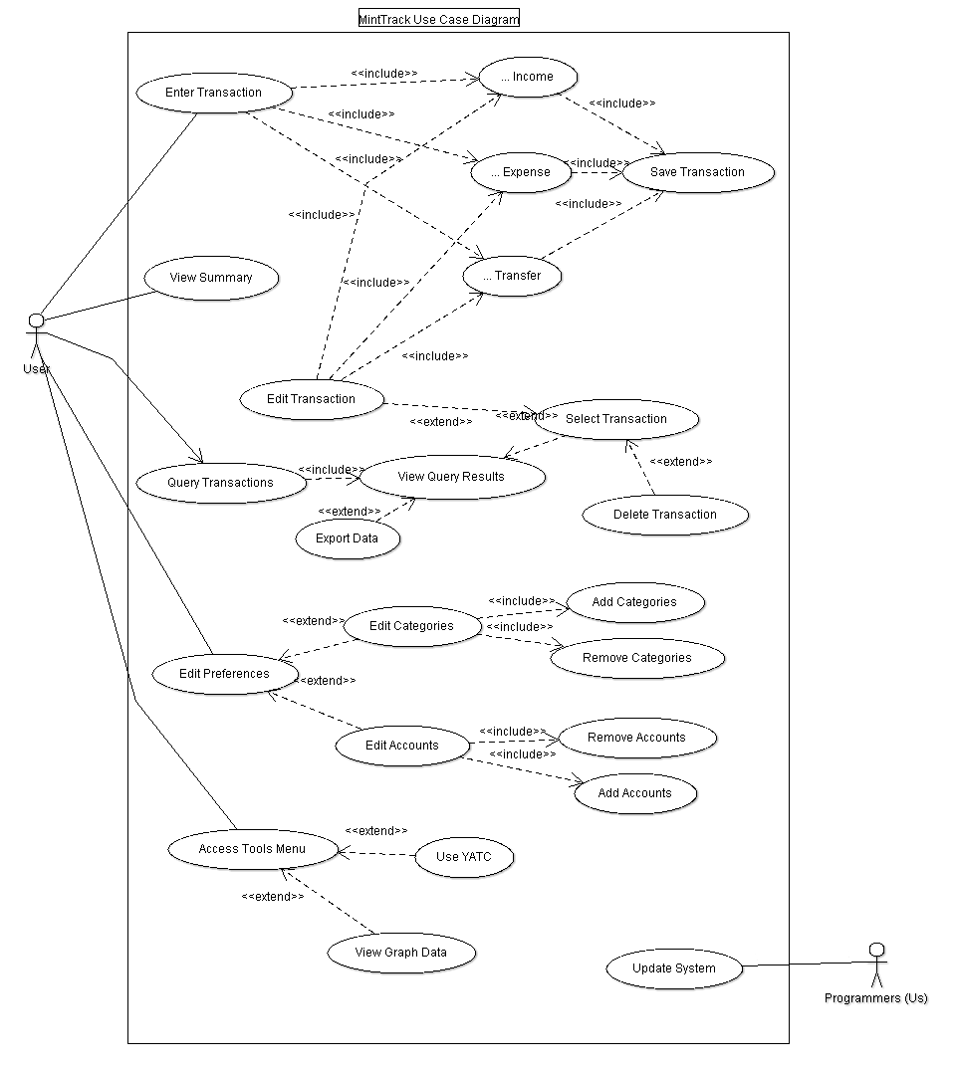
Use Case Model

Slide 9
Examples of Use Case Descriptions
Use case name | EnterTransaction
Actors | User
Flow of Events | 1. User clicks on transaction tab 2. MintTrack loads transaction screen 3. User chooses transaction type 4. MintTrack loads screen associated with transaction type 5. User enters transaction information and presses save button 6. MintTrack updates database
Entry Condition(s) | - User selects transaction tab
Exit Condition(s) | - User presses save button - User selects another tab

Slide 10
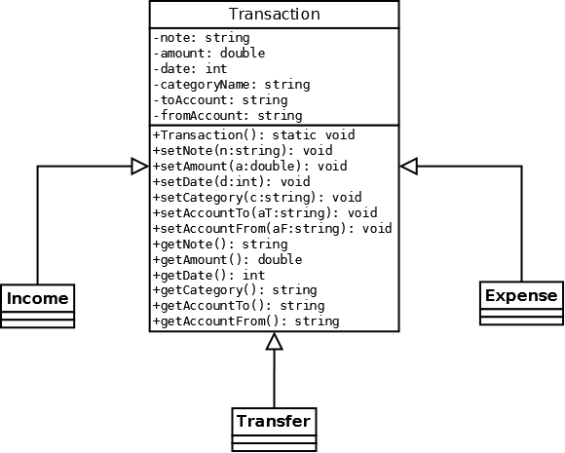
Object model: transaction class with Inheritance and Class Diagram

Slide 11
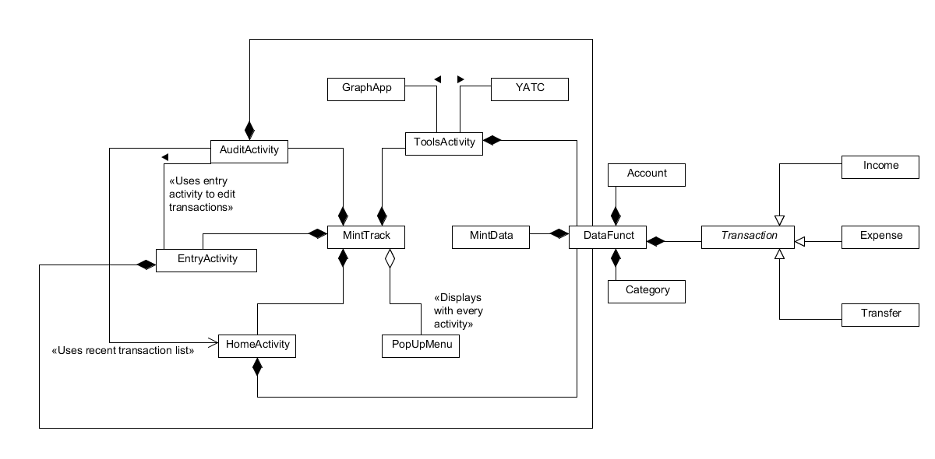
Full class diagram

Slide 12
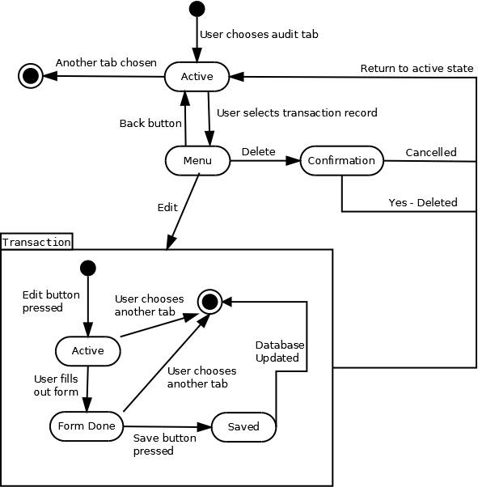
Dynamic model-Audit/Transaction Interaction

Slide 13
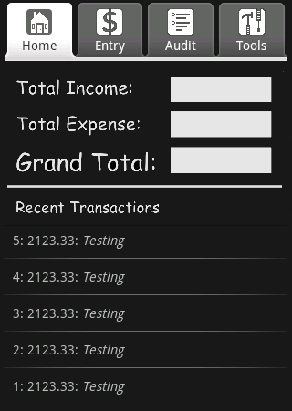
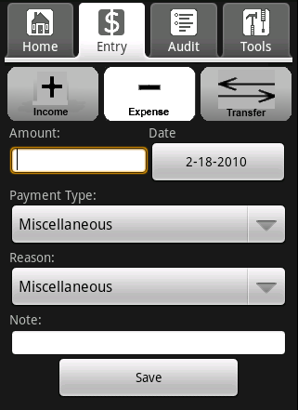
User Interface: Home and Entry

Slide 14
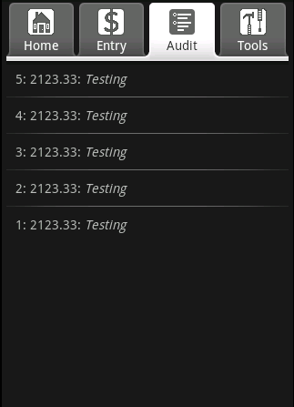
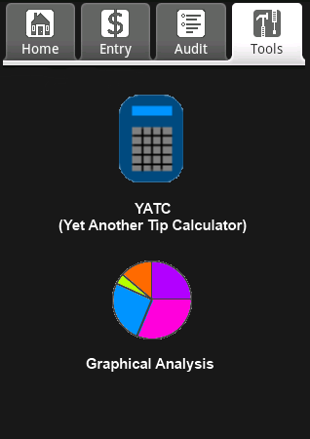
Audit and Tools

Slide 15
Conclusion
Update the tabs; more usability.
Only author the user.
The program focus on transaction: incomes, expenses and transfers.

