Slide 1
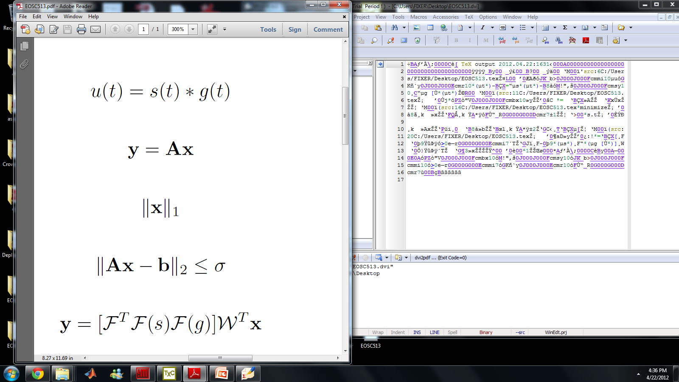
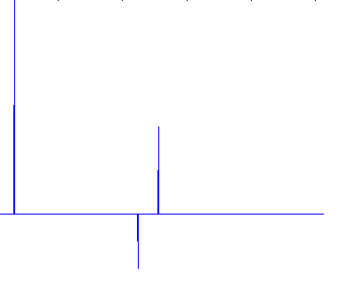
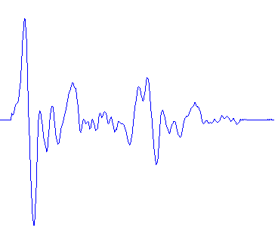
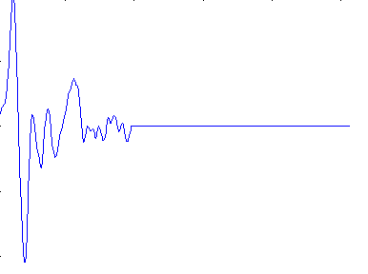
Deconvolution
u(t) – Recorded seismogram s(t) – source function g(t) – receiver function
=
Produce synthetic seismograms from a synthetic receiver function convolved with P-Codas obtained from windowed P waves of actual data.

Slide 2
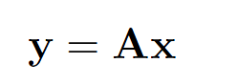
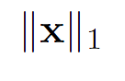
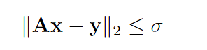
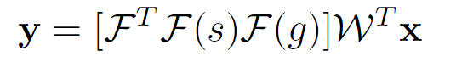
Deconvolution
Aim: Produce g(t) by deconvolving source functions from multiple seismograms.
Construct the problem as an optimization problem.
Seek a solution which is sparse in the wavelet domain.
X is the wavelet transform of g(t)
y is a vector of seismograms in the time domain.
Seek to minimize s.t.
Convolution operator

Slide 3
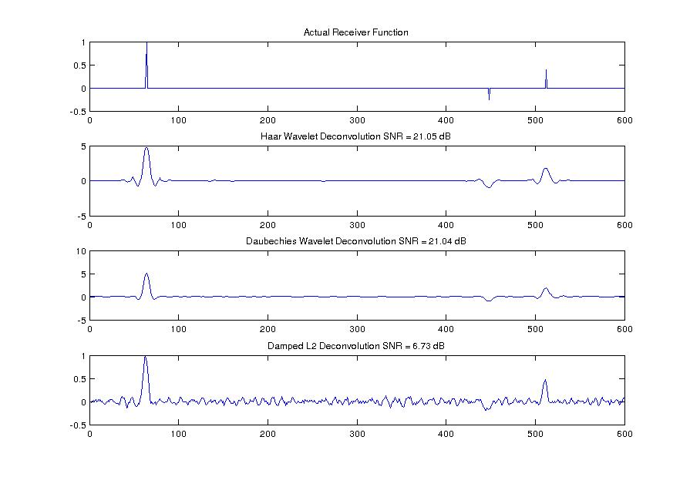
Synthetic Tests – Standard wavelets

Slide 4
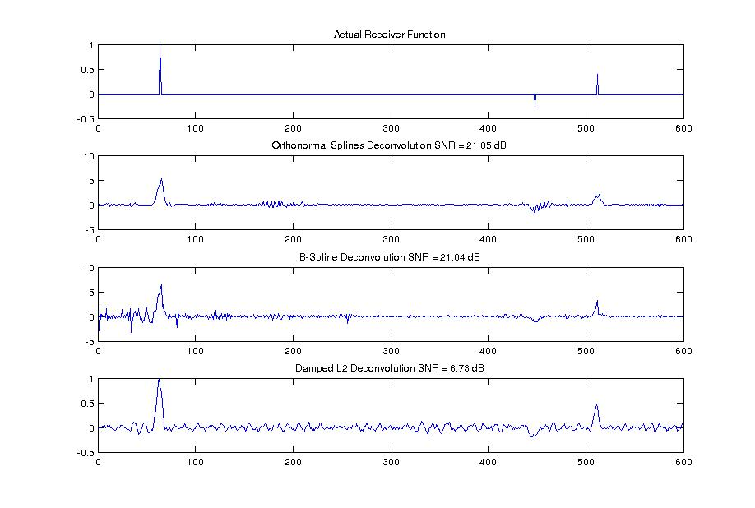
Synthetic Tests – Spline wavelets

Slide 5
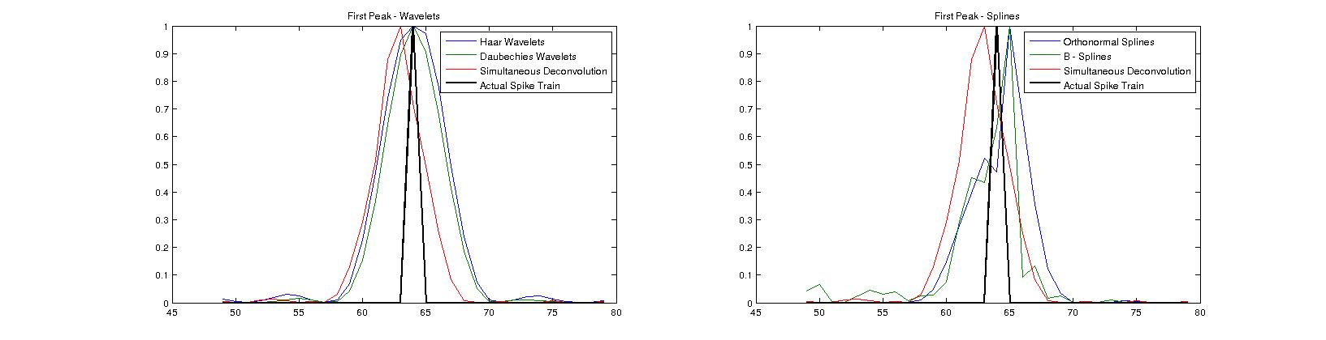
Peak comparison
SNR is an uninformative measure on the quality of fit in this case.
Whilst simple wavelets provide a sparse solution we also aim for a sharper peak which allows us to better constrain parameters computed later.
Compare the normalized peak recoveries for a range of wavelet types for each peak in the receiver function.

Slide 6
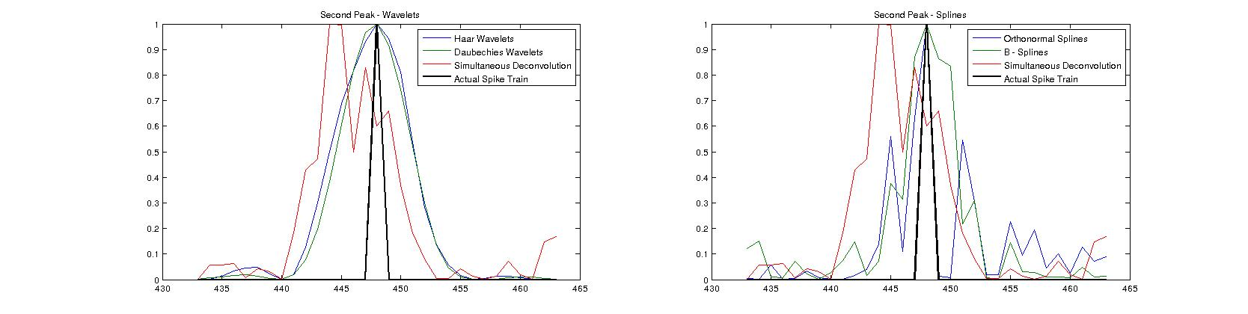
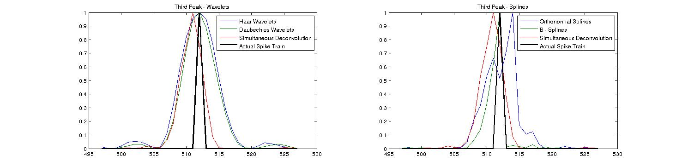
Peak comparison
Peak 2
Peak 3

Slide 7
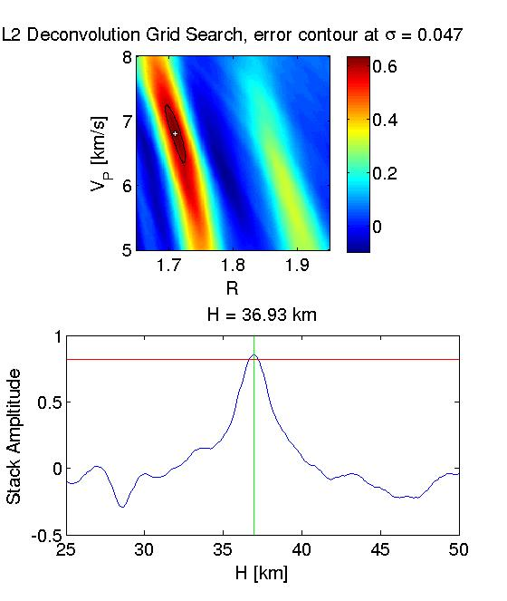
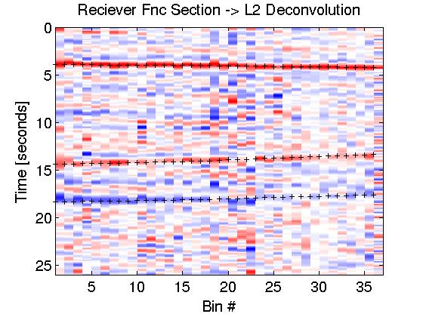
Results – Simultaneous Deconvolution
Seismograms are binned depending on their slowness, p.
For each bin an L1 optimization problem is solved producing a receiver function.
Receiver function traces are collected and plotted by bin.

Slide 8
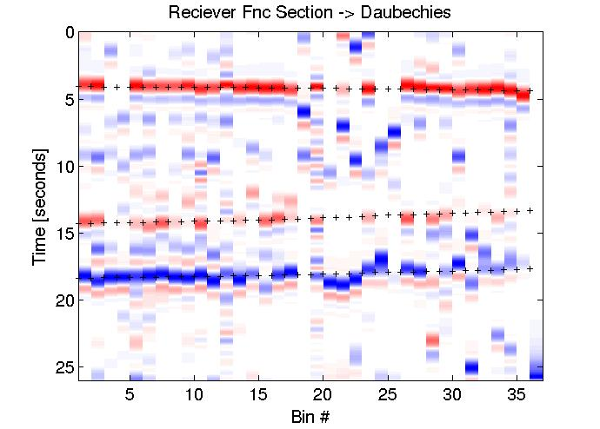
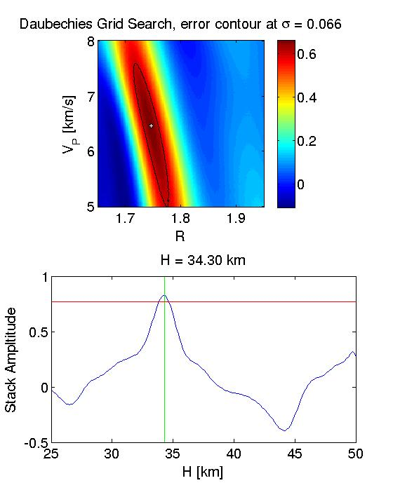
Results – Daubechies Wavelets
As earlier observed, Daubechies wavelets provides a much sparser representation but peaks are less tightly constrained.

Slide 9
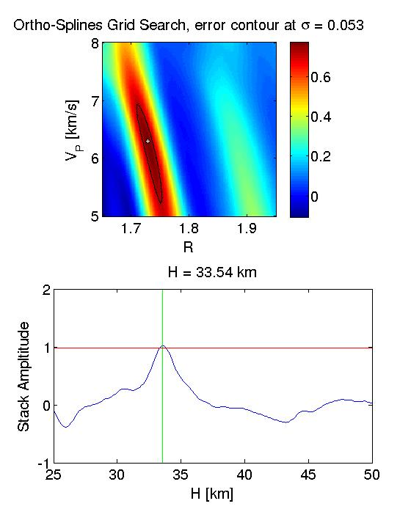
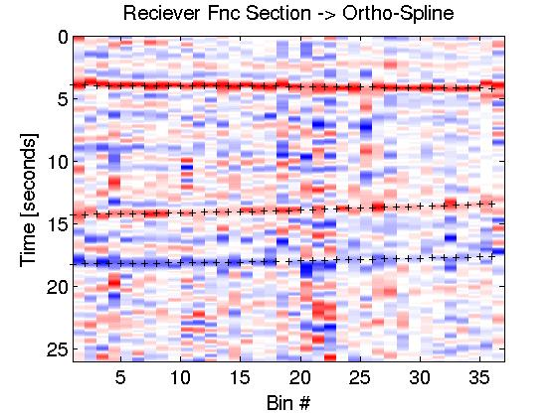
Results – Ortho Spline Wavelets

Slide 10
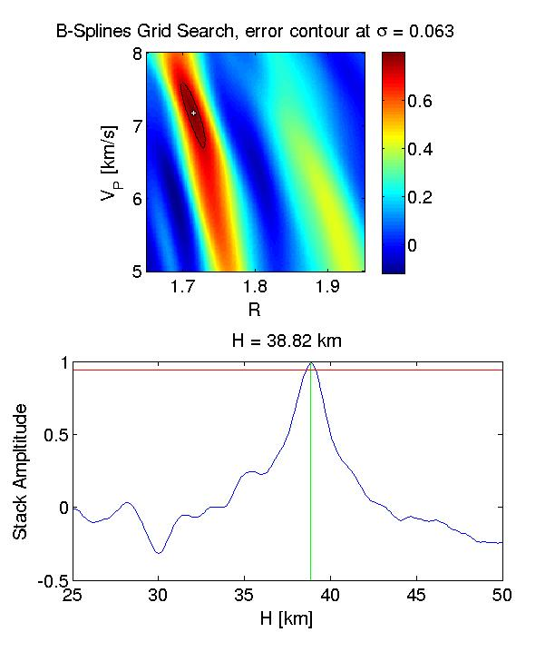
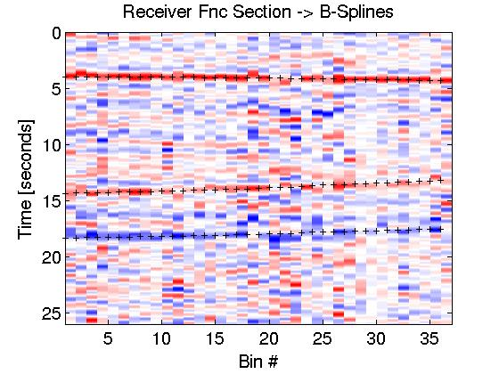
Results – B Spline Wavelets

Slide 11
Summary
Performed a deconvolution to acquire receiver functions from recorded seismograms.
Solved an L1 optimization problem and obtained a solution which promoted sparsity for the receiver function in the wavelet domain.
Compared a range of wavelets with an L2 type algorithm.
L1 algorithms failed to reproduce results which were as tightly constrained as the L2 method but show promising initial results which can be further developed.

