Slide 1
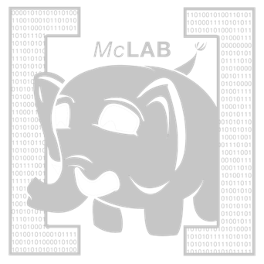
McLab Tutorial www.sable.mcgill.ca/mclab
Laurie Hendren, Rahul Garg and Nurudeen Lameed
Other McLab team members:
Andrew Casey, Jesse Doherty, Anton Dubrau, Jun Li, Amina Aslam, Toheed Aslam, Maxime Chevalier-Boisvert, Soroush Radpour, Oliver Savary , Maja Frydrychowicz, Clark Verbrugge
Sable Research Group
School of Computer Science
McGill University, Montreal, Canada
Notes:
This tutorial is intended to provide an overview of the challenges of compiling MATLAB and the tools provided by McGill’s McLab project. Please feel free to reuse these slides, however please make sure you credit the authors of the slides and that you indicate the source of the original slides.

Slide 2
Tutorial Overview
Why MATLAB?
Introduction to MATLAB – challenges
Overview of the McLab tools
Introduction to the front-end and extensions
IRs, Flow analysis framework and examples
Back-ends including the McVM virtual machine
Wrap-up
Notes:
This tutorial starts with an exploration of why it is important for compiler/PL researchers to work on MATLAB and languages like MATLAB.
We then proceed to an introduction to the MATLAB language, and we illustrate some of the challenges of dealing with MATLAB.
The main body of the tutorial is composed of an introduction to the McLab toolset. We will give an introduction to the front-end and how it can be used to build MATLAB extensions, then we introduce our two IRs, McAST a high-level AST and McLAST a lower-level AST. We then move to an overview of our back-ends, with a particular focus on McVM and McJIT. Finally, we will give a short wrap-up.

Slide 3
Nature Article: “Why Scientific Computing does not compute
38% of scientists spend at least 1/5th of their time programming.
Codes often buggy, sometimes leading to papers being retracted. Self-taught programmers.
Monster codes, poorly documented, poorly tested, and often used inappropriately.
45% say scientists spend more time programming than 5 years ago.
Notes:
October 2010 article in Nature, by Zeeya Merali. Survey of 2000 scientists.
It is important that compiler/PL researchers aim to provide programming languages and systems that both provide:
programming environments in which scientists can program easily
systems that lead to solid and extensible code.

Slide 4

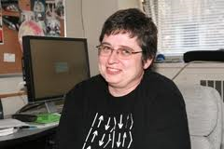
FORTRAN
C/C++
Java
AspectJ
MATLAB
PERL
Python
Domain-specific
Notes:
Scientist in upper right ... Many different applications to program, which language to pick? Increasingly picking dynamic or scripting languages. Many scientific and engineering computations use MATLAB.
Computer Scientist, Compiler writer, lower left. Has worked on compilers and tools for object-oriented and aspect-oriented languages ... But scientists are not interested in these languages.

Slide 5
A lot of MATLAB programmers!
Started as an interface to standard FORTRAN libraries for use by students.... but now
1 million MATLAB programmers in 2004, number doubling every 1.5 to 2 years.
over 1200 MATLAB/Simulink books
used in many sciences and engineering disciplines
Even more “unofficial” MATLAB programmers including those using free systems such as Octave or SciLab.
Notes:
There are a lot of MATLAB users, shouldn't we be doing something for them?

Slide 6
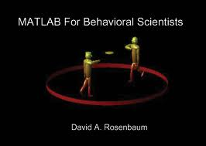
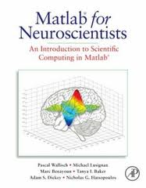
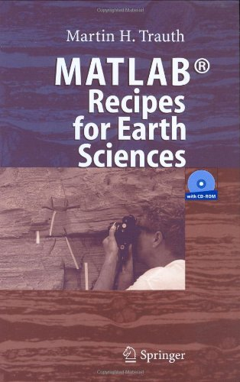
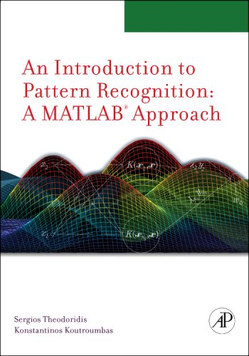
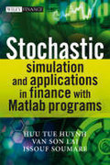

Notes:
Check out the number and variety of disciplines ….
Books are often "how to" in terms of using MATLAB. We also need some books that describe MATLAB in way that both uses solid PL terminology and foundations, but also talks about the domain-specific applications.

Slide 7
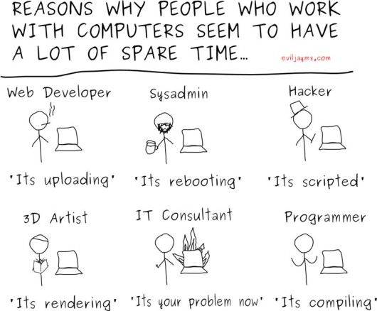
Why do Scientists choose MATLAB?
MATLAB
FORTRAN
Notes:
Why do scientists choose MATLAB?
Why not something like FORTRAN? - advantages are good compilers, efficient execution.
But programmers are choosing MATAB – faster prototyping – no types, lots of toolboxes, interactive development style...

Slide 8
Implications of choosing a dynamic, “scripting” language like MATLAB….
Notes:
Although Scientists like the interactive and "wild west" development style of MATLAB, what are the implications of choosing a dynamic "scripting" language like MATLAB?

Slide 9
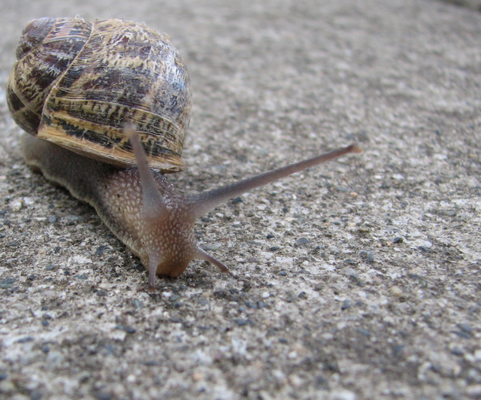
Interpreted …
Potentially large runtime overhead in
both time and
space
Notes:
Original implementation by MATHWORKs interpreted, their system now contains a JIT (which they call an "accelerater"). Open implementations like Octave and Scilab are interepreted.

Slide 10
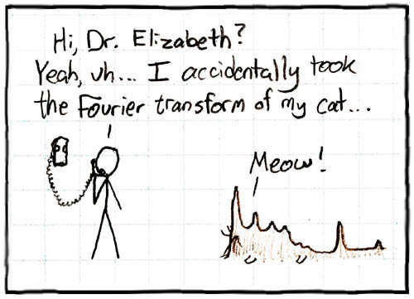
No types and “flexible” syntax
Notes:
MATLAB often computes something, even if it was not was intended.

Slide 11

Most semantic (syntactic) checks made at runtime … No static guarantees
Notes:
MATLAB programmers get very few static guarantees, but quite often program in some dynamic checks.

Slide 12
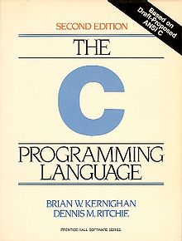
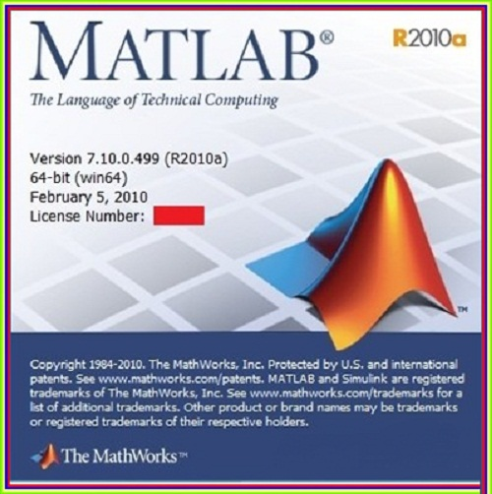
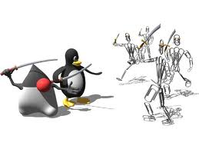
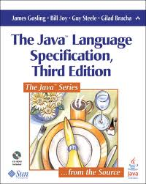
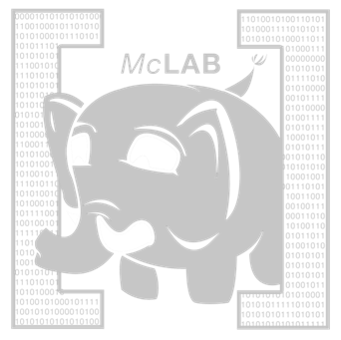
No formal standards for MATLAB
Notes:
Lack of a standard – the semantics can change in a new release from Mathworks.
If the research community can help distill out a proper specification, it will enhance research opportunities and perhaps encourage some standardization.

Slide 13
Culture Clash
Scientists / Engineers
Programming Language / Compiler Researchers
Comfortable with informal descriptions and “how to” documentation.
Don’t really care about types and scoping mechanisms, at least when developing small prototypes.
Appreciate libraries, simple tool support, and interactive development tools.
Prefer more formal language specifications.
Prefer well-defined types (even if dynamic) and well-defined scoping and modularization mechanisms.
Appreciate “harder/deeper/more beautiful” research problems.
Notes:
PL and compiler researchers need to consider the scientific community and their perspective.
What can we do to enhance their programming experience, while still doing interesting research from a CS perspective?
Does the PL/compiler community need to broaden their perspective of what is useful/good research?

Slide 14
Goals of the McLab Project
Improve the understanding and documentation of the semantics of MATLAB.
Provide front-end compiler tools suitable for MATLAB and language extensions of MATLAB.
Provide a flow-analysis framework and a suite of analyses suitable for a wide range of compiler/soft. eng. applications.
Provide back-ends that enable experimentation with JIT and ahead-of-time compilation.
Notes:
Our goals are to provide an infrastructure that supports the research for MATLAB, and to do such research ourselves.

Slide 15
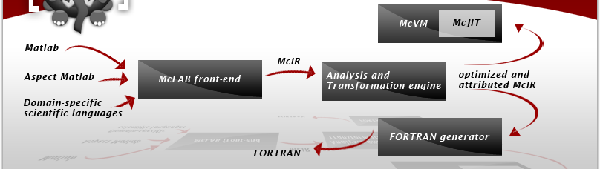
Overview of McLab/Tutorial
1
4
2
3
Notes:
The rest of this tutorial will:
Introduce MATLAB
Give an overview of the McLab front-end and a small example of an extension
Give an overview of the IRs and the Analysis Framework
Discuss the back-ends, concentrating on McVM/McJIT

