Slide 1

Language Extensions for MATLAB
Amina Aslam
Toheed Aslam
Andrew Casey
Maxime Chevalier- Boisvert
Jesse Doherty
Anton Dubrau
Rahul Garg
Maja Frydrychowicz
Nurudeen Lameed
Jun Li
Soroush Radpour
Olivier Savary
Laurie Hendren
McGill University
Leverhulme Visiting Professor
Department of Computer Science
University of Oxford
TexPoint fonts used in EMF.
Read the TexPoint manual before you delete this box.: AAAAAAAAAAAAAAAAAAAAAA
Notes:
MATLAB is a popular dynamic programming language used for scientific and numerical programming. As a language, it has evolved from a small scripting language intended as an interactive interface to numerical libraries, to a very popular language supporting many language features and libraries. The overloaded syntax and dynamic nature of the language, plus the somewhat organic addition of language features over the years, makes static analysis of modern MATLAB quite challenging. In this talk I will motivate why it is important for programming language and compiler researchers to work on MATLAB and I will provide a high-level overview of McLab, a suite of compiler tools my group is developing at McGill. The main technical focus of the talk will be on the foundational problem of resolving the meaning of an identifier in MATLAB. To solve this problem we have developed two analyses, a flow-insensitive "kind analysis" and a flow-sensitive "handle analysis". I will present the analyses, some experimental results and show how the results of the analysis are required for other compiler tools.

Slide 2

Overview
How does one make language extensions for MATLAB using McLab?
MetaLexer
Aspects for MATLAB
["Types" for MATLAB]
Notes:
This talk starts with an exploration of why it is important for compiler/PL researchers to work on MATLAB and languages like MATLAB.
We then proceed to an introduction to the MATLAB language, and we illustrate some of the challenges of dealing with MATLAB.

Slide 3
McLab Extensible Front-end
.m source
AspectMatlab
.m source
MATLAB-to-Natlab
Scanner
(MetaLexer)
.m source
Parser
(Beaver)
AspectMatlab
AspectMatlab
AST attributes, rewrites
(JastAdd)
XML
Other
Attributed AST
Notes:
Implemented in Java and Java-based tools.

Slide 4
MetaLexer
Modular Lexer Generator
M.Sc. thesis, Andrew Casey
AOSD 2011
www.sable.mcgill.ca/metalexer
Notes:
This talk starts with an exploration of why it is important for compiler/PL researchers to work on MATLAB and languages like MATLAB.
We then proceed to an introduction to the MATLAB language, and we illustrate some of the challenges of dealing with MATLAB.

Slide 5

Given a front-end specification for a language (i.e. MATLAB), current method to implement a front-end for an extension of that language (i.e. AspectMatlab)?
Lexical specification for original language
Grammar and actions for original language
Modified lexical specification for extended language
Grammar and actions for original language
Grammar rules for extension
Notes:
Tools like Polyglot and JastAdd allow for modular extensions of the grammar. However, there is no equivalent extensible way of specifying the extended scanner modularly. We hit this problem when we were building abc, which is an extensible compiler toolkit for AspectJ, and then hit this problem again designing the new McLab system, an extensible compiler toolkit for Matlab.

Slide 6
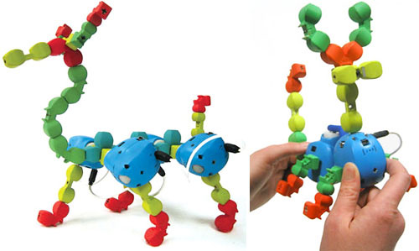
Desired Modular MetaLexer Approach
Lexical rules for extension
Lexical specification for original language
Grammar and actions for original language
Lexical specification for original language
Grammar and actions for original language
Grammar rules for extension
Notes:
So, we decided to build a tool that would provide a more modular approach.

Slide 7
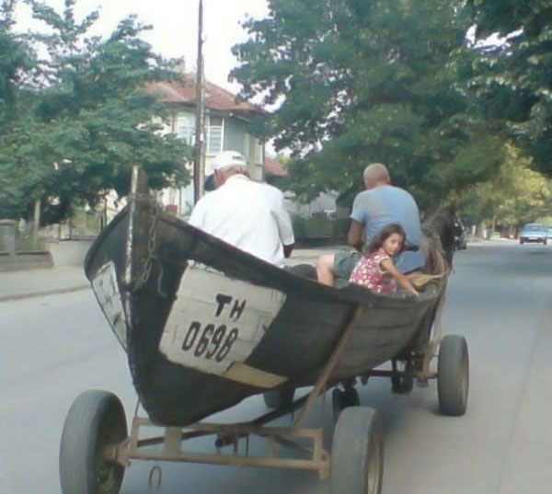
We also want to be able to combine lexical specifications for diverse languages.
Java + HTML
Java + Aspects (AspectJ)
Java + SQL
MATLAB + Aspects (AspectMatlab)

Slide 8

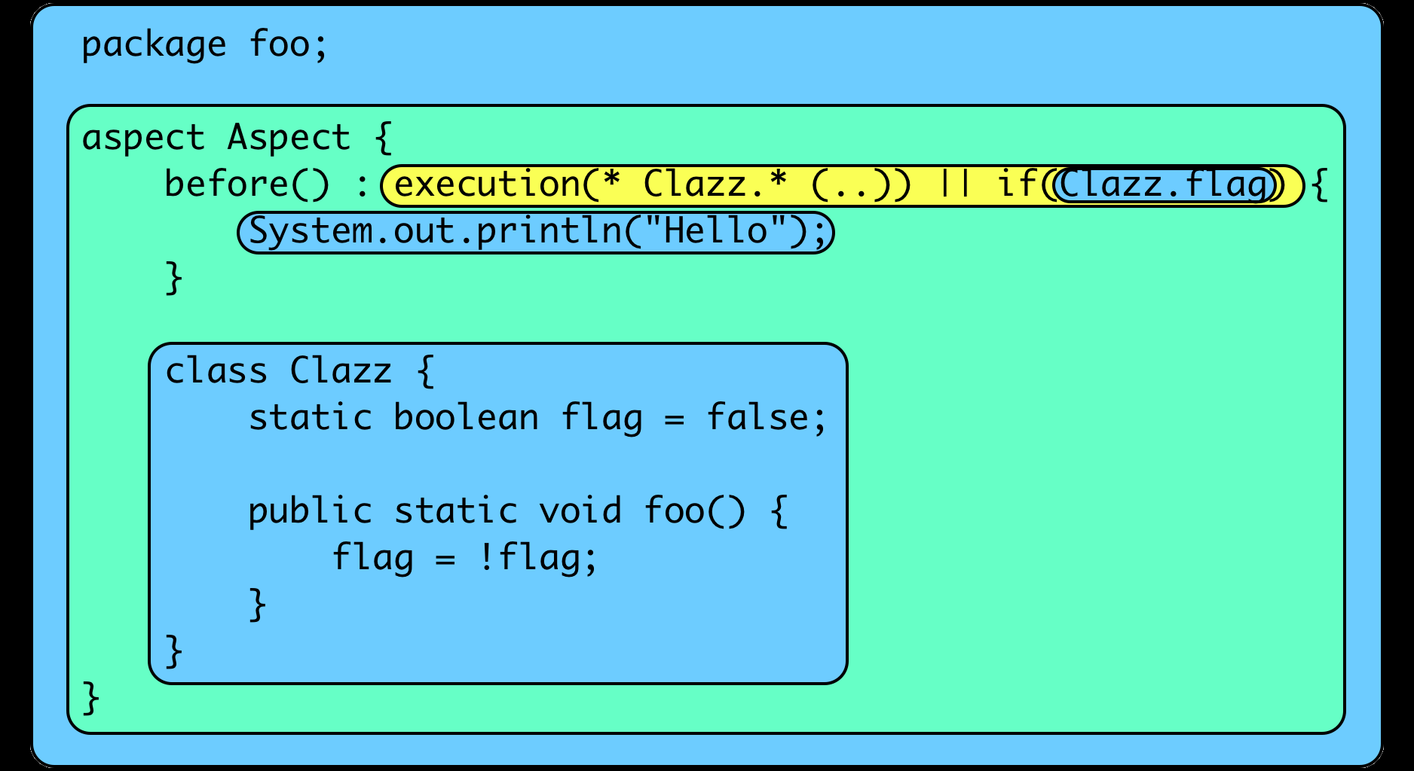
Scanning AspectJ
Notes:
Let’s look at the scanning problem for AspectJ. Different regions of the program have different lexical structures. The outermost region has the lexical structure of Java, but once you enter an Aspect declaration the lexical structure changes. For example, new keywords are introduced, such as “before”. Inside pointcuts, there is even a more radically different lexical structure, which many new symbols inside patterns. Furthermore inside a pointcut specification you can have an “if” pointcut, which contains Java code. So between the opening paren and the matching closing paren the scanner must tokenize as Java.
Furthermore, inside an aspect declaration you may have an inner class, the inner class should be scanned as Java .
Note that each context can be signaled by some sequence of opening tokens and closing tokens. Sometimes the opening and closing tokens must be nested at the same level.

Slide 9
Would like to be able to reuse and extend lexical specification modules
Nested C-style comments
Javadoc comments
Floating-point constants
URL
regular expressions
…

Slide 10

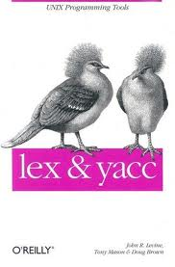
First, let’s understand the traditional lexer tools (lex, flex, jflex).
programmer specifies regular expressions + actions
tools generate a finite automaton-based implementation
states are used to handle different language contexts

Slide 11
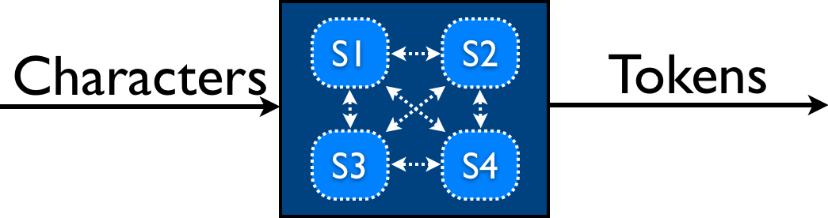
JFlex Lexing Structure
Specification in one file.
Lexing rules associated with a state.
Changing states associated with action code.

Slide 12
Notes:
Here is an example extracted from the Jflex manual for scanning a typical language which includes strings.

Slide 13
Current (ugly) method for extending jflex specifications - copy&modify
Copy jflex specification.
Insert new scanner rules into copy.
Order of rules matters!
Introduce new states and action logic for converting between states.
Principled way of weaving new rules into existing rules.
Modular and abstract notion of state and changing between states.

Slide 14
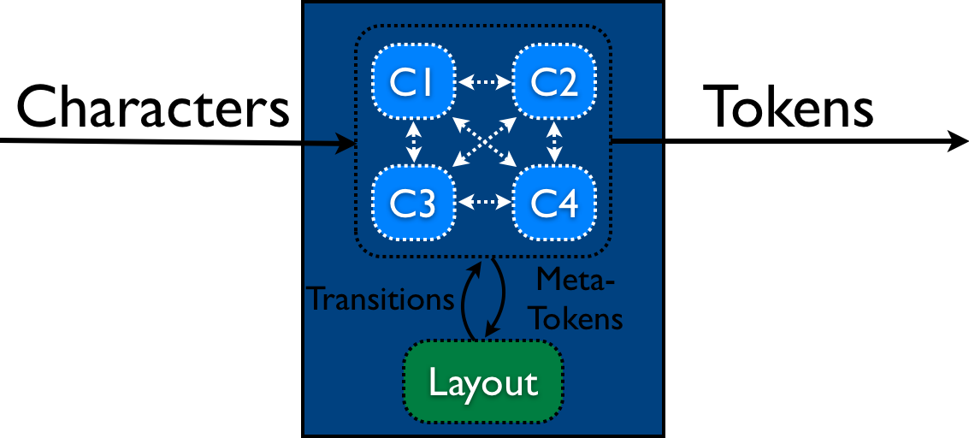
Each component specified in its own file.
MetaLexer Structure
Layout specified in its own file.
Components define lexing rules associated with a state, rules produce meta-tokens.
Layout defines transitions between components, state changes by meta-lexer (regular expressions + matching pairs of start/end symbols).

Slide 15
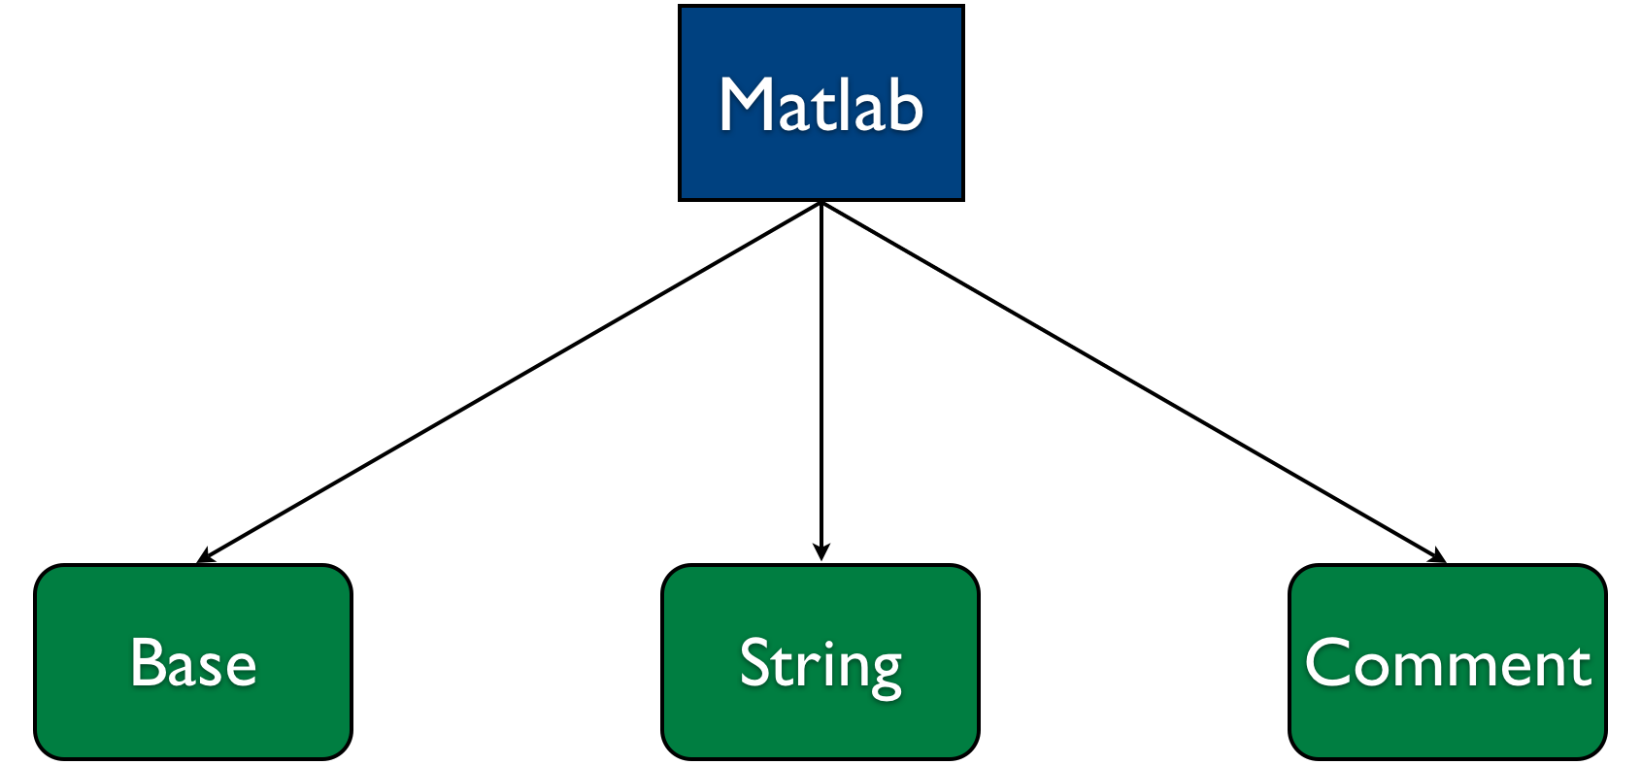
Example Structure of a MetaLexer Specification for MATLAB

Slide 16
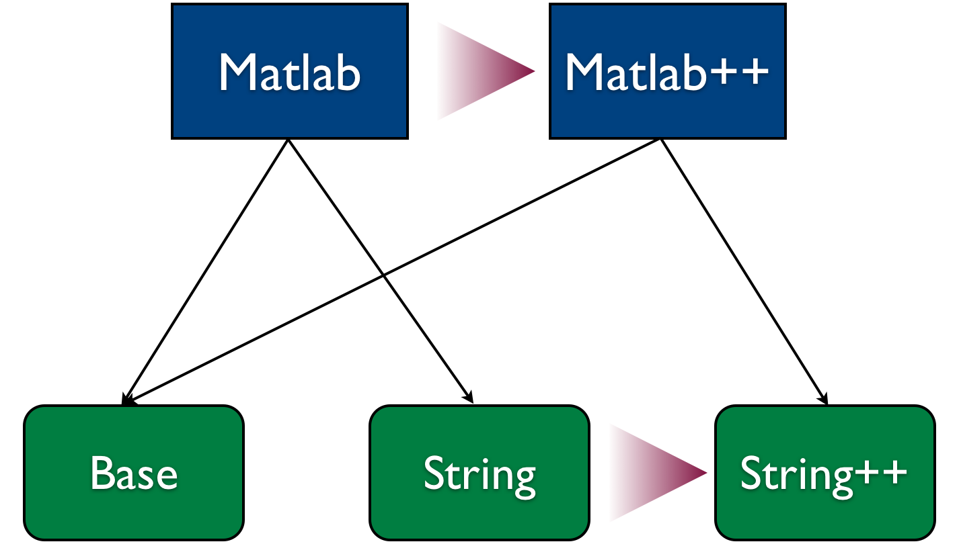
Extending a MetaLexer Specification for Matlab

Slide 17
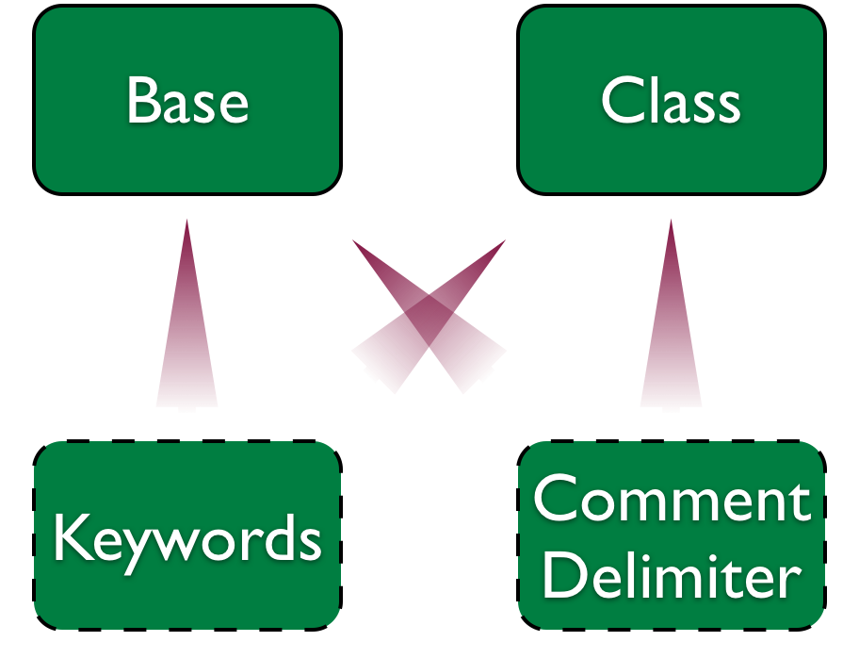
Sharing component specifications with MetaLexer

Slide 18
Scanning a properties file
Properties
Key
Value
Util_Patterns

Slide 19
util_properties.mlc helper component

Slide 20
key.mlc component
Notes:
Three sections of rules: acyclic, cyclic and cleanup.
Note METATOKEN ASSIGN

Slide 21
value.mlc component
Notes:
Note that the value component allows one to build a complete token.
Note the METATOKEN, LINE_TERMINATOR

Slide 22
properties.mll layout
Notes:
Note that this layout includes two components, key and value, and the start component is “key”
The embedding defines the metalexer transitions.
Need to give each transition a name, so we can have a way of modifying or deleting them.

Slide 23
MetaLexer is implemented and available:
www.sable.mcgill.ca/metalexer
properties.mll
util_patterns.mlc
properties.jflex
MetaLexer
key.mlc
value.mlc
Notes:
Explain metalexer.

Slide 24
Key problems to solve:
How to implement the meta-token lexer?
How to allow for insertion of new components, replacing of components, adding new embeddings (metalexer transitions).
How to insert new patterns into components at specific points.

Slide 25
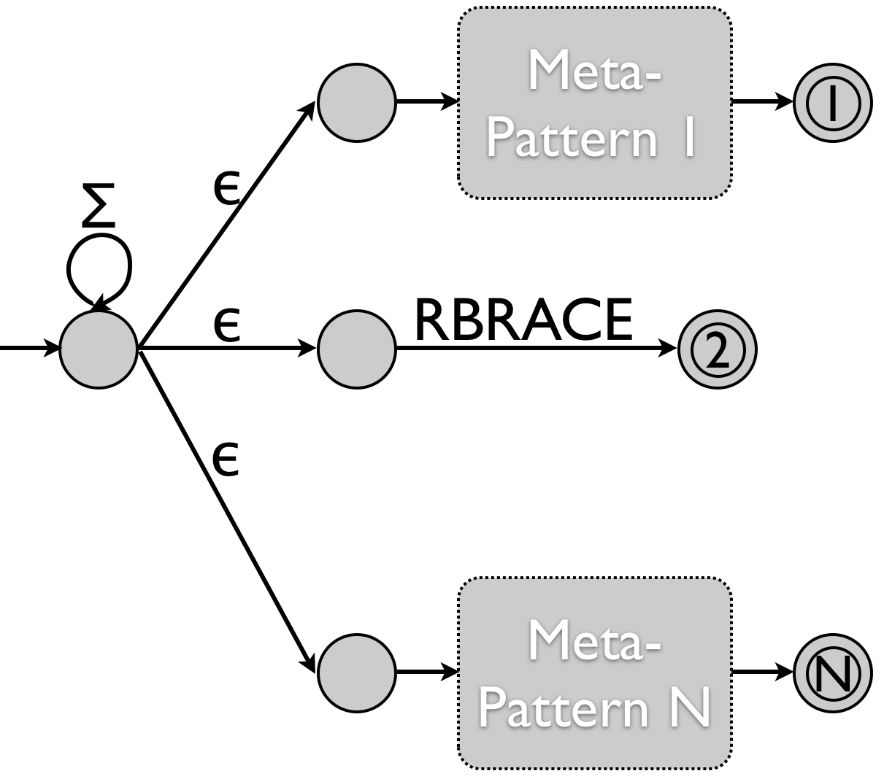
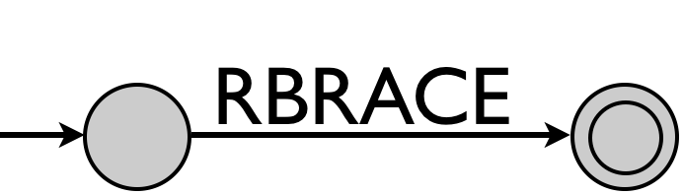
Implementing the meta-token lexer
Recognize a meta-pattern, i.e. when to go to a new component and when to return.
Recognize the matching suffix.
Notes:
Regular pattern lexer communicates with the meta-lexer. When each token of the regular lexer is accepted it receives back a response from the metalexer. If a component should be entered or exited, the matching meta-tokens are provided.
Shortest match.

Slide 26
Implementing inheritance (structured weaving).
Notes:
Reminder of how a lexer extension would look like. Extend or add new components, extend the layout, possibly replacing previous components with newly extended ones.

Slide 27
Implementing MetaLexer layout inheritance
Layouts can inherit other layouts
%inherit directive put at the location at which the inherited transition rules (embeddings) should be placed.
each %inherit directive can be followed by:
%unoption
%replace
%unembed
new embeddings

Slide 28
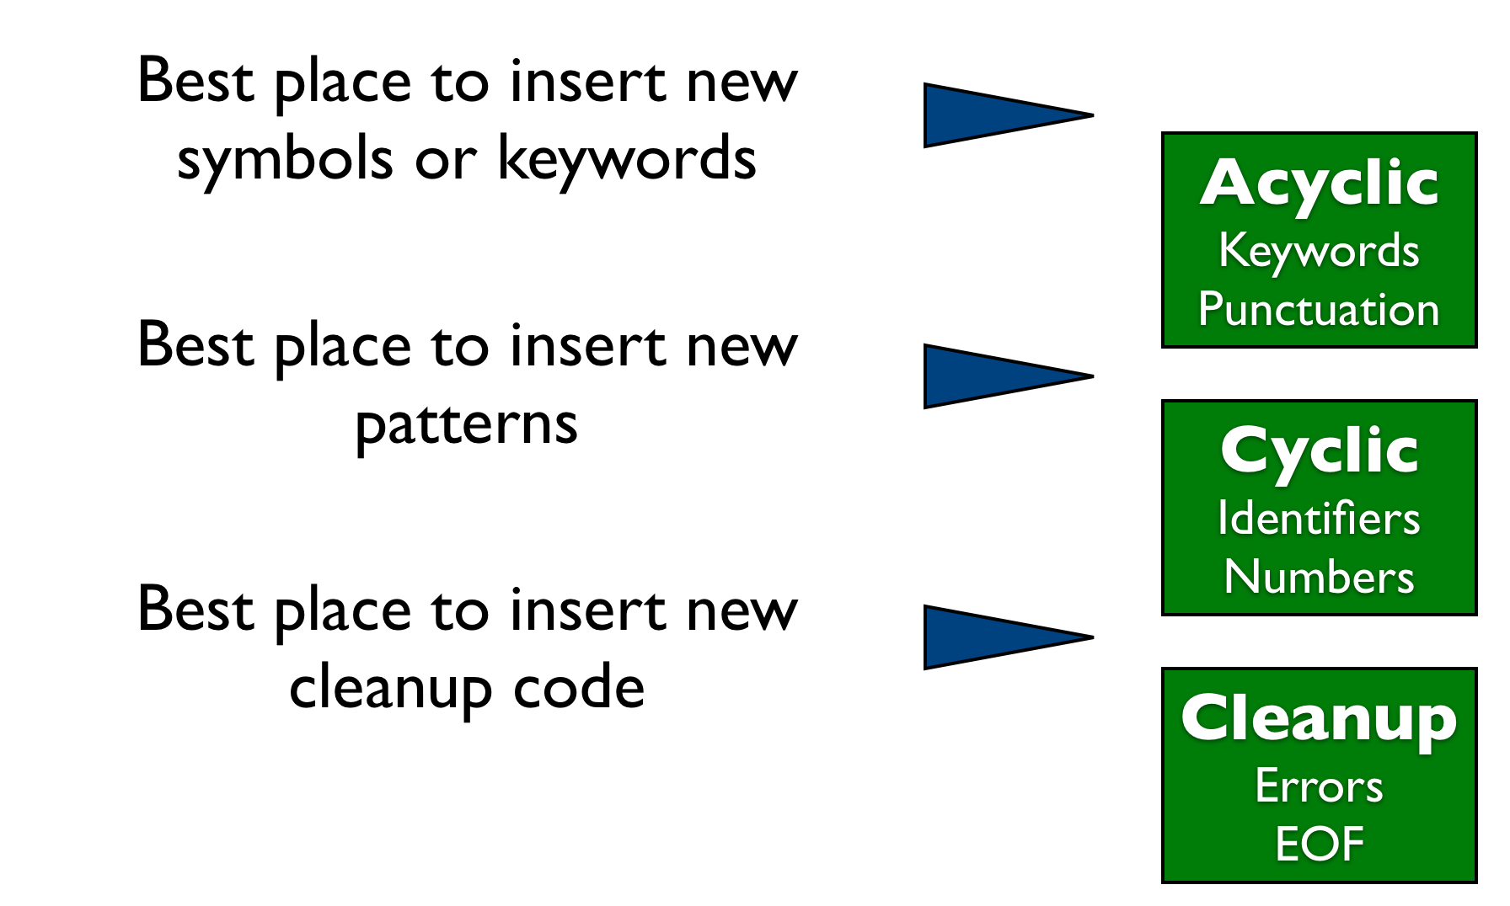
Implementing MetaLexer component inheritance
Notes:
Remember that we need to be able to add new lexing rules at specific places … but don’t want to have to identify every line.

Slide 29
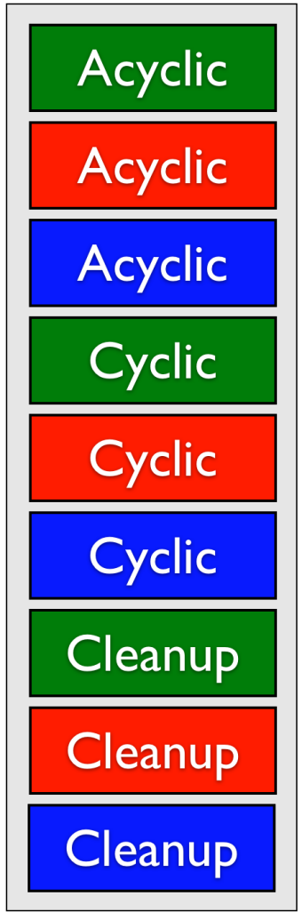
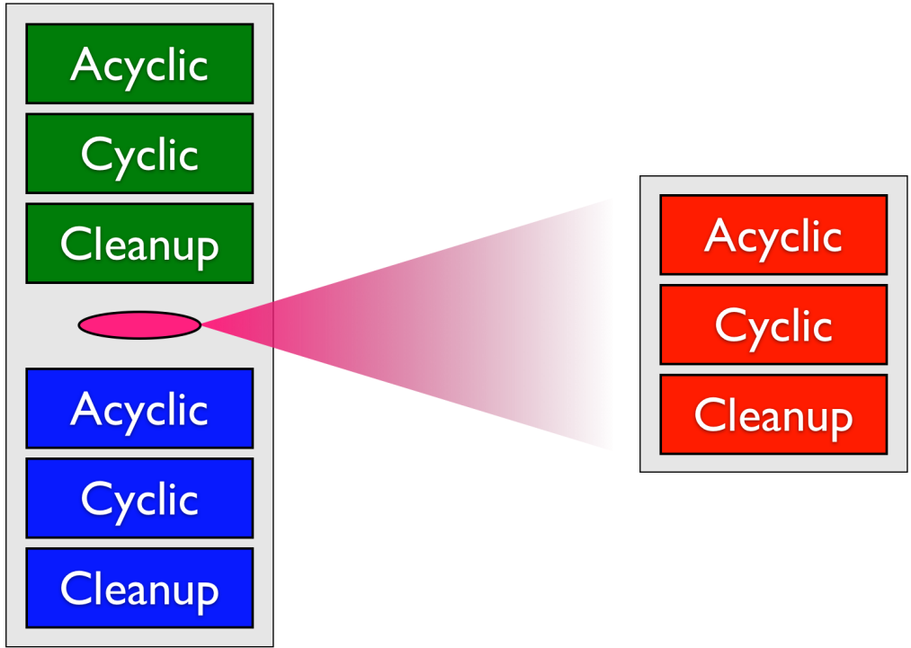
Weaving in an inherited component
O
Woven output
New Component adds some rules and inherits original component.
Original Component

Slide 30

Results:
Applied to three projects with complex scanners:
AspectJ (abc and extensions)
Matlab (Annotations and AspectMatlab extensions)
MetaLexer

Slide 31
AspectJ and Extensions

Slide 32
MetaLexer scanner implemented in MetaLexer
1st version of MetaLexer written in JFlex, one for components and one for layouts.
2nd version implemented in MetaLexer, many shared components between the component lexer and the layout lexer.

Slide 33
Related Work for MetaLexer
Ad-hoc systems with separate scanner/ LALR parser
Polyglot
JastAdd
abc
Recursive-descent scanner/parser
ANTLR and systems using ANTLR
Scannerless systems
Rats! (PEGs)
Integrated systems
Copper (modified LALR parser which communicates with DFA-based scanner)
Notes:
Why use LALR .... Grammars available, gives fast parsers ...

Slide 34
Metalexer Conclusions
MetaLexer allows one to specify modular and extensible scanners suitable for any system that works with JFlex.
Two main ideas: meta-lexing and component/layout inheritance.
Used in large projects such as abc, McLab and MetaLexer itself.
Available at: www.sable.mcgill.ca/metalexer

Slide 35
AspectMatlab
Simple Aspect-Oriented extension to MATLAB
M.Sc. thesis, Toheed Aslam
Analysis by Jesse Doherty, applications by Anton Dubrau, extensions by Olivier Savary-Belanger
AOSD 2010
www.sable.mcgill.ca/mclab
Notes:
This talk starts with an exploration of why it is important for compiler/PL researchers to work on MATLAB and languages like MATLAB.
We then proceed to an introduction to the MATLAB language, and we illustrate some of the challenges of dealing with MATLAB.

Slide 36
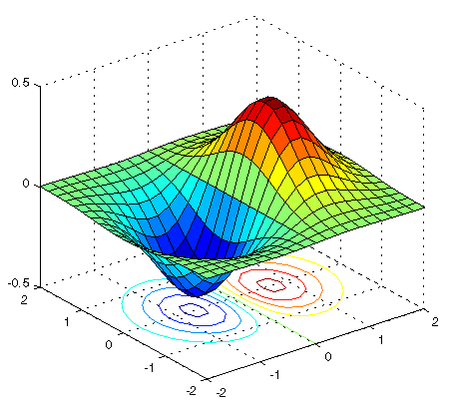
Why AspectMatlab?
AspectJ
AspectC++
AspectCobol
…
Test the McLab framework for extensibility
Bring a simple and relevant version of AOP to scientists.
simple language constructs
focus on arrays and loops
Notes:
MATLAB is a well-known, widely-adopted and easy-to-use programming language aimed at the scientific and engineering communities. Matlab provides scientists with an interactive development loop, high-level array operations and a rich collection of built-in and library functions. Matlab is also a very dynamic language in which variable types are not declared, and in which new functions and scripts are loaded dynamically. Both array and loop operations are central to scientific programming. We also wanted to introduce aspect-oriented programming in a way that was a natural extension to the Matlab language and so that it would be understood and adopted by the scientific programmers. And to integrate the both worlds together in a way which is helpful for scientists.

Slide 37
What is an Aspect?
Event
Observer
Pattern specifying events to match.
Action to do before, after or around the matched events.
Action can use context information from the matched event.

Slide 38
Example: Profiling Array Sparsity
Capture the sparsity and size at each operation on the whole array.
Capture the number of indexed references to each array.
Print out a summary for each array, allowing the programmer to identify good candidates to implement as sparse arrays.
0 0 0 9 0 0 0 0 0 0
0 0 0 0 0 0 5 0 0 0
0 1 0 0 0 0 0 3 0 0
0 0 0 0 4 0 0 0 0 0
0 0 7 0 0 0 0 0 0 0

Slide 39
Background - MATLAB Class
classdef myClass
properties
…
end
methods
…
end
end
data
count = 0;
helper functions
function x=getCount(this)‏
x = this.count;
end

Slide 40
Aspect Definition
aspect myAspect
properties
…
end
methods
…
end
patterns
…
end
actions
…
end
end
data
count = 0;
helper functions
function x=getCount(this)‏
x = this.count;
end
pointcuts
foocalls : call(foo);
advice
foocounter : before foocalls
this.count = this.count + 1;
end

Slide 41
Function and Operator Patterns
patterns
pCallFoo : call(foo);
pExecBar : execution(bar);
pCallFoo2args : call(foo(*,*));
pExecutionMain : mainexecution();
end
patterns
plusOp : op(+);
timesOp : op(.*) || op(*);
matrixOps: op(matrix);
allButMinus: op(all) & ~op(-);
end

Slide 42
Array Patterns
‏
Context Info
name
indices
object (value)‏
line number
location
file name
a(i) = b(j,k)
also,
new value
patterns
pSetX : set(a);
pGetX : get(b);
arraySet : set(*);
arrayWholeGet : get(*());
arrayIndexedGet : get(*(..));
end
Notes:
All variables in Matlab are arrays or 1x1 matrix.

Slide 43
Loop Patterns
t1 = [1,3,5,7,9,…,n];
for
end
i = 1:2:n
t2 = 1:numel(t1)
i = t1(t2);
…
…
…
patterns
pLoopI : loop(i);
pLoopHeadI : loophead(i);
pLoopBodyI : loopbody(i);
end

Slide 44
Scope Patterns
patterns
pWithinFoo : within(function, foo);
pWithinBar : within(script, bar);
pWithinMyClass : within(class, myClass);
pWithinLoops : within(loops, *);
pWithinAllAbc : within(*, abc);
end

Slide 45
Compound Patterns
Logical combinations of primitive patterns
patterns
pCallFoo : call(foo) & within(loops, *);
pGetOrSet : (get(*) | set(*)) & within(function, bar);
end

Slide 46
Before & After Actions
actions
aCountCall : before pCall
this.count = this.count + 1;
disp(‘calling a function’);
end
aExecution : after executionMain
total = this.getCount();
disp([‘total calls: ’, num2str(total)]);
end
end

Slide 47
Context Exposure
actions
aCountCall : before pCall : (name, args)‏
this.count = this.count + 1;
disp([‘calling ’,name,‘ with args(’,args, ‘)’]);
end
aExecution : after executionMain : (file)‏
total = this.getCount();
disp([‘total calls in ’,file,‘: ’,num2str(total)]);
end
end

Slide 48
Around Actions
actions
actcall : around pCallFoo : (args)‏
disp([‘before foo call with args(’, args , ‘)’]);
proceed();
disp([‘after foo call with args(’, args , ‘)’]);
end
end
actions
actcall : around pCallFoo : (args)‏
% proceed not called, so varargout is set
varargout{1} = bar(args{1}, args{2});
end
end

Slide 49
Actions Weaving Order
actions
before1 : before pCallFoo
…
around1 : around pCallFoo
…
after1 : after pCallFoo
…
before2 : before pCallFoo
…
around2 : around pCallFoo
…
after2 : after pCallFoo
…
end
before1();
around1();
after1();
foo();
before2();
around2();
after2();

Slide 50
Compiler Structure
.m
.m
Woven
Base Matlab
Matlab Impl.
of Aspects
Base
Matlab
Aspects
AspectMatlab Compiler
Front-end
Post-processing
AST
(Matlab+Aspects)‏
Woven AST
Separator
Matcher & Weaver
Matlab AST
AspectInfo
Name Resolution
Analysis
Resolved
Name Set
Transformations
Simplified AST

Slide 51
Compiler Structure
.m
.m
Woven
Base Matlab
Matlab Impl.
of Aspects
Base
Matlab
Aspects
Front-end
Post-processing
AST
(Matlab+Aspects)‏
Woven AST
Separator
Matcher & Weaver
Matlab AST
AspectInfo
Name Resolution
Analysis
Resolved
Name Set
Transformations
Simplified AST

Slide 52
Name Resolution Analysis
patterns
pCallFoo : call(foo);
pGetFoo : get(foo);
end
actions
before1 : before pCallFoo
…
before2 : before pGetFoo
…
end
before1();
before1();
before2();
before2();
if isFun(foo)
if isVar(foo)
foo();
function
foo();
variable
foo();
unresolved

Slide 53
Scientific Use Cases
Domain-Specific Profiling of Programs
Tracking array sparsity
Tracking array size-growing operations
Counting floating-point operations
Extending Functionality
Interpreting loop iteration space
Adding units to computations

Slide 54
Related Work for AspectMatlab
AspectJ (Kiczales et al., ECOOP '01)‏
abc (The de Moor and Hendren gang, AOSD '05)
Array pointcuts (Chen et al., JSES '07)‏
Loop pointcuts (Harbulot et al., AOSD '06)‏
AspectCobol (Lammel et al., AOSD '05)‏
Domain-Specific Aspects in Matlab (Cardoso et al., DSAL workshop held at AOSD '10)‏

Slide 55
Conclusions
McLab supports extensions to MATLAB
We developed MetaLexer to support modular and extensible lexers, and then used it in McLab.
We designed and implemented AspectMatlab as an exercise in using McLab for extensions, and also to provide simple and relevant AOP for scientists.

Slide 56
Typing Aspects
Types for MATLAB, somewhat in the spirit of aspects.
Designed by what programmers might want to say.
Checked at run-time, but some static analysis could be done.
Notes:
This talk starts with an exploration of why it is important for compiler/PL researchers to work on MATLAB and languages like MATLAB.
We then proceed to an introduction to the MATLAB language, and we illustrate some of the challenges of dealing with MATLAB.

Slide 57
Simple Example MATLAB function

Slide 60
MATLAB prorammers often expect certain types

Slide 62
High-level types in MATLAB
Notes:
Array, homogeneous rectangular array with n dimensions and a basetype.
Cellarray, rectangular array with n dimensions, each element is a cell which can contain any type.
Struct, a heterogeneous structure with fieldnames associated with values.
Focus mostly on arrays. Let’s look at the basetype of arrays.

Slide 63
Notes:
Leaves on the right are all of the concrete basetypes. For example int32, uint64.
By defaults types are double, but other basetypes can be created explicitly. Note all the basetypes have a real version and a complex version.

Slide 64
Simple Example
Notes:
Let’s look at the basetypes … int, complex, uint32

Slide 66
Capturing reflective information
a.type
a.value
a.dims
a.basetype

Slide 67
Capturing dimensions and basetype
<n> can be used as a dimension spec
value of n is instantiated from the runtime dimension
repeated use in same atype statement implies equality

