Slide 1

McLAB: A toolkit for static and dynamic compilers for MATLAB
Amina Aslam
Toheed Aslam
Andrew Casey
Maxime Chevalier- Boisvert
Jesse Doherty
Anton Dubrau
Rahul Garg
Maja Frydrychowicz
Nurudeen Lameed
Jun Li
Soroush Radpour
Olivier Savary
Laurie Hendren
McGill University
Leverhulme Visiting Professor
Department of Computer Science
University of Oxford
TexPoint fonts used in EMF.
Read the TexPoint manual before you delete this box.: AAAAAAAAA
Notes:
MATLAB is a popular dynamic programming language used for scientific and numerical programming. As a language, it has evolved from a small scripting language intended as an interactive interface to numerical libraries, to a very popular language supporting many language features and libraries. The overloaded syntax and dynamic nature of the language, plus the somewhat organic addition of language features over the years, makes static analysis of modern MATLAB quite challenging. In this talk I will motivate why it is important for programming language and compiler researchers to work on MATLAB and I will provide a high-level overview of McLab, a suite of compiler tools my group is developing at McGill. The main technical focus of the talk will be on the foundational problem of resolving the meaning of an identifier in MATLAB. To solve this problem we have developed two analyses, a flow-insensitive "kind analysis" and a flow-sensitive "handle analysis". I will present the analyses, some experimental results and show how the results of the analysis are required for other compiler tools.

Slide 2

Overview
Why MATLAB?
Overview of the McLAB tools
McVM – a Virtual Machine and Just-In-Time (JIT) compiler
McFOR – translating MATLAB to FORTRAN95
Notes:
This talk starts with an exploration of why it is important for compiler/PL researchers to work on MATLAB and languages like MATLAB.
We then proceed to an introduction to the MATLAB language, and we illustrate some of the challenges of dealing with MATLAB.

Slide 3


FORTRAN
C/C++
C, Parallel C,
Java, AspectJ
MATLAB
PERL
Python
Domain-specific
Notes:
Scientist in upper right ... Many different applications to program, which language to pick? Increasingly picking dynamic or scripting languages. Many scientific and engineering computations use MATLAB.
Computer Scientist, Compiler writer, lower left. Has worked on compilers and tools for object-oriented and aspect-oriented languages ... But scientists are not interested in these languages.

Slide 4
Culture Gap
Scientists / Engineers
Programming Language / Compiler Researchers
Comfortable with informal descriptions and “how to” documentation.
Don’t really care about types and scoping mechanisms, at least when developing small prototypes.
Appreciate libraries, convenient syntax, simple tool support, and interactive development tools.
Prefer more formal language specifications.
Prefer well-defined types (even if dynamic) and well-defined scoping and modularization mechanisms.
Appreciate “harder/deeper/more beautiful” programming language/compiler research problems.
Notes:
PL and compiler researchers need to consider the scientific community and their perspective.
What can we do to enhance their programming experience, while still doing interesting research from a CS perspective?
Does the PL/compiler community need to broaden their perspective of what is useful/good research?

Slide 5
Ok, I can deal with this!
McLAB Compiler Framework
Back-ends
Analysis Frame-work
Front-end
Ok, this is useful!
Notes:
McLAB is intended to be a clean interface that compiler/PL/SE people are happy to deal with. Allow us to produce tools useful to the scientist.

Slide 6
Goals of the McLab Project
Improve the understanding and documentation of the semantics of MATLAB.
Provide front-end compiler tools suitable for MATLAB and language extensions of MATLAB.
Provide a flow-analysis framework and a suite of analyses suitable for a wide range of compiler/soft. eng. applications.
Provide back-ends that enable experimentation with JIT and ahead-of-time compilation.
Enable PL, Compiler and SE Researchers to work on MATLAB
Notes:
Our goals are to provide an infrastructure that supports the research for MATLAB, and to do such research ourselves.

Slide 7
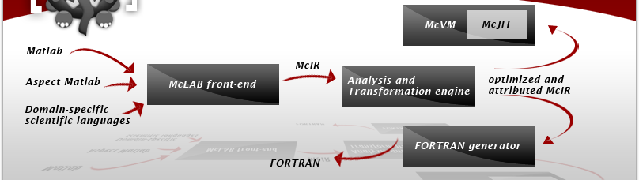
McLAB – Overall Structure
Notes:
Talk about front-end and back-ends, then focus on middle part – topic of this talk.

Slide 8
McLAB Extensible Front-end
.m source
AspectMatlab
.m source
MATLAB-to-Natlab
Scanner
(MetaLexer)
.m source
Parser
(Beaver)
AspectMatlab
AspectMatlab
AST attributes, rewrites
(JastAdd)
XML
Other
Attributed AST
Notes:
Implemented in Java and Java-based tools.

Slide 9
Analysis Engine
Analyses are written using an Analysis Framework that supports forward and backward flow analysis over McAST and McLAST.
MATLAB
MATLAB-to-Natlab Translator and Natlab front-end
McAST Analyses
McAST
McLab Simplifier
McLAST Analyses
McLAST + dataflow info
MATLAB generator
McVM
McFOR
Notes:
Kind Analysis implemented on McAST, handle analysis implemented on McLAST.

Slide 10

How to build the back-ends?
No official language specification.
Closed-source implementations, including the library.

Slide 11
Back-end #1: MATLAB generator
McLAB can be used as a source-to-source translator:
source-level optimizations like loop unrolling
source-level refactoring tool
McLAB can generate:
xml files (used to communicate with McVM)
text .m files
Comments are maintained to enable readable output.

Slide 12
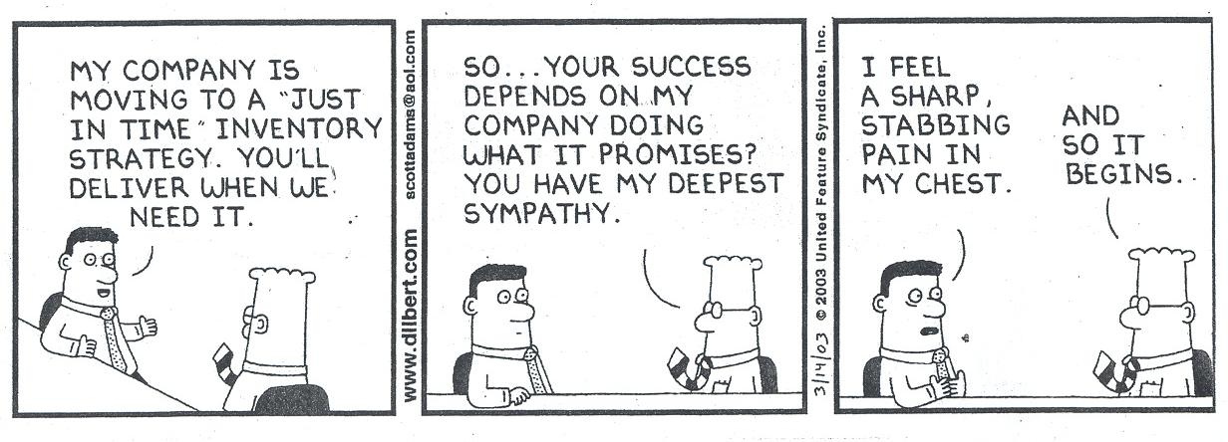
Back-end #2: McVM with JIT compiler
Based on Maxime Chevalier-Boisvert's M.Sc. thesis, McGill, published in CC 2010.
Currently being extended by Nurudeen Lameed and Rahul Garg, Ph.D. candidates, McGill.

Slide 13
McVM-McJIT
The dynamic nature of MATLAB makes it very suitable for a VM/JIT.
MathWorks' implementation does have a JIT, although technical details are not known.
McVM/McJIT is an open implementation aimed at supporting research into dynamic optimization techniques for MATLAB.
Notes:
McVM is designed for flexibility and high performance.

Slide 14
Design Choices for JITs
Interpreter + JIT compiler with various levels of optimizations.
Fast JIT for naïve code generation + optimizing JIT with various levels of optimizations.
McVM uses the 1st option because it simplifies adding new features, if a feature is not yet supported by the JIT it can back-up to the interpreter implementation, which is easy to provide.

Slide 15
McVM Design
A basic, but fast, interpreter for the MATLAB language.
A garbage-collected JIT Compiler as an extension to the interpreter.
Easy to add new data types and statements by modifying only the interpreter.
Supported by the LLVM compiler framework and some numerical computing libraries.
Written entirely in C++; interface with the McLAB front-end via a network port.
Notes:
McVM is designed for flexibility and high performance.

Slide 16
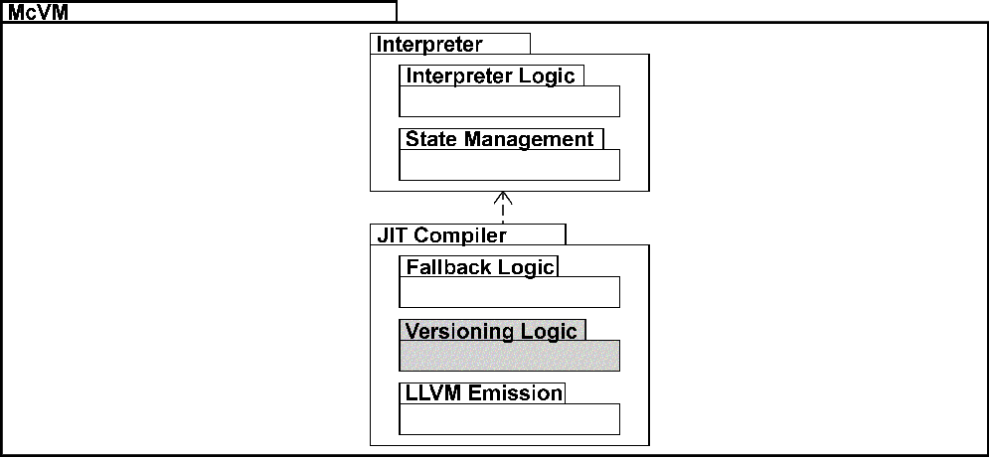
McVM Organization

Slide 17
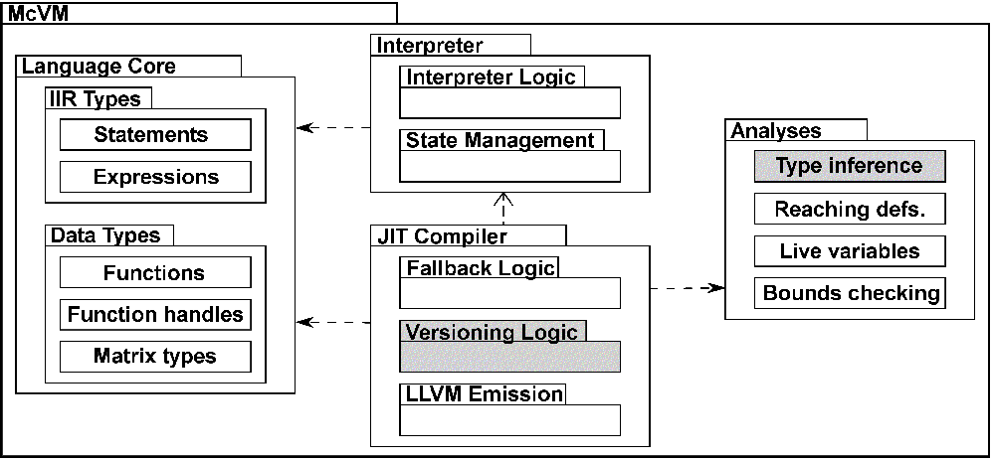
McVM Organization

Slide 18
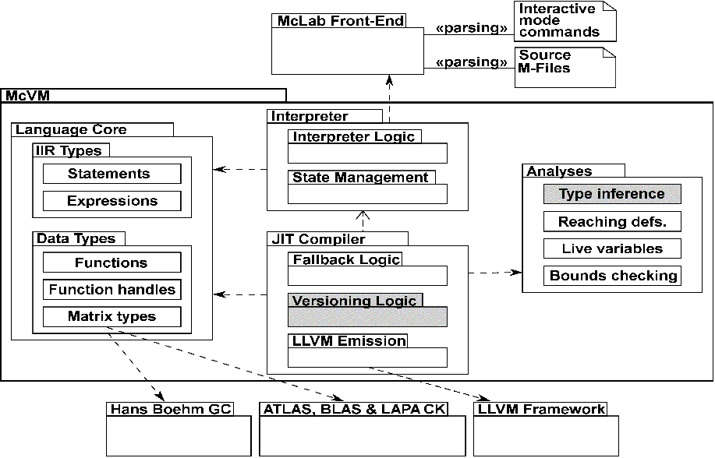
McVM Organization

Slide 19
MATLAB Optimization Challenges
float sumvals(float start, float step, float stop)
{
float i = start;
float s = i;
while (i < stop)
{
i = i + step;
s = s + i;
}
return s;
}
Notes:
In C/Java, type annotations at every declaration site.

Slide 20
MATLAB Optimization Challenges
function s = sumvals(start, step, stop)
i = start;
s = i;
while i < stop
i = i + step;
s = s + i;
end
end
function caller()
a = sumvals(1, 1, 10^6);
b = sumvals([1 2], [1.5 3], [20^5 20^5]);
c = [a b];
disp(c);
end
Notes:
Is it obvious what combinations of types sumvals can apply to in MATLAB?
What makes MATLAB difficult to optimize
Dynamic typing
No type annotations
A single variable could represent many times
Variables can change type at run-time
Semantically: merely references to boxed objects
Other dynamic features: eval, cd
cd/eval constructs cause loss of information

Slide 21

McJIT: Executing a Function
f(arg_types)
Code Cache
Compiled code exists in the code cache?
yes
Execute function
Mclab
Front-end
no
Generate LLVM & Machine Code
Parse function code;
generate XML
IIR exist?
no
Load function
Yes
Perform analyses & transformations
Send code string to the front-end; receive AST as XML
Parse XML; build AST
Notes:
How does the JIT compiler execute a function? Given a function called with some argument types; McVM checks if a compiled code exists that match the call, in terms of the types of the arguments and proceed as shown.

Slide 22
Just-In-Time Specialization (1)
>> a = sumvals(1, 1, 10^6);
>> b = sumvals([1 2], [1.5 3], [20^5 20^5]);
>> a = sumvals(1, 1, 500);
>> c = [a b];
>> disp(c);
Notes:
Capture of function param. types
Done by interpreter
Inference of local var. types
Abstract interpretation
Specialization
Procedure cloning
Partial evaluation w.r.t. type information
Just-In-Time Specialization Show how interpreter runs into a call, calls JIT, JIT does inference JIT does specialization Specialized function is executed Return to call point
This can trigger indirect specializations

Slide 23
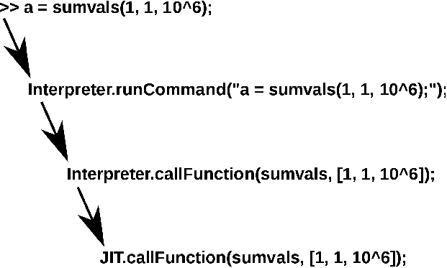
Just-In-Time Specialization (2)

Slide 24
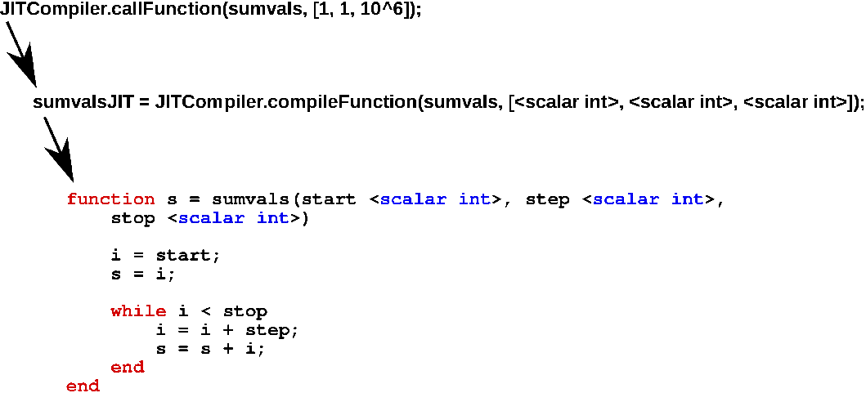
Just-In-Time Specialization (3)

Slide 25
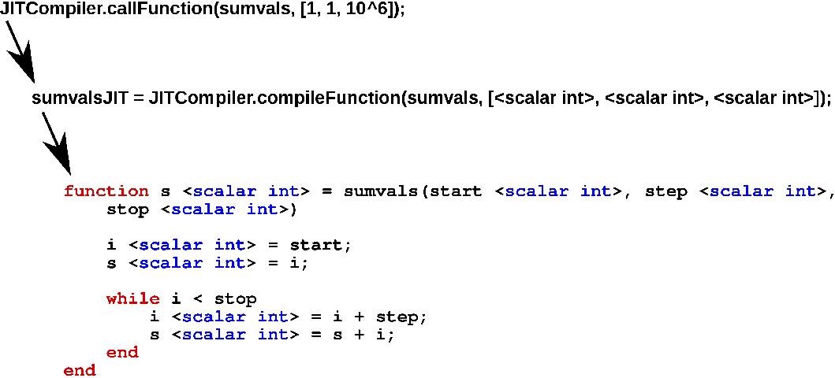
Just-In-Time Specialization (4)

Slide 26
Just-In-Time Specialization - 2nd example
>> a = sumvals(1, 1, 10^6);
>> b = sumvals([1 2], [1.5 3], [20^5 20^5]);
>> a = sumvals(1, 1, 500);
>> c = [a b];
>> disp(c);

Slide 27
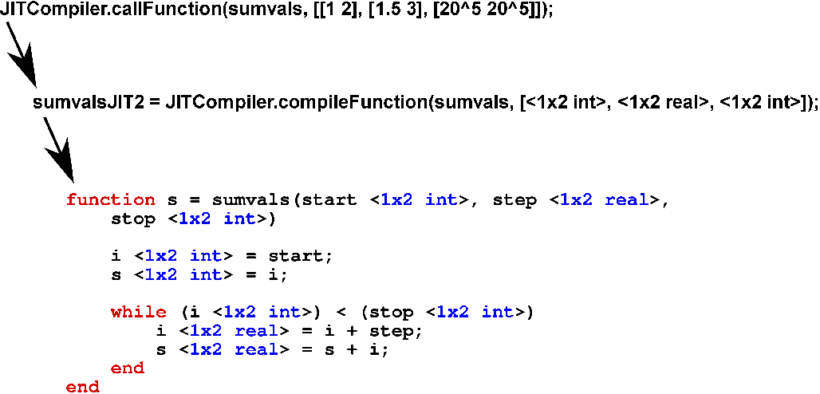
JIT – second specialization (1)

Slide 28
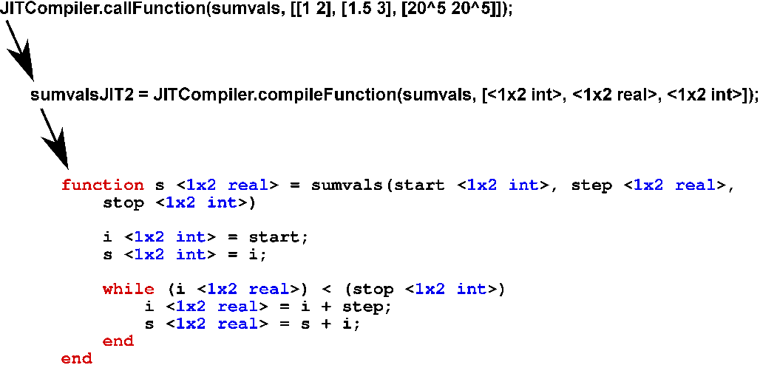
JIT – second specialization (2)

Slide 29
JIT – third specialization same as first
>> a = sumvals(1, 1, 10^6);
>> b = sumvals([1 2], [1.5 3], [20^5 20^5]);
>> a = sumvals(1, 1, 500);
>> c = [a b];
>> disp(c);
Notes:
Mention lookup

Slide 30
Type and Shape Inference
In MATLAB, work with incomplete information
Dynamic loading: working with incomplete program
Dynamic typing : variables can change type
Know argument types, what can we infer?
Propagate type info to deduce locals type and return type
Forward dataflow analysis
Based on abstract interpretation
Structure-based fixed point
Annotates AST with type info

Slide 31
Flow Analysis Summary
Start from known argument types
Propagate type information forward
Use a transfer function for each expression
Transfer functions provided for all primitive operators
Library functions provide their own transfer functions
Function calls resolved, recursively inferred
Assignment statements can change var. types
Merge operator
Union + filtering

Slide 32
Lattice of McVM types
Top (Unknown type, could be any)
Function handle
Matrix-like types
Cell Array
Matrix types
Char array
Logical array
Double matrix
Complex Matrix
Bottom (No information inferred)
Notes:
A key analysis performed McVM is the type inference analysis …

Slide 33
Type Abstraction Properties
Collection of simple abstractions
Specific features computed in parallel
Represent variable types with 8-tuples:
<overallType, is2D, isScalar, isInteger,
sizeKnown, size, handle, cellTypes>
Notes:
Collection of simple abstractions, specific features computed in parallel
Why is each field useful to know?
Spend more time, why is each abstraction important***

Slide 34
Type Abstraction Properties
a = [1 2];
type(a) =
<overallType = double, is2D = T, isScalar = F, isInteger = T, sizeKnown = T, size = (1,2), handle = null, cellTypes = {}>
Notes:
Why is overallType double here?
Why is it 2D?

Slide 35
Variable Types: Type Sets
if (c1)
a = [1 2];
elseif (c2)
a = 1.5;
else
a = 'a';
end
type(a) = {
<overallType = double, is2D = T, isScalar = F,
isInteger = T, sizeKnown = T, size = (1,2),
handle = null, cellTypes = {}>,
<overallType = double, is2D = T, isScalar = T,
isInteger = F, sizeKnown = T, size = (1,1),
handle = null, cellTypes = {}>,
<overallType = char, is2D = T, isScalar = T,
isInteger = T, sizeKnown = T, size = (1,1),
handle = null, cellTypes = {}>
}
Notes:
Collection of simple abstractions, specific features computed in parallel
Why is each field useful to know?

Slide 36
Type Set Filtering
type(a) = {
<overallType = double, is2D = T, isScalar = F,
isInteger = T, sizeKnown = T, size = (1,2),
handle = null, cellTypes = {}>,
<overallType = double, is2D = T, isScalar = T,
isInteger = F, sizeKnown = T, size = (1,1),
handle = null, cellTypes = {}>
}
Becomes:
type(a) = {
<overallType = double, is2D = T, isScalar = F,
isInteger = F, sizeKnown = F, size = (),
handle = null, cellTypes = {}>
}
Notes:
Assumes compiler will want to generate one optimized path for each overall type
Avoids type set size explosion

Slide 37
Transfer Functions
a = 5 * 10e11;
b = 1.0e12 * [0.8533 1.7067];
c = [a b];
type(a) = {
<overallType = double, is2D = T, isScalar = T, isInteger = T,
sizeKnown = T, size = (1,1), handle = null, cellTypes = {}>
}
type(b) = {
<overallType = double, is2D = T, isScalar = F, isInteger = F,
sizeKnown = T, size = (1,2), handle = null, cellTypes = {}>
}
type([a b]) = {
<overallType = double, is2D = T, isScalar = F,isInteger = F,
sizeKnown = T, size = (1,3), handle = null, cellTypes = {}>
}
Notes:
Assumes compiler will want to generate one optimized path for each overall type
Avoids type set size explosion

Slide 38
Experimental Results
20 benchmark programs
FALCON, OTTER, etc. Some made by McLAB
Measured
Dynamic availability of type info.
Number of versions compiled
Compilation time
0.55s per benchmark, on average

Slide 39
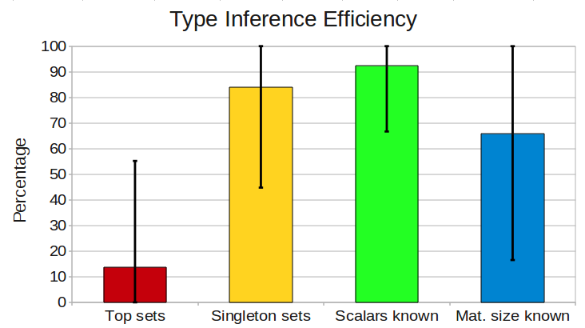
Results of Type Analysis
Notes:
Tell people if big or small is better
Top sets are bad, why?

Slide 40
How many versions...

Slide 41
Performance Results
Experimental setup
Core 2 Quad Q6600, 4GB RAM
Ubuntu 9.10, kernel 2.6.31, 32-bit
All timings averaged over 10 runs
Comparing
McVM interpreter, McVM JIT w/ spec.
MATLAB R2009a
GNU Octave 3.0.5
McFor / GNU Fortran 4.4.1

Slide 42
Results (Speed-up vs Interpreters)

Slide 43
Results (Speed-up vs MATLAB, McFOR)
Notes:
Why some red bars missing:
McFor makes many assumptions

Slide 44
About Slow Benchmarks
crni benchmark takes 1321s to execute in McVM, 6.95s in MATLAB
~4x faster than Octave, but still slow
Why?
Scalars known 68.7%, one of the lowest ratios
Unknown types propagated through entire benchmark
Weakness of type inference system to be fixed in future work

Slide 45
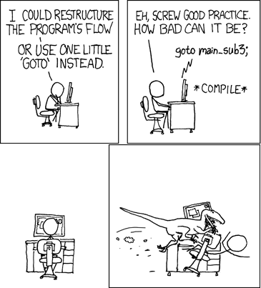
Back-end #3: McFOR FORTRAN95 generator
First version of McFOR based on Jun Li's M.Sc. thesis, McGill.
Current version under development by Anton Dubrau, M.Sc. candidate, McGill.

Slide 46
Goals of McFOR
Handle as large a sub-set of MATLAB as possible, while staying in the "static" setting.
Generate code that can be effectively compiled by modern FORTRAN compilers.
Make the generated code readable by programmers.
Allow longer compile times and whole program analysis.
Limit the need for type annotations.

Slide 47
Challenges
Determining which identifiers are variables and which are functions.
Finding static types which match those of FORTRAN.
Mapping high-level MATLAB array operations to the FORTRAN95 equivalents.
Handling reshaping implicit in MATLAB operations, including concatenation.

Slide 48
Handling Incompatible Types
Alpha Nodes
Eliminating Alpha Nodes
x = 0;
if (i>0)
S1: x = foo(i);
else
S2: x = bar(i);
end
x = alpha(S1,S2);
y = x;
x = 0;
if (i>0)
x = foo(i);
y = x;
else
x1 = bar(i)
y = x1;
end

Slide 49
Value Range Propagation
MATLAB
FORTRAN
n = floor(11.5); //n =[n,n]
for i = 1:n // i=[1,n]
x = 1+2*i; // x=[3,1+2*n]
A(x) = i; // Size(A)=
end 1+2*n
n = fix(n/2); // n = [n,n]
A(n+1) = n;
n = foor(10.5);
DO i = 1,n
x = (1+(2*i));
IF((.NOT.ALLOCATED(A))) THEN
ALLOCATE(A((1+(2*n))));
END IF
A(x) = i;
END DO
n = fix(n/2);
ARRAYBOUNDSCHECKING(A,[n+1]);
A(n+1) = n;

Slide 50
Basic structure of 2nd generation McFOR
Front-end
Simplification
Call graph, class and shape analysis
Fortran-specific transformations
Other target-language
transformations
Fortran Generation

Slide 51
Related Work
Procedure cloning: Cooper et al. (1992)
MATLAB type inference: Joisha & Banerjee (2001)
Suggested for error detection
MATLAB Partial Evaluator: Elphick et al. (2003)
Source-to-source transformation
MaJIC: JIT compilation and offline code cache (2002)
Speculative compilation MATLAB to C/Fortran
Psyco: Python VM with specialization by need (2004)
TraceMonkey: JIT optimization of code traces (2009)
Notes:
How is related work different from your work?

Slide 52
Ongoing Work
McVM:
profile-guided optimization and re-optimization with on-stack replacement
target GPU/multi-core
McFOR:
"decompile" to more programmer-friendly FORTRAN95
refactoring toolkit to help restructure "dynamic" features to "static" features

Slide 53
Conclusions
McLAB is a toolkit to enable PL, Compiler and SE research for MATLAB
front-end for language extensions
analysis framework
three back-ends including McVM and McFOR
http://www.sable.mcgill.ca/mclab

Slide 54
Extra Slides
Intermediate Representation

Slide 55
Internal Intermediate Representation
A simplified form of the Abstract Syntax Tree (AST) of the original source program
It is machine independent
All IIR nodes are garbage collected
Notes:
McVM converts source code into a form more amenable to analyses. It is similar in form to a three address code.

Slide 56
IIR: A Simple MATLAB Program
IIR form
.m file
function [a] = test(n)
a = zeros(1, n);
$t1 = 1; $t0 = 1;
$t2 = $t1; $t3 = n;
while True
$t4 = ($t0 <= $t3);
if ~$t4
break;
end
i = $t0;
a(i) = (i * i);
$t0 = ($t0 + $t2);
end
end
function a = test(n)
a = zeros(1,n);
for i = 1:n
a(i) = i*i;
end
end
Notes:
The box on the left-hand side shows the code of an .m file. This is transformed into the box on the right : the corresponding function in internal IR form.

Slide 57
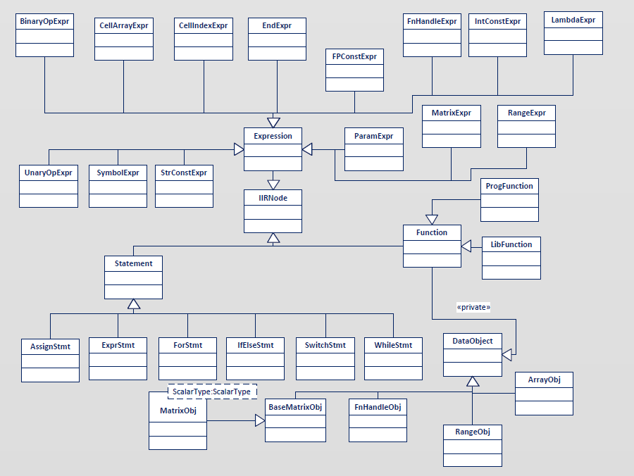
McVM Project Class Hierarchy (C++ Classes)
Notes:
The figure shows a simplified UML class diagram for the McVM project. At the root of class hierarchy is the IIRNode. There are a number of statements and expressions as well.

Slide 58
Supported Types
Logical Arrays
Double-precision floating points
Double-precision complex number matrices
Character Arrays
Cell arrays
Function Handles
Notes:
These are the currently supported types in McVM.

