Slide 1
MiX10 First steps to compiling MATLAB to X10
Vineet Kumar and Laurie Hendren
McGill University
Notes:
This presentation demonstrates the new capabilities of PowerPoint and it is best viewed in Slide Show. These slides are designed to give you great ideas for the presentations you’ll create in PowerPoint 2010!
For more sample templates, click the File tab, and then on the New tab, click Sample Templates.

Slide 2
In this talk
1
2
3
WHY?
WHAT?
WOW!

Slide 3
Why? Why not !
1
motivation and challenges

Slide 4

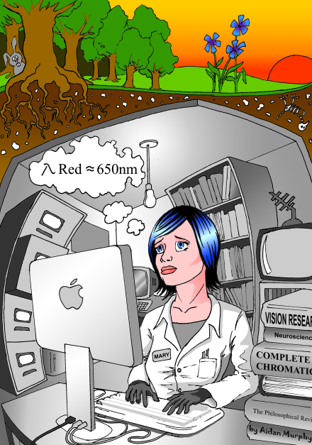
Why MATLAB to X10?
I wish I could make better use of that super computer !
I wish my program could run faster !
What do I do about all the programs that I are already written ?
I wish I had time to learn that cool new language I read about!

Slide 5

Captain MiX10 comes to rescue
Keep programming in MATLAB and translate your MATLAB programs to X10
Run your programs faster
No need to learn X10
Make good use of your supercomputing resources

Slide 6

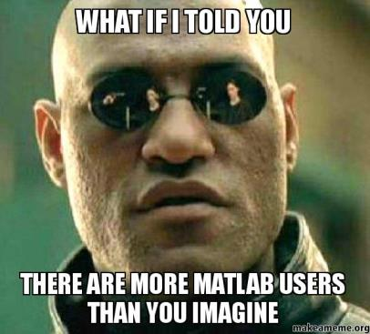
Why do we care about MATLAB?
Over 1 million MATLAB users in 2004 and numbers doubling every 1.5 to 2 years.
Even more MATLAB users who use free systems Octave or SciLab.
11.1 million monthly google searches for “MATLAB”.
Thousands of MATLAB/Simulink books.
Users from disciplines in science, engineering and economics in academia as well as industry.

Slide 7

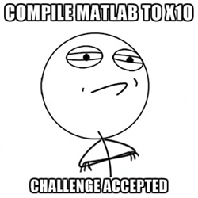
The job’s not easy
MATLAB
no formal language specification
dynamically typed
flexible syntax
unconventional semantics
everything is a matrix
huge builtin library
MiX10

Slide 8

What? Under the hood
2
The McLab project, specific technical challenges and useful X10 features

Slide 9


MATLAB
Aspect MATLAB
Frontend
McSAF
Tamer
Fortran backend
Dynamic analysis
McVM
X10 backend
McIR
McSAF IR, Kind analysis
Tame IR, Callgraph, Analyses
The McLab project overview

Slide 10
Source code
function[x,y] = rgbFilter(h,w,c,p,g)
% h : height of the image
% w : width of the image
% c : colour of the filter
% p : pixel matrix of the image
% g : gradient factor
filter=ones(h,w);
filter=filter*c;
%applyFilter=filter;
%x = i;
for i=1:w
x = p(:,i);
x = x+gradient(w,g);
end
x = p;
y = applyFilter(p,filter);
end
Apply gradient and filter to an image
Create a filter
Apply gradient
Apply filter

Slide 11
McSAF Static Analysis Framework
function[x,y] = rgbFilter(h,w,c,p,g)
% h : height of the image
% w : width of the image
% c : colour of the filter
% p : pixel matrix of the image
% g : gradient factor
filter=ones(h,w);
filter=filter*c;
%applyFilter=filter;
%x = i;
for i=1:w
x = p(:,i);
x = x+gradient(w,g);
end
x = p;
y = applyFilter(p,filter);
end
McSAF
function[x,y] = rgbFilter(h,w,c,p,g)
% h : height of the image
% w : width of the image
% c : colour of the filter
% p : pixel matrix of the image
% g : gradient factor
filter=ones(h,w);
filter=filter*c;
%applyFilter=filter;
x = i;
% for i=1:w
%x = p(:,i);
%x = x+gradient(w,g);
%end
x = p;
y = applyFilter(p,filter);
end
What happens if we uncomment
%applyFilter=filter; ?
A low-level IR
Kind analysis
Is this an error ?
No, it’s a call to the builtin i();
y = applyFilter(p,filter); becomes an array access

Slide 12
Tamer
function[x,y] = rgbFilter(h,w,c,p,g)
% h : height of the image
% w : width of the image
% c : colour of the filter
% p : pixel matrix of the image
% g : gradient factor
filter=ones(h,w);
filter=filter*c;
%applyFilter=filter;
%x = i;
for i=1:w
x = p(:,i);
x = x+gradient(w,g);
end
x = p;
y = applyFilter(p,filter);
end
What are the types of h, w, c, p and g ?
Is ones(h,w) builtin or
user-defined?
What is the shape of filter ?
Is g real or complex ?
What are the types of x and y ?

Slide 13
Tamer
Tamer
function[x,y] = rgbFilter(h,w,c,p,g)
% h : height of the image
% w : width of the image
% c : colour of the filter
% p : pixel matrix of the image
% g : gradient factor
filter=ones(h,w);
filter=filter*c;
%applyFilter=filter;
%x = i;
for i=1:w
x = p(:,i);
x = x+gradient(w,g);
end
x = p;
y = applyFilter(p,filter);
end
Very low-level IR
Callgraph
Type analysis
Shape analysis
IsComplex analysis

Slide 14
MATLAB
Aspect MATLAB
Frontend
McSAF
Tamer
Fortran backend
Dynamic analysis
McVM
X10 backend
McIR
McSAF IR, Kind analysis
Tame IR, Callgraph, Analyses
The McLab project overview

Slide 15
builtins.xml
MiX10 IR generator
Code transformations
Code printer
Builtin handler
Mix10.x10
<Program>.x10
Tamer Ir
Callgraph
Analyses
Mix10 IR
Transformed IR
MiX10

Slide 16
Builtin methods
//1
public static def mtimes(
a: Array[Double], b:Array[Double])
{a.rank == b.rank}{
val x = new Array[Double](a.region);
for (p in a.region){
x(p) = a(p)* b(p);
}
return x;
}
//2
public static def mtimes(a:Double, b:Array[Double]){
val x = new Array[Double](b.region);
for (p in b.region){
x(p) = a* b(p);
}
return x;
}
function[x,y] = rgbFilter(h,w,c,p,g)
% h : height of the image
% w : width of the image
% c : colour of the filter
% p : pixel matrix of the image
% g : gradient factor
filter=ones(h,w);
filter=filter .* c;
%applyFilter=filter;
%x = i;
for i=1:w
x = p(:,i);
x = x+gradient(w,g);
end
x = p;
y = applyFilter(p,filter);
end
x = mtimes(a,b);
% same as x = a+b;

Slide 17
Builtin methods (contd.)
//3
public static def mtimes(a:Array[Double], b:Double){
val x = new Array[Double](a.region);
for (p in a.region){
x(p) = a(p)* b;
}
return x;
}
//4
public static def mtimes(a:Double, b:Double){
val x: Double;
x = a*b;
return x;
}
//And 4 more for complex numbers
function[x,y] = rgbFilter(h,w,c,p,g)
% h : height of the image
% w : width of the image
% c : colour of the filter
% p : pixel matrix of the image
% g : gradient factor
filter=ones(h,w);
filter=filter .* c;
%applyFilter=filter;
%x = i;
for i=1:w
x = p(:,i);
x = x+gradient(w,g);
end
x = p;
y = applyFilter(p,filter);
end

Slide 18

Should we have all the possible overloaded methods for every builtin used in the generated code ?

Slide 19
That’s what Builtin handler solves!
Template based specialization
Generates only required overloaded versions
Creates a separate class
Improves readability

Slide 20
X10 as a target language
Nice X10 features

Slide 21
The type ‘Any’
function[x,y] = rgbFilter(h,w,c,p,g)
% h : height of the image
% w : width of the image
% c : colour of the filter
% p : pixel matrix of the image
% g : gradient factor
filter=ones(h,w);
filter=filter .* c;
%applyFilter=filter;
%x = i;
for i=1:w
x = p(:,i);
x = x+gradient(w,g);
end
x = p;
y = applyFilter(p,filter);
end
return [x as Any, y as Any];
Same idea also used for Cell Arrays

Slide 22
Point and Region API
function[x,y] = rgbFilter(h,w,c,p,g)
% h : height of the image
% w : width of the image
% c : colour of the filter
% p : pixel matrix of the image
% g : gradient factor
filter=ones(h,w);
filter=filter .* c;
%applyFilter=filter;
%x = i;
for i=1:w
x = p(:,i);
x = x+gradient(w,g);
end
x = p;
y = applyFilter(p,filter);
end
mix10_pt_p = Point.make(0, 1-(i as Int));
mix10_ptOff_p = p;
x = new Array[Double](
((p.region.min(0))..(p.region.max(0)))*(1..1),
(pt:Point(2))=>
mix10_ptOff_p(pt.operator-(mix10_pt_p)));
mix10_pt_p = Point.make(0, 1-(i as Int));
mix10_ptOff_p = p;
x = new Array[Double](
((p.region.min(0))..(p.region.max(0)))*(1..1),
(p:Point(2))=>
mix10_ptOff_p(p.operator-(mix10_pt_p)));
Works even when shape is unknown at compile time

Slide 23
Wow! Some preliminary results
3
Results for managed and native backends

Slide 24
Benchmarks
bubble - bubble sort
capr - computes the capacitance per unit length of a coaxial pair of rectangles
dich - ﬁnds the Dirichlet solution to Laplace’s equation
fiff - a ﬁnite diﬀerence solution to a wave equation
mbrt - computes a mandelbrot set
nb1d - simulates the gravitational movement of a set of objects in 1 dimension

Slide 25
Compilation flow
MiX10
X10c
javac
x10c++
gc++
MATLAB
X10
Java, C++
-O, -NO_CHECKS
Managed backend
-O, -NO_CHECKS
Native backend

Slide 26
Native backend

Slide 27
Managed backend

Slide 28


Slide 29
“The JIT is very unhappy”
Optimizer triggered code inlining
Resultant code too big for JIT compiler to compile
Switched to interpreter
Static rank declaration eliminated runtime rank checks
Reduced code size for capr enough for JIT compiler to compile
Dich was still too large (for HotSpot JIT compiler)
Static rank declaration gave significant performance improvements for other benchmarks (upto 30% depending on number of array accesses)
Thank you Dave for figuring this out

Slide 30
This was just the beginning
Support for vector instructions and parfor loops
Analyses and transformations for performance and readability
Thank You

Slide 31
Acknowledgements
NSERC for supporting this research, in part
David Grove for helping us validate and understand some results
Anton Dubrau for his help in using Tamer
Xu Li for providing valuable suggestions

