Slide 1
haystack_cur
a
b
a
b
a
b
a
b
c
a
haystack
a
b
a
b
a
b
c
a
needle
开始匹配！
needle_cur

Slide 2
haystack_cur
a
b
a
b
a
b
a
b
c
a
haystack
a
b
a
b
a
b
c
a
needle
needle_cur

Slide 3
haystack_cur
a
b
a
b
a
b
a
b
c
a
haystack
a
b
a
b
a
b
c
a
needle
needle_cur

Slide 4
haystack_cur
a
b
a
b
a
b
a
b
c
a
haystack
a
b
a
b
a
b
c
a
needle
needle_cur

Slide 5
haystack_cur
a
b
a
b
a
b
a
b
c
a
haystack
a
b
a
b
a
b
c
a
needle
needle_cur

Slide 6
haystack_cur
a
b
a
b
a
b
a
b
c
a
haystack
a
b
a
b
a
b
c
a
needle
needle_cur

Slide 7
haystack_cur
a
b
a
b
a
b
a
b
c
a
haystack
a
b
a
b
a
b
c
a
needle
needle_cur

Slide 8
haystack_cur
a
b
a
b
a
b
a
b
c
a
haystack
a
b
a
b
a
b
c
a
needle
needle_cur

Slide 9
haystack_cur
a
b
a
b
a
b
a
b
c
a
haystack
a
b
a
b
a
b
c
a
needle
needle_cur

Slide 10
haystack_cur
a
b
a
b
a
b
a
b
c
a
haystack
a
b
a
b
a
b
c
a
needle
needle_cur

Slide 11
haystack_cur
a
b
a
b
a
b
a
b
c
a
haystack
a
b
a
b
a
b
c
a
needle
needle_cur

Slide 12
haystack_cur
a
b
a
b
a
b
a
b
c
a
haystack
a
b
a
b
a
b
c
a
needle
needle_cur

Slide 13
haystack_cur
a
b
a
b
a
b
a
b
c
a
haystack
a
b
a
b
a
b
c
a
needle
needle_cur

Slide 14
haystack_cur
a
b
a
b
a
b
a
b
c
a
haystack
a
b
a
b
a
b
c
a
needle
needle_cur

Slide 15
haystack_cur
a
b
a
b
a
b
a
b
c
a
haystack
a
b
a
b
a
b
c
a
needle
needle_cur

Slide 16
haystack_cur
a
b
a
b
a
b
a
b
c
a
haystack
a
b
a
b
a
b
c
a
needle
needle_cur

Slide 17
res
haystack_cur
a
b
a
b
a
b
a
b
c
a
haystack
a
b
a
b
a
b
c
a
needle
匹配成功！
返回res！
needle_cur

Slide 18
haystack_cur
a
b
a
b
a
b
a
b
c
a
haystack
a
b
a
b
a
b
c
a
needle
needle_cur

Slide 19
haystack_cur
a
b
a
b
a
b
a
b
c
a
haystack
a
b
a
b
a
b
c
a
needle
needle_cur

Slide 20
char
a
b
a
b
a
b
c
a
index
0
1
2
3
4
5
6
7
value
0
0
1
2
3
4
0
1

Slide 21
char
a
b
a
b
a
b
c
a
index
0
1
2
3
4
5
6
7
value
0
0
1
2
3
4
0
1
next
-1
0
0
1
2
3
4
0

Slide 22
k
index
a
a
b
a
a
a
c
needle
-1
0
k = -1

Slide 23
k
index
a
a
b
a
a
a
c
needle
-1
0
1
needle[index] = needle[k]

Slide 24
k
k
index
a
a
b
a
a
a
c
needle
-1
0
1
needle[index] != needle[k]

Slide 25
k
index
a
a
b
a
a
a
c
needle
-1
0
1
needle[index] != needle[k]

Slide 26
k
index
a
a
b
a
a
a
c
needle
-1
0
1
0
k = -1

Slide 27
k
index
a
a
b
a
a
a
c
needle
-1
0
1
0
1
needle[index] == needle[k]

Slide 28
k
index
a
a
b
a
a
a
c
needle
-1
0
1
0
1
2
needle[index] == needle[k]

Slide 29
k
k
index
a
a
b
a
a
a
c
needle
-1
0
1
0
1
2
needle[index] ！= needle[k]

Slide 30
k
index
a
a
b
a
a
a
c
needle
-1
0
1
0
1
2
2
needle[index] ！= needle[k]

Slide 31


Slide 32
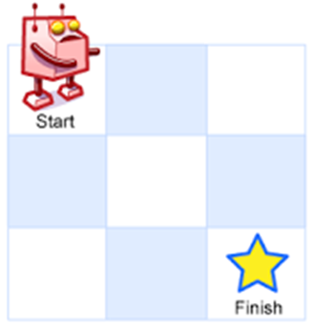
(0,0)
(1,0)
下
右
(0,1)
下
右
(1,1)
(1,1)
下
右
(0,2)
(2,0)
右
下
右
下
右
下
(2,1)
(2,1)
(1,2)
(2,1)
(1,2)
(1,2)
右
右
下
右
下
下
(2,2)
(2,2)
(2,2)
(2,2)
(2,2)
(2,2)

Slide 33
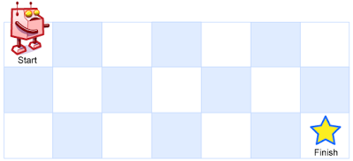
0
1
2
3
4
5
6
0
1 | 1 | 1 | 1 | 1 | 1 | 1
1 | 2
1
1
2

Slide 34
0
1
2
3
4
5
6
0
1 | 1 | 1 | 1 | 1 | 1 | 1
1 | 2
1
1
2

Slide 35
0
1
2
3
4
5
6
0
1 | 1 | 1 | 1 | 1 | 1 | 1
1 | 2 | 3
1
1
2

Slide 36
0
1
2
3
4
5
6
0
1 | 1 | 1 | 1 | 1 | 1 | 1
1 | 2 | 3 | 4
1
1
2

Slide 37
0
1
2
3
4
5
6
0
1 | 1 | 1 | 1 | 1 | 1 | 1
1 | 2 | 3 | 4 | 5
1
1
2

Slide 38
0
1
2
3
4
5
6
0
1 | 1 | 1 | 1 | 1 | 1 | 1
1 | 2 | 3 | 4 | 5 | 6
1
1
2

Slide 39
0
1
2
3
4
5
6
0
1 | 1 | 1 | 1 | 1 | 1 | 1
1 | 2 | 3 | 4 | 5 | 6 | 7
1
1
2

Slide 40
0
1
2
3
4
5
6
0
1 | 1 | 1 | 1 | 1 | 1 | 1
1 | 2 | 3 | 4 | 5 | 6 | 7
1 | 3
1
2

Slide 41
0
1
2
3
4
5
6
0
1 | 1 | 1 | 1 | 1 | 1 | 1
1 | 2 | 3 | 4 | 5 | 6 | 7
1 | 3 | 6
1
2

Slide 42
0
1
2
3
4
5
6
0
1 | 1 | 1 | 1 | 1 | 1 | 1
1 | 2 | 3 | 4 | 5 | 6 | 7
1 | 3 | 6 | 10
1
2

Slide 43
0
1
2
3
4
5
6
0
1 | 1 | 1 | 1 | 1 | 1 | 1
1 | 2 | 3 | 4 | 5 | 6 | 7
1 | 3 | 6 | 10 | 15
1
2

Slide 44
0
1
2
3
4
5
6
0
1 | 1 | 1 | 1 | 1 | 1 | 1
1 | 2 | 3 | 4 | 5 | 6 | 7
1 | 3 | 6 | 10 | 15 | 21
1
2

Slide 45
0
1
2
3
4
5
6
0
1 | 1 | 1 | 1 | 1 | 1 | 1
1 | 2 | 3 | 4 | 5 | 6 | 7
1 | 3 | 6 | 10 | 15 | 21 | 28
1
2

Slide 46
0
1
2
3
4
5
6
0
1 | 1 | 1 | 1 | 1 | 1 | 1
1 | 2 | 3 | 4 | 5 | 6 | 7
1 | 3 | 6 | 10 | 15 | 21 | 28
1
2

Slide 47
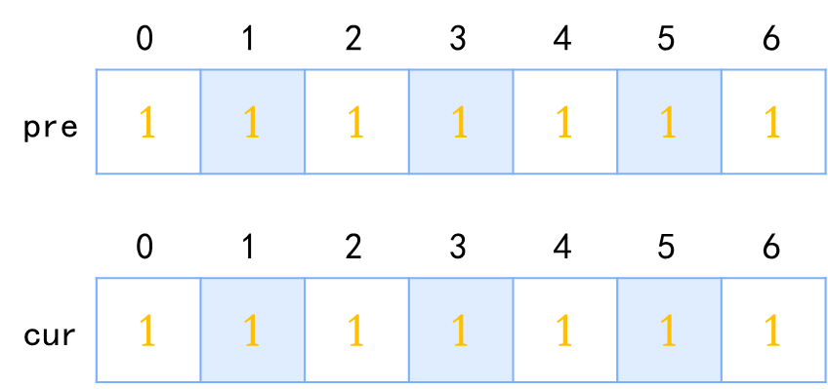
0
1
2
3
4
5
6
1 | 1 | 1 | 1 | 1 | 1 | 1
pre
0
1
2
3
4
5
6
1 | 1 | 1 | 1 | 1 | 1 | 1
cur

Slide 48
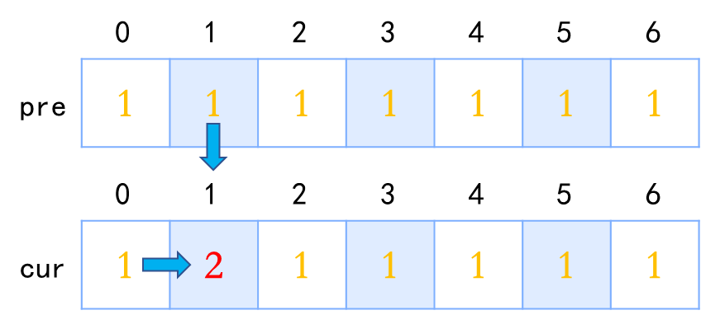
0
1
2
3
4
5
6
1 | 1 | 1 | 1 | 1 | 1 | 1
pre
0
1
2
3
4
5
6
1 | 2 | 1 | 1 | 1 | 1 | 1
cur

Slide 49
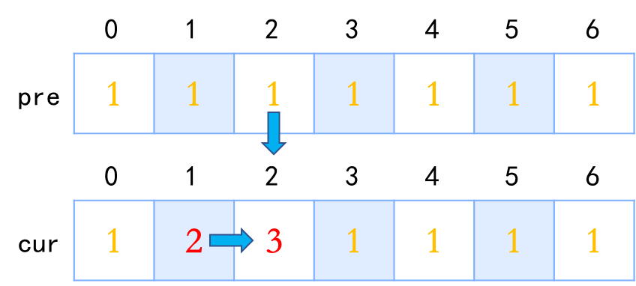
0
1
2
3
4
5
6
1 | 1 | 1 | 1 | 1 | 1 | 1
pre
0
1
2
3
4
5
6
1 | 2 | 3 | 1 | 1 | 1 | 1
cur

Slide 50
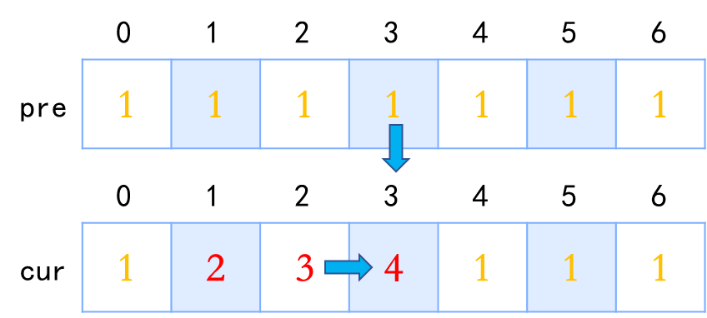
0
1
2
3
4
5
6
1 | 1 | 1 | 1 | 1 | 1 | 1
pre
0
1
2
3
4
5
6
1 | 2 | 3 | 4 | 1 | 1 | 1
cur

Slide 51
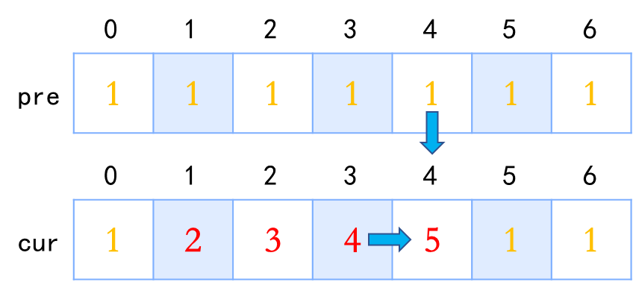
0
1
2
3
4
5
6
1 | 1 | 1 | 1 | 1 | 1 | 1
pre
0
1
2
3
4
5
6
1 | 2 | 3 | 4 | 5 | 1 | 1
cur

Slide 52
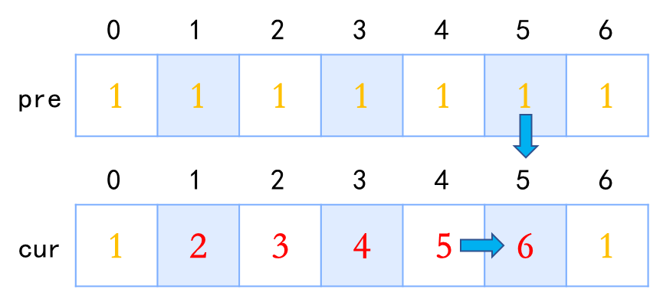
0
1
2
3
4
5
6
1 | 1 | 1 | 1 | 1 | 1 | 1
pre
0
1
2
3
4
5
6
1 | 2 | 3 | 4 | 5 | 6 | 1
cur

Slide 53
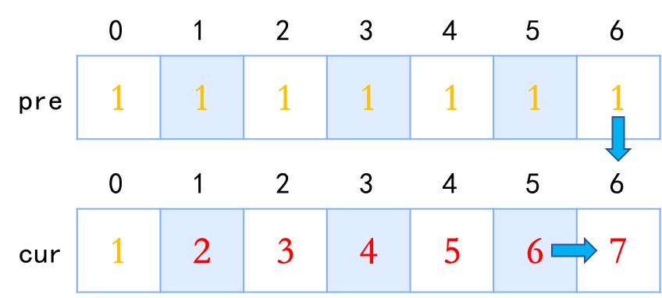
0
1
2
3
4
5
6
1 | 1 | 1 | 1 | 1 | 1 | 1
pre
0
1
2
3
4
5
6
1 | 2 | 3 | 4 | 5 | 6 | 7
cur

Slide 54
0
1
2
3
4
5
6
1 | 2 | 3 | 4 | 5 | 6 | 7
pre
0
1
2
3
4
5
6
1 | 2 | 3 | 4 | 5 | 6 | 7
cur

Slide 55
0
1
2
3
4
5
6
1 | 2 | 3 | 4 | 5 | 6 | 7
pre
0
1
2
3
4
5
6
1 | 3 | 3 | 4 | 5 | 6 | 7
cur

Slide 56
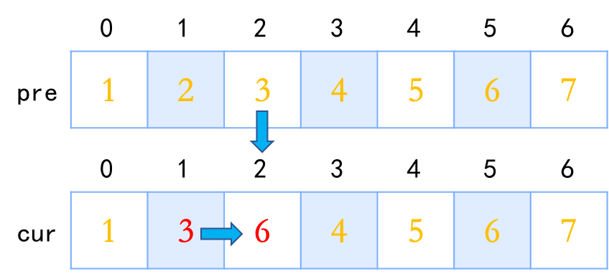
0
1
2
3
4
5
6
1 | 2 | 3 | 4 | 5 | 6 | 7
pre
0
1
2
3
4
5
6
1 | 3 | 6 | 4 | 5 | 6 | 7
cur

Slide 57
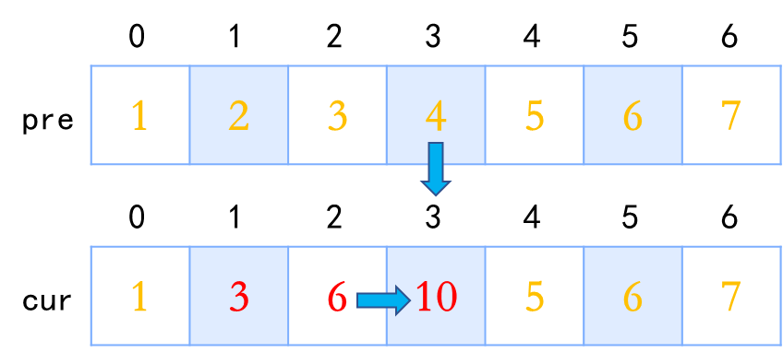
0
1
2
3
4
5
6
1 | 2 | 3 | 4 | 5 | 6 | 7
pre
0
1
2
3
4
5
6
1 | 3 | 6 | 10 | 5 | 6 | 7
cur

Slide 58

0
1
2
3
4
5
6
1 | 2 | 3 | 4 | 5 | 6 | 7
pre
0
1
2
3
4
5
6
1 | 3 | 6 | 10 | 15 | 6 | 7
cur

Slide 59
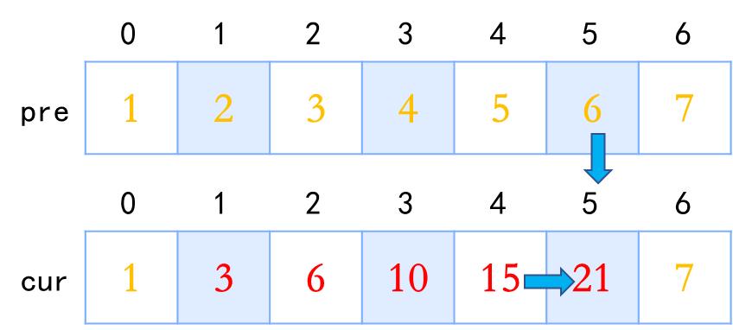
0
1
2
3
4
5
6
1 | 2 | 3 | 4 | 5 | 6 | 7
pre
0
1
2
3
4
5
6
1 | 3 | 6 | 10 | 15 | 21 | 7
cur

Slide 60
0
1
2
3
4
5
6
1 | 2 | 3 | 4 | 5 | 6 | 7
pre
0
1
2
3
4
5
6
1 | 3 | 6 | 10 | 15 | 21 | 28
cur

Slide 61
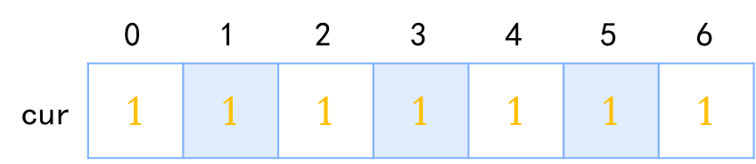
0
1
2
3
4
5
6
1 | 1 | 1 | 1 | 1 | 1 | 1
cur

Slide 62
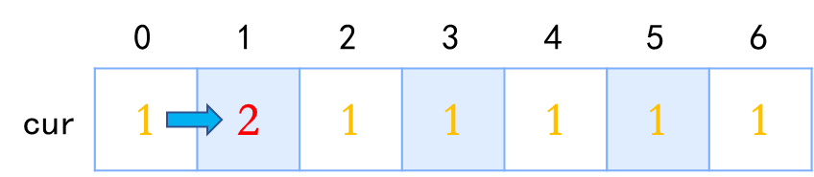
0
1
2
3
4
5
6
1 | 2 | 1 | 1 | 1 | 1 | 1
cur

Slide 63
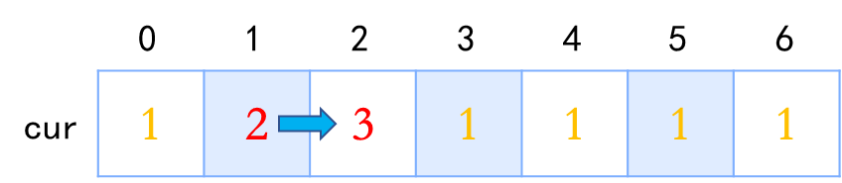
0
1
2
3
4
5
6
1 | 2 | 3 | 1 | 1 | 1 | 1
cur

Slide 64
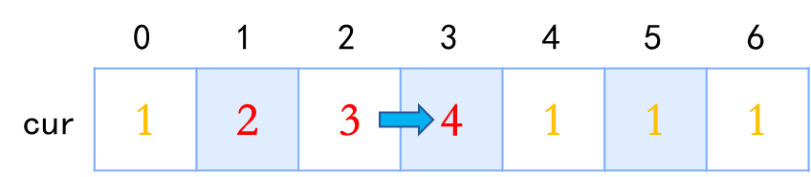
0
1
2
3
4
5
6
1 | 2 | 3 | 4 | 1 | 1 | 1
cur

Slide 65
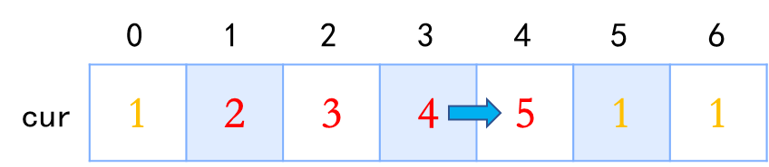
0
1
2
3
4
5
6
1 | 2 | 3 | 4 | 5 | 1 | 1
cur

Slide 66
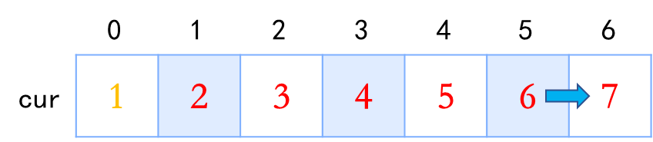
0
1
2
3
4
5
6
1 | 2 | 3 | 4 | 5 | 6 | 7
cur

Slide 67
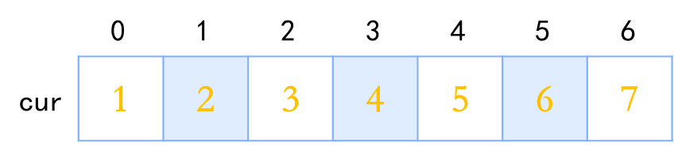
0
1
2
3
4
5
6
1 | 2 | 3 | 4 | 5 | 6 | 7
cur

Slide 68
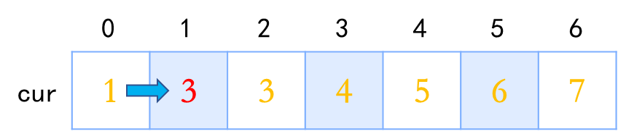
0
1
2
3
4
5
6
1 | 3 | 3 | 4 | 5 | 6 | 7
cur

Slide 69
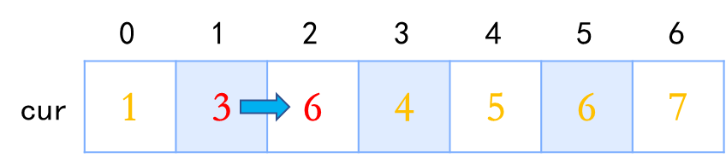
0
1
2
3
4
5
6
1 | 3 | 6 | 4 | 5 | 6 | 7
cur

Slide 70
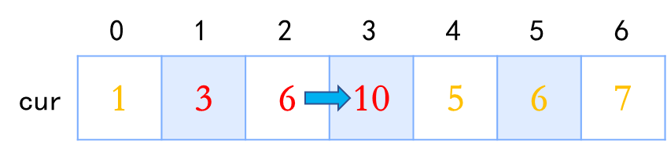
0
1
2
3
4
5
6
1 | 3 | 6 | 10 | 5 | 6 | 7
cur

Slide 71
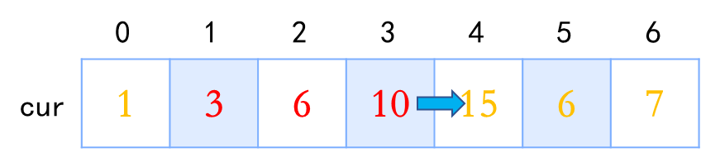
0
1
2
3
4
5
6
1 | 3 | 6 | 10 | 15 | 6 | 7
cur

Slide 72
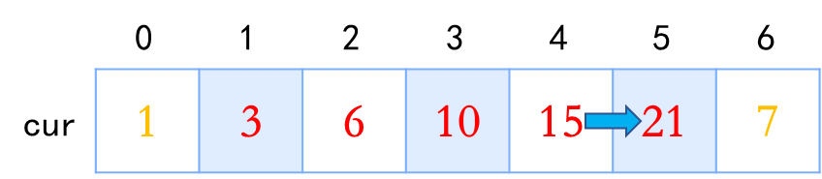
0
1
2
3
4
5
6
1 | 3 | 6 | 10 | 15 | 21 | 7
cur

Slide 73
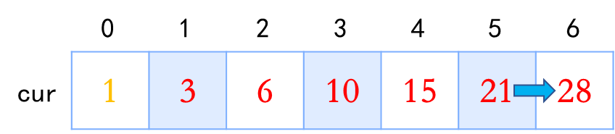
0
1
2
3
4
5
6
1 | 3 | 6 | 10 | 15 | 21 | 28
cur

Slide 74
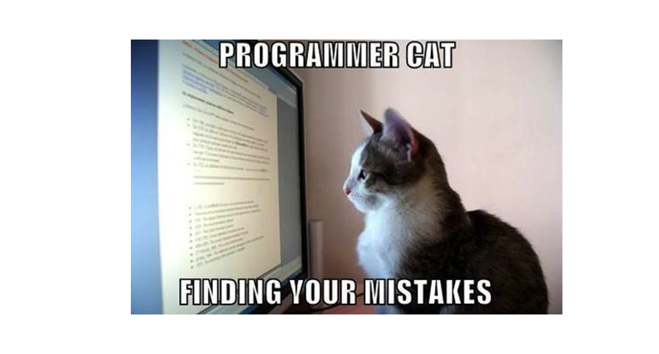
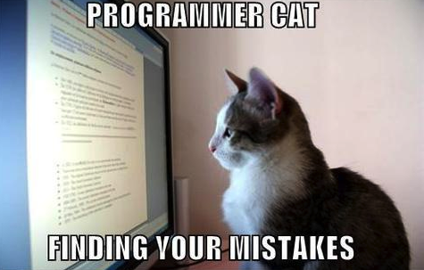

Slide 75
ROOT
end: false
a b c d e f g h i j k l m n o p q r s t u v d x y z
end: false
a b c d e f g h i j k l m n o p q r s t u v d x y z
end: false
a b c d e f g h i j k l m n o p q r s t u v d x y z
end: true
a b c d e f g h i j k l m n o p q r s t u v d x y z

Slide 76
/
oh
my
bug
boy
code
end: false
cool
end: true
y

Slide 77
/
o
oh
my
h
bug
boy
code
end: false
cool
end: true
y

Slide 78
/
m
o
oh
my
y
h
bug
boy
code
end: false
cool
end: true
y

Slide 79
/
b
m
o
oh
my
u
y
h
bug
boy
code
g
end: false
cool
end: true
y

Slide 80
/
b
m
o
oh
my
u
o
y
h
bug
boy
code
g
y
end: false
cool
end: true
y

Slide 81
/
b
c
m
o
oh
my
u
o
o
y
h
bug
boy
code
g
y
d
end: false
cool
e
end: true
y

Slide 82
/
b
c
m
o
oh
my
u
o
o
y
h
bug
boy
code
g
y
d
o
end: false
cool
e
l
end: true
y

