Slide 1
HELPER BOT
TEAM : 위기탈출 넘버원이조
Oh Jae Geun
oon6114@naver.com
010 4903 5051
Kim doo hyeon
kacl2035@gmail.com
010 2185 5120
Shin young joo
eksqlll0@gmail.com
010 2308 8407

Slide 2



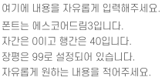

CONTENTS
PROJECT SUMMARY
- name, period, object
- market research

Slide 3














Slide 4




Slide 5









Slide 6

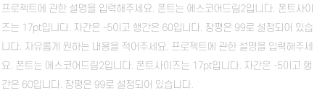





Slide 7




Slide 8



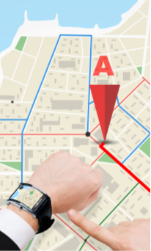







Slide 9






Slide 10



Slide 11



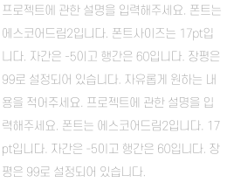
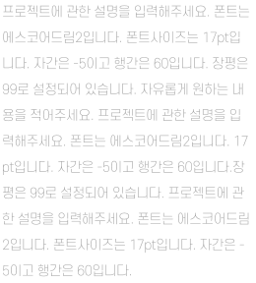

Slide 12





