Slide 1
Daemon Processes and inetd Superserver
Ways to start a daemon
syslogd daemon
syslog function
daemon_init function
inetd daemon
daemon_inetd function

Slide 2
Ways to Start a Daemon
Daemon: background process with no controlling terminal
Ways to start a daemon:
  system initialization script in /etc or /etc/rc (superuser daemons: inetd, httpd, smtpd, syslogd, cron, etc.)
  started by inetd superserver: telnet, ftp, etc.
  executed on a regular basis by cron daemon
  executed once, specified by at command, by cron
  (re)started from user terminals

Slide 3
syslog Daemon
Upon startup, syslogd performs:
  read configuration file /etc/syslog.conf which specifies what to do with each log message (append to a log file or send to syslogd on another host)
  create a Unix domain socket bound to /var/run/log
  create a UDP socket bound to port 514
  open /dev/klog for kernel to input
syslogd then
  calls select for I/O multiplexing on the above 3 file descriptors
  reads log message and does action in conf

Slide 4
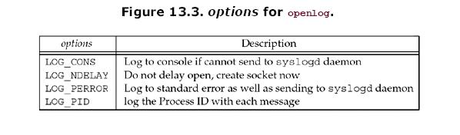
syslog Function
#include <syslog.h>
void syslog (int priority, const char *message, … );
priority: level (0 ~ 7) and facility (type of process sending this message)
(Upon the first call, syslog creates a Unix domain datagram socket and
calls connect to /var/ run/log of syslogd.)
void openlog (const char *ident, int options, int facility);
(can be called before the first call to syslog)
void closelog (void);

Slide 5
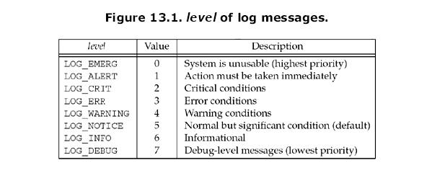

Slide 6
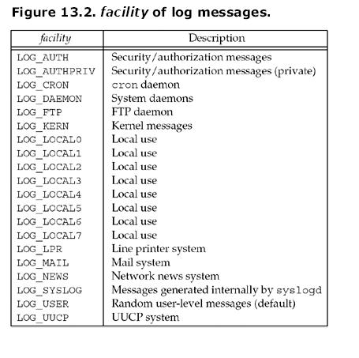

Slide 7
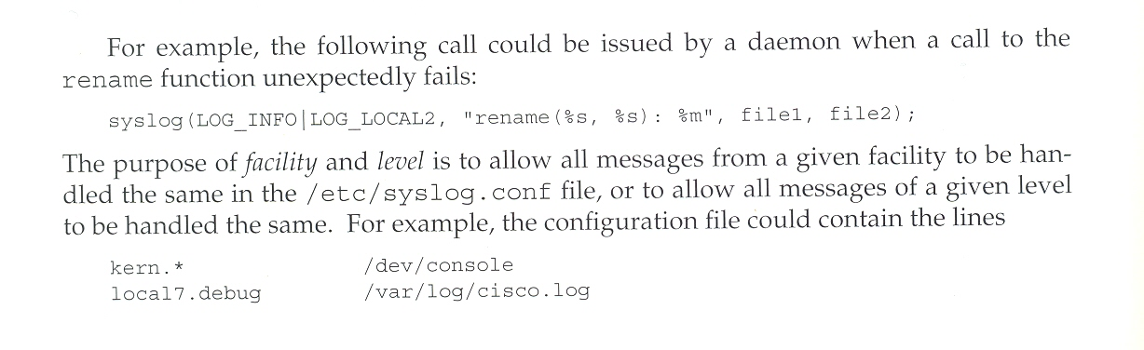

Slide 8
daemon_init Function
Sequence to daemonize a process in daemon_init
  fork and terminate the parent
  setsid: child becomes process group leader with no controlling terminal
  ignore SIGHUP and fork again, terminate the first child and leave the second child running (no longer a session leader)
  set error functions, change working directory, clear file mode creation mask, close open descriptors
  use syslogd for errors

Slide 9
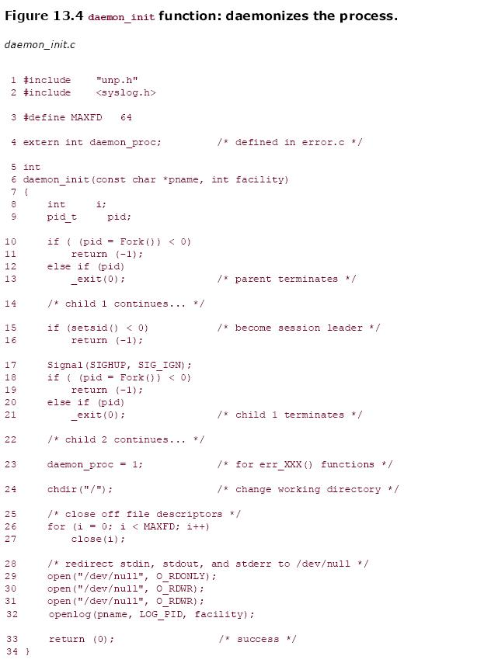
daemon_init Function

Slide 10
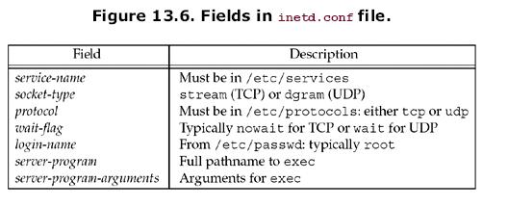
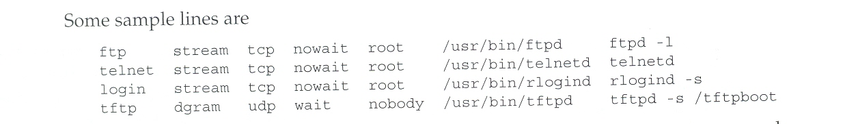

Slide 11
inetd Daemon
daemonize itself
read /etc/inetd.conf
socket ( )
bind ( )
listen ( ) (if TCP socket)
select ( ) for readability
accept ( ) (if TCP socket)
fork ( )
close all descriptors
other than socket
dup socket to
descriptors 0, 1, 2;
close socket
setgid ( )
setuid ( )
(if uer not roor)
exec ( ) server
for each service
listed in
/etc/inetd.conf
child
parent
close connected
socket (if TCP)

Slide 12
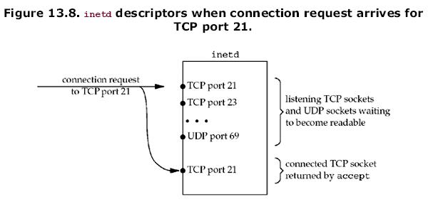

Slide 13
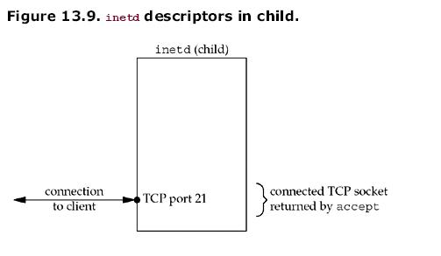

Slide 14
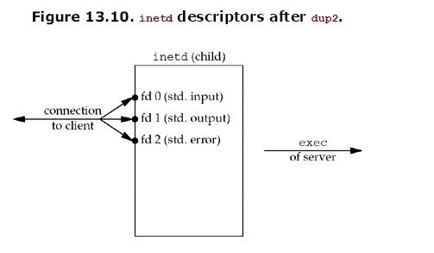

Slide 15
Daytime Server as a Daemon Invoked by inetd
Two major changes:
  all socket creation code (tcp_listen, accept) is gone (these steps are done by inetd)
  infinite for loop is gone (the server is invoked once per client connection)

Slide 16
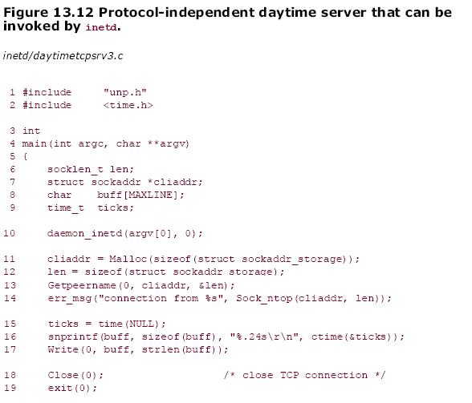

Slide 17
