Slide 1
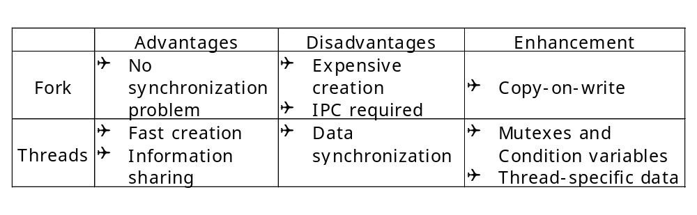
Chap. 23 Threads
(1) Threads v.s. Fork
(2) Basic Thread Functions
#include <pthread.h>
int pthread_create ( pthread_t *tid, const pthread_attr_t *attr,
void *(*func)(void *), void *arg);
int pthread_join ( pthread_t tid, void ** status);
pthread_t pthread_self (void);
int pthread_detach (pthread_ tid);
void pthread_exit (void *status);

Slide 2
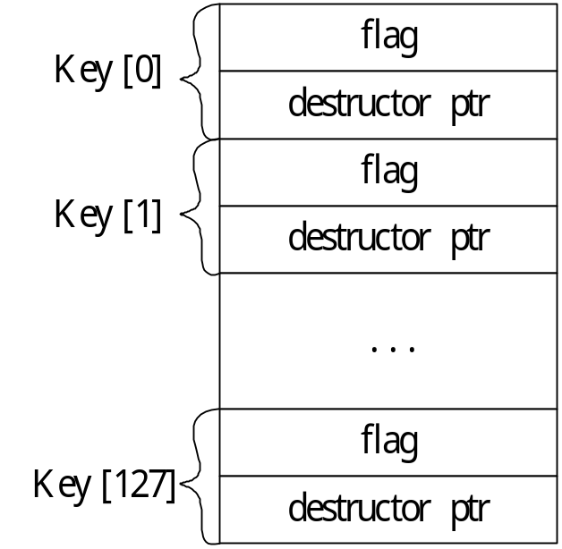
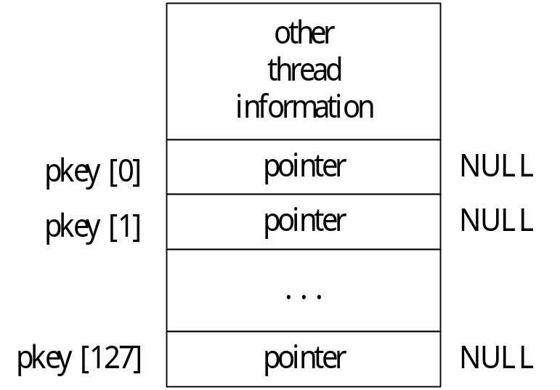
(3) Thread-specific Data
Thread-specific data per process
Thread-specific data items per thread

Slide 3
Functions for Thread-specific Data
int pthread_once (pthread_once_t *onceptr, void (*init)(void));
int pthread_key_create(pthread_key_t *keyptr,
void (*destructor) (void *value));
void *pthread_getspecific (pthread_key_t key);
int pthread_setspecific (pthread_key_t key, const void *value);
(4) Mutexes : Mutual Exclusion
int pthread_mutex_lock (pthread_mutex_t *mptr);
int pthread_mutex_unlock (pthread_mutex_ *mptr);
(5) Condition Variables
int pthread_cond_wait (pthread_cond_t *cptr, pthread_mutex_ *mptr);
int pthread_cond_signal (pthread_cond_t *cptr);
int pthread_cond_broadcast (pthread_cond_t *cptr);
int pthread_cond_timedwait (pthread_cond_t *cptr,
pthread_mutex_t *mptr, const struct timespec *abstime)

