Slide 1
Chap.24 IP Options
(1) IPv4 Options
1. NOP => no-operation
2. EOL => end-of-list
3. LSRR => loose source and record route
4. SSRR => strict source and record route
5. Timestamp
6. Record route
7. Basic security
8. Extended security
9. Stream identifier (obsolete)
10. Router alert
(2) Source Route
(3) IPv6 Extension Headers
1. Hop-by-hop options
2. Destination options
3. Routing header
4. Fragmentation header
5. Authentication header (AH)
6. Encapsulating security payload (ESP) header

Slide 2
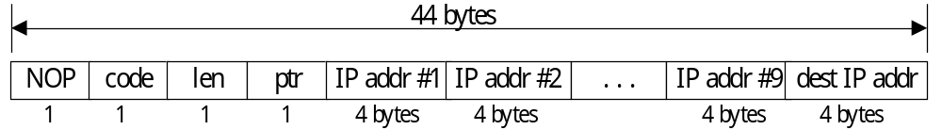
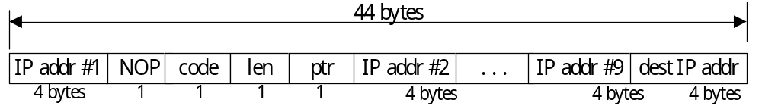
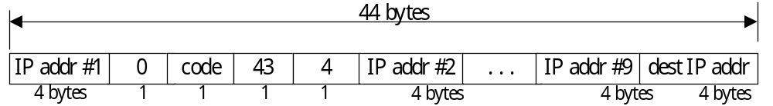
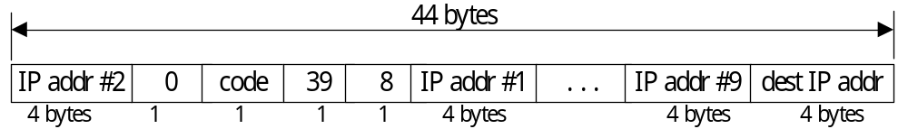
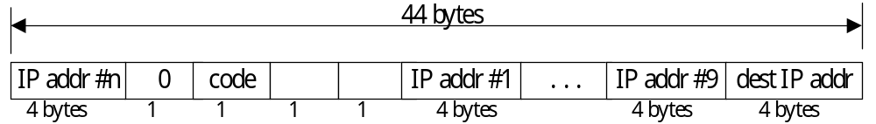
(2) Source Route
At Source Node
At Address # 1
At Address # n-1

Slide 3


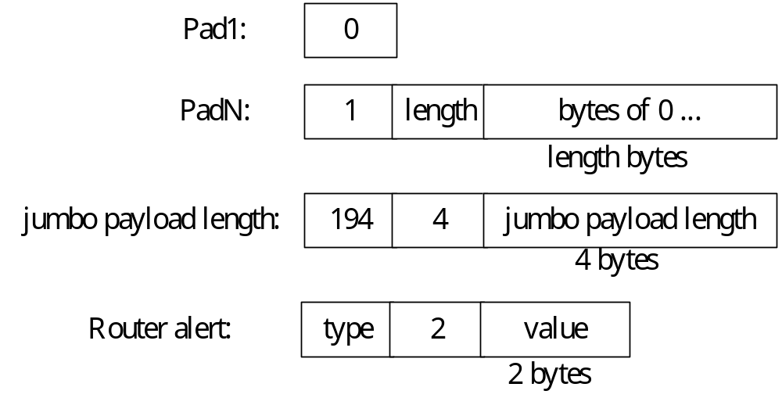
(3.1) IPv6 Hop-by-Hop Options & Destination Options
Hop-by-hop and destination options
Individual Hop-by-hop and destination options
Hop-by-hop options

Slide 4
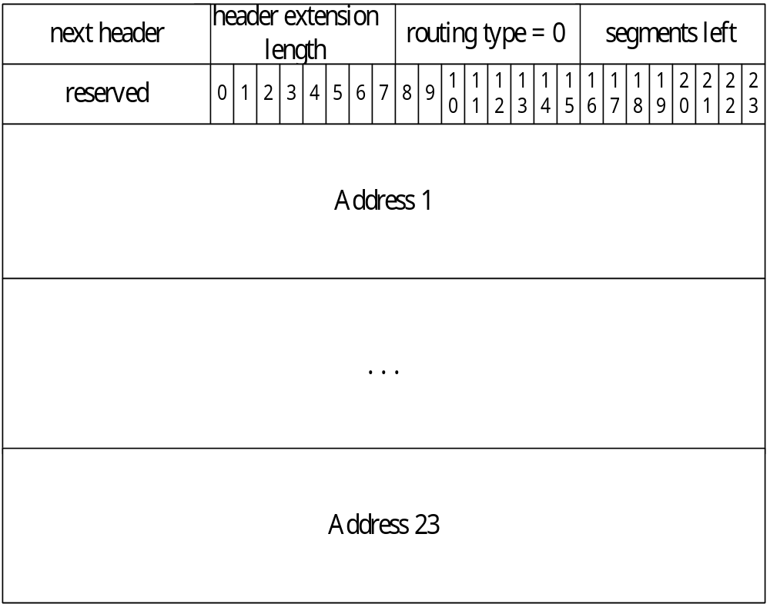
(3.2) IPv6 Routing Header
(3.3) IPv6 Sticky Options

