Slide 1

7
Application
Application
Application
details
6
Presentation
User
process
5
Session
Sockets
XTI
4
Transport
TCP
UDP
Raw Sockets
Datalink Access
3
Network
IPv4, IPv6
kernel
2
Datalink
Device
Driver
Hardware
Communications
details
1
Physical
OSI model
Internet protocol suite

Slide 2
Raw Sockets
Usage
Creation. Output. Input
Ping
Traceroute

Slide 3
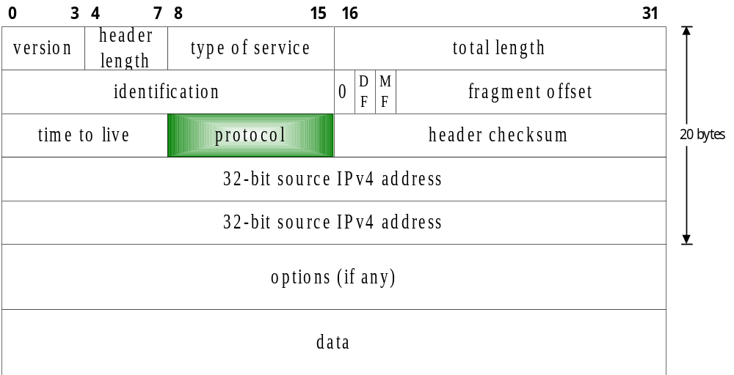
Raw Socket Usage
1 ICMP
2 IGMP
6 TCP
17 UDP
1. R/W ICMPv4. IGMPv4. ICMPv6
ex. Ping
2. R/W other datagrams not processed by kernel
ex. Gated => implement OSPF (protocol = 89)
3. Build one’s own IPv4 Header
ex. traceroute

Slide 4
Raw Socket Creation
BIND
No port number concept
Sockfd = socket ( AF_INET, SOCK_RAW, protocol)
CONNECT
No port number concept
Set IP_HDRINCL socket option
If (setsockopt (sockfd, IPPROTO_IP, IP_HDRINCL, &on, sizeof (on))>0) error ;

Slide 5
Raw Socket Output
Raw Sockets
Checksum:
IPv4 => By Application
IPv6 => By Kernel
Kernel
1. Sendto / sendmsg + destination IP
connect => write / writev / send
2. Starting Address for the kernel to write
Starting Addr. = First byte following the IP header
Set IP_HDRINCL =>
Starting Addr. = First byte of the IP header
3. Fragmentation by kernel

Slide 6
Raw Socket Input
1. UDP / TCP Never pass to Raw Socket
2. Most ICMP Kernel => Raw Socket
3. All IGMP Kernel => Raw Socket
4. All Unknown IP Datagram
Kernel ~> Raw Socket
5. Fragment In Reassemble ~> Raw Socket
protocol field
bound addr. = dest. IP
connected addr. = source IP
Kernel
Raw Sockets

Slide 7
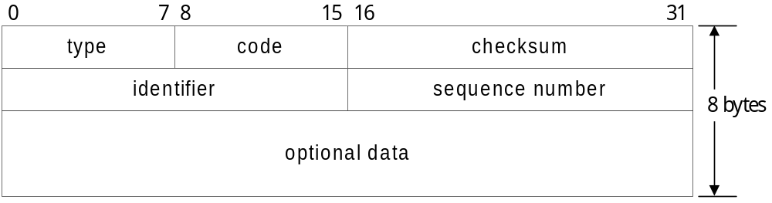
Ping Operation
Solaris # ping gemini.tuc.noao.edu
PING gemini.tuc.noao.edu (140.252.4.54):56 data bytes
64 bytes from 140.252.4.54: seq=0, ttl=248, rtt=37.542 ms
64 bytes from 140.252.4.54: seq=1, ttl=248, rtt=34.596 ms
64 bytes from 140.252.4.54: seq=2, ttl=248, rtt=29.204 ms
64 bytes from 140.252.4.54: seq=3, ttl=248, rtt=52.630 ms
ICMP echo request
< type =128 , code = 0 >
Source
Dest.
ICMP echo reply
< type = 129 , code = 0 >
Format of ICMPv4 & ICMPv6 message

Slide 8
Overview of Ping
Establish signal handler for SIGALRM
main
sig_alrm
readloop
send_v4
or
send_v6
recvfrom
proc_v4
or
proc_v6
Infinite receive loop
Send an echo request once a second

Slide 9

Traceroute with TTL Mechanism
Router
(Remote)
B
TTL=0
(Local)
A
TTL=1
TTL=2
ICMP
ICMP

Slide 10
Example of Traceroute
Solaris # traceroute gemini.tuc.noao.edu
traceroute to gemini.tuc.noao.edu (140. 252. 3. 54): 30 hops max, 12 data bytes
1 gw.kohala.com (206.62.226.62) 3.839ms 3.595ms 3.722ms
2 tuc -1 -s1 -9 .rtd.net (206.85.40.73) 40.014ms 21.078ms 18.826ms
3 frame -gw.ttn.ep.net (198.32.152.9) 39.283ms 24.598ms 50.037ms
.
.
.
7 gemini.tuc.noao.edu (140.252.3.54) 70.476ms 43.555ms 88.716ms

Slide 11
Datalink Access
Usage

Slide 12
Datalink Access
Watch packets received by datalink layer
ex. Tcpdump on normal computer systems
=> watch all packets on the local cable
Run certain programs as normal applications
instead of part of the kernel
ex. RARP (R/W over datalink)

