Slide 1




Notes:
Introduction:
“Lags”

Slide 2
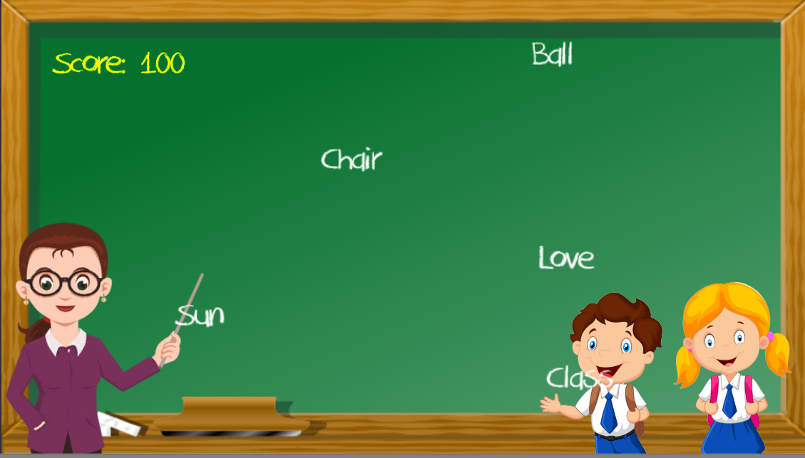
How to play Speaky Learn
Speaky learn uses voice recognition in order to play.
Pronounce the incoming words that are falling correctly to get a points
Pronounce all words correctly to win.

Slide 3



REQUIREMENTS

Slide 4

DEMO

