Slide 1
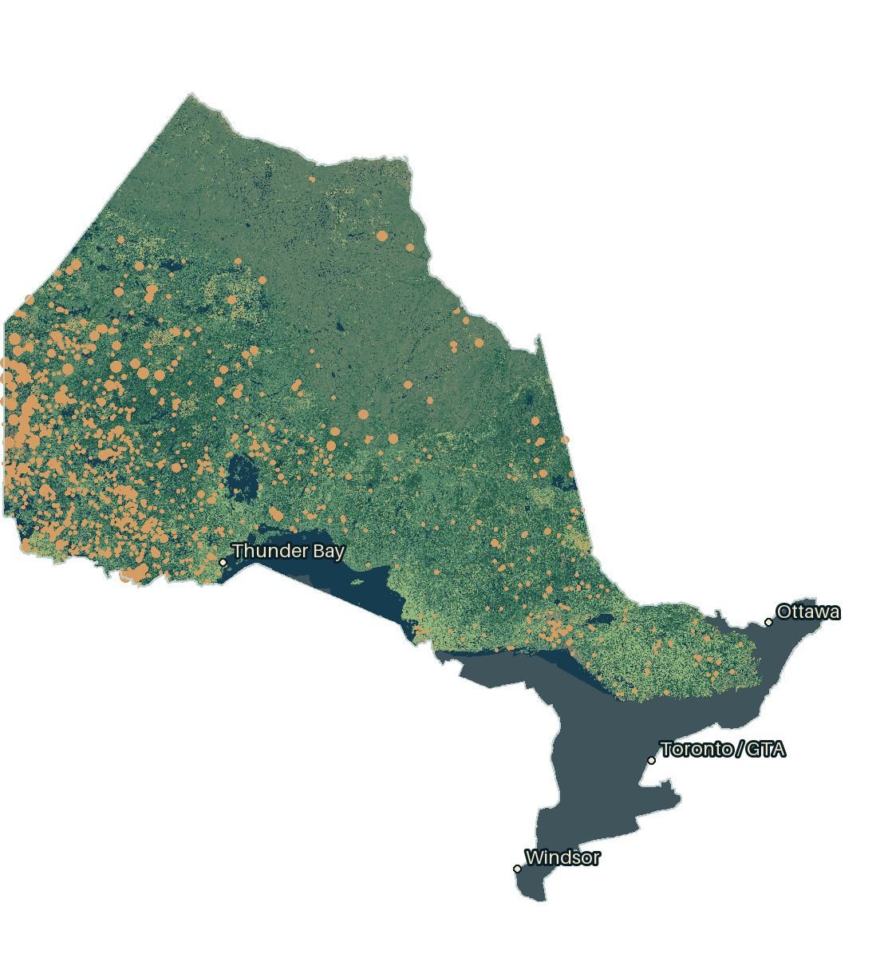
Ontario · Qiskit Fall Fest
Can quantum kernels
estimate fire size?
Annual mean size. Four qubits.
A matched comparison.
657
ha / recorded fire
Ontario, 2021
Full Ontario boundary · grey = unmapped woodland · 2021 records
Notes:
Map display: the complete official Ontario boundary remains visible; grey denotes unmapped woodland classes (0/255), not absence of vegetation. Toronto/GTA, Ottawa and Windsor are WGS84 control points transformed to EPSG:3978. Our question is annual mean reported size in Ontario, not individual-fire occurrence or advance forecasting. We used actual Qiskit kernels and strong classical comparisons. The outcome is a reproducible negative comparison with a useful encoding diagnosis. The opening map shows source land-cover pixels and raw recorded 2021 coordinates, not predicted hotspots or simulated spread. Source evidence
Sources:
https://github.com/OhRats-Technologies/OhRats_QFF2026_uottawa/blob/main/docs/REPORT.md

Slide 2
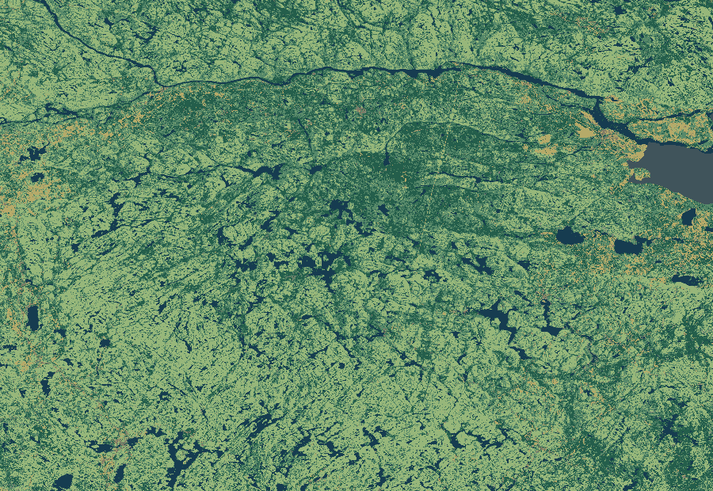
One Ontario year. One row.
NRCan · NFDB
784,447 ha ÷ 1,194 fires
657 ha/fire
ECCC · Monthly Climate Summaries
Ten annual / seasonal climate inputs
Join by year → one observation
Algonquin-area source cover pixels · 2021
31 training years · 1988–2018
6 reused years · 2019–2024
Woodland = context / separate ablation. Final predictors use climate.
Notes:
Our historical fire source is NRCan NFDB point records, not daily operational updates. We select Ontario agency records, quarantine ambiguous identities and exclude prescribed codes, then sum observed sizes and divide by their count. No coordinates, valid daily date or nearest-weather filter removes fires from the annual target. ECCC monthly measurements become station-year summaries; only stations meeting each feature's coverage threshold contribute, with equal station weights. Join aggregates by year to obtain ten climate features and one mean-size label per year. 39,616 training fires aggregate into only 31 annual rows. Years can be temporally dependent. The raw audit confirms 2021's 784,447/1,194 ratio; median fire was 0.3 ha, so large fires dominate the mean. Six later years were previously inspected in incident work. Woodland classes were screened separately and are not final predictors. The interactive map uses raw recorded 2021 locations for context, including identity-quarantined rows, distinct from the 1,194 accepted annual label records. Pixels are nearest-neighbour downsampled; location sizes are display glyphs, not fire perimeters. Schema · Independent raw-source audit · Source acquisition
Sources:
https://github.com/OhRats-Technologies/OhRats_QFF2026_uottawa/blob/main/docs/DATA_SCHEMA.md
https://github.com/OhRats-Technologies/OhRats_QFF2026_uottawa/blob/main/docs/DATA_REVIEW.md
https://github.com/OhRats-Technologies/OhRats_QFF2026_uottawa/blob/main/docs/DATA_DOWNLOADS.md

Slide 3
Choose four. Compare fairly.
Ten candidate climate features
1
0
1
0
0
1
0
1
0
0
Classical search
QAOA samples → SQD
Four-of-ten subset schematic
210 possible subsets
Fixed-ridge MAE · ha/fire · lower is better.
Diagonal SQD returns the best sampled subset. No quantum advantage.
Notes:
We test feature selection separately from prediction. Eight selectors see only training years: predefined physical inputs, all ten, Lasso ranking, mutual information, exact QUBO, QAOA sampling, uniformly sampled bitstrings and random four. Ranking/objective favors training-target relevance and penalizes redundant features. Exact and sampled methods use the same objective; Lasso and mutual information are additional controls. QAOA samples subsets, then actual qiskit-addon-sqd projects the diagonal Hamiltonian into sampled bitstrings and recovers its minimum energy. With only 210 feasible four-of-ten subsets, SQD adds no improvement beyond choosing the best sampled candidate. Three sensitivity seeds and fixed ridge give 79.58 exact, 80.31 uniform and 81.66 QAOA ha/fire. These are distinct from tuned SVR scores; the main kernel comparison uses the same predeclared four inputs, not SQD-selected inputs. This is a verified application and limitation, not a speedup. Selector results · SQD implementation · Selector plan
Sources:
https://github.com/OhRats-Technologies/OhRats_QFF2026_uottawa/blob/main/docs/results/annual-selectors.json
https://github.com/OhRats-Technologies/OhRats_QFF2026_uottawa/blob/main/wildfire_lab/sqd_selection.py
https://github.com/OhRats-Technologies/OhRats_QFF2026_uottawa/blob/main/experiments/annual_selectors.json

Slide 4
Classical kernels lead.
Same four inputs. Same tuning budget.
Qiskit encodes angles and computes overlaps; both models use classical SVR.
Equal tuning budgets and chronological preprocessing. MAE · ha/fire · lower is better.
Notes:
In the prediction comparison, both methods receive the same predeclared four climate inputs: annual/summer temperature and annual/summer precipitation. Classical RBF compares distances; Qiskit encodes bounded angles in shallow ZZ circuits and computes squared state overlap using FidelityQuantumKernel. Both feed similarities to a classical SVR optimizer; the feature map has no learned variational circuit parameters. Each family receives 36 configurations per width/fold. RBF is better in development: 77.02 versus 86.64 hectares per fire. QSVR wins one outer block and loses two. Outer blocks are 2007–2010, 2011–2014 and 2015–2018, with three inner splits for settings. The selector experiment is separate and uses fixed ridge, not these tuned kernel results. Matched results · Classical controls
Sources:
https://github.com/OhRats-Technologies/OhRats_QFF2026_uottawa/blob/main/docs/results/annual-matched.json
https://github.com/OhRats-Technologies/OhRats_QFF2026_uottawa/blob/main/docs/results/annual-classical.json

Slide 5
The extremes remain missed.
Recorded mean hectares per fire—not total burned area.
Mean fire size · hectares per recorded fire
Reused-year MAE · mean 276.81 · QSVR 280.68 · RBF 299.81 ha/fire
Frozen before annual evaluation; these six years are not a pristine holdout.
Notes:
Each group is one Ontario year. Orange is the total recorded hectares divided by the number of size-observed fires that year: for example, 2021 averages 656.99 hectares per fire. It is neither the total area burned, an individual fire's size nor a monthly trajectory. The grey bar repeats the training-year mean of 124.63; teal and green show the four-input QSVR and RBF estimates. High-year recorded averages dwarf those estimates. None of eleven main models beats the training mean across these six years. QSVR beats matched RBF here, but both lose to the constant, so that pairwise gain is not useful skill or quantum advantage. Model parameters and recipes froze before annual evaluation; earlier incident exposure limits independence. Same-year climate remains retrospective. All final errors · Freeze and limitations
Sources:
https://github.com/OhRats-Technologies/OhRats_QFF2026_uottawa/blob/main/docs/results/annual-final.json
https://github.com/OhRats-Technologies/OhRats_QFF2026_uottawa/blob/main/docs/ANNUAL_FINAL.md

Slide 6
Turn the angle. Change similarity.
A measured scale sweep—not a newly fitted predictor.
Measured effective rank · maximum 31
θ = -0.36
θ = 0.12
θ = 0.30
θ = 0.47
Illustrative phase rotations at π/4 · radians
0.000805 → 0.538897
Mean training fidelity · π/4 → π/32
Input-only diagnostic. Narrower angles can also make kernels ill-conditioned.
Notes:
The rotating phase diagrams use illustrative standardized inputs [-1,0.3,0.8,1.4] and phase 2 theta for RZ applied to a superposition; they do not depict the full entangled ZZ state or measured probabilities. At pi/4, the ten-qubit training matrix is almost identity: rank 31, mean off-diagonal fidelity 0.000805. At pi/32 its entropy effective rank is 5.19 and similarity is 0.538897. Click pi/32 to demonstrate the measured matrix, then return to pi/4. This is a post-final input-only probe, not a new prediction comparison. Narrow angles can become poorly conditioned: the four-qubit narrowest map reaches 45.8 million. This scale diagnostic fitted no predictor and selected no replacement for the frozen final model. A later, separate training-only context pilot uses a fixed pi/32 recipe and a same-width zero control. Its exploratory estimates do not replace these final predictions. Diagnostic chronology · Five measured scales
Sources:
https://github.com/OhRats-Technologies/OhRats_QFF2026_uottawa/blob/main/docs/ANNUAL_BANDWIDTH_GEOMETRY.md
https://github.com/OhRats-Technologies/OhRats_QFF2026_uottawa/blob/main/docs/results/annual-bandwidth-geometry.json

Slide 7
What we can defend.
77.02 vs 86.64
RBF / QSVR development MAE · ha/fire
No later-year win.
The training mean beats every main model.
Encoding matters.
Similarity changes with angle scale; skill is not guaranteed.
Next: prospective targets, independent observations and raw/log-target controls.
Notes:
Our contribution is a source-audited annual dataset, a matched Qiskit experiment and a concrete explanation of a failing kernel regime. It is not a novel quantum algorithm or operational fire forecast. The next scientific step is to improve the task and independent evidence, not claim a win from reused years. The public 267 kB package reconstructs all 83 predictions and 24 kernels with no fitting or quantum states. Repository entry point · Report
Sources:
https://github.com/OhRats-Technologies/OhRats_QFF2026_uottawa/blob/main/README.md
https://github.com/OhRats-Technologies/OhRats_QFF2026_uottawa/blob/main/docs/REPORT.md

Slide 8
Measurements → phases → similarities.
Bound the standardized input
q0
H
P(2θ0)
θ = a tanh(z / 2)
ZZ
q1
H
P(2θ1)
ZZ
Compare the encoded states
q2
H
P(2θ2)
k(x,y) = |〈φ(x) | φ(y)〉|²
ZZ
q3
H
P(2θ3)
Classical prediction
Similarity matrix → SVR
Four-qubit linear ZZ map · schematic gate layout
Actual FidelityQuantumKernel + QSVR · exact simulation · training-only preprocessing
Entangling features does not guarantee predictive skill.
Notes:
Qiskit computes squared state overlaps through compute-uncompute. QSVR's optimization remains classical. A linear ZZ map contains single-feature phase terms and pairwise coupling, at one or two repetitions. We fit all preprocessing within training folds and compare RBF on the same inputs. Both families get four bandwidth/map choices crossed with nine C/epsilon settings. Entanglement does not guarantee useful climate interactions. Methods and budgets · Matched plan
Sources:
https://github.com/OhRats-Technologies/OhRats_QFF2026_uottawa/blob/main/docs/ANNUAL_FINAL.md
https://github.com/OhRats-Technologies/OhRats_QFF2026_uottawa/blob/main/experiments/annual_matched.json

Slide 9
Small data. Explicit compute.
Final fit / saved-year evaluation · seconds
Fidelity pairs | 12,092 train 2,232 evaluation
Scale diagnostic | 4,650 pairs 48.89 s
Evaluation refits | 0
Hardware jobs | 0
93.75
Training
9.63
Evaluation
267 kB
Frozen evidence package
No-fit public replay
Local analytic circuits, not physical shots. Runtime excludes installation.
Seven main slides · 300-second plan · appendices for questions.
Notes:
36 training quantum matrices and 12 evaluation matrices. Final training fits 80 sklearn/QSVR predictors plus a separate polynomial trend; evaluation fits none. Local statevector simulation has no hardware shots. Selector draws are synthetic and accounted separately. Historical scientific QA is snapshot-specific; presentation checks are separate. Sources: NRCan NFDB, ECCC monthly summaries, NRCan cover and official Ontario boundary, documented with hashes. Resource receipts · Dataset attribution · Submission checks
Sources:
https://github.com/OhRats-Technologies/OhRats_QFF2026_uottawa/blob/main/docs/ANNUAL_FINAL.md
https://github.com/OhRats-Technologies/OhRats_QFF2026_uottawa/blob/main/docs/DATA_DOWNLOADS.md
https://github.com/OhRats-Technologies/OhRats_QFF2026_uottawa/blob/main/docs/SUBMISSION_AUDIT.md

