Slide 1
Chinese Checker
Ferne 2130034033
Ramona 2130034023
Spade 2130034050
Doris 2130034021
Aslina 2130034006

Slide 2
Algorithm
Introduction
Introduction
System
Implementation
Demonstration and Conclusion

Slide 3
1
Introduction

Slide 4
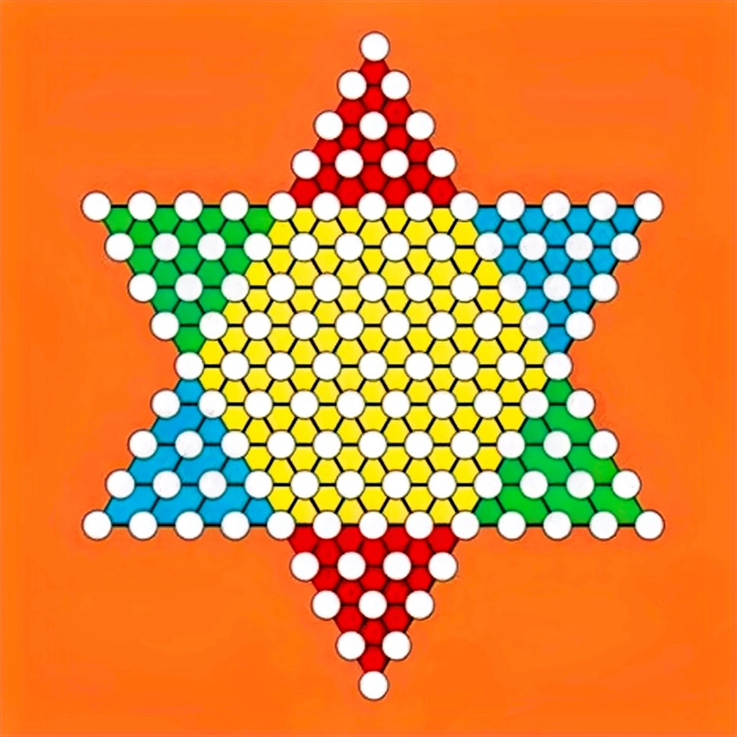
1
Working Principle
2 kinds of moves:

Slide 5
2
Difficulty Setting and Goal
4 Levels:
1: Simple, appropriate for beginners.
2&3&4: Rather difficult and is appropriate for advanced players.

Slide 6
2
Difficulty Setting and Goal
Goal:
1. Arouse interest in Chinese Checkers
2. Promote Chinese Checkers

Slide 7
2
System
Implementation

Slide 8
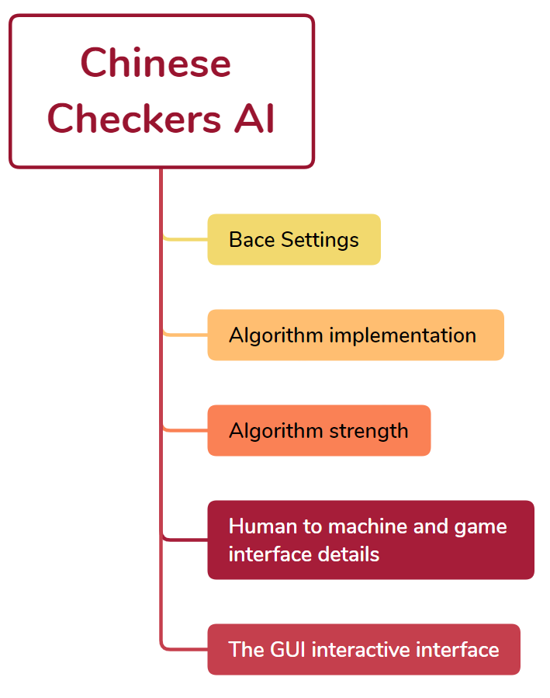
0
System Implementation Process
Strategy
wisdom
thinking
calmness
patience
Chinese checkers

Slide 9

1
Base Setting
Define a series of functions.
Adding the rules to the movement of the pieces.
Implement the basic operation of the move
rules
move

Slide 10
2
Algorithm Implementation
alphabeta
greedy
minmax
Residual CNN
Call the base function and the model of each algorithm to search

Slide 11
3
Algorithm Strength
The difference in intensity between different algorithms
添加标题
The number of wins
The time it takes for algorithms of different depths to search

Slide 12
4
Human to Machine
Step 1
Step 3
Set the player position for the person and the machine to be able to interact.
User plays:
Mark the position that the user's chess pieces can reach.
User can use the mouse to interact with the computer.
A
B
C
User plays:
User can use the mouse to interact with the computer. the mouse clicks the marked position, the computer can obtain and record the coordinates corresponding to the position
Step 2
Step 4
Machine plays:
Calculate the optimal movement, and move pieces to the relative position.
D

Slide 13
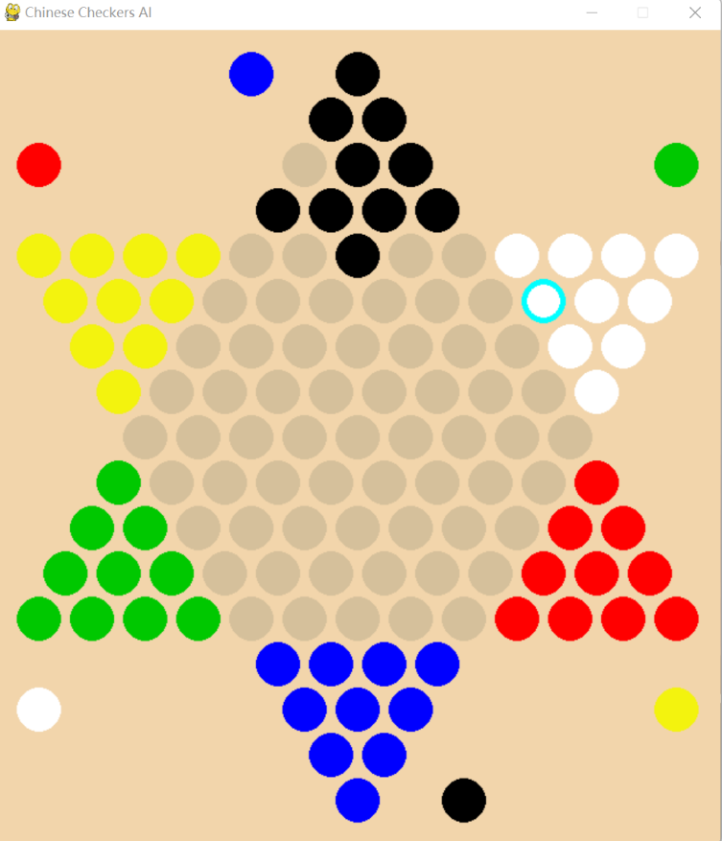
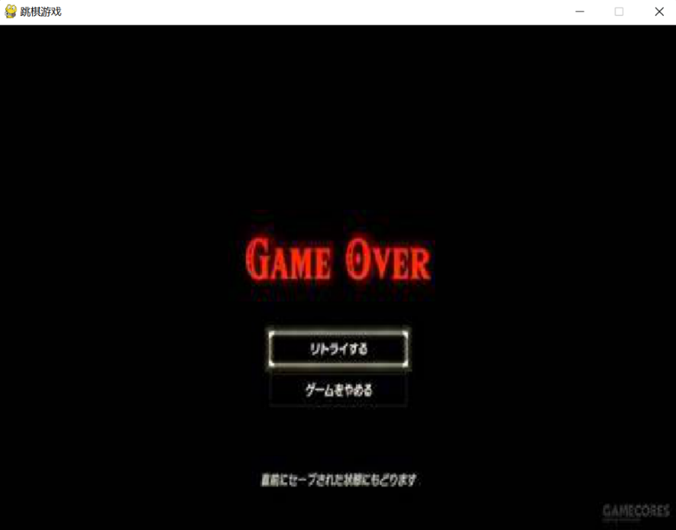
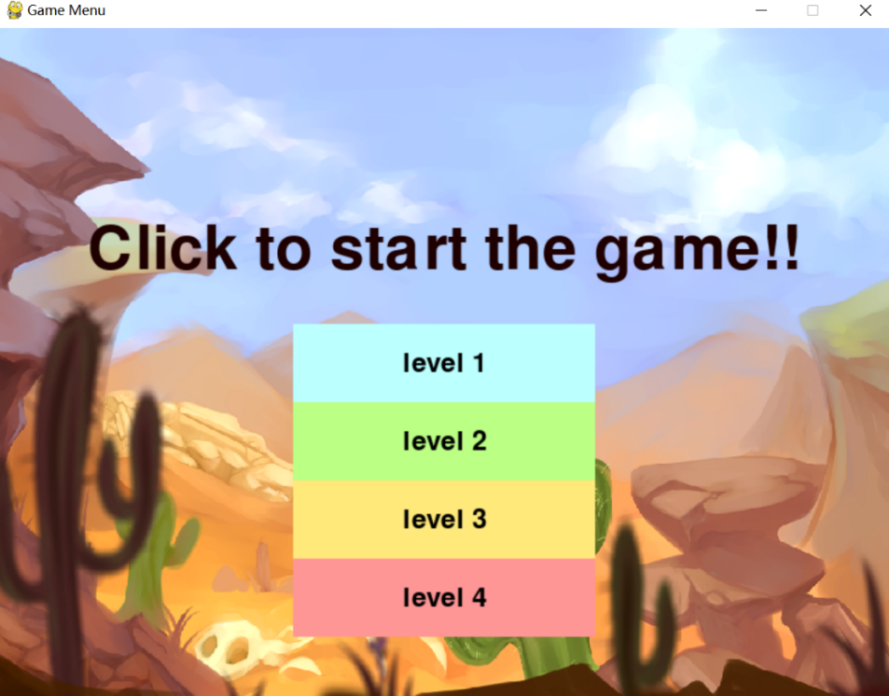
5
GUI Interactive Interface
End Interface
This interface is used to display the result of the game.
User clicks the end button, the GUI interface will automatically jump to the initial interface.
Initial Interface
Four difficulty selection buttons in the initial screen, corresponding to four checkers opponents of different difficulty.
Game Interface
User corresponds to the lowest character, the user needs to face five robot opponents for checkers, and the game will end when the first player reaches the end.

Slide 14
3
Algorithm
Introduction

Slide 15
1
Algorithm Introduction
Minimax Algorithm
Pessimistic algorithm, considers its opponent to be perfect and will lead it to the worst situation, minimize the damage and manage to be in the best situation among all worst ones.
Greedy Algorithm
Finds the global best solution by finding local best solutions, namely, it does the current optimal decision each time it chooses.
Alpha-beta Pruning Algorithm
Promotion of Minmax algorithm. High efficiency due to the application of pruning, which reduces the search space and therefore, less resources and time are needed for searching.
CNN Algorithm
Convolutional neural network to do the calculation and prediction, and it predicts the probability of a movement or step the opponent will take and the evaluation of whether we will win

Slide 16
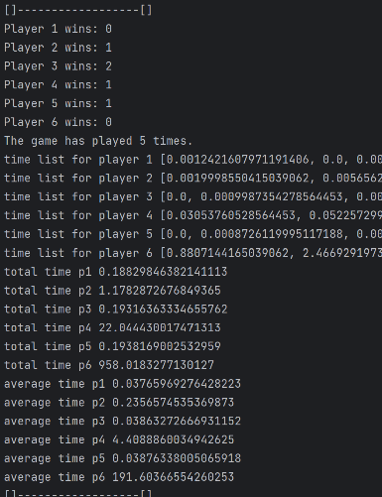
2
Result Analysis
Time: greedy < minimax algorithm < alphabeta
Wining times (levels hard to easy): minimax > greedy > alphabeta > CNN
Fig. code excerpt for calculating average time

Slide 17
4
Demonstration
and Conclusion

Slide 18
Future works
Demonstration
Deficiency
Summary

Slide 19
THANK
YOU

