Slide 1

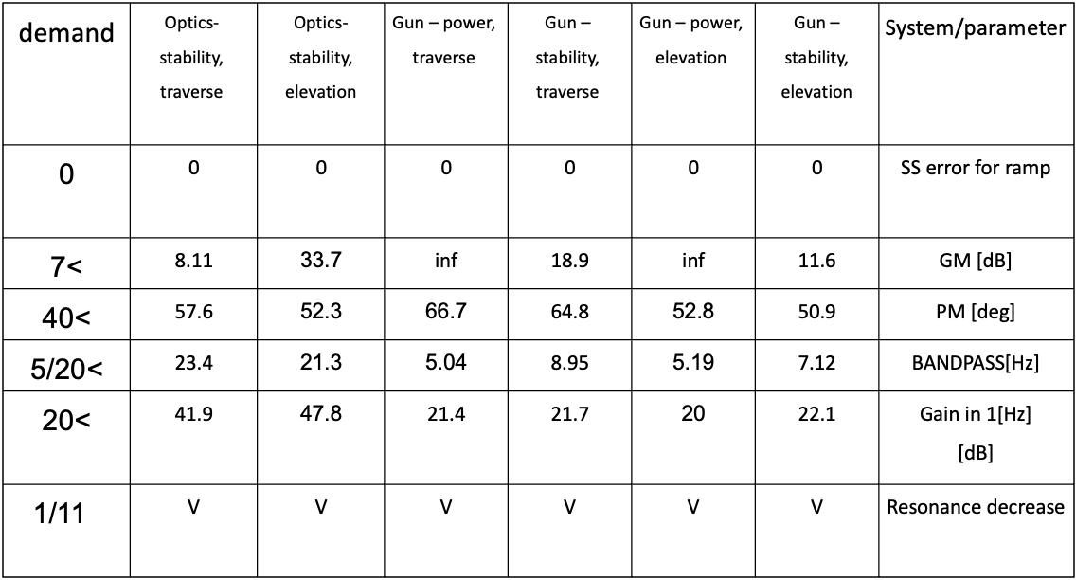
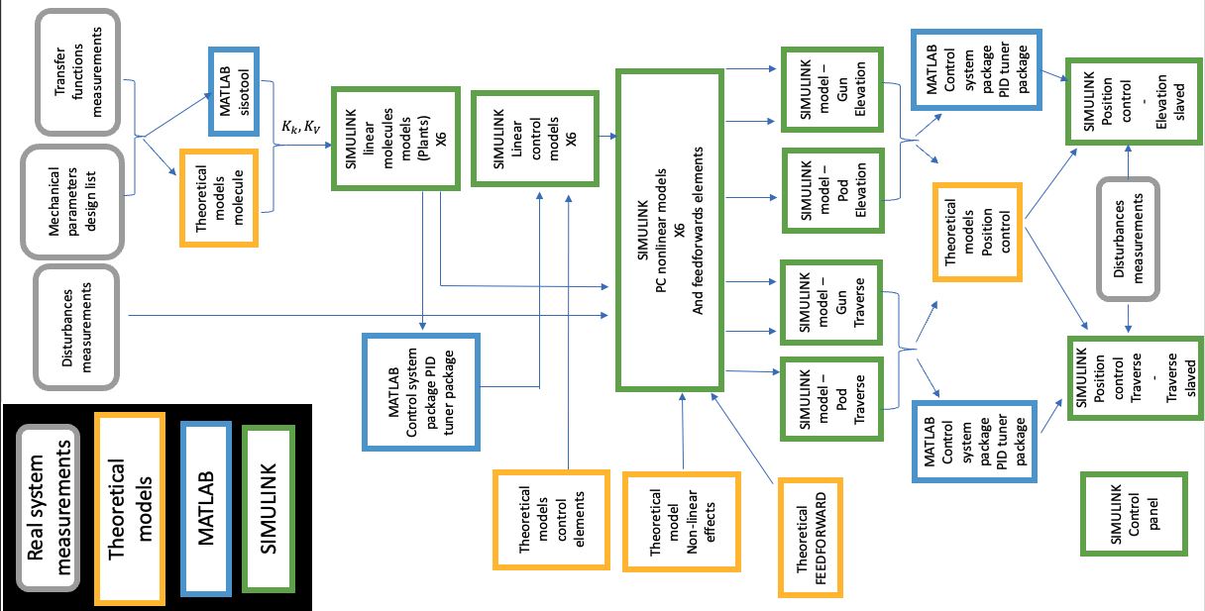
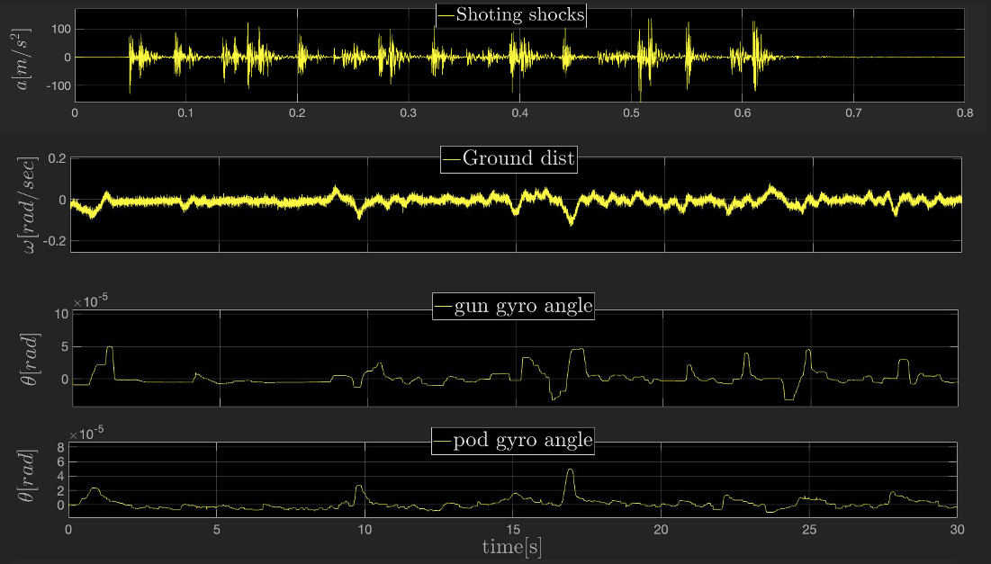
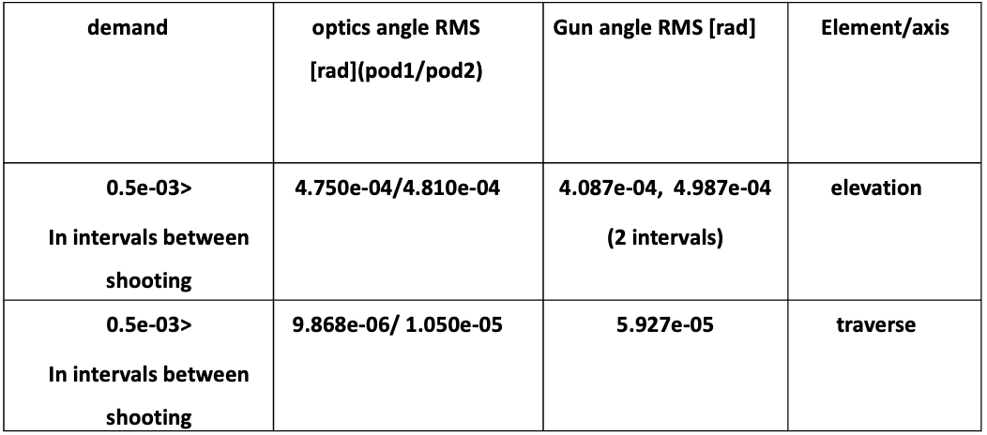
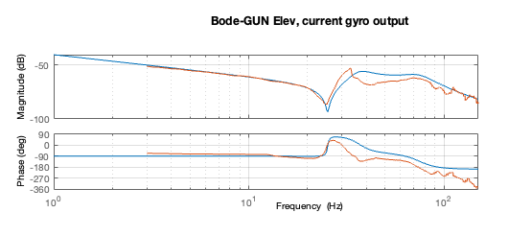
Simulator of a moving observation and gun post
Project Number: 22-2-1-2206
Name: Ohad Forman
Advisor: Dr. Gavriel Davidov
Introduction Simulator of a mechanical system of a moving observation and gun post as been built, based on: measurements of the transfer functions of the real system from input command to strategic placed sensors measurements of the system under shooting and ground disturbances mechanical parameters of the system. The simulator include: Controllers designs to meet stability and goodness of stabilization demands Non-linear effects, un-balance and coulomb friction Feedforward elements to improve the goodness of stabilization result, reduce the error cause by friction, shooting and ground disturbances. Slavery position control system, for the following of the gun after the optics position (angle) state The simulator build on SIMULINK Platform. Motivation A reliable simulator based on a good simulation of the mechanical system gives a good predictor of the behavior of the real system. Saving in resources of time/money, from less field tests on the real system Check for the possibility for a wanted performances for a given mechanical system in terms of stability and goodness of balance. being an advisor for changes in the real system for the mechanical engineer to meet the demands wanted. Implementation 6 sub systems as been simulated based on the real system measurements and parameters. for the gun system, 2 axis-Elevation and Traverse, 2 operation modes per axis , Power and stability, and 2 stability operation mode for 2 axis of the optics system. Using molecule models and unknown coefficients estimation for stiffness and damping of the systems Simulation (blue) vs. measurements (orange) bode—Elevation, stability mode | For the 6-sub systems a Controllers as build to meet a stability criteria’s non-linear effects as been theoretically planed and implement to the Simulink models The system as been tested under disturbances measurements on the real system, and been calibrated to stand in the goodness of balance and stability criteria A feedforward techniques as been implemented to decrease errors from friction, ground disturbances and set point The gun system as been slaved to the optics system to follow the position state (angle) of the optics system. All the above using: Theoretical developments, SIMULINK and MATLAB tools implementation hierarchy Results The simulator: simulator of elevation axis (controlled by a control panel, not in the figure) ©photos from Dr. Gavriel Davidov “Control 2” course presentation and parameters system list | Stability results: stability results table Goodness of stabilization results: From top - shooting shocks, ground disturbances, gun angle, optics angle Goodness of stability results table Conclusions Complex non-linear mechanical system can be simulated using molecule method and non-linear models for coulomb friction and unbalance Feedforwards techniques improve the system performances in terms of goodness of stabilization The dynamics of the optics system produce a better stability performances, from that the gun slave to the the optics cause an improvement in the performances overall Bibliography [1] G. Davidov, " SELECTED TOPICS OF THE SYNTHESIS AND ANALYSIS OF ALL-ELECTRIC HEAVY GUN/TURRET DRIVE CONTROL SYSTEMS", conference paper: THE FIRST INTERNATIONAL CONFERENCE ON ALL ELECTRIC COMBAT VEHICLE (AECV), HAIFA ISRAEL DAN-CARMEL HOTEL, May 1995

