Slide 1

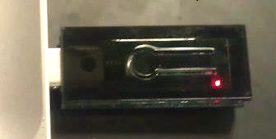
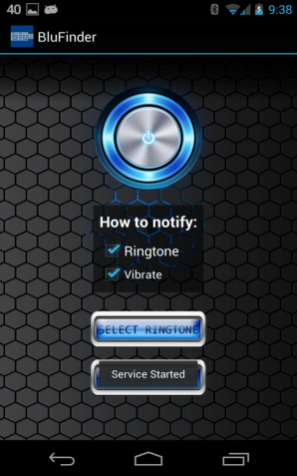

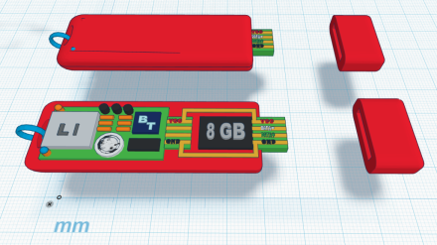


What would you do if you lost your Flash Drive?
Will Protect:
Assignments
Media Files
Resumes/CV
Much More!
May Prevent:
Panic
Data loss
Stress
Failure
8GB!
Buy now!
www.blu-finder.com
With App!
What is Blu-finder?
A brand new device that links Flash Drive with Bluetooth!
Blu-finder sends a signal to your cellphone if you forget it!
Was designed on campus by Cal Poly Pomona students!
We are on Campus now!
Don’t miss a deadline because you lost your flash drive!
Find us on Facebook!
www.facebook.com/blufinder
Support Cal Poly Pomona!
www.polypresents.com

