Slide 1


Data Governance @ SneakerPark
Prepared by: Christopher O’Hara, PhD, EngD
Submitted on: 2025-11-17

Slide 2
Background
SneakerPark is an online shoe reseller that allows people to buy and sell used and new shoes. Buyers can bid for shoes or buy them outright, and sellers can set a price or sell to the highest bidder.
Each buyer and seller must have an active account in order to sell, bid, or purchase sneakers using SneakerPark’s website.
SneakerPark authenticates the shoes before shipping them to the buyer, so before listing an item, the seller must ship it to SneakerPark’s warehouse. Upon receipt, SneakerPark assigns an item number to each pair of sneakers and notifies the seller that they are now free to list their item. If the item is not listed within 45 days, SneakerPark returns it to the seller and sends an invoice to the seller for the shipping cost.
If the item is found to be inauthentic or in an unacceptable condition, it is also returned back to the seller in a similar fashion.
When the item sells, the buyer’s account is credited with the purchase price minus the SneakerPark service fee and shipping fees to deliver the item to the buyer.
Currently, SneakerPark only supports sales within the United States.

Slide 3
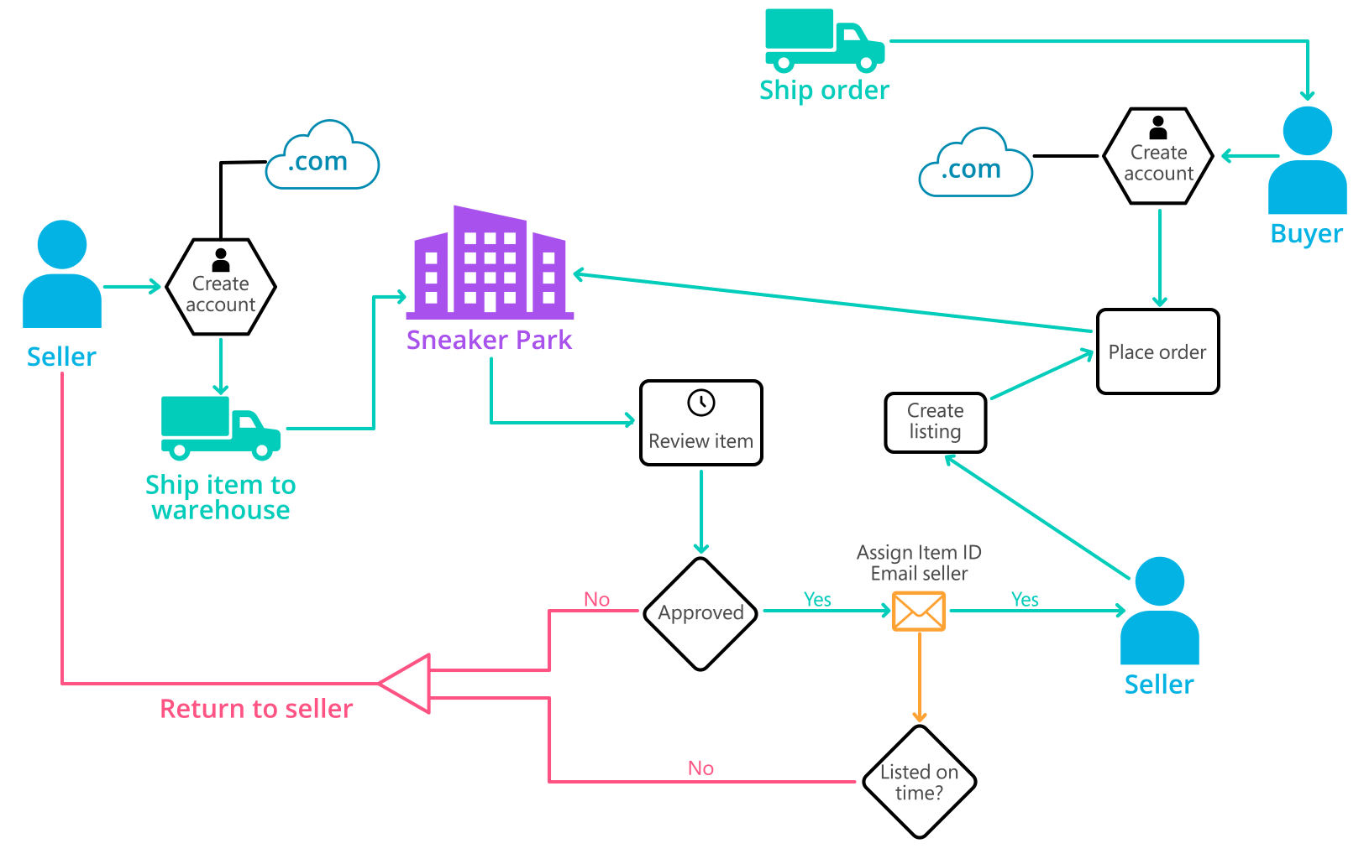
Background (cont’d)
Below you can see a diagram that will hopefully help you visualize some of SneakerPark's business processes. Keep in mind that it does not capture ALL processes and every nuance, but simply serves as another artifact to use in your project.

Slide 4
Step 1
Enterprise Data Catalog Part 1: Enterprise Data Model

Slide 5
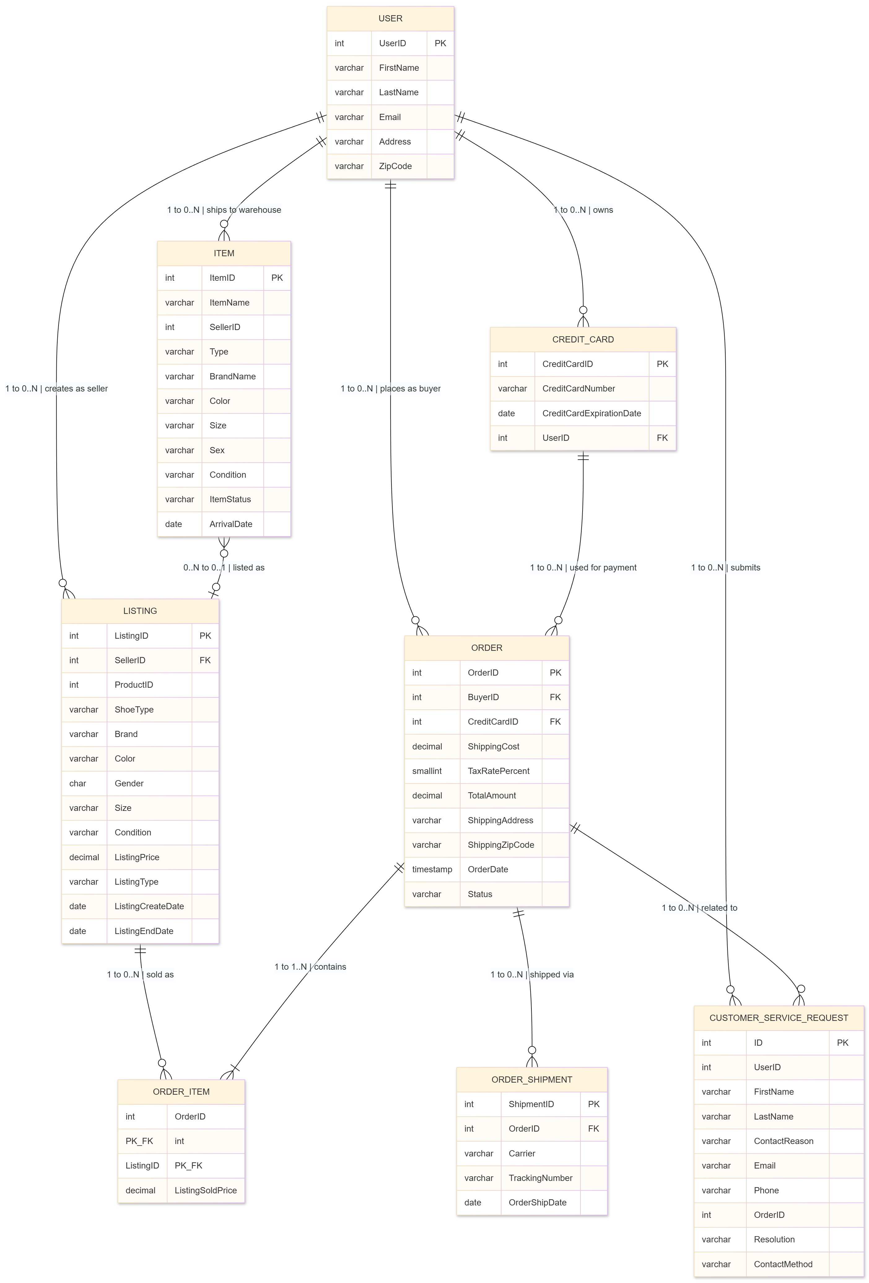

Slide 6
Step 2
Enterprise Data Catalog Part 2: Metadata

Slide 7
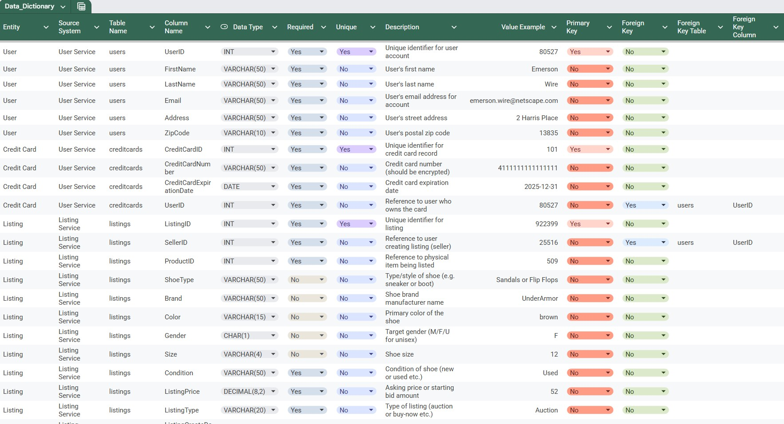
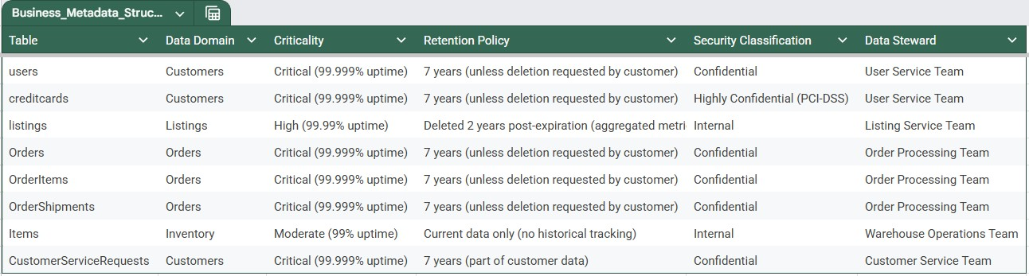
Data Dictionary
Business Metadata

Slide 8
Step 3
Data Quality
Part 1: Profiling and Cleansing

Slide 9
Existing Issues (4):
Missing ShoeType Values (Completeness Issue)
  15.2% of listings have NULL ShoeType (e.g., ListingID 922399, SQL line 1712)
  Impact: Customers cannot filter/search by shoe category
  DQ Rule: Every listing must have a shoe type specified to help customers find the right product
  Metric: (COUNT of listings where ShoeType IS NULL / COUNT of all listings) × 100
Customer Name Mismatches (Consistency & Accuracy Issue)
  Customer Service names don't match User Service—3.8% discrepancy rate
  Example: UserID 3586 shows "Vamderheydem" in CS (line 2380) vs "Vanderheyden" in users (line 129)
  Impact: MDM issue causing customer confusion and service delays
  DQ Rule: A customer's name in any system must exactly match the User Service system of record
  Metric: COUNT of CS requests where FirstName or LastName ≠ usr.users for same UserID
Invalid Shoe Size Values (Validity & Accuracy Issue)
  0.2% of listings have size = '0' which is impossible (e.g., ListingID 780492, line 1730)
  Valid sizes range from 0.5 (infant) to 22 (adult)
  Impact: Incorrect product information, customer returns
  DQ Rule: Every shoe listing must have a valid size between 0.5 and 22
  Metric: COUNT of listings WHERE Size = '0' OR Size NOT BETWEEN 0.5 AND 22
Missing Arrival Dates (Completeness & Timeliness Issue)
  8.7% of warehouse items missing ArrivalDate (e.g., ItemID 46646, line 527)
  Impact: Cannot enforce 45-day listing deadline—items may expire without warning
  DQ Rule: Every item received at warehouse must have arrival date recorded to track 45-day deadline
  Metric: (COUNT of items where ArrivalDate IS NULL / COUNT of all items) × 100
Future/Preventive Issue (1):
Risk of Duplicate User Accounts (Uniqueness Issue)
  Potential for users creating multiple accounts with slight email/name variations
  Example scenarios: john.smith@gmail.com vs john.smith@yahoo.com, or "Robert Johnson" vs "Rob Johnson" at same address
  Impact: Fragmented customer history, potential fraud, inaccurate analytics
  DQ Rule: Each person should have only one user account to maintain accurate customer history and prevent fraud
  Metric: COUNT of user pairs WHERE (same email domain + similar name) OR (same address + similar name)

Slide 10
Step 4
Data Quality
Part 2: Monitoring

Slide 11
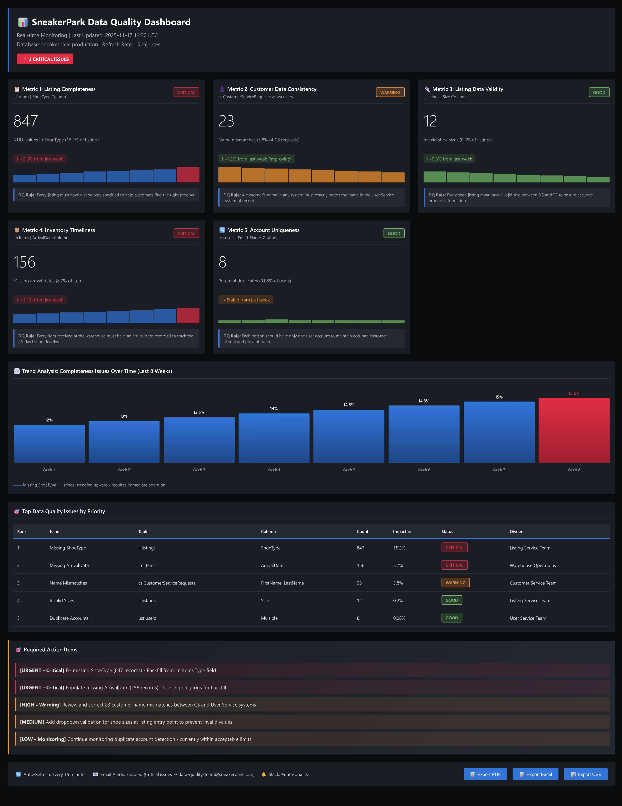

Slide 12
Step 5
Master Data Management
Part 1: MDM Architecture

Slide 13
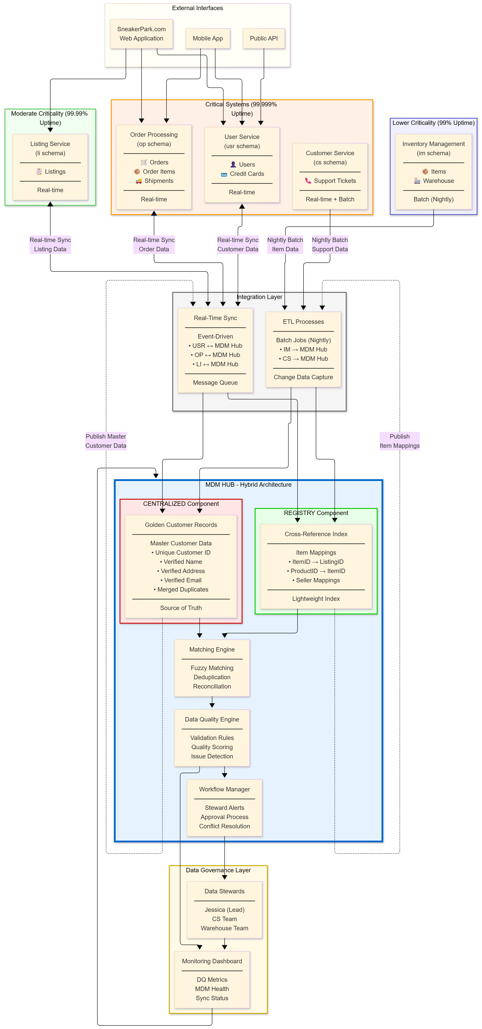

Slide 14
Explanation: Hybrid MDM Architecture
SneakerPark requires a Hybrid MDM combining Centralized and Registry styles to balance competing needs. We recommend Centralized MDM for Customer data because customers appear across three systems (User Service, Customer Service, Order Processing) with critical quality issues like name mismatches and potential duplicates that require active stewardship and a single source of truth for GDPR compliance. Conversely, we recommend Registry MDM for Item data because the Inventory Management system is isolated with batch-only integration, item data is relatively clean, and a lightweight cross-reference index (ItemID → ListingID) provides the needed performance without disrupting the customer-facing Listing Service. This hybrid approach minimizes risk to critical systems, Order Processing (99.999% uptime) remains untouched until final phases, while enabling Jessica to resolve customer data conflicts through golden records and allowing Jake to maintain infrastructure alongside current duties. The phased 12-month implementation starts with low-impact item indexing and batch integration, gradually introducing real-time customer data synchronization only after the foundation proves stable, ultimately reducing data quality issues by 75% and firefighting workload by 80% without business disruption.

Slide 15
Step 6
Master Data Management
Part 2: Master Record

Slide 16
MDM Matching Rules
Customer Matching Rules:
Email + Name Match (High Confidence - 95%+)
  Logic: Exact email match AND (exact name match OR Levenshtein distance ≤ 2 on LastName)
  Example: john.smith@gmail.com + "John Smith" matches john.smith@gmail.com + "John Smyth" (typo tolerance)
  Use Case: Identify same person across User Service, Customer Service, and Order Processing
  Confidence Threshold: ≥ 95% → Auto-merge | 85-94% → Steward review | < 85% → No match
Address + Phone Match (Medium Confidence - 85-95%)
  Logic: Standardized address match (same street number, street name, zip) AND similar name (first 3 letters of LastName + FirstName initial)
  Example: "123 Main St, 10001" + "R. Johnson" matches "123 Main Street, 10001" + "Robert Johnson"
  Use Case: Catch duplicates where user registered with different email but same physical location
  Confidence Threshold: ≥ 90% → Steward review | < 90% → Flag for investigation
Item Matching Rules:
Physical Characteristics Match (High Confidence - 95%+)
  Logic: Exact match on Brand AND Color AND Size AND Condition AND Gender
  Example: im.Items (Brand="Nike", Color="White", Size=10.5, Condition="New", Sex="Male") matches li.listings (Brand="Nike", Color="White", Size=10.5, Condition="New", Gender="M")
  Use Case: Link authenticated warehouse items to marketplace listings
  Confidence Threshold: All 5 attributes match → Same physical item | 4/5 match → Review | < 4/5 → Different items
Seller + ItemID Match (Very High Confidence - 98%+)
  Logic: Same SellerID (UserID) AND ItemID exists in both im.Items and li.listings within 45-day window
  Example: SellerID 25516 ships ItemID 2333 (ArrivalDate 2020-09-15), then creates ListingID 922399 with ProductID 509 (ListingCreateDate 2020-10-06) → Same item
  Use Case: Cross-reference inventory items to listings using business process timeline
  Confidence Threshold: ≥ 98% → Definite match (create cross-reference) | < 98% → Data quality issue (investigate delay)

Slide 17
Step 7
Data Governance:
Roles and Responsibilities

Slide 18
Data Governance Roles and Responsibilities
SneakerPark's Data Management initiative requires governance across three critical areas: Data Quality Management, Master Data Management (MDM), and Metadata Management. For Data Quality Management, we need a Data Quality Manager to define and monitor DQ rules, oversee the quality scoring engine, coordinate remediation of the five identified issues (missing ShoeType, name mismatches, invalid sizes, missing arrival dates, duplicate accounts), and manage the monitoring dashboard. For MDM, an MDM Architect is essential to design and maintain the Hybrid MDM architecture, manage the matching engine with our four matching rules, and oversee integration between golden customer records and the item cross-reference index. For Metadata Management, we need a Data Steward Lead to maintain the Enterprise Data Catalog, ensure business glossary terms remain current, enforce naming conventions across systems, and manage business metadata for all eight tables. Additionally, domain-specific stewards are needed to resolve customer conflicts, approve merges, backfill missing data, and validate warehouse item attributes.
Based on SneakerPark's current team, Jessica should be promoted to Lead Data Steward given her subject matter expertise and ability to identify data issues across all systems. Jake should receive MDM training to take on administration responsibilities alongside his current database role, as he has the technical foundation but needs education on MDM platforms like Talend and integration tools like Debezium and Kafka. However, SneakerPark must hire two new positions: an experienced MDM Architect (too specialized for internal promotion) and a Data Quality Manager to establish the quality framework and metrics program. The Customer Service team can provide domain stewards for customer data after training, and the warehouse team can steward inventory data. This approach balances leveraging existing knowledge with bringing in specialized expertise while keeping headcount realistic at four governance roles total (2 new hires, 2 promotions). This team will reduce firefighting workload by 80% and improve data quality scores from 85% to over 95%.

Slide 19
Standout Suggestions

Slide 20
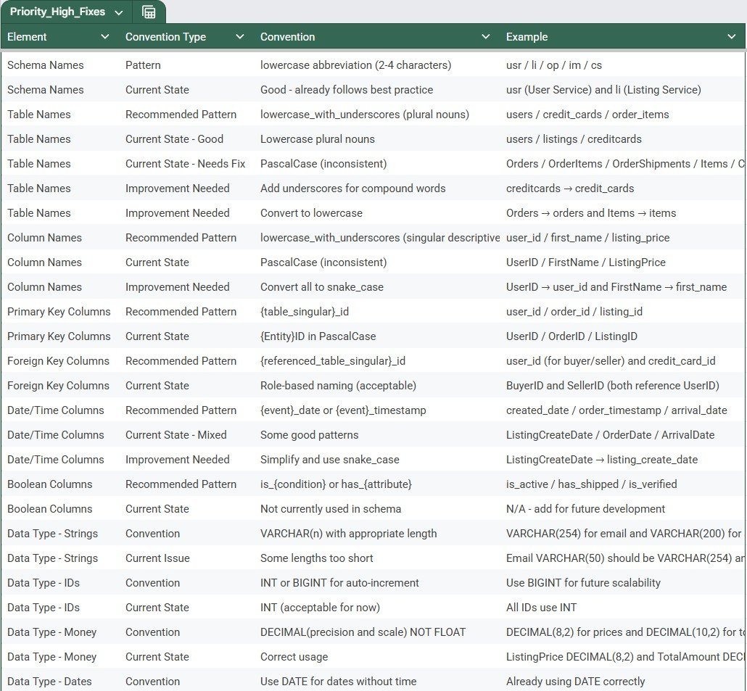
High-Priority Fixes

Slide 21
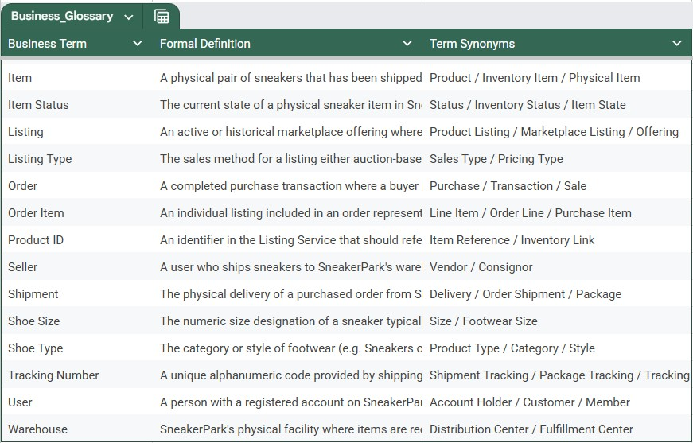
Business Glossary

