Slide 1
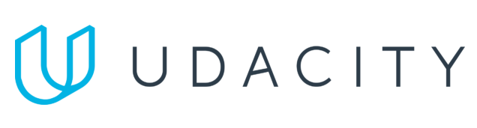
Data Lake Value Proposition
Medical Data Processing Company
Christopher O’Hara, PhD, EngD
Udacity IPS Version 1.0

Slide 2
Agenda
What is a Data Lake
Components of a Data Lake
Data Lake vs Data Warehouse
Business Value of Data Lake Solution
Proposed Data Lake Architecture for Medical Data Processing system
Udacity IPS Ver. 1 2/2020

Slide 3
What is a Data Lake
Executive summary
A Data Lake is a centralized repository that stores all enterprise data at any scale. Data Lakes eliminates capacity constraints; no more forced deletions or expensive upgrades. They offer real-time processing, which replaces nightly batch windows. Some Data Lakes are open-source technology, thus no vendor lock-in.

Slide 4
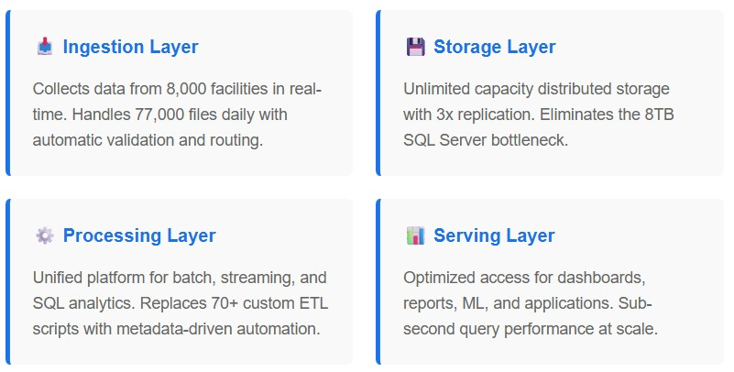
Components of Data Lake

Slide 5
Data Lake vs Data Warehouse
Data warehouses require extensive planning before storing information
Data lakes accept information in original form with flexibility for multiple uses
Our current SQL Server operates as a data warehouse - explaining our performance problems.

Slide 6
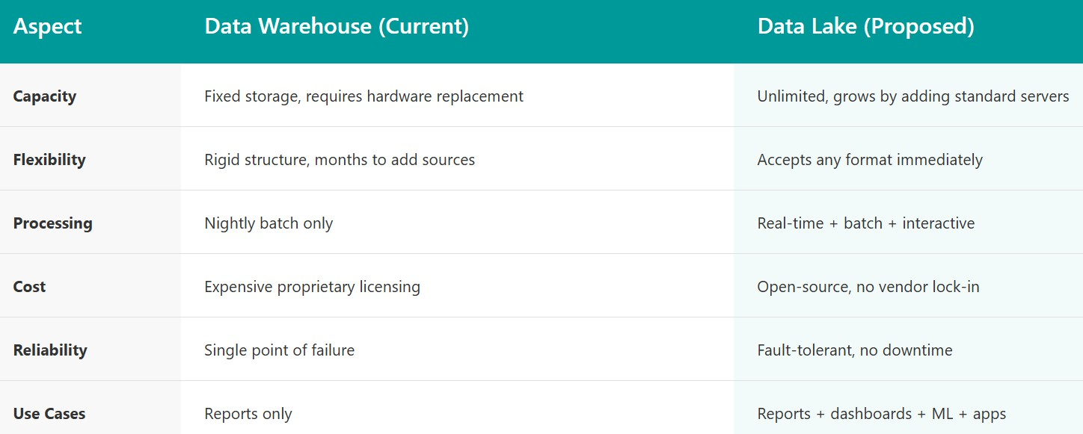
Data Lake vs Data Warehouse
Data warehouses require extensive planning before storing information
Data lakes accept information in original form with flexibility for multiple uses
Our current SQL Server operates as a data warehouse - explaining our performance problems.

Slide 7
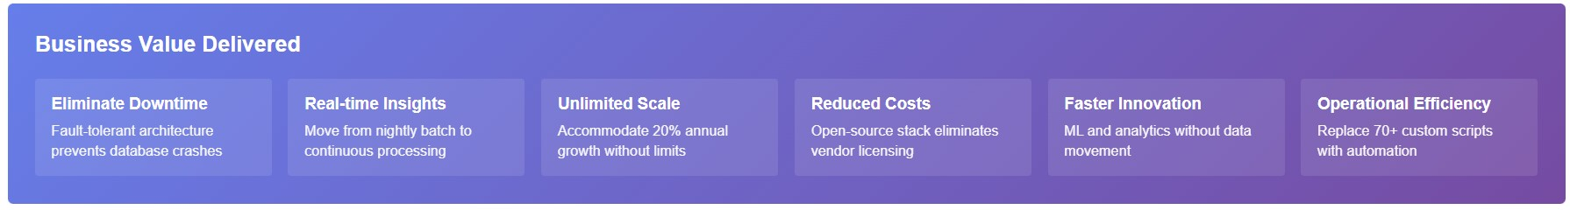
Business Value of Data Lake
The data lake solution directly addresses our three critical business challenges. First, it eliminates system downtime that currently threatens customer relationships - the recent database crash that took us offline for hours cannot occur with fault-tolerant distributed architecture. Second, it enables unlimited growth to support our 8,000 facilities and 15-20% annual expansion without the capacity constraints forcing us to delete historical data today. Third, it transforms our competitive position by enabling real-time dashboards and machine learning capabilities that our current nightly-batch-only system cannot support, allowing us to deliver the advanced analytics our customers increasingly demand. Additionally, replacing 70+ custom scripts with automated workflows and eliminating expensive proprietary licensing reduces operational costs by an estimated 30-40% while improving reliability and accelerating innovation timelines from months to weeks.

Slide 8
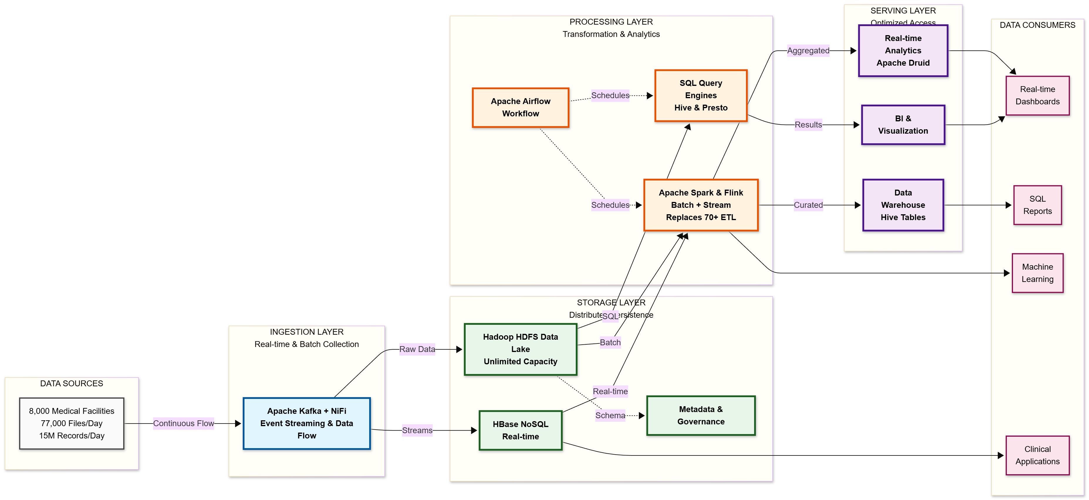
Data Lake Architecture

Slide 9
THANK YOU
Udacity IPS Version 1.0

