Slide 1
Project success rate

Slide 2

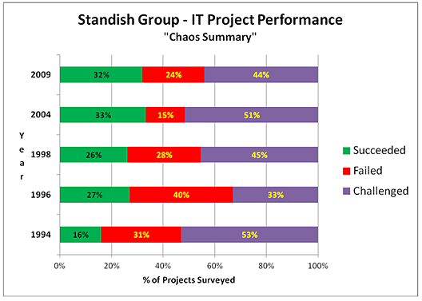
Standich Group CHAOS reports

Slide 3
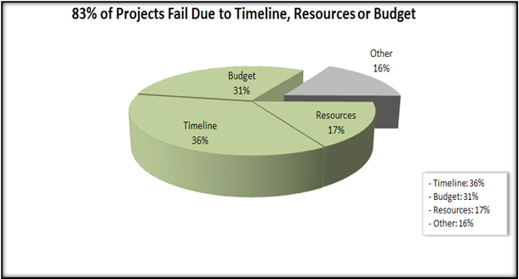
Standich Group CHAOS reports

Slide 4
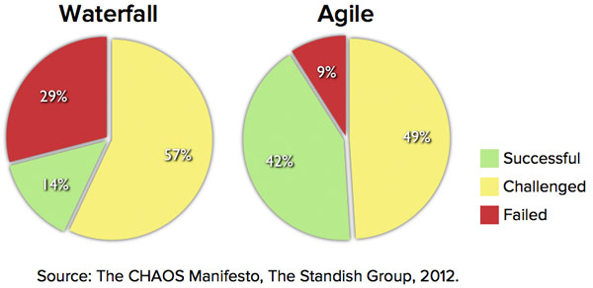
Standich Group CHAOS reports

Slide 5
Lifecycle models
Different methodologies or approaches

Slide 6
methodologies
A formalized approach or series of steps
Examples
Process-Centered
Data-Centered
Object-Oriented where process and data are intergrated

Slide 7
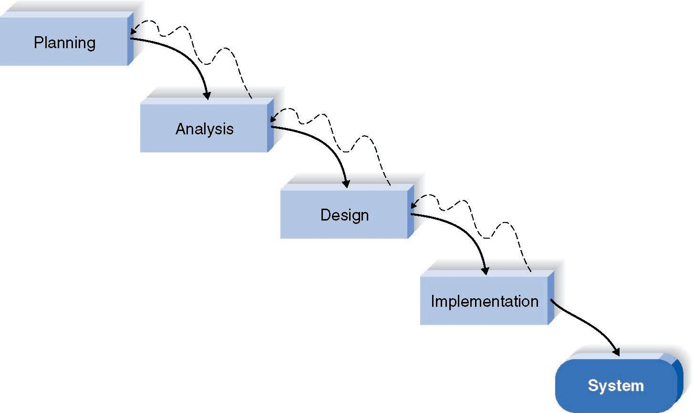
Waterfall Development Method

Slide 8
Pros and Cons of the Waterfall Method
Pros
Cons
Identifies systems
requirements long
before programming
begins
Design must be
specified on paper
before programming
begins
Long time between
system proposal and
delivery of new
system

Slide 9
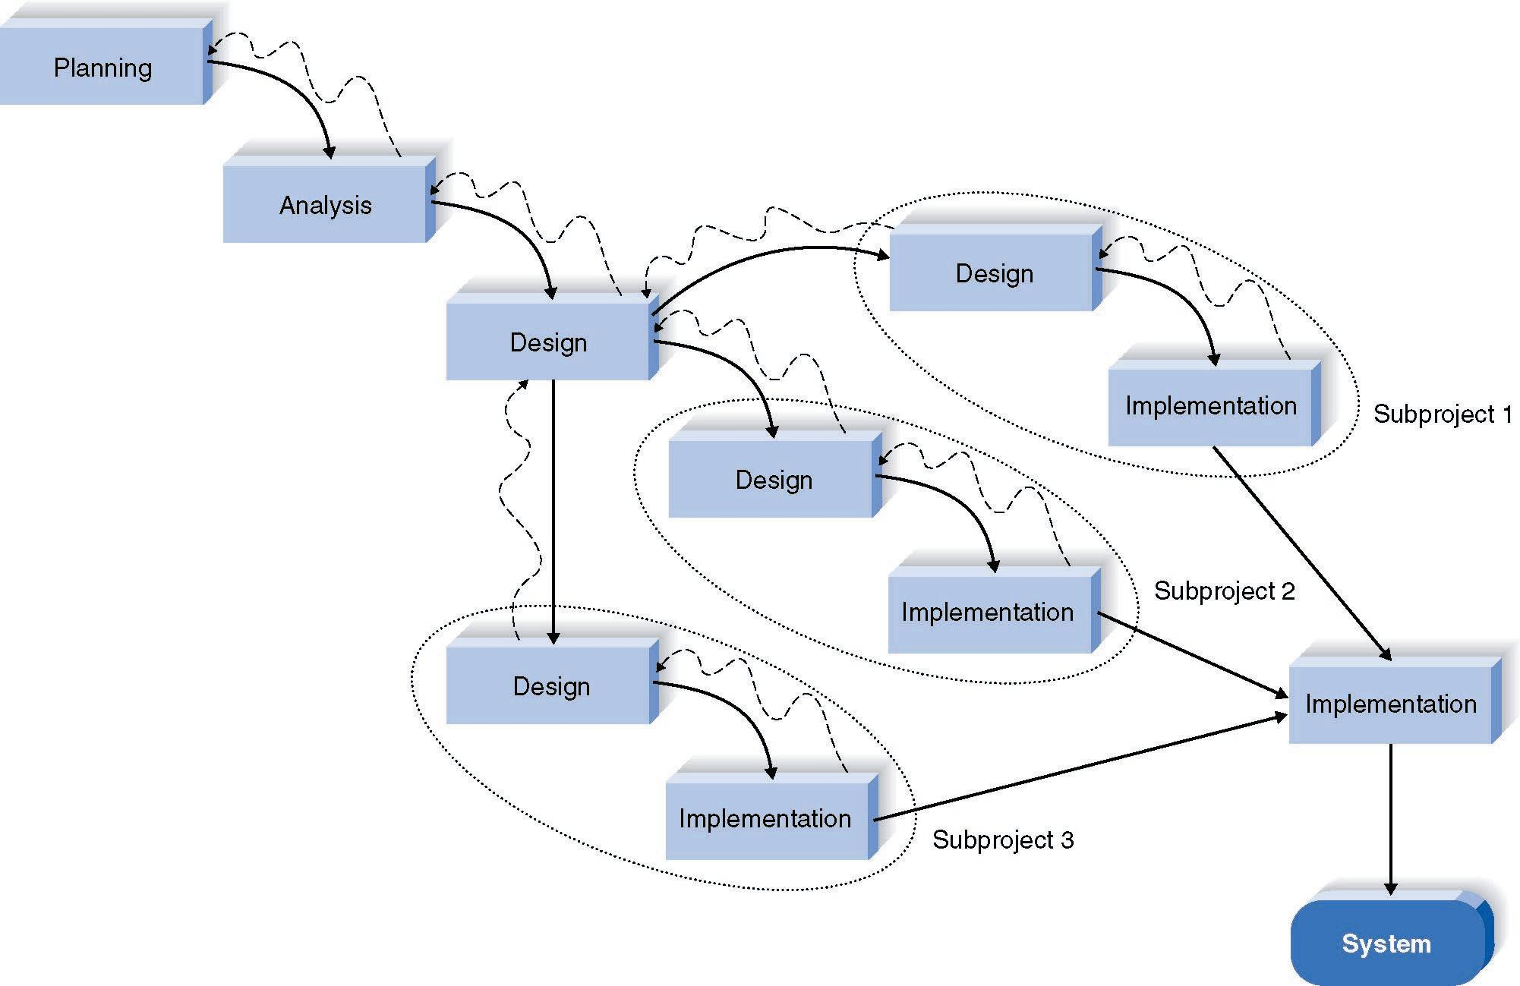
Parallel Development Method

Slide 10
Pros and Cons of Parallel Development
Pros
Cons
Reduces Scheduled
Time
Still Uses Paper
Documents
Less Chance of
Rework
Sub-projects May Be
Difficult to Integrate

Slide 11
Alternatives to the SDLC or SystemDevelomentLifeCycle
Rapid Application Development (RAD)
Phased Development
Prototyping
Spiral Development or iterative design
Packaged Systems
Agile development => SCRUM
…..

Slide 12
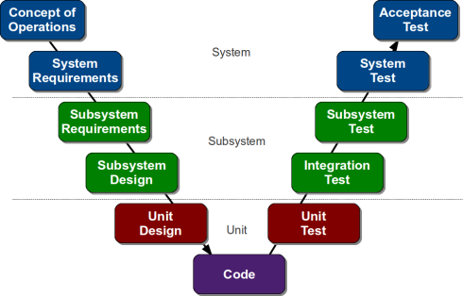
V-shape model

Slide 13
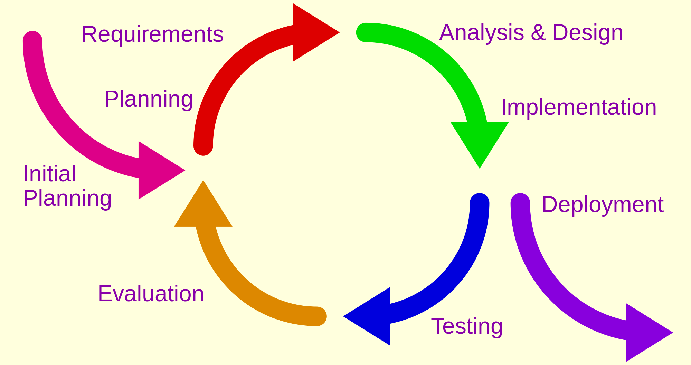
Iterative design

Slide 14
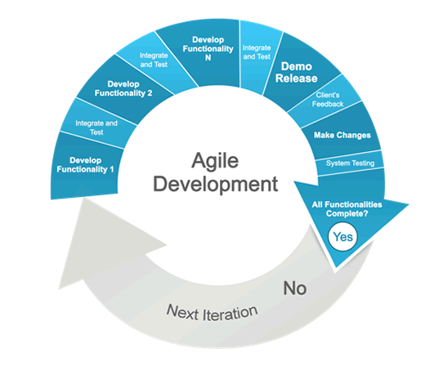
Agile development

Slide 15
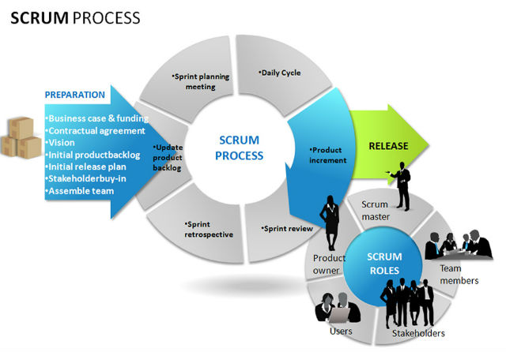
Agile => SCRUM
See http://scrummethodology.com

Slide 16
RAD: Rapid Application Development
CASE tools
JAD sessions
Fourth generation/visualization programming languages
Code generators

Slide 17
Three RAD Categories
Phased development
A series of versions
Prototyping
System prototyping
Throw-away prototyping
Design prototyping

Slide 18
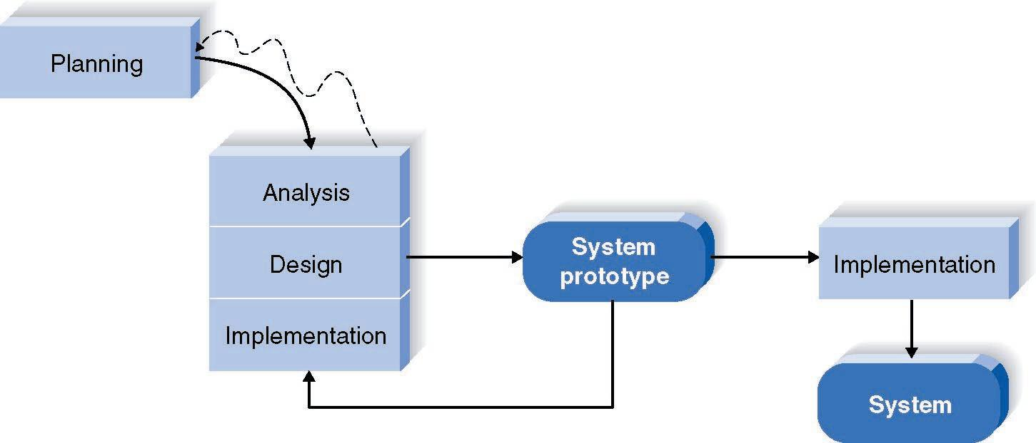
How Prototyping Works

Slide 19
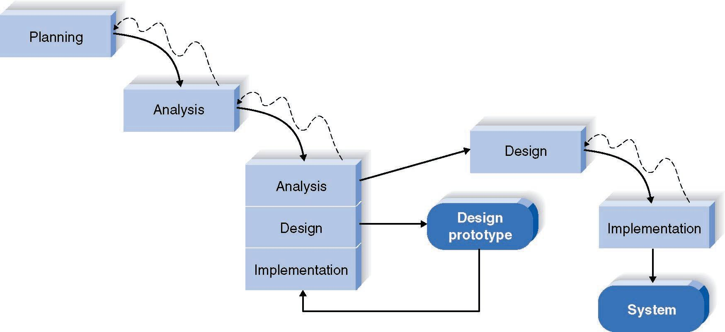
Throwaway Prototyping

Slide 20
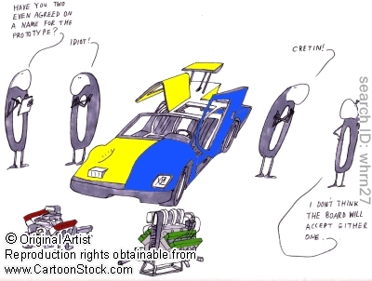
Prototyping

Slide 21
Criteria for Selecting the Appropriate Methodology
Clear user requirements
Familiar technology
Complexity
Reliability
Time schedule
Schedule visibility

Slide 22
(more) FORMAL approaches
Model based development methodologies
Model the different aspects of a system/hardware/software
ASPECTS are
Functions
Data
(time) behaviour
….

Slide 23
Model based design

Slide 24
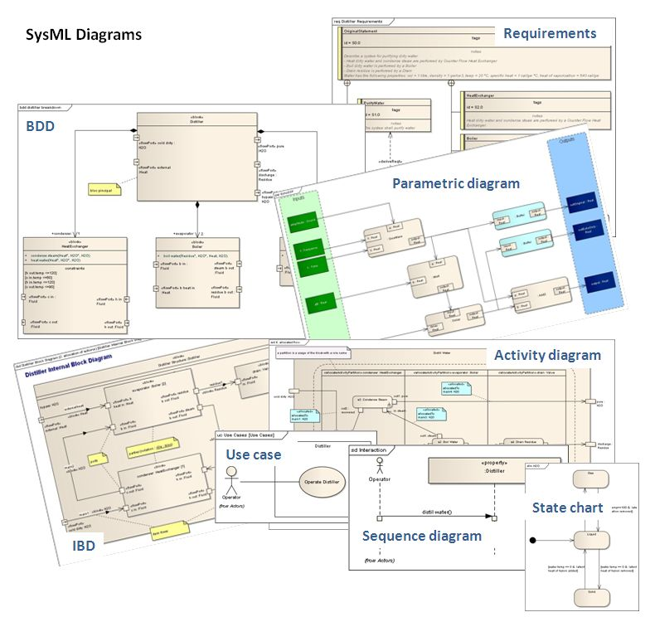
Model based design
What does it represent? An ABSTRACT product!

