Slide 1
DoorDash: Autonomous Delivery
Design Sprint
Product Manager: Christopher O’Hara
© 2019 Udacity. All rights reserved.

Slide 2
Set the stage
Set the stage for the Design Sprint by framing the problem
© 2019 Udacity. All rights reserved.
Notes:
[ALL PARTICIPATION]

Slide 3

Initial PRD
Link to PRDv1

Slide 4
Understand
Create a shared understanding of the space, problem, and goals
© 2019 Udacity. All rights reserved.
Notes:
[ALL PARTICIPATION]

Slide 5
How Might We: Christopher
How might we enable robots to send confirmations to users?
How might we allow users to track robots/orders?
How might we optimize path planning?
How might we ensure robots adhere to safety policies?
How might we construct robot greetings for interacting with users?
How might we control multi-agent systems effectively?
How might we prevent degradation of robots due to high usage?
How might we prevent mold from growing inside the robot?
How might we handle charging of robot fuel cells?
How might we prevent robots from harming pedestrians?
How might we raise user trust in the domain of robotics?
How might we prevent robots from being stolen or abused?
How might we make the API/platform open source?
How might we implement affective computing in robots?
How might we confirm robots deliver to the proper client?
How might we protect the privacy of users when interacting?
How might we evaluate customer satisfaction upon delivery?
How might we collaborate with other delivery services?
How do we prevent hacking for our robots?
How might we autonomously check for degradation in components?

Slide 6
How Might We: Shin
How might we keep vermin away from the robots?
How might we keep robots odor free, even when carrying smelly food?
How might we make robots not scary for dogs?
How might we make routes more efficient?
How might we use robots to make people excited about our brand?
How might we have robots entertain customers at delivery?
How might we have robots signal distress when something goes wrong?
How might we teach robots to avoid trouble?
How might we share robot progress with consumers?
How might we teach robots to avoid obstacles?
How might we move robots to a safe place before stopping?
How might we make our robots tamperproof?
How might we change robot's appearance?
How might we teach users to interact with humans?
How might we see real-time traffic on the route?
How might we communicate with humans around the robot?
How might we confirm that the robot is at the right address?
How might we anticipate mechanical failures?
How might we give robots a personality?
How might we monitor robot progress?

Slide 7
How Might We: Tiffany
How might we deal with accidents that might occur?
How might we control robots?
How might we alert consumers if their delivery is delayed?
How might we determine when to recharge robot batteries?
How might we establish preferred routes?
How might we determine the best area for launching this program?
How might we allow users to help us with tracking and feedback?
How might we teach robots manners?
How might we mitigate accidents between robots and pedestrians?
How might we train our operations team on monitoring and controlling a robot?
How might we use existing technologies?
How might we track each robot?
How might we collect data about where the robot got stuck?
How might we handle edge case issues that may arise?
How might we get food to people quickly when the robot fails?
How might we use use greener energy to power our robots?
How might we leverage existing tools to better track our robots?
How might we create ML/AI models to help robots learn to get better overtime?
How might we build redundancy into our system?
How might we ensure food gets delivered without incident?

Slide 8
How Might We: Alex
How might we streamline communications between operators and robots?
How might we address a sudden power outage?
How might we program robots to address delays in deliveries?
How might we enable robots to interpret and speak different languages?
How might we make interacting with robots more fun?
How might we
Increase robot speed?
How might we overcome technical glitches during a delivery?
How might we allow robots to detect real-time traffic patterns?
How might we prepare robot to handle deliveries to persons with disabilities?
How might we accept tips that some customers may want to give a robot?
How might we enable robots to detect missing items in the order during pickup?
How might we make our robots act like people?
How might we enable “emotion” modes in robots?
How might we detect when a robot needs help?
How might we alert operators of need for robot intervention conveniently?
How might we program robots to address order cancellations?
How might we teach empathy to robots?
How might we enable robots enter a crowded restaurant to pickup food?
How might we help robots talk to people?
How might we program robots to address customer returns?

Slide 9
[Affective/Emotional Intelligence]
How might we enable “emotion” modes in robots?
How might we teach empathy to robots?
How might we construct robot greetings for interacting with users?
How might we enable robots to interpret and speak different languages?
How might we evaluate customer satisfaction upon delivery?
How might we implement affective computing in robots?
How might we make our robots act like people?
How might we teach users to interact with humans?
How might we help robots talk to people?
How might we teach robots manners?
How might we make robots not scary for dogs?
How might we prepare robot to handle deliveries to persons with disabilities?
How might we give robots a personality?
How might we have robots entertain customers at delivery?
How might we make interacting with robots more fun?
[Affective Computing]
[Human-Robot Interaction]
[Edge Cases]

Slide 10
[Quality Assurance]
How might we alert consumers if their delivery is delayed?
How might we ensure food gets delivered without incident?
How might we program robots to address order cancellations?
How might we allow users to help us with tracking and feedback?
How might we deal with accidents that might occur?
How might we overcome technical glitches during a delivery?
How might we program robots to address delays in deliveries?
How might we program robots to address customer returns?
How might we get food to people quickly when the robot fails?
How might we build redundancy into our system?
How might we handle edge case issues that may arise?
How might we confirm robots deliver to the proper client?
How might we enable robots to detect missing items in the order during pickup?
[Operations]
[Orders]

Slide 11
[Maintenance & Control]
How might we train our operations team on monitoring and controlling a robot?
How might we control robots?
How might we handle edge case issues that may arise?
How might we anticipate mechanical failures?
How might we prevent degradation of robots due to high usage?
How might we alert operators of need for robot intervention conveniently?
How might we control multi-agent systems effectively?
How might we overcome technical glitches during a delivery?
How might we autonomously check for degradation in components?
[Maintenance]
[Control]

Slide 12
[Path Planning & Obstacle Avoidance]
How might we optimize path planning?
How might we make routes more efficient?
How might we allow robots to detect real-time traffic patterns?
How might we mitigate accidents between robots and pedestrians?
How might we teach robots to avoid obstacles?
How might we teach robots to avoid trouble?
How might we move robots to a safe place before stopping?
How might we see real-time traffic on the route?
How might we monitor robot progress?
How might we enable robots enter a crowded restaurant to pickup food?
How might we collect data about where the robot got stuck?
[Path Planning]
[Obstacle Avoidance]

Slide 13
[Security & Safety]
How might we deal with accidents that might occur?
How might we ensure robots adhere to safety policies?
How do we prevent hacking for our robots?
How might we prevent robots from being stolen or abused?
How might we prevent mold from growing inside the robot?
How might we keep vermin away from the robots?
How might we prevent robots from harming pedestrians?
How might we make our robots tamperproof?
[Security]
[Safety]

Slide 14
[Performance]
How might we have robots signal distress when something goes wrong?
How might we communicate with humans around the robot?
How might we determine when to recharge robot batteries?
How might we address a sudden power outage?
How might we use use greener energy to power our robots?
How might we streamline communications between operators and robots?
How might we enable robots to send confirmations to users?
How might we handle charging of robot fuel cells?
[Energy]
[Communication]

Slide 15
Others
How might we raise user trust in the domain of robotics?
How might we use robots to make people excited about our brand?
How might we make the API/platform open source?
How might we create ML/AI models to help robots learn to get better overtime?
How might we
Increase robot speed?
How might we change robot's appearance?
How might we leverage existing tools to better track our robots?
How might we use existing technologies?
[Speed]
How might we accept tips that some customers may want to give a robot?
How might we collaborate with other delivery services?
[Image]
[Technology]
How might we protect the privacy of users when interacting?
[Interaction]
[Privacy]

Slide 16
Sprint Focus
Focus | Quality Assurance: Orders
Slide # | List slide #10
Theme Selection Decision: | This theme appears to have a largest number of opportunities that are technologically feasible to solve. Furthermore, QA allows for user-centered design and engagement for user interfaces. The user interface is ultimately where users will spend the most time and should be intuitive and optimal in design to ensure proper user experience.

Slide 17
Define
With an understanding of the problem space, create focus and align on specific outcomes for the Design Sprint
© 2019 Udacity. All rights reserved.
Notes:
[ALL PARTICIPATION]

Slide 18
Success Metrics
 | Goals | Signals | Metrics
Happiness | High level of user satisfaction when using app DoorDash review ratings improve | Users provide positive reviews for DoorDash online | Number of high-level ratings on appropriate websites (quantitative) Positive feedback and content within review/rating (qualitative)
Engagement | Users directly communicate with the robot regarding order status Users look forward to interacting with the “delivery robot” | Changes in the amount of time spent in app | Percent change of time spent in app to complete a task (quantitative, lower % is better) Percent change of amount of app uses (higher % is better)
Adoption | Users recommend service to others (self-advertisement) Potential users have a peaked interest | Increased number of new user acquisitions Expansion of desired coverage area | Quantitative increase in unique (new) users Maximum range of delivery location value
Retention | Users continue using the service/app Users use the service more often | Previous users utilizing app for additional orders | Increased number of returning users Increased frequency of user orders
Task Success | Users can easily order/adjust using the app Users can easily interact with the delivery robot | Proportion of customer support requests are decreased for hotline/chat and increased for the robot/app | Percent decrease in human representative conversations Percent increase in automated tickets to the robot

Slide 19
“DoorDash: Robots Get it Right” by MIT Media Lab
Ordering food has become ubiquitous in modern society with over 971 million users generating over $107,438,000,000 in 2019 [Statista 2019]. However, it is no secret that ordering food online comes with its own share of problems including delayed orders, user cancellations, and missing items (like your dipping sauce for your wing). Calling into the restaurant or delivery service for inquiries can be troublesome and it is often not clear for users what they should. This leads to customer dissatisfaction and a desire to use a different service (or no service).
However, all of that is about to change with DoorDash’s new robot delivery service. Cute, autonomous robots will be able to handle food delivery orders by communicating directly with the user via an application. From the application, users will be able to track, cancel, and modify orders by interacting with the delivery robot. The app will allow for the robot to “talk” to the user in natural language or via text. This will lessen the annoyance and burden of the customer that does not understand why their Pizza is missing and who they should talk to. A quick google search for “[x] pizza company reviews” will demonstrate what an “unhappy” customer looks like. This technology will result in a decrease in the need for contacting the ordering service directly.
According to the Project Manager, Christopher O’Hara, the goal is to “provide users with a comfortable interface that reduces the shortcomings of food delivery services while providing users with a direct line of communication to a friendly, cute, autonomous agent.” Future plans are to incorporate affective computing via sentiment analysis, as well as users being able to “virtually personalize” the robot from their app (customizable colors, voice, and personality). Depending on the impact and adoption rate, it is anticipated that all orders will be handled autonomously in the future. To handle delivery issues, DoorDash will have an operations team that can remotely control the robot. Happy eating!

Slide 20
Sketch
Generate tons of ideas, then narrow them down to two in depth solution sketches
© 2019 Udacity. All rights reserved.
Notes:
[ALL PARTICIPATION]

Slide 21
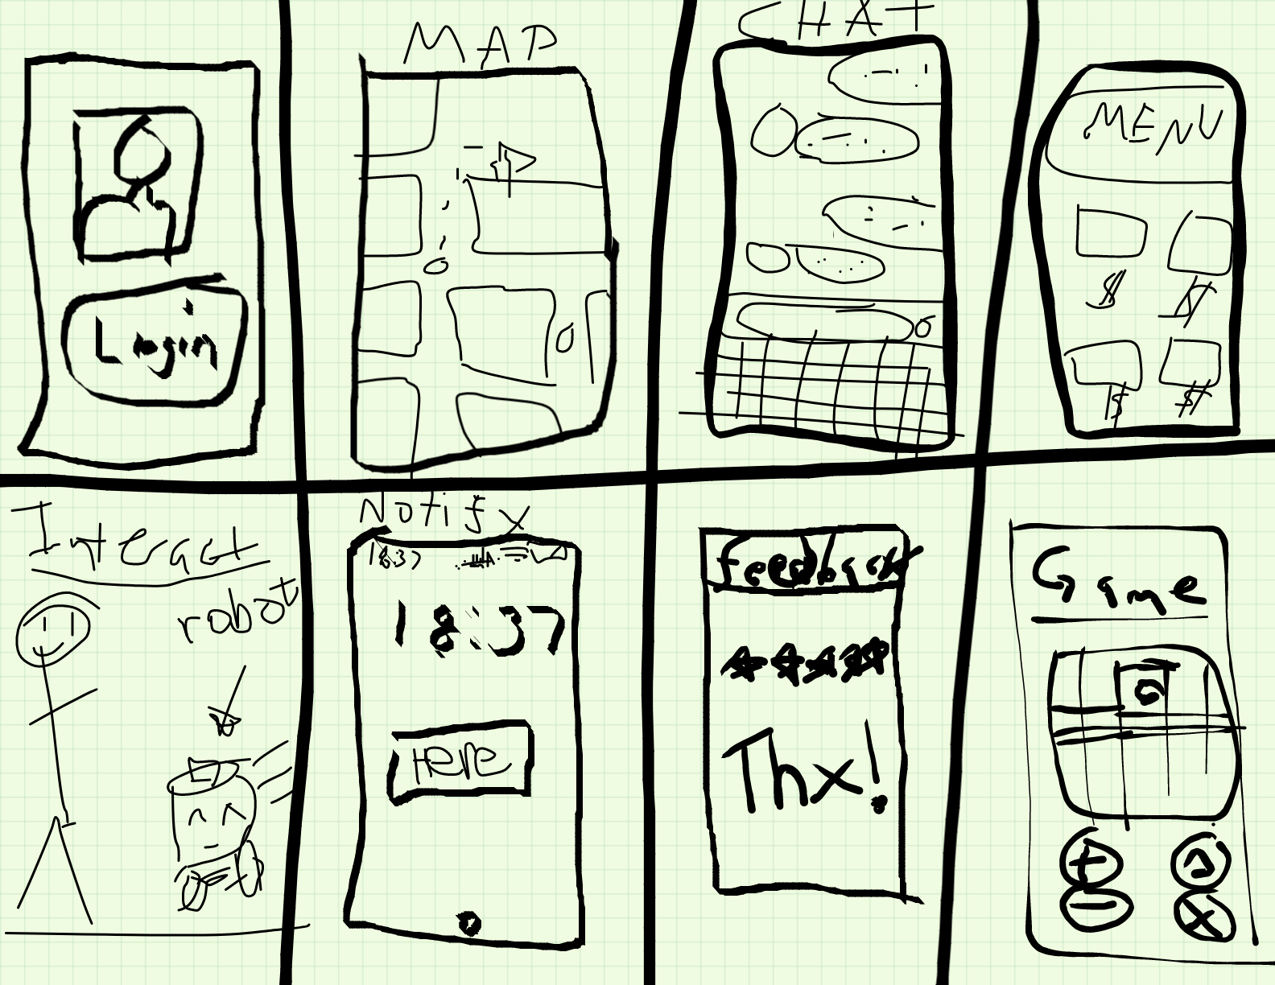
8 Sketches

Slide 22
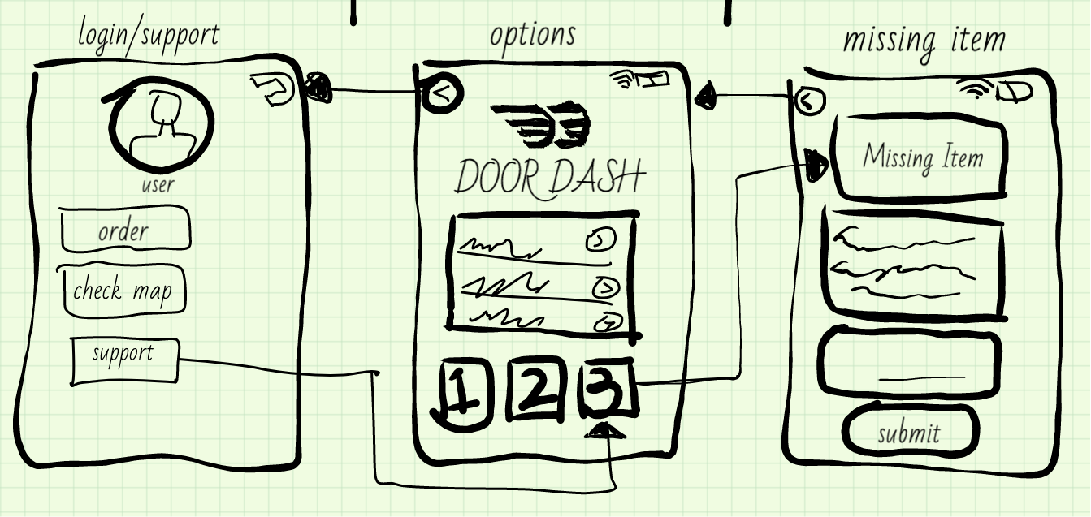
Login/Missing Item Sketch
Upload a photo of your sketch on this slide

Slide 23
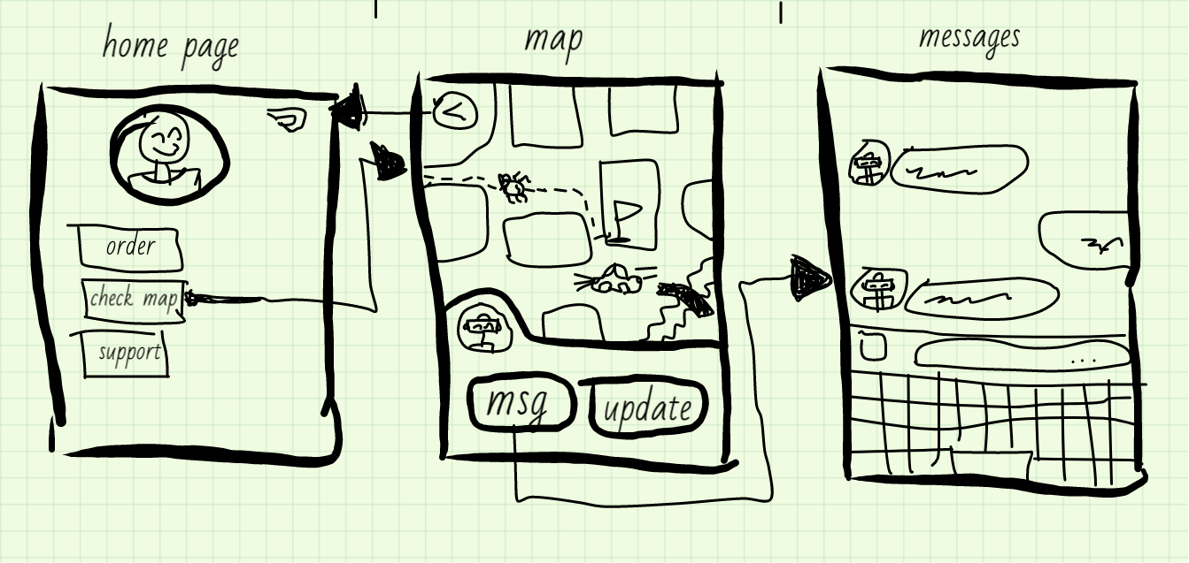
Map/Messages Sketch
Upload a photo of your sketch on this slide

Slide 24
Decide
Pick the final concept that you develop into a prototype
© 2019 Udacity. All rights reserved.
Notes:
[ALL PARTICIPATION]

Slide 25
Decision
Decision | Combination: Login/Missing Item and Map/Messages Sketches
Rationale | As each UI path can be accessed from the “Home” screen, it should require little additional effort to explore both sketches simultaneously. Furthermore, it is not expected to require additional narration to complete a task that has been designed within three layers (standard UI/UX rules).

Slide 26
Prototype
Turn your concept into a realistic, interactive prototype that you will use to validate your assumptions and ideas
© 2019 Udacity. All rights reserved.
Notes:
[ALL PARTICIPATION]

Slide 27

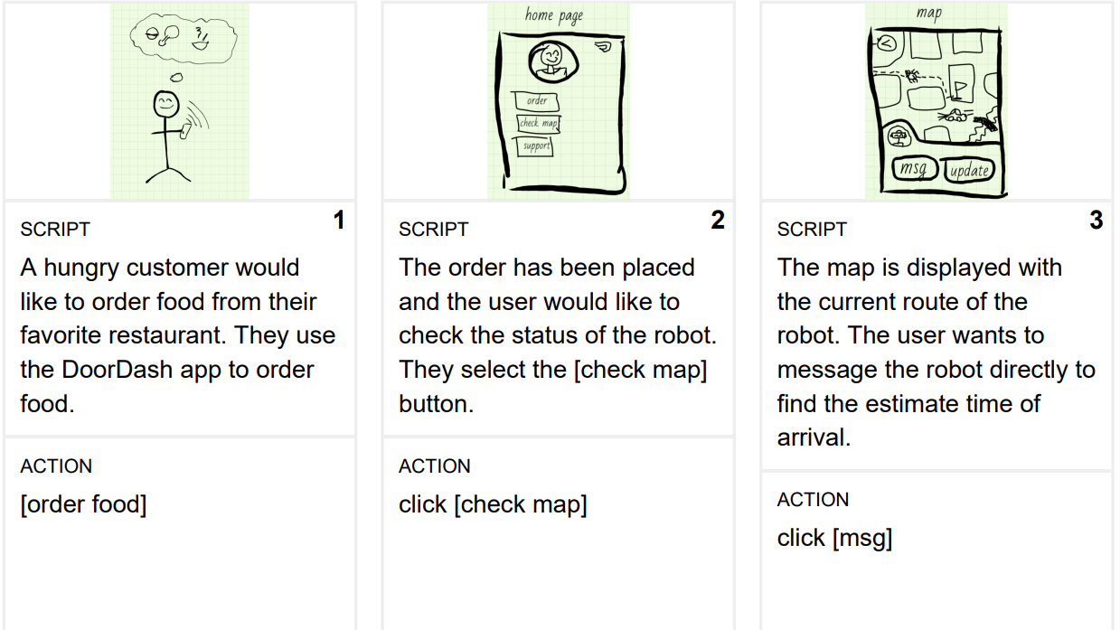
Storyboard
Link to plot

Slide 28
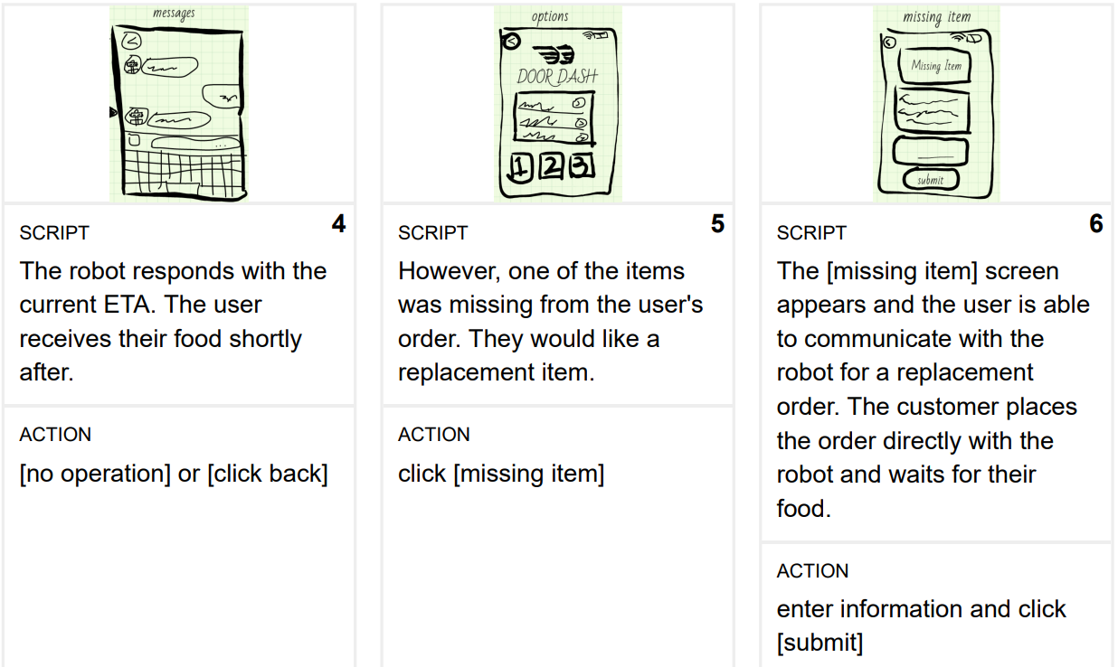
Storyboard
Link to plot

Slide 29
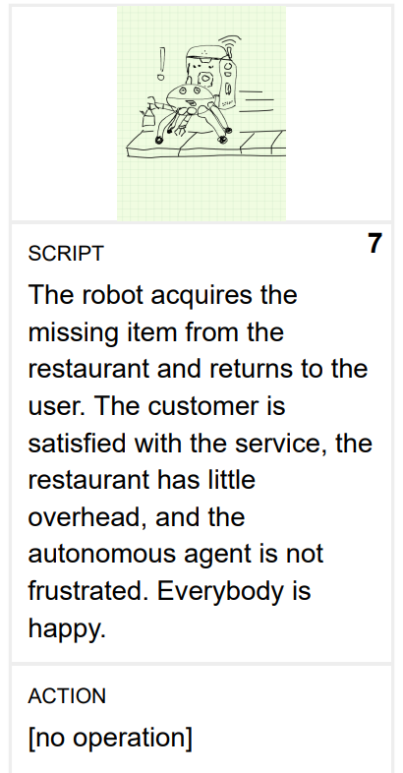
Storyboard
Link to plot

Slide 30

Prototype
Description | The prototype is designed to take the user through two possible uses of the application. The user will check the location of the robot on the map and send them a “dummy message.” The user is also able to report a missing item.
Assumptions | Assumptions made regarding the prototype: Users will not engage in a detailed walkthrough of the prototype Users will have already signed-up/signed-in Users can easily understand symbols
Tasks | Flows/tasks that a user can complete in the prototype: Users can check the map/robot status Users can send the robot a message Users can report a missing item
Link to Prototype

Slide 31
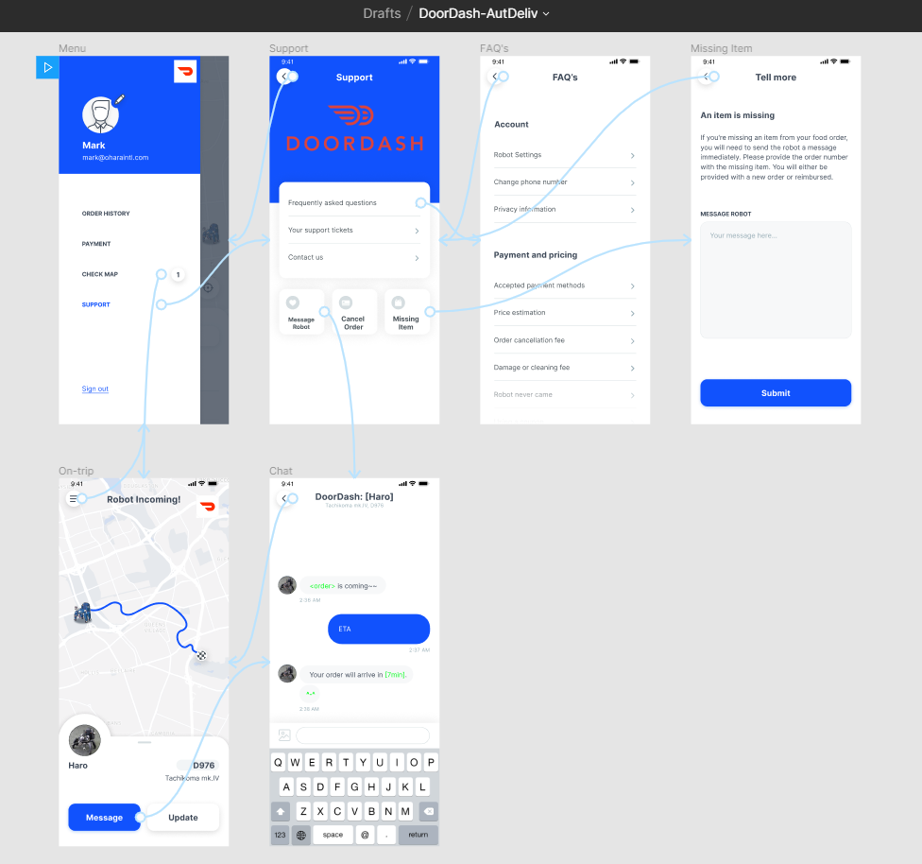
Prototype

Slide 32
Validate
Users will go through your prototype and provide feedback on your concept. This is also an opportunity to have an engineering feasibility discussion
© 2019 Udacity. All rights reserved.
Notes:
[ALL PARTICIPATION]

Slide 33
Plan and recruit for research
Link to research plan

Slide 34

User Testing
Link to notes
Link to audio recording
Key Findings from Participant 1
What worked well | General layout, task flow for using map and messaging the robot.
Where participants got stuck | Difficulty in translating the “support” button as the method for reporting an item was missing. Appropriate clicking of buttons on the home page.
Other observations | The application seemed intuitive and easy to use. Reminded the user of a taxi application.

Slide 35
User Testing
Link to notes
Link to audio recording
Key Findings from Participant 2
What worked well | General layout, task flow for using map and messaging the robot are good.
Where participants got stuck | Difficulty in translating the “support” button as the method for reporting an item was missing. Appropriate clicking of buttons on the home page.
Other observations | The application seemed intuitive and easy to use. Reminded the user of the Uber application. “Support” seems more for technical problems like reporting email issues. Enthusiastic about autonomous robotic delivery.

Slide 36
Improvements
Improvement #1 | Make larger buttons on Home screen.
Rationale | User disliked the “list” method for buttons on the top page. The buttons will be enlarged to make them more easily clickable.
Improvement #2 | Improve Home screen layout.
Rationale | User disliked the layout and button style on the Home screen. The layout will be updated to move the DoorDash logo and the buttons will be placed in a more intuitive and easier to access manner.

Slide 37
Feasibility
 | Your Assumptions | Specific feasibility questions
Drawing the UI | Robot telemetry information needed in real-time Restaurant order information needed in real-time Text from messages between user and robot should be recorded | Which GPS service would be the most reliable? What metadata related to the user will be stored? Should data be updated to the Cloud in real-time or based on a schedule?
User generated data | User data will be stored on a Cloud server User data will be used to improve application performance and delivery service | What is the minimal amount of data needed for future datasets? How much overhead costs will be incurred for using Cloud services?
Latency | Screens should load within 200ms Telemetry data might have delays in the returning the accurate position of the robot | Can the application throughput be optimized by continuously synchronizing the application? Will this synchronization require additional energy consumption of the device? How will restaurant, user, and robot data be synchronized?

Slide 38
Iterate
Leverage learnings from your first two user interviews to make changes to your prototype. Then run another round of user interviews.
© 2019 Udacity. All rights reserved.
Notes:
[ALL PARTICIPATION]

Slide 39
Prototype v2
Description | The prototype is designed to take the user through two possible uses of the application. The user will check the location of the robot on the map and send them a “dummy message.” The user is also able to report a missing item.
Assumptions | Assumptions made regarding the prototype: Users will not engage in a detailed walkthrough of the prototype Users will have already signed-up/signed-in Users can easily understand symbols
Tasks | Flows/tasks that a user can complete in the prototype: Users can check the map/robot status Users can send the robot a message Users can report a missing item
Link to Prototype

Slide 40
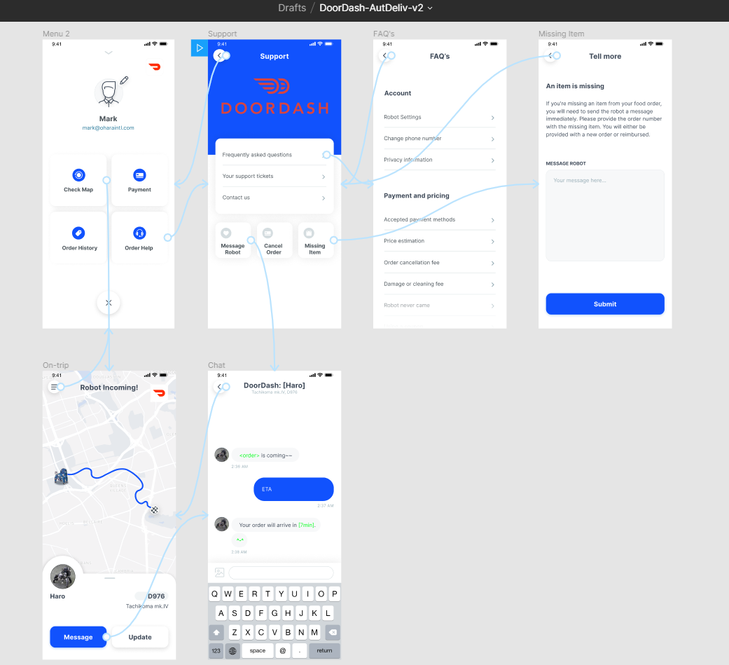
Prototype v2

Slide 41
User Testing Round 2
Key Findings from Participant 3
Link to notes
Link to audio recording
What worked well | The application is easy to navigate, familiar, and contains all of the features needed for users.
Where participants got stuck | The user got stuck with a non-interactive “Update” button. Otherwise, there were no issues.
Other observations | The user compared the app to Postmates.

Slide 42
Handoff
© 2019 Udacity. All rights reserved.
Notes:
[ALL PARTICIPATION]

Slide 43
Updated PRD
Link to PRD v2

