Slide 1
WorldVisitz Mobile Application Agile Delivery Launch
Agile Onboarding - Presentation for the Agile Team
Presented by: Christopher O’Hara, PhD
© 2019 Udacity. All rights reserved.
Notes:
Presenter notes
Greetings and thank everyone for joining.
Normal introduction, read title and subtitle. Introduce myself, move on smoothly.

Slide 2
Agile Onboarding
Our shared promise: a usable, tested increment every two weeks
We will work as one cross-functional Scrum Team, learning from working software rather than handing work through separate phases.
- One Product Backlog and one Sprint Goal focus the entire team
- A visible Definition of Done protects quality and makes progress truthful
- Sprint Reviews invite stakeholder feedback before a feature is scaled
- Retrospectives improve our process, trust, and technical practices
Notes:
Presenter notes
Use this slide to guide the Agile delivery team through Our shared promise: a usable, tested increment every two weeks. Explain the main point in plain language, then connect it to the WorldVisitz mobile-launch scenario. Agile Onboarding We will work as one cross-functional Scrum Team, learning from working software rather than handing work through separate phases.
- One Product Backlog and one Sprint Goal focus the entire team
- A visible Definition of Done protects quality and makes progress truthful
- Sprint Reviews invite stakeholder feedback before a feature is scaled
- Retrospectives improve our process, trust, and technical practices
Pause for questions and emphasize how this point supports predictable, value-driven delivery.

Slide 3
Onboarding the Team
Notes:
Presenter notes
Use this slide to guide the Agile delivery team through Onboarding the Team. Explain the main point in plain language, then connect it to the WorldVisitz mobile-launch scenario.
Pause for questions and emphasize how this point supports predictable, value-driven delivery.

Slide 4
Agile Benefits for the Team
Agile gives the team earlier feedback, shared ownership, and safer delivery
The team gains clarity and autonomy by delivering small pieces of customer value together.
- Developers, tester, UX, BA, and product leadership collaborate during not after delivery
- Kathy helps define acceptance and automation early, reducing late-test surprises
- James and Holly see working slices early, so customer and SME feedback arrives sooner
- Pairing and shared standards transfer knowledge across USA and India
Notes:
Presenter notes
Use this slide to guide the Agile delivery team through Agile gives the team earlier feedback, shared ownership, and safer delivery. Explain the main point in plain language, then connect it to the WorldVisitz mobile-launch scenario. Agile Benefits for the Team The team gains clarity and autonomy by delivering small pieces of customer value together.
- Developers, tester, UX, BA, and product leadership collaborate during not after delivery
- Kathy helps define acceptance and automation early, reducing late-test surprises
- James and Holly see working slices early, so customer and SME feedback arrives sooner
- Pairing and shared standards transfer knowledge across USA and India
Pause for questions and emphasize how this point supports predictable, value-driven delivery.

Slide 5
Agile Benefits for the Team
Working agreements make distributed collaboration explicit
These agreements support the Agile Manifesto value of individuals and interactions.
- No side assignments: Developers pull work toward the Sprint Goal
- Pair across locations; rotate partners to spread domain and technical knowledge
- Review code, automate relevant tests, and integrate before calling work Done
- Raise blockers in the Daily Scrum; document decisions in the shared board
- Invite Holly and other stakeholders to refinement and Sprint Review
Notes:
Presenter notes
Use this slide to guide the Agile delivery team through Working agreements make distributed collaboration explicit. Explain the main point in plain language, then connect it to the WorldVisitz mobile-launch scenario. Agile Benefits for the Team These agreements support the Agile Manifesto value of individuals and interactions.
- No side assignments: Developers pull work toward the Sprint Goal
- Pair across locations; rotate partners to spread domain and technical knowledge
- Review code, automate relevant tests, and integrate before calling work Done
- Raise blockers in the Daily Scrum; document decisions in the shared board
- Invite Holly and other stakeholders to refinement and Sprint Review
Pause for questions and emphasize how this point supports predictable, value-driven delivery.

Slide 6
Agile Practice
Notes:
Presenter notes
Use this slide to guide the Agile delivery team through Agile Practice. Explain the main point in plain language, then connect it to the WorldVisitz mobile-launch scenario.
Pause for questions and emphasize how this point supports predictable, value-driven delivery.

Slide 7
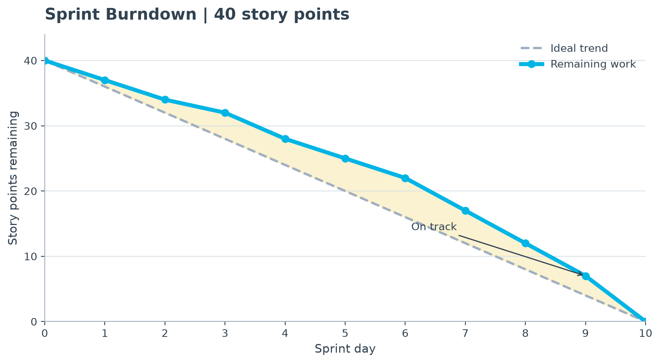
Radiator 1: Sprint Burndown
The Sprint Burndown shows whether the team is trending toward the Sprint Goal before the end of the two-week Sprint.
How to read it
Metric: story points remaining by Sprint day. Developers inspect it in the Daily Scrum; the Scrum Master uses it to surface blockers.
Why it helps
Value: it makes scope growth, slow testing, or blocked integration visible early enough for the Developers to adapt their plan.
Notes:
Presenter notes
Use this slide to guide the Agile delivery team through The Sprint Burndown shows whether the team is trending toward the Sprint Goal before the end of the two-week Sprint.. Explain the main point in plain language, then connect it to the WorldVisitz mobile-launch scenario. Radiator 1: Sprint Burndown How to read it
Metric: story points remaining by Sprint day. Developers inspect it in the Daily Scrum; the Scrum Master uses it to surface blockers.
Why it helps
Value: it makes scope growth, slow testing, or blocked integration visible early enough for the Developers to adapt their plan.
Pause for questions and emphasize how this point supports predictable, value-driven delivery.

Slide 8
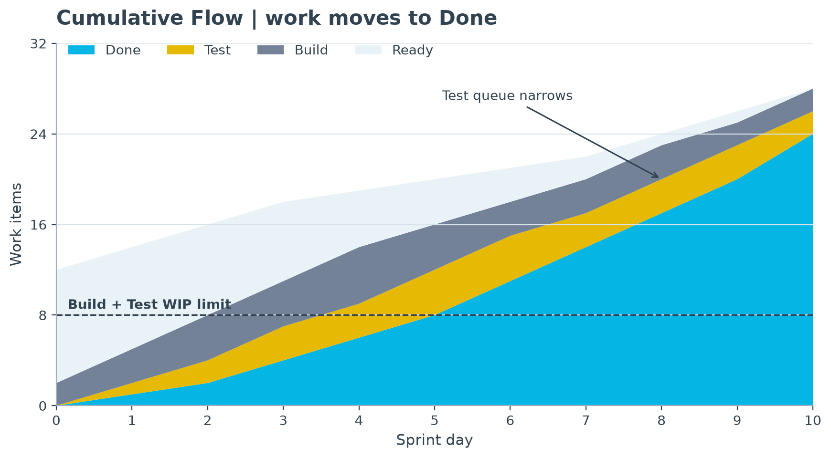
Radiator 2: Cumulative Flow with WIP limits
The cumulative-flow chart shows where work is accumulating from Ready through Build, Test, and Done.
How to read it
Metric: work-item count by workflow state and item age. Review Build and Test limits daily to protect flow.
Why it helps
Value: it exposes queues so the team can swarm to finish work, reduce cycle time, and communicate reliable flow status to stakeholders.
Notes:
Presenter notes
Use this slide to guide the Agile delivery team through The cumulative-flow chart shows where work is accumulating from Ready through Build, Test, and Done.. Explain the main point in plain language, then connect it to the WorldVisitz mobile-launch scenario. Radiator 2: Cumulative Flow with WIP limits How to read it
Metric: work-item count by workflow state and item age. Review Build and Test limits daily to protect flow.
Why it helps
Value: it exposes queues so the team can swarm to finish work, reduce cycle time, and communicate reliable flow status to stakeholders.
Pause for questions and emphasize how this point supports predictable, value-driven delivery.

Slide 9
Ceremony Schedule & Each Agenda
The schedule follows the Scrum Guide for a two-week Sprint; durations are deliberately short and purposeful.
Scrum events create a predictable inspect-and-adapt rhythm
- Sprint Planning | every Sprint | up to 2 hours | set Sprint Goal, select work, plan delivery
- Daily Scrum | every workday | 15 minutes | Developers inspect progress and adapt their plan
- Sprint Review | end of Sprint | up to 90 minutes | inspect the Increment with stakeholders and adapt backlog
- Retrospective | after Review | up to 60 minutes | improve quality, collaboration, and ways of working
Notes:
Presenter notes
Use this slide to guide the Agile delivery team through The schedule follows the Scrum Guide for a two-week Sprint; durations are deliberately short and purposeful.
Scrum events create a predictable inspect-and-adapt rhythm. Explain the main point in plain language, then connect it to the WorldVisitz mobile-launch scenario. Ceremony Schedule & Each Agenda - Sprint Planning | every Sprint | up to 2 hours | set Sprint Goal, select work, plan delivery
- Daily Scrum | every workday | 15 minutes | Developers inspect progress and adapt their plan
- Sprint Review | end of Sprint | up to 90 minutes | inspect the Increment with stakeholders and adapt backlog
- Retrospective | after Review | up to 60 minutes | improve quality, collaboration, and ways of working
Pause for questions and emphasize how this point supports predictable, value-driven delivery.

Slide 10
High Performing Agile Teams
Notes:
Presenter notes
Use this slide to guide the Agile delivery team through High Performing Agile Teams. Explain the main point in plain language, then connect it to the WorldVisitz mobile-launch scenario.
Pause for questions and emphasize how this point supports predictable, value-driven delivery.

Slide 11
Team Composition and Role Assignments
Role assignments use current strengths while removing functional silos
Accountability is clear, but everyone contributes to delivering a Done increment.
- Product Owner: John Smith orders the Product Backlog and collaborates with customers; Jerry supports analysis and refinement
- Scrum Master: Jane Doe coaches Scrum, removes impediments, and stops command-and-control assignment
- Developers: Jim, Nathan, Venkat, Ali, Kathy, James, and Jerry build, test, design, analyze, and integrate the Increment
- Stakeholder/SME: Holly Vogt provides domain feedback in refinement and Sprint Reviews
- Executives: set outcomes, fund the team, and use Sprint Reviews for evidence-based decisions
Notes:
Presenter notes
Use this slide to guide the Agile delivery team through Role assignments use current strengths while removing functional silos. Explain the main point in plain language, then connect it to the WorldVisitz mobile-launch scenario. Team Composition and Role Assignments Accountability is clear, but everyone contributes to delivering a Done increment.
- Product Owner: John Smith orders the Product Backlog and collaborates with customers; Jerry supports analysis and refinement
- Scrum Master: Jane Doe coaches Scrum, removes impediments, and stops command-and-control assignment
- Developers: Jim, Nathan, Venkat, Ali, Kathy, James, and Jerry build, test, design, analyze, and integrate the Increment
- Stakeholder/SME: Holly Vogt provides domain feedback in refinement and Sprint Reviews
- Executives: set outcomes, fund the team, and use Sprint Reviews for evidence-based decisions
Pause for questions and emphasize how this point supports predictable, value-driven delivery.

Slide 12
Appendix 1 - Skill Gaps
Private notes: current gaps and anti-patterns need direct coaching
These observations are confidential coaching inputs, not performance labels.
- Jane: individual work assignment and scope-control mindset
- John and Jerry: heavy upfront planning; separation from Developers
- Offshore/onshore Developers: complex-work siloing, weak transfer, and low trust
- Kathy: testing starts after development rather than throughout
- Team: inconsistent coding standards, frozen requirements, late UX/customer feedback, and one-to-one SME channels
Notes:
Presenter notes
Use this slide to guide the Agile delivery team through Private notes: current gaps and anti-patterns need direct coaching. Explain the main point in plain language, then connect it to the WorldVisitz mobile-launch scenario. Appendix 1 - Skill Gaps These observations are confidential coaching inputs, not performance labels.
- Jane: individual work assignment and scope-control mindset
- John and Jerry: heavy upfront planning; separation from Developers
- Offshore/onshore Developers: complex-work siloing, weak transfer, and low trust
- Kathy: testing starts after development rather than throughout
- Team: inconsistent coding standards, frozen requirements, late UX/customer feedback, and one-to-one SME channels
Pause for questions and emphasize how this point supports predictable, value-driven delivery.

Slide 13
Appendix 2 - Training & Coaching Plan
Private notes: 90-day Shu Ha Ri plan combines team and one-to-one coaching
The plan moves from following shared practices (Shu), to adapting them with support (Ha), to team-owned improvement (Ri).
- Days 1-30, Shu: whole-team Scrum basics, Definition of Done, coding standards, pairing, refinement; coach Jane and John weekly
- Days 31-60, Ha: rotate pairs, joint test design, mob refinement, WIP review; coach Kathy on shift-left quality and Jerry on outcome-focused analysis
- Days 61-90, Ri: team facilitates events, owns standards, and experiments using radiator evidence; coach Jane on servant leadership and conflict facilitation
- Measure progress: smaller handoffs, more paired work, automated-test coverage, fewer late defects, and retrospective actions completed
Notes:
Presenter notes
Use this slide to guide the Agile delivery team through Private notes: 90-day Shu Ha Ri plan combines team and one-to-one coaching. Explain the main point in plain language, then connect it to the WorldVisitz mobile-launch scenario. Appendix 2 - Training & Coaching Plan The plan moves from following shared practices (Shu), to adapting them with support (Ha), to team-owned improvement (Ri).
- Days 1-30, Shu: whole-team Scrum basics, Definition of Done, coding standards, pairing, refinement; coach Jane and John weekly
- Days 31-60, Ha: rotate pairs, joint test design, mob refinement, WIP review; coach Kathy on shift-left quality and Jerry on outcome-focused analysis
- Days 61-90, Ri: team facilitates events, owns standards, and experiments using radiator evidence; coach Jane on servant leadership and conflict facilitation
- Measure progress: smaller handoffs, more paired work, automated-test coverage, fewer late defects, and retrospective actions completed
Thank everyone for joining and allow for questions.

