Slide 1
Data Product Manager Nanodegree
Applying Data Science to Product Management
Final Project: Developing an MVP Launch Strategy for a Flying Taxi Service

Slide 2
Welcome to your first week at Flyber

Slide 3


Slide 4
In this project, you will apply the skills acquired in this course to create the MVP launch strategy for the first flying car taxi service, Flyber, in one of the most congested cities in America -- New York City.
You are responsible for bringing the first flying car taxi service to market by analyzing data and building a product proposal.

Slide 5
You will need to use the SQL workspace provided in the Classroom, and Tableau Public, in order to successfully complete the project.
You'll present your answers, findings, and insights in the Answer Slides found in this deck. Feel free to include any additional slides, if needed.

Slide 6
Section 1: Data Exploration

Slide 7
Back to the basics of product management, identify your customer and their pain points:
What are taxis used for?
What are the characteristics of the users that leverage them?
What are existing pain points with taxis?
What are the existing pain points with digital ride-sharing services?

Slide 8
Ground travel creates uncertainty
USES: commuting, airport transfers, appointments, nightlife, tourism, and transit-gap trips. USERS: residents and visitors without cars, time-sensitive riders, and people needing door-to-door access. TAXI PAINS: road congestion, uncertain arrival time, variable availability, fare opacity, and driver idle/deadhead time. RIDESHARE PAINS: surge pricing, cancellations, pickup mismatch, driver pay volatility, curb congestion, and privacy concerns.
Notes:
[Sources]
- Supplied project requirements and PowerPoint prompts
- taxi_rides.csv and user-research.csv

Slide 9
What user improvements do you hypothesize a flying taxi service would have over the existing state of taxis today?
What market improvements do you hypothesize a flying taxi service would have the existing taxi service industry & physical road infrastructure today?

Slide 10
Flyber's advantage is time certainty
USER HYPOTHESIS: bypassing road bottlenecks will reduce travel-time variance on short, slow trips and make airport/business-district transfers more predictable. DRIVER/PILOT HYPOTHESIS: scheduled nodes and reservations can reduce curb searching, cancellations, and unpaid deadhead time. MARKET HYPOTHESIS: shifting selected trips off roads may reduce localized curb and road demand, but could create noise, airspace, safety, and access externalities. These are testable hypotheses, not promised outcomes.
Notes:
[Sources]
- Supplied project requirements and PowerPoint prompts

Slide 11
Upload this dataset into Tableau Online.
Ensure the fields are parsed correctly; field headers are included in the first row of the CSV. Let's begin exploration!

Slide 12
Acquire a high-level understanding of the granularity and scope of the dataset, to inform the basis for your analyses:
How many records are in the dataset
What does each record represent?
What is the primary key?
What date range is your dataset bound to?
What are the geographical bounds of this dataset? Is it limited to Manhattan, or is Brooklyn, Queens, Staten Island, the Bronx, and New Jersey included? Where are most of the data points centralized at? Are there outliers?

Slide 13
1,048,468 unique trips define the market
GRAIN: one completed taxi trip with pickup/dropoff time and coordinates, passengers, duration, and distance. PRIMARY KEY: id; 1,048,468 records and 1,048,468 unique ids. TIME: pickups from Jan 1 through Jun 30, 2016; the latest dropoff is Jul 1, 2016. SPACE: trips center on Manhattan and extend to outer borough/airport catchments. Raw outlier bounds reach 32.18-51.88 N and 79.82-61.34 W. QUALITY: 1,031,441 records (98.4%) pass the documented operational filter; 99.9% of pickups and 99.6% of dropoffs map to an NYC NTA.
Notes:
[Sources]
- taxi_rides.csv
- flyber-analysis-output/data_quality_reconciliation.csv
- NYC NTA overlay: https://data.cityofnewyork.us/City-Government/2020-Neighborhood-Tabulation-Areas-NTAs-/9nt8-h7nd

Slide 14
You notice that the dataset does not contain explicit data points out-of the-box, we'll need to enrich the dataset with relevant fields:
You notice that ride price is not included, but figure it could be derived. Based on information about New York taxi prices gleaned from the internet, create a calculated field called `price` using the `duration`, `distance`, and `passenger count` fields.
You hypothesize your target users will be those who take a relatively longer time getting to a destination that is relatively close, due to heavy traffic conditions and/or limitations to physical road infrastructure. To be able to analyze where this is happening, you will need to create a calculated field called `duration-to-distance ratio`.

Slide 15
Let's understand the scope and distribution various dimensions within the dataset. Calculate the average, median, and the first & second standard deviation of the mean for the following measures:
duration
distance
passenger counts
duration-to-distance ratio
price

Slide 16
A typical trip is 11 min over 2.1 mi
Operational-quality subset: n = 1,031,441 (98.4% of records) Duration (min): mean 14.04 | median 11.12 | SD 10.85 1 SD: 3.19 to 24.89 | 2 SD: -7.67 to 35.71 Distance (mi): mean 3.48 | median 2.13 | SD 3.92 1 SD: -0.44 to 7.41 | 2 SD: -4.37 to 11.33 Passengers: mean 1.66 | median 1.00 | SD 1.31 1 SD: 0.35 to 2.98 | 2 SD: -0.96 to 4.29 Minutes/mile: mean 5.39 | median 4.66 | SD 3.33 1 SD: 2.06 to 8.71 | 2 SD: -1.26 to 12.04 Fare proxy (USD): mean 12.94 | median 9.83 | SD 9.70 1 SD: 3.24 to 22.65 | 2 SD: -6.46 to 32.35 SD bands are descriptive and may cross impossible values; medians are retained for skewed measures.
Notes:
[Sources]
- flyber-analysis-output/descriptive_statistics.csv
- Historical fare basis: https://www.nyc.gov/assets/tlc/downloads/pdf/taxi_information.pdf
Fare proxy excludes tolls, tips, special surcharges, and mixed meter states.

Slide 17
Flying cars may have to have to be a lower weight for efficiency & take-off. Or you may just decide to leverage mini-copters for your initial MVP.
Create a histogram that visualizes the number of total rides grouped by passenger counts to analyze the potential market volume of low passenger pickups (1-2 passengers).

Slide 18
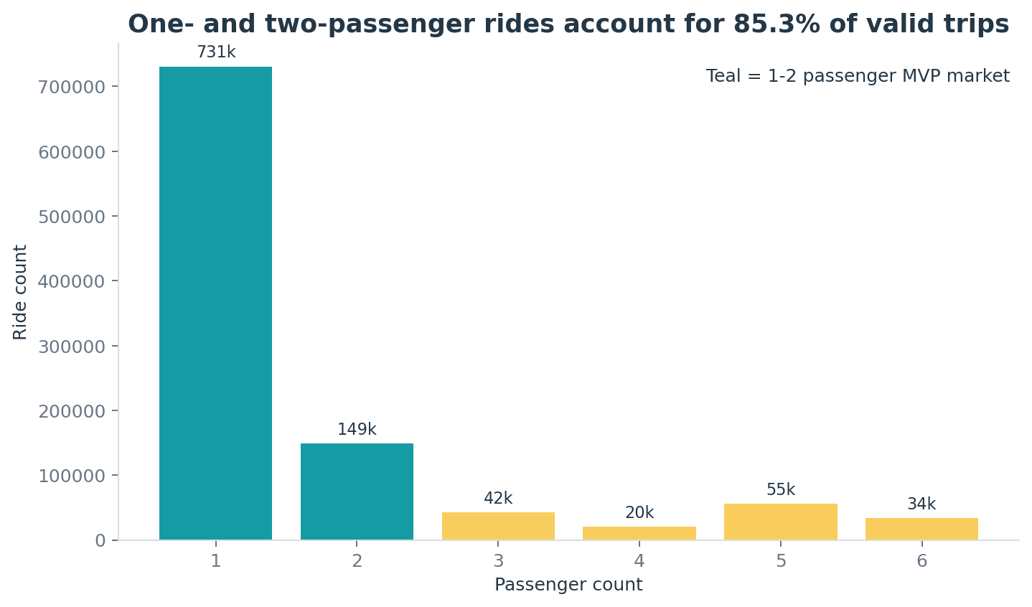
1-2 riders represent 85.3% of trips
Full-data analysis; operational-quality subset n = 1,031,441.
Notes:
[Sources]
- taxi_rides.csv
- flyber-analysis-output/passenger_counts.csv

Slide 19
For the initial MVP launch (& most likely GA), we have a finite amount of monetary resources to build Flyber pick-up / drop-off nodes. We'll need to be strategic on where we'll place them:
Which neighborhoods/zip codes tends to experience a relatively higher density of pick-ups?
Which neighborhoods/zip codes tends to experience a relatively higher density of drop-offs?
Which neighborhoods/zip codes tends to have the highest duration-to-distance ratios, based on pick-up?
Which neighborhoods/zip codes tends to have the highest duration-to-distance ratios, based on drop-off?
For any of the neighborhoods identified, are there any potential areas within the neighborhood that are optimal for flying taxi pick-up / drop-off? What makes them suitable?

Slide 20
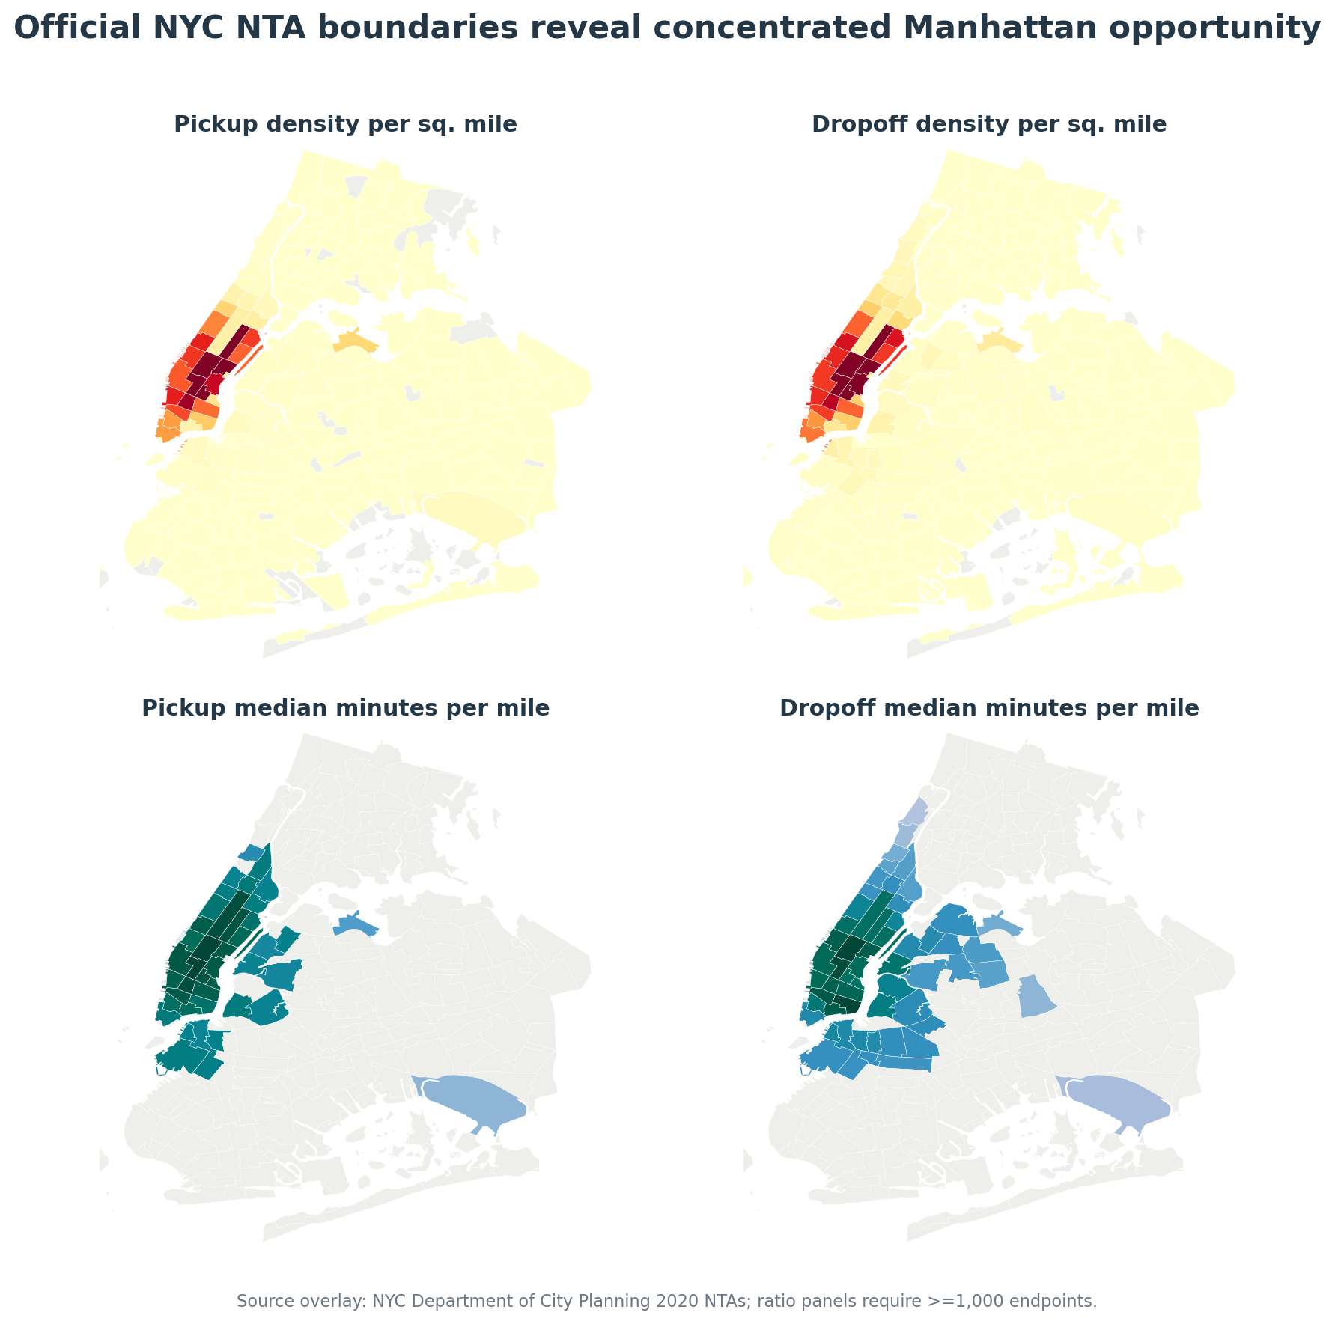
Midtown concentrates demand and delay
Midtown leads density and delay. Open Tableau Public workbook.
Notes:
[Sources]
- taxi_rides.csv
- flyber-analysis-output/pickup_neighborhoods.csv
- flyber-analysis-output/dropoff_neighborhoods.csv
- NYC NTA overlay: https://data.cityofnewyork.us/City-Government/2020-Neighborhood-Tabulation-Areas-NTAs-/9nt8-h7nd
2020 boundaries are an approximation for 2016 rides.

Slide 21
It may not make operational sense to have the service running 24/7, for now.
What times throughout the day experience relatively higher volumes of ride pick-ups?
What days throughout the week experience relatively higher volumes of ride pick-ups?
Pinpoint any periods throughout the year that experience trend fluctuation or seasonality around ride pick-up volumes. This will help us in our post-launch analyses to determine if any spikes or dips were influenced by seasonality or through actual feature adoption/regression.

Slide 22
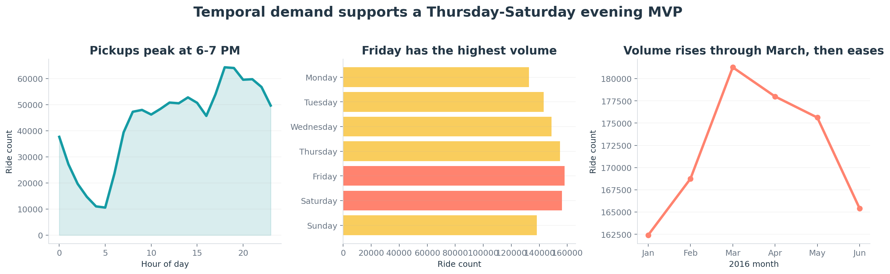
Thu-Sat evenings maximize demand
6-7 PM leads hourly volume; Friday, Saturday, and Thursday lead days.
Notes:
[Sources]
- taxi_rides.csv
- flyber-analysis-output/pickups_by_hour.csv
- flyber-analysis-output/pickups_by_day.csv
- flyber-analysis-output/pickups_by_month.csv

Slide 23
You and the user research team ran a quantitative survey on existing taxi and/or rideshare users in New York City to determine sentiment around potentially using a flying taxi service.
Dive into the survey results dataset in order to extract insights from explicit feedback.
Upload this dataset into Tableau Online or a SQL database (the classroom contains a workspace with the data for you as well).

Slide 24
Ensure the fields are parsed correctly, field headers are included in the first row of the CSV.
Question schema:
Q1 - What is your email?
Q2 - What gender do you identify as?
Q3 - What is your age?
Q4 - What is your annual income? (income bands)
Q5 - What neighborhood do you reside in?
Q6 - Do you currently use taxis? (Y/N)
Q7 - Do you currently use ridesharing services? (Y/N)
Q8 - Would you use a flying taxi service, if such a concept existed? (Y/N)
Q9 - If yes to Q8, how much would you be willing to pay per mile for such a service? (USD)
Q10 - If no to Q8, what is the reason?

Slide 25
To inform our future product marketing efforts, we'll want to extract the following:
Is there an inclination of better Flyber adoption based on gender, age, income level, or neighborhood of residence?
What is the distribution of potential price per mile based on gender, age, income level, and neighborhood of residence?
What is the different personas/segments of negative sentiment towards not using a flying taxi car service?
Please support your answers with clear, relevant visualizations.

Slide 26
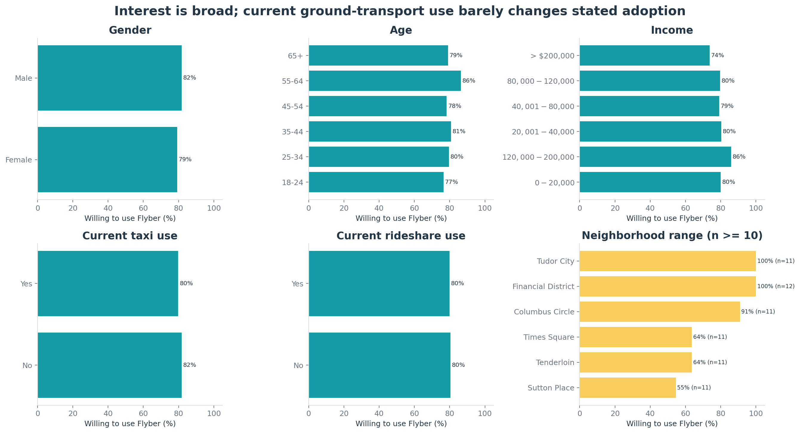
Transport use barely changes interest
Taxi: 79.8% vs 81.7%; rideshare: 80.0% vs 80.4%. Neighborhoods: n >= 10.
Notes:
[Sources]
- user-research.csv
- flyber-analysis-output/survey_adoption_segments.csv
Unweighted stated-preference survey; do not generalize directly to NYC.

Slide 27
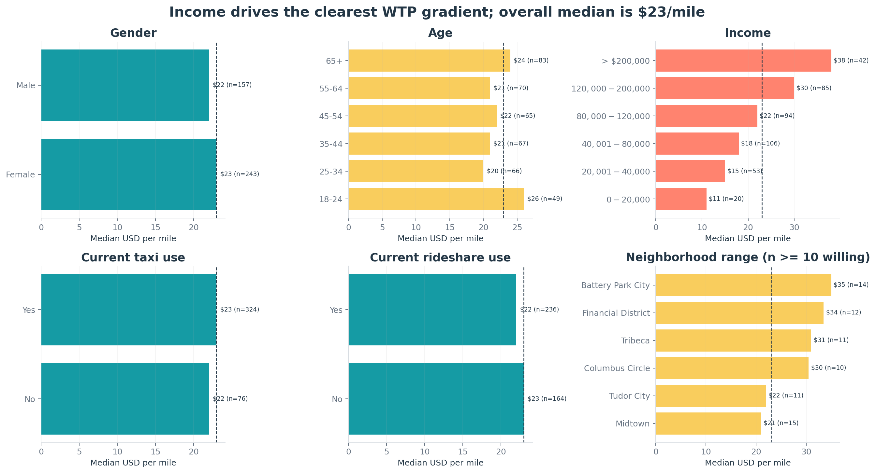
Income predicts willingness to pay
$23/mile overall; income leads differences; neighborhoods use n >= 10.
Notes:
[Sources]
- user-research.csv
- flyber-analysis-output/survey_willingness_to_pay.csv

Slide 28
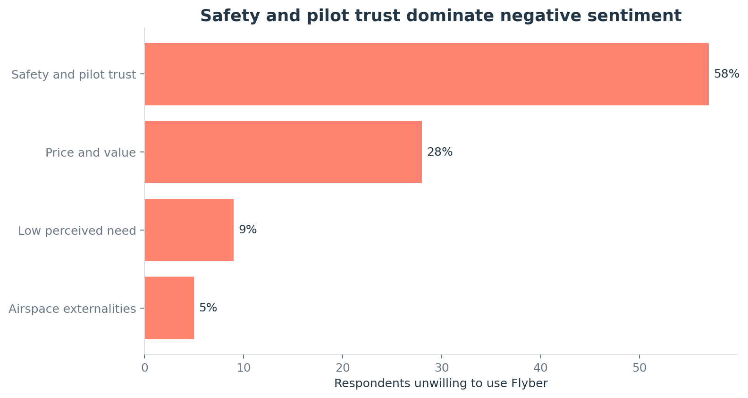
Safety drives 57.6% of objections
Negative-response segmentation: n = 99; safety and pilot trust lead.
Notes:
[Sources]
- user-research.csv
- flyber-analysis-output/survey_objections.csv

Slide 29
Hooray! End of Section 1.

Slide 30
You will complete Section 2 at the end of this course.
Please submit this file for review for Section 1.

Slide 31
Section 2: Proposal Synthesis

Slide 32
Identify a product objective for Flyber's launch. Your product objective will guide your KPIs, so identify what Flyber should optimize for. Your objective should be centered around one the following focus areas:
User Acquisition
User Engagement
User Retention
Profitability
Explain your reasoning. Include both why you feel your focus area is more relevant than the others for Flyber at this time of the product development cycle.

Slide 33
Objective: acquire qualified riders
Optimize USER ACQUISITION for time-sensitive one- and two-person trips in the four-node Manhattan/airport catchment. WHY NOW: Flyber has no installed base. Test whether 80.2% stated interest becomes completed paid rides at feasible nodes, times, and prices. ENGAGEMENT is premature before a repeatable first-use funnel; measure it diagnostically. RETENTION requires an activated cohort; track 30-day repeat as a secondary metric. PROFITABILITY follows demand and safety validation; measure cost now, but defer scale optimization.
Notes:
[Sources]
- taxi_rides.csv
- user-research.csv
- flyber-analysis-output/analysis_summary.json

Slide 34
Formulate 3-5 Key Performance Indicators (KPIs), to measure if the product is heading towards the right direction based on your objective

Slide 35
Four KPIs connect acquisition to trust
1. FIRST-RIDE CONVERSION = unique riders with trip_completed(first_ride=true) / unique eligible riders offered service. 2. ACTIVATED RIDERS = count distinct rider_id with a first trip_completed event, reported per week and cumulatively. 3. FIXED-PRICE BOOKING RATE = booking_confirmed / quote_shown where quoted_price = $20/mile and minimum = $60. 4. COMPLETION RATE = trip_completed / booking_confirmed; serious incidents = count distinct incident_id at severity >= serious. Diagnostics: CAC = acquisition spend / activated riders; 30-day repeat = activated riders with another trip_completed within 30 days / eligible activated riders.
Notes:
[Sources]
- Supplied PowerPoint template, KPI requirements

Slide 36
Create hypotheses around what thresholds your KPIs would need to hit in order to determine success

Slide 37
Growth must pass a safety gate
H1: first-ride conversion >= 25%. This realizes 31.2% of the survey's 80.2% stated interest and remains deliberately conservative. H2: 500 activations in 12 weeks = 2,000 prospects x 25% conversion. H3: fixed-price booking rate >= 50%. The $20/mile offer is below the $23/mile median among willing respondents. GATE: completion >= 95% and zero serious incidents. Zero observed incidents is a stop/go guardrail, not proof of safety. LEARN: report CAC and 30-day repeat, but do not claim unsupported pre-launch baselines for either measure.
Notes:
[Sources]
- Supplied PowerPoint template, KPI-threshold requirements

Slide 38
As the product manager, you make decisions based on the insights you extract, we'll need to know the feature set we'll include in the MVP to measure viability, while keeping operational expenditure under control:
What times/days of operation should the service run for?
How many pick-up / drop-off nodes should we have?
Where should the nodes be located?
Should we initially use copters or homegrown hardware?
Should the pricing be fixed or dynamic? At what rates?

Slide 39
A four-node, fixed-price MVP limits risk
WHEN: Thursday-Saturday, 5-11 PM; demand peaks at 6-7 PM and stays high through 10 PM. NODES: East 34th Street, West 30th Street, Downtown/Pier 6, and LaGuardia connect key Manhattan demand to airport access. AIRCRAFT: use contracted, certified copters and operators; defer homegrown hardware so the MVP tests demand rather than aircraft development. PRICING: fixed $20/mile with a $60 minimum and no surge; defer dynamic pricing. The rate is below the $23/mile median among willing respondents. GATES: permits, weather, airspace, noise, accessibility, insurance, community acceptance, and unit economics.
Notes:
[Sources]
- flyber-analysis-output/analysis_summary.json
- NYC heliport context: https://council.nyc.gov/data/helicopter-noise-and-safety/
- Historical taxi fare basis: https://www.nyc.gov/assets/tlc/downloads/pdf/taxi_information.pdf

Slide 40
Determine the MVP sample size & time period allotted estimated to come to a conclusion on your hypotheses.

Slide 41
Power and capacity support 12 weeks
POWER: Optimizely inputs are 20% baseline, 25% relative MDE (20% to 25%), and 95% significance. RESULT: 670 prospects per variation, or 1,340 total. Recruit 2,000 (1,000 each) to exceed the minimum and preserve node/day strata. CAPACITY: 28 completed rides per operating day; reserve half for first rides = 14 activations/day, three days/week. DURATION: 500 target activations / (14 per day x 3 days/week) = 11.9 weeks; round to 12. This yields about 1,000 total rides. DECISION: review safety weekly; evaluate at weeks 4, 8, and 12; preserve 30-day follow-up for early cohorts.
Notes:
[Sources]
- Optimizely A/B Test Sample Size Calculator: https://www.optimizely.com/tools/sample-size-calculator
- Calculator checked 2026-08-07: baseline 20%, relative MDE 25%, significance 95%, result 670 prospects per variation
- Capacity and duration are planning assumptions, not observed Flyber operating results.

Slide 42
Create an instrumentation plan for the events you need collected and logged, in order to be able to physically measure your KPIs.

Slide 43
KPI events and formulas are auditable
TRIGGERS: eligibility_viewed on offer; quote_shown on price; booking_confirmed on payment; trip_completed on arrival; incident_logged on safety review. FORMULAS: first-ride conversion = distinct first-time completers / distinct eligible offers; fixed-price booking = confirmations / $20/mile quotes; activations = distinct first-time completers. GATES: completion = completed trips / confirmed bookings; incidents = distinct serious incident_id. DATA: event, rider, trip, cohort, node, aircraft/operator, schema, time, price, distance, status, source, and consent. Log cancellation, delay, no-show, refund, and survey; minimize PII and test completeness/duplicates.
Notes:
[Sources]
- Supplied PowerPoint template, instrumentation requirement

Slide 44
Create a qualitative feedback survey questions for users after their ride, to further understand and optimize the product for future iterations.

Slide 45
Post-ride feedback explains the metrics
MECHANIC: send within 15 minutes of arrival; mobile form under three minutes; optional interview follow-up; link by survey_id to trip and cohort, not free-text identity. 1. How likely are you to ride Flyber again in the next 30 days? 0 (not at all) to 10 (extremely likely). Why? 2. Did anything go wrong? Select all: safety concern, delay, cancellation, node access, booking/payment, comfort, price, accessibility, other. Describe the most important issue. 3. Rate safety/trust, node access, travel time, price/value, and support from 1 (poor) to 5 (excellent). 4. Which should Flyber improve or launch next? Rank: more nodes, longer hours, lower/flexible price, booking changes, comfort, accessibility, disruption support. 5. What single change would most increase your likelihood of riding again?
Notes:
[Sources]
- Supplied PowerPoint template, qualitative-feedback requirement

Slide 46
Summarize everything you have learned into your final proposal
Identify the target population. Why did you select that target population? What are their pain points?
Create a product proposal containing claim, evidence, estimated impact, and risks
Claims should be backed by quantitative evidence, impact should assess market needs/benefits
Risks involve any known unknowns that we'll still need to monitor post-launch
State cross-functional stakeholder teams that will need to be involved

Slide 47
Target slow, time-sensitive short trips
TARGET: adults making one- or two-person, time-sensitive trips near Midtown, Lower Manhattan, and LaGuardia during Thursday-Saturday evenings. WHY: 85.3% of valid taxi rides carry 1-2 passengers; Midtown NTAs lead endpoint density and minutes-per-mile; 80.2% of valid survey responses state interest. PAIN: unpredictable road delay, missed connections, surge/cancellation uncertainty, and poor time reliability on short congested routes. SEGMENTATION: prioritize observed trip context and proximity to nodes, not demographic stereotypes. The survey is unweighted and measures stated preference.
Notes:
[Sources]
- taxi_rides.csv
- user-research.csv
- flyber-analysis-output/analysis_summary.json

Slide 48
Proposal: test four nodes for 12 weeks
CLAIM: four-node evening service at fixed $20/mile can convert high-friction Manhattan/airport trips into paid first rides. EVIDENCE: 85.3% one- or two-rider share; Midtown density/delay; 80.2% interest; $23/mile median willingness to pay. IMPACT: recruit 2,000 prospects, activate 500 riders, and complete about 1,000 rides while measuring conversion, completion, and safety. KNOWN UNKNOWNS: conversion, capacity, repeat demand, unit margin, permits, weather, accessibility, noise response, and serious-event risk. RISK: failure could waste capital or harm safety and trust; success establishes bounded demand evidence. Scale only if all gates pass.
Notes:
[Sources]
- flyber-analysis-output/analysis_summary.json
- NYC heliport context: https://council.nyc.gov/data/helicopter-noise-and-safety/

Slide 49
Cross-functional ownership is explicit
PRODUCT + RESEARCH: objective, experiment design, eligibility, post-ride learning, and roadmap. DATA + ENGINEERING: schemas, instrumentation, identity, dashboards, QA, privacy, booking, payments, and reliability. FLIGHT OPS + SAFETY: operator qualification, dispatch, weather, aircraft readiness, incident command, and stop-work authority. LEGAL + REGULATORY + SECURITY: permits, insurance, accessibility, privacy, cyber risk, and agency coordination. COMMERCIAL + COMMUNITY: unit economics, contracts, node operators, acquisition, support, service recovery, noise engagement, and public trust.
Notes:
[Sources]
- Supplied PowerPoint template, final-proposal stakeholder requirement

Slide 50
Interactive Tableau workbook
Explore the full enriched taxi dataset through the published pickup-opportunity map. TABLEAU PUBLIC VIEW: https://public.tableau.com/app/profile/christopher.ohara/viz/FlyberMVPLaunchStrategy_17861346231600/PickupOpportunityMap#1 Select map marks or neighborhood legend entries to inspect the NYC pickup geography interactively.
Notes:
[Sources]
- Published Tableau Public workbook: https://public.tableau.com/app/profile/christopher.ohara/viz/FlyberMVPLaunchStrategy_17861346231600/PickupOpportunityMap#1

