Slide 1

Monetization Strategy
Priceless Penny

Slide 2

Part One:
Original Pricing Scheme

Slide 3
Product Description
The product offered by the company is online learning in the domains of recreational and professional development. It targets individuals looking to provide employees with professional and recreational development.
Classes only start on the first of the month.
Learners can choose between three paid tiers: Basic, Professional, and Premium.
Learners can’t change their subscription during the month; they can only request the change that will take effect at the beginning of the following month (even cancellations).
Learners pay each month, and their payment is deducted on the first day of their month when they start/continue learning.
Free-tier learners do not cancel their accounts; they just stop using the platform.

Slide 4
Acquisition channels
The company has two acquisition channels:
Paid search: The company is not focused on optimizing its campaigns, which results in an increasing cost of CPC
Paid referral: All learners can refer their friends, even if they are not paying customers. If they sign up for a paid plan, then both learners are instantly paid a referral bonus of 50$.

Slide 5
Calculate the models
You need to create the models by calculating the missing data in the Priceless Penny Project spreadsheet. It already contains all the starter data that you will need. During your work, please pay attention to the following parts from the briefing:
Customers change their status during a month (upgrade/downgrade/cancel), but it only takes effect at the beginning of the following month.
Customers only pay when they start the class.
Because no change happens during the month, the total revenue calculation does not include expansion or contraction.
All active learners can send referral emails. The referral cost is incurred as soon as the referral signs up.
The "Fixed Values" column contains the values you should use every month.
Do not change any provided (blue) value except for the last part of the project.
All the cells you need to calculate are highlighted, but if you think you need any additional ones, feel free to add them.
Do not use any rounding in your calculations, not even for the number of students.

Slide 6
Tips for the calculations
Use the $ sign to fix the column or the row in a formula.
Some inputs for a given month might come from the previous month.
Once you have a formula for a row, you can copy it to all the other columns in the row, even if the input has not been filled in for all the months yet.

Slide 7
Order of the calculations
Some calculation results serve as an input to others. You can do the calculations in any order you like, but if you need some help, the steps below are the ones we would follow.
Acquisition during the month - Paid Referral
Acquisition during the month - Paid Search
Non-Paying Learners - Growth Accounting
Plan Upsell
Plan Downgrade
Plan Cancellation
Plan Change Requests by Existing Customers During the Month
Paying Learners Starting - Growth Accounting
Revenue Accounting
Cost of Goods Sale
Gross margin
Operating Expenses
Operating Margin

Slide 8
Check your calculations
After the December 2024 column, you will find one named "Value checker". It is, by default, red, but if you fill out the row with the correct values, it will turn green. Use this indicator to ensure that your numbers for the row are correct.
It only checks the December 2024 value; therefore, it will only work once the whole row is filled with the final data. You mustn't round any numbers in your calculations, as the checker would not work with that.

Slide 9
Part Two:
Insights from the data

Slide 10
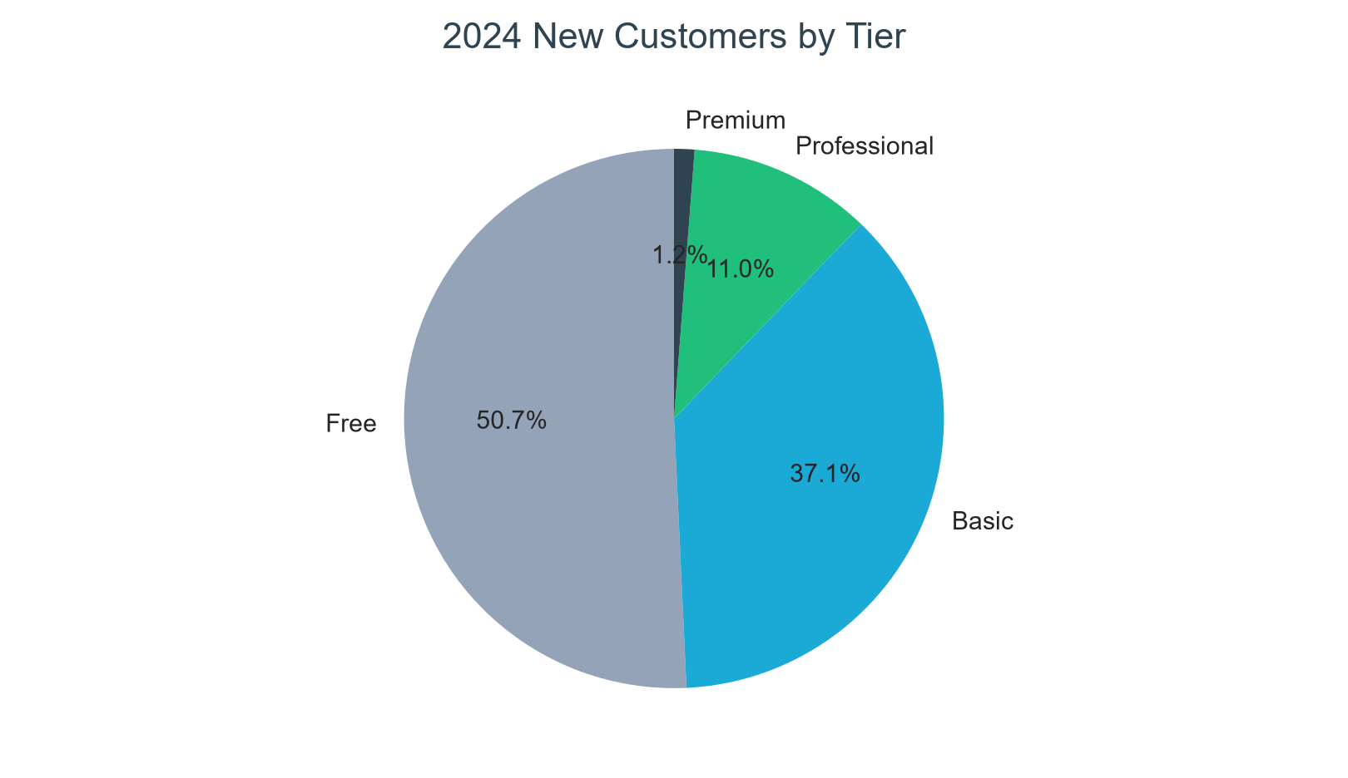
Customer Sign Ups in 2024
Free-tier sign-ups make up the majority of new customers in 2024. Among paid plans, Basic is the largest entry tier, followed by Professional and Premium.

Slide 11
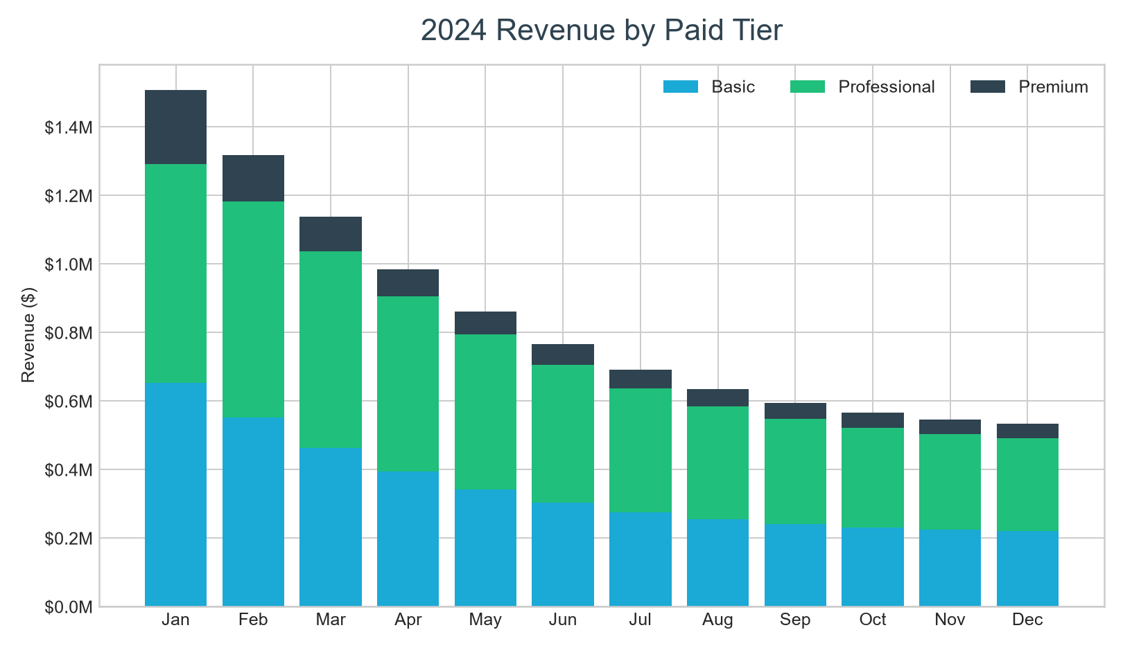
Revenue from different tiers in 2024
Revenue is led by the Professional and Basic plans. The paid-tier mix shows why retaining and upgrading learners is essential as acquisition spending increases.

Slide 12
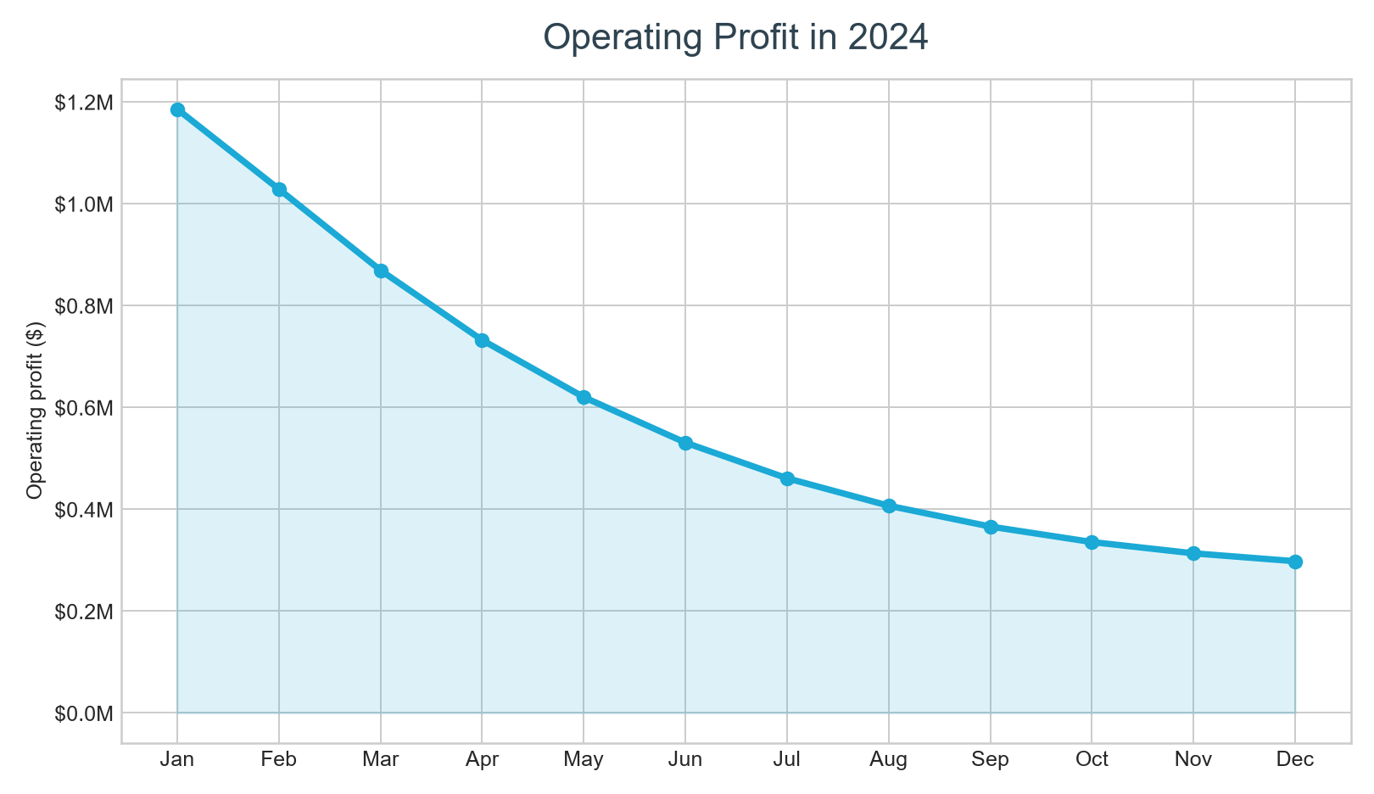
Operating Profit in 2024
Operating profit declines over 2024 as the paid customer base contracts while advertising spend rises. Retention and upsell conversion therefore offer the clearest profit levers.

Slide 13
Part Three:
Recommendations

Slide 14
Recommendation 1
Reduce Professional cancellation-start rate from 45% to 35%.
Professional-plan cancellation is the largest modeled churn pressure. Improve cancellation saves through proactive success outreach, annual-plan offers, and targeted product support; this is a feasible 10-point reduction in starts, while all other assumptions remain unchanged.
Yearly Original Operating Profit in 2024 |  | $7,147,817
Yearly Operating Profit in 2024 if recommendation implemented |  | $8,379,885
Operating profit increase |  | 17.2%

Slide 15
Recommendation 2
Raise the Basic-to-Professional upsell conversion from 40% to 50%.
Basic is the largest paid cohort, so a focused value-messaging and upgrade-path experiment can increase conversion to Professional. The scenario changes only the Basic upsell conversion and keeps pricing, acquisition, and cancellation assumptions unchanged.
Yearly Original Operating Profit in 2024 |  | $7,147,817
Yearly Operating Profit in 2024 if recommendation implemented |  | $7,313,062
Operating profit increase |  | 2.3%

Slide 16
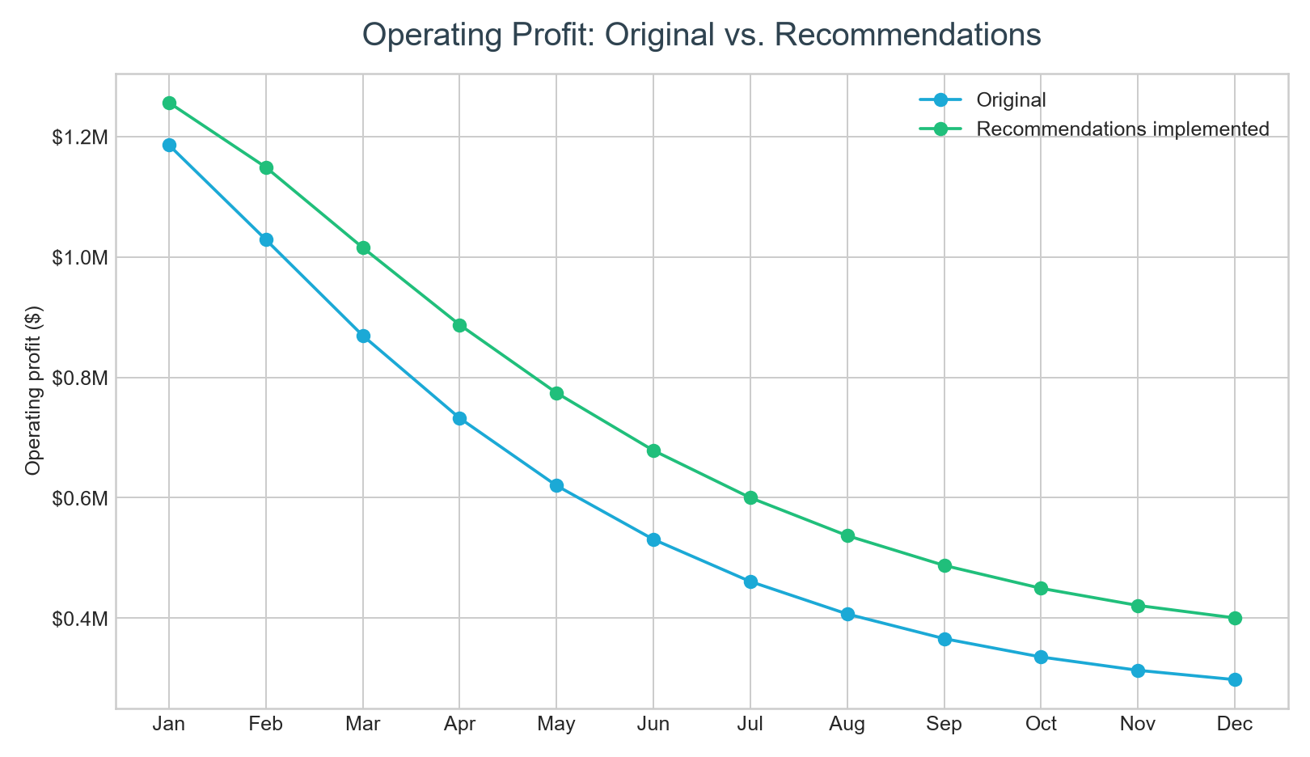
Operating Profit in 2024 with recommendations
The combined scenario improves operating profit throughout the year by retaining more Professional learners and converting more Basic learners to Professional.

