Slide 1
Object Oriented Programming
Subject Code: MCA 4121

Slide 2
Course Outcomes:
At the end of the program the student must be able to:
Describe and differentiate the procedural and object oriented paradigm with concepts of data types, streams, classes, functions, data and objects. Understand and implement the OOP idea of data hiding, abstraction, encapsulation and polymorphism, reference arguments, static members, pointers.
Identifying and utilizing the concepts of constructors, destructors, function overloading, operator overloading and dynamic memory management operators.
Classify inheritance with the understanding of early and late binding, usage of virtual base classes, virtual functions.
Explain and use the concept of files, exception handling, generic programming.
To demonstrate usage of three entities of STL: containers, algorithms and iterators.

Slide 3
Text Books:
  Robert Lafore, “Object Oriented Programming in C++”, 4th Edition, Galgotia Publications Pvt.
Reference Books:
  Deitel & Deitel, “C++ - How to program”, Prentice Hall.
  K R Venugopal, Rajkumar, T Ravishankar, “Mastering C++”, Tata McGrawHill, 2005.
  Herbert Schildt, “The Complete Reference- C++”, Tata McGraw Hill, 2000.
  Stanley B Lippman, Josee Lajoie and Barbara E Moo “C++ Primer”, 5th Edition, 2012.

Slide 4
Websites
A C++ online tutorial:
http://www.cplusplus.com/doc/tutorial/
The C++ FAQ:
http://www.parashift.com/c++-faq-lite
The homepage of Bjarne Stroustrup, the inventor of C++:
https://www.stroustrup.com/C++.html
And many, many more!

Slide 5
Mode of Evaluation – Theory
Internal Assessment
  Mid-semester exam two hour duration 30 marks
  Sum of scores from 4 assignments(4*5) = 20 marks
  Total Internal semester marks: 30 + 20 = 50
End Semester Assessment
  3 hour paper with weightage of 50 marks
Total Assessment = 50 (internal)+50(end semester) = 100 marks

Slide 6
Mode of evaluation – Laboratory
Continuous evaluation = 60 marks (Internal)
  4 evaluations : 10 x 4 = 40 *
5th evaluation for project : 10
Lab Test : 10
---------------------------------------------------------------------
Total : 60
* Evaluation of 10 marks (Observation Book=4 marks, Execution=3 marks & Viva = 3 marks)
End Semester Exam=40 marks
2 questions of 25 and 15 marks = 40 marks
Change of question NOT allowed.
Total : 60 + 40 = 100 marks

Slide 7
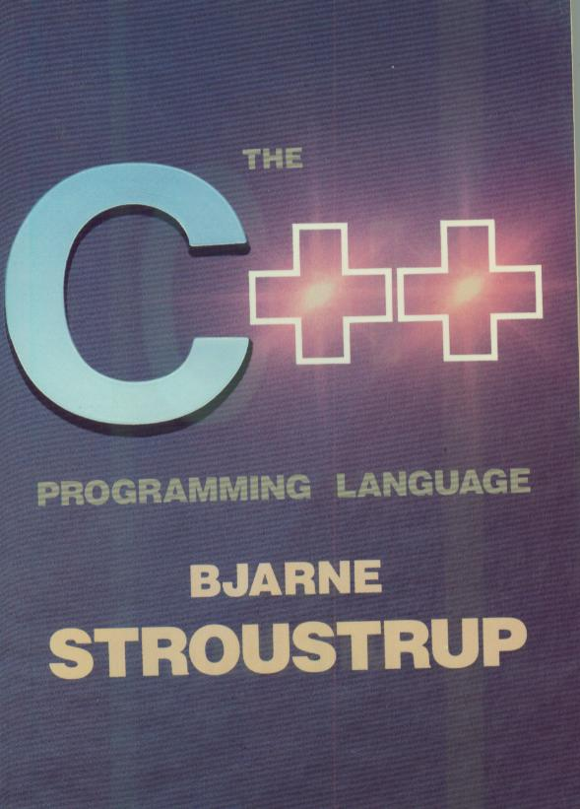
Historical Notes
C++ owes most to C.
Other ancestors are Simula67 and Algol68.
First versions of C++ in 1980 under the name “C with classes”. Since 1983 the name C++ is used.
1990: ANSI/ISO 9899 defines a standard for C
1998: ISO/IEC 14882 specifies the standard for C++
2003: Minor revision
2011: Major update, C++11
Current standard is C++14

Slide 8
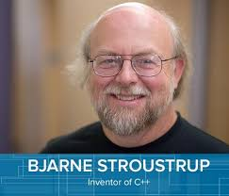
C++ and C
C is a subset of C++.
Advantages: Existing C libraries can be used, efficient code can be generated.
is a better C
supports data abstraction
supports object-oriented programming
supports generic programming

Slide 9

C++ and Java
Java is a full object oriented language, all code has to go into classes.
C++ - in contrast - is a hybrid language, capable both of functional and object oriented programming.
So, C++ is more powerful but also
more difficult to handle than Java.

Slide 10
Compiling C++ programs on Linux
Use
#include <iostream>
using namespace std;
Use .cpp as extension eg: prg1.cpp
Use the following compile command
g++ prg1.cpp
To run the program: ./a.out
Notes:
Instructor:
On our system we should be employing the ANSI standard libraries with the correct compile command.
#include <iostream> and using namespace std;
To use these, the usual compile command will not work. We need to use the one shown here.

Slide 11
Other Editors
Turbo C++
Borland C++
DevC++
  http://www.bloodshed.net/dev/devcpp.html
Sublime
Code blocks
Microsoft Visual C++

Slide 12
Program Hello
// This program outputs the message
//
// Hello!
//
// to the screen
#include <iostream>
using namespace std;
int main() {
cout <<"Hello!"<< endl;
return 0;
}

Slide 13
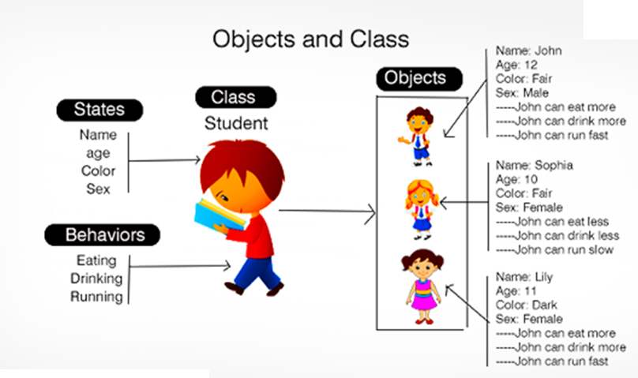

Slide 14
Classes
The entire set of data and code of an object can be made a user defined data type with the help of a class.
Objects are variables of the type class.
Once a class has been defined, we can create any number of objects belonging to that class.
Classes are user defined data types and behave like the built-in types of a programming language.
Internal data of a class – member data
Internal functions of a class – member functions

Slide 15
Namespaces -1
Almost all compilers allow the use of the traditional header files
ANSI standard has completely redesigned these libraries using templates features
All functions and variables are declared under the namespace “std”
the new names for these “headers” are basically the same for C++, but without the “.h”

Slide 16
Namespaces
Namespaces are used to prevent name conflicts
Namespace std is used routinely to cover the standard C++ definitions, declarations, and so on for standard C++ library
The using directive is equivalent to using a declaration for each item in a namespace

Slide 17
Header Files
Header files are used for declarations
Header files can be included for using their corresponding .cpp files
Header files can be included in a nested structure
Standard C header files have been renamed and placed in namespaces
  e.g. <cstdlib>, <cctype>,<cstdio> etc.

Slide 18
Keyboard & Screen I/O in C++
It is perfectly valid to use the same I/O statements in C++ as in C -- The very same printf, scanf, and other stdio.h functions that have been used until now.
However, C++ provides an alternative with the new stream input/output features.
#include <iostream> // No “.h” on std headers
using namespace std; // To avoid things like
// std::cout and std::cin
  cin // Used for keyboard input (std::cin)
  cout // Used for screen output (std::cout)
Notes:
Instructor notes:
We now begin the migration from I/O in C to I/O in C++. A reminder that because C++ is a superset of C, all of the I/O functions that we have been using, such as printf and scanf which are found in the stdio.h header file, are still valid in C++.
C++ does provide alternative means of performing I/O on streams using the iostream header file. To take advantage of these stream I/O features we will need to include the iostream header file as described on this slide. To be completely ANSI compliant, we should also indicate that we are using the standard namespace “std” by including using namespace std; A namespace is a way of dividing the global space into subsections so that there are not conflicts with variables of the same name. Obviously this would be more of a problem on a very large project with many people writing software. All of the standard functions have been set up inside of the namespace “std”. If we do not declare that we are using the std namespace, then technically when we use any of the functions, such as cout and cin, we should prefix them with std:: to indicate that they come from the standard namespace. By indicating that we are using the standard namespace, we can use these functions without the prefix. Many compilers will allow us to get away with using the non-prefixed functions without having declared that we are using the standard namespace, but in a strictly ANSI compliant sense, we should indicate that we are using the standard namespace.

Slide 19
Keyboard & Screen I/O in C++
Several new I/O objects available when you include the iostream header file. Two important ones are:
  cin // Used for keyboard input (std::cin)
  cout // Used for screen output (std::cout)
Both cin and cout can be combined with other member functions for a wide variety of special I/O capabilities in program applications.
Notes:
Instructor notes:
Using the iostream header file in C++ makes available several new I/O objects. Two of the most common are cin and cout. To reemphasize, in a strict ANSI sense we should refer to them as std::cin and std::cout unless we have indicated that we are using the standard namespace with using namespace std; cin is used for keyboard input and cout is used for screen output.
cin and cout are both objects in C++. They each also have member functions that make it possible to perform a variety of special I/O functions in addition to simple input and output.

Slide 20
Keyboard & Screen I/O in C++
Since cin and cout are C++ objects, they are somewhat "intelligent":
  They do not require the usual format strings and conversion specifications.
  They do automatically know what data types are involved.
  They do not need the address operator, &.
  They do require the use of the stream extraction ( >> ) and insertion ( << ) operators.
The next slide shows an example of the use of cin and cout.
Notes:
Instructor notes:
Because cin and cout are objects in C++ they have some built in “intelligence”. Effectively they can see the “signature” of the value or variable that is being input or output and based on this signature cin and cout can process the information without the use of the usual format strings and conversion specifiers that are needed in C. cin and cout are able to look at the signature of the data and automatically know the data’s type. Often times one of the operators that is most easily missed in C is the address operator, &, which if frequently used with the scanf function. Fortunately in C++ the address operator is not required. cout and cin do require the use of the extraction and insertion operators.

Slide 21




What else are we doing today?
Introduction of:
  Objects
  Basic Terminology
  C++ Concepts
Notes:
Marc Conrad
University of Luton

Slide 22
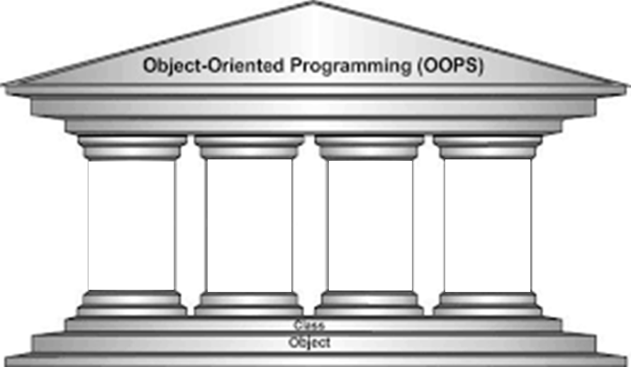
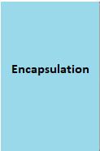
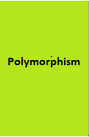

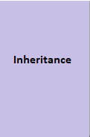
Object Oriented Programming Concepts
Source: Wattpad.com

Slide 23


Encapuslation
Class
Functions/Methods
Data/Variables

Slide 24
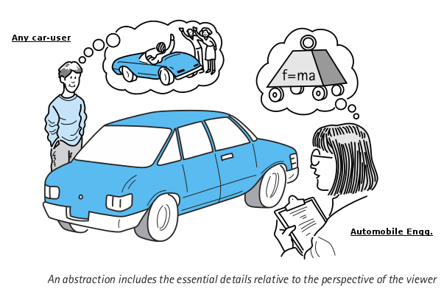
Abstraction

Slide 25
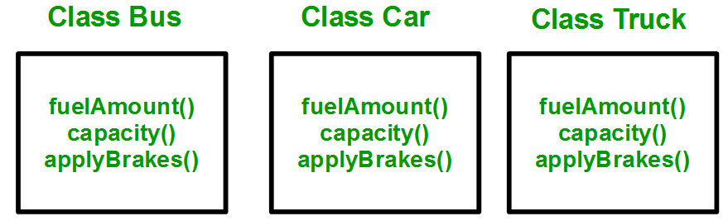
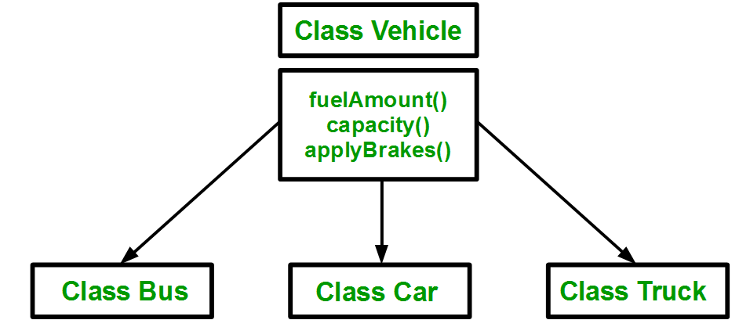
Inheritance
    Process by which one object acquires the properties of another object

Slide 26
Polymorphism
Polymorphism means the ability to take more than one form. The behavior depends upon the types of data used in the operation.
This is something similar to a particular word having several different meanings depending on the context.
Shape
Draw( )
Circle: object
Box: object
Triangle:object
Draw(circle)
Draw(box)
Draw(triangle)

Slide 27
Procedure Oriented Programming
Emphasis is on doing things (algorithms/ procedures).
Large programs are divided into smaller programs known as functions.
Most of the functions share global data.
Data moves openly around the system from function to function.
Uses top-down approach in program design.

Slide 28
Functional Programming
Global
Data
Function C
Main
Function
Function B
Function A
Notes:
3

Slide 29
Object Oriented Programming
Emphasis is on data rather than procedure.
Programs are divided into what are known as objects.
Data is hidden and cannot be accessed by external functions.
Functions that operate on the data of an object are tied together in the data structure.
Objects may communicate with each other through functions.
Follows bottom-up approach in program design

Slide 30
Object-Oriented Programming
Object A
Object B
Objects as
“Reusable Software
Components”
Data
Data
Function
Function
Function
Function
Object C
Data
Main
Function
Function
Function
Notes:
4

Slide 31
Concepts of Object Oriented Programming
Objects
Classes
Data abstraction and encapsulation
Inheritance
Polymorphism
Dynamic binding
Message passing

Slide 32
Objects
An object is like a black box.
The internal details are hidden.
Objects are the basic run-time entities in an object oriented system.
They may represent a place, a bank account, a table of data or any item that the program has to handle.
When a program is executed, the objects interact by sending messages to one another. For example, if “customer” and “account” are two objects in a program, then the customer object may send a message to the account object requesting for the bank balance.
Each object contains data, and code to manipulate the data.

Slide 33
Reminder Pop Quiz!
Objects have:
  Both attributes and behaviour
  Only attributes
  Only behaviour
  Attributes often, behaviour less often

Slide 34
Reminder Pop Quiz!
Which of the following are objects?
  Salesperson
  A dictionary
  Points on a plane
  Cars in an auto race
  Keyboard
  Country

Slide 35
Classes
The entire set of data and code of an object can be made a user defined data type with the help of a class.
Objects are variables of the type class.
Once a class has been defined, we can create any number of objects belonging to that class.
Classes are user defined data types and behave like the built-in types of a programming language.
Internal data of a class – member data
Internal functions of a class – member functions

Slide 36
Example: The Person class
#include<string>
#include<iostream>
class Person{
char name[20];
int yearOfBirth;
public:
void displayDetails() {
cout << name << " born in "
<< yearOfBirth << endl;
}
//...
};
private
data
public
members

Slide 37
Data Encapsulation
The wrapping of data and functions into a single unit (called class) is known as encapsulation.
The data is not accessible to the outside world, and only those functions which wrapped in the class can access it.
These functions provide the interface between the object’s data and the program.
This insulation of the data from direct access by the program is called data hiding or information hiding.

Slide 38
Data Abstraction
This refers to the act of representing essential features without including the background details or explanations.
Classes use the concept of abstraction.
They encapsulate all the essential properties of the objects that are to be created.

Slide 39
What is Abstraction?
Not saying Which salesperson – just a salesperson in general!!!
Salesperson
Product
Customer
Manages Complexity
Notes:
39
Discuss what makes a good abstraction with the students:
Concise,
Represents a single coherent concept,
etc.

Slide 40
Inheritance
Inheritance is the process by which objects of one class acquire the properties of another class. It supports the concept of hierarchical classification.
In OOP, the concept of inheritance provides the idea of reusability.
This means that we can add additional features to an existing class without modifying it.
This is possible by deriving a new class from the existing one. (Base class and derived class)
The new class will have the combined features of both the classes.

Slide 41




Inheritance
Common behaviors:
React
ReactiveSubstance
Behaviors:
React
ReactiveSubstance
Behaviors:
React
ReactiveSubstance
Behaviors:
React
ReactiveSubstance
Notes:
We have 3 objects, all with the same behaviors. Instead of implementing similar function 3 times we <click> move the similar function to an ancestor class

Slide 42
Polymorphism
Polymorphism means the ability to take more than one form. The behavior depends upon the types of data used in the operation.
This is something similar to a particular word having several different meanings depending on the context.
Shape
Draw( )
Circle: object
Box: object
Triangle:object
Draw(circle)
Draw(box)
Draw(triangle)

Slide 43
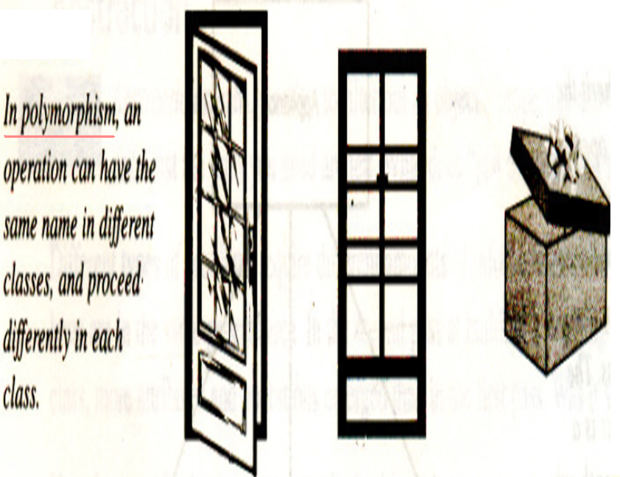

Slide 44
Dynamic binding & Message passing
Dynamic binding: Code associated with a given procedure call is not known until the time of the call at run time.
  It is associated with polymorphism and inheritance.
Message Passing
  An object oriented program consists of a set of objects that communicate with each other.
  The process of programming in an object oriented language, therefore, involves the following basic steps:
    Creating classes that define objects and their behavior,
    Creating objects from class definitions, and
    Establishing communication among objects

Slide 45
Message Passing
Objects communicate with one another by sending and receiving information much the same way as people pass messages to one another.
A message for an object is a request for execution of a procedure, and therefore will invoke a function (procedure) in the receiving object that generates the desired result.
Message passing involves specifying the name of the object, the name of the function (message) and the information to be sent.
Ex:- employee.cal_salary(name);

Slide 46
Benefits of Object Oriented Programming
Through inheritance, we can eliminate redundant code and extend the use of existing classes.
The principle of data hiding helps the programmer to build secure programs that cannot be invaded by code in other parts of the program.
It is possible to map objects in the problem domain to those in the program.
It is easy to partition the work in a project based on objects.
Object oriented systems can be easily upgraded from small to large systems.
Software complexity can be easily managed

Slide 47
Applications written in C++
Apple OS and iPod user interface
Google file system, Google chromium
Mozilla Firefox & email client thunderbird
Symbian OS
Win 95, 98, XP, IE, Visual Studio, SQL
WinAmp media Player
Adobe systems: Photoshop, Illustrator
Alias system: Maya
Amadeus: in excess of 5000 transactions per second, 200000 terminals connected, 24/7 operations. All Unix based-server apps completely in C++
http://www.stroustrup.com/applications.html

Slide 48
General form of a class declaration
class class_name
{
private:
variable declarations;
function declarations;
public:
variable declarations;
function declarations;
};
The private class numbers can only be accessed from within the class.
The public class numbers can be accessed from outside the class also.
By default, the members of a class are private.

Slide 49
A simple class example
class item
{
int number;
float cost;
public:
void getdata(int a, float b);
void putdata(void);
};

Slide 50
Creating Objects
item x,y,z;
// x,y and z are objects of type item.
The class specification provides only a template & does not create any memory space for the objects.
The declaration of an object is similar to that of a variable of any basic type.
The necessary memory space is allocated to an object at this stage.

Slide 51
Accessing Class Members
Format for calling a member function:
object-name.function-name(actual-arguments);
Ex:- x.getdata(100,75.5);
This statements assigns 100 to number and 75.5 to cost of the object x.
A member function can be invoked only by using an object.
getdata(100,75.5); //illegal
number (declared private) can be accessed only through a member function.
x. number=100; // illegal

Slide 52
Defining Member functions
Outside the class definition
The general form -
    return-type class-name:: function-name (argument declaration)
    {
    Function body
    }
The membership label class name :: tells the compiler that the function function-name belongs to the class class-name.
The symbol :: is called the scope resolution operator.
Member functions can also be defined inside the class definition

Slide 53
A C++ program with a class
class student
{
char name[30];
int rollno;
public:
void getdata(char a[ ],int n)
{
strcpy(name,a);
rollno=n;
}
void putdata( );
};
void student::putdata( )
{
cout<<“Name:”<<name;
cout<<“Roll No:”<<rollno;
}

Slide 54
Program continued………..
void main( )
{
student s1;
char name1[20];
int roll1;
cout<<“Enter name”<<endl;
cin>>name1;
cout<<“Enter roll no”<<endl;
cin>>roll1;
s1.getdata(name1,roll1);
s1.putdata( );
}

Slide 55
Nesting of Member functions
A member function can call another member function directly, without using the dot operator.
class set
{
int m, n;
public:
void input( );
void display( );
int largest( );
};
int set::largest( )
{
if(m>=n) return m;
else return n;
}

Slide 56
void set::input( )
{
cout<<“Enter values for m and n”<< endl;
cin >> m >> n;
}
void set::display ( )
{
cout<<“largest value=“<<largest( );
}
void main( )
{
set A;
A.input( );
A.display( );
}

Slide 57
Sorting an array using classes
const int size=10;
class array
{
int a[size];
public:
void setval( );
void display( );
void sort( );
};
int i ,j, temp;
void array :: setval( )
{
cout<<“enter 10 values”;
for (i=0; i<size; i++)
cin >> a[i];
cout<< endl;
}
void array::sort(void)
{
for(i=0;i<size-1;i++)
for(j=i+1;j<size ;j++)
if(a[i]>a[j])
{
temp=a[i];
a[i]=a[j];
a[j]=temp;
}
}
void array :: display( )
{
for(i=0; i<size; i++)
cout<<a[i]<<“ ”;
cout<<endl;
}

Slide 58
void main( )
{
array obj1;
objl. setval( );
cout<<“original array”<<endl;
objl.display( );
objl.sort( );
cout<<“sorted array”<< endl;
objl.display( );
getch( );
}

