Slide 1
Loops & Decisions

Slide 2
The “if” condition
General format:
  if (test expression)
  {
  statement-block;
  }
  statement-x;
// demonstrates IF statement
#include <iostream>
using namespace std;
int main()
{
  int x;
  cout << “Enter a number: “;
  cin >> x;
  if( x > 100 )
  cout << “That number is greater than 100\n”;
  return 0;
}

Slide 3
Flow of Control of Simple if statement
Entry
Example: ………..
…………
if (salary >10000)
{
salary= salary + commission;
cout<<salary;
}
cout<<“end”;
……..
test
expression
?
True
statement-block
False
statement -x
Next statement
Notes:
3

Slide 4
Variations of if statement
Simple if
if…else
Nested if…else
else if ladder

Slide 5
If – else
Entry
test
expression
?
General form
if (test expression)
{
True block statement(s);
}
else
{
False block statement(s);
}
statement-x
True
False
True-block
statement
False-block
statement
statement-x

Slide 6
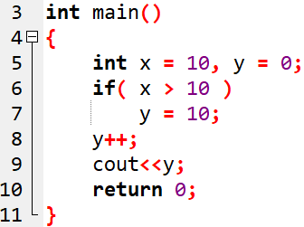
OUTPUT

Slide 7
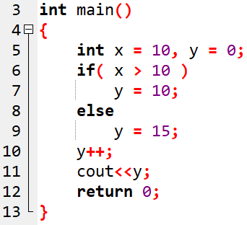
OUTPUT

Slide 8
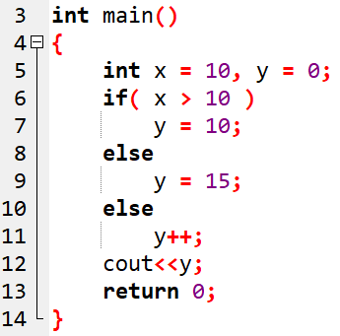
Syntax error !!

Slide 9
Nesting of if..else statements
if (test condition-1)
{
if (test condition-2)
{
statement-1;
}
else
{
statement-2;
}
}
else
{
statement-3;
}
statement-x;
If the test condition-1 is false,
statement-3 will be executed;
otherwise it continues to perform
the second test.
If the test condition-2 is true,
statement-1 will be evaluated;
otherwise statement-2
will be evaluated and then the
control is transferred to statement-x

Slide 10
Flow chart showing nesting of if..else statements
Entry
False
test
condition-1 ?
True
False
test
condition 2 ?
True
statement-3
statement-2
statement-1
statement-x
next statement

Slide 11
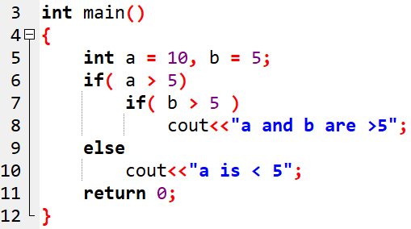
OUTPUT
Notes:
If brackets are not put, else will be part of closest if stmt. Here else is part of second if

Slide 12
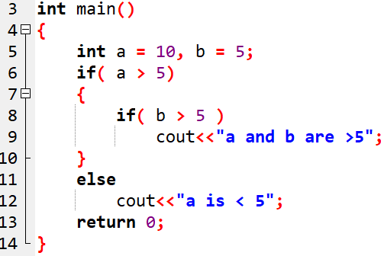
Notes:
Here else is a part of first if ,,, here no output

Slide 13
Flow chart to find the largest of three numbers
Start
Read A, B, C
True
False
A>B
True
False
True
False
A>C
B>C
Print B
Print C
Print A
Print C
Stop
8/3/2024
Notes:
13

Slide 14
else- if ladder
The conditions are evaluated from the top of the ladder downwards.
As soon as the true condition is found, statement associated with it is executed and the control is transferred to the statement-x (skipping the rest of the ladder)
When all the n conditions become false, then the final else containing the default statement will be executed
if (condition-1)
statement-1;
else if (condition-2)
statement-2;
else if (condition-3)
statement-3;
else if (condition-n)
statement-n;
else
default-statement;
statement-x

Slide 15
Flow chart for else- if ladder
True
False
Condition-1
True
False
statement-1
Condition-2
True
False
statement-2
Condition-3
True
False
statement-3
Condition-n
statement-n
default statement
statement-x
next statement
8/3/2024

Slide 16
Example: To calculate the grade for the marks entered
avg -marks grade
80-100 A
60-79 B
50-59 C
40-49 D
00-39 F
Notes:
16

Slide 17
Program to calculate the grade for the marks entered
/* Program WITHOUT indentation */
int main()
{
char grade;
int marks;
cout<<"enter marks”;
cin>>marks;
if (marks>79)
grade = 'A';
else if (marks>59)
grade = 'B';
else if (marks>49)
grade = 'C';
else if (marks>39)
grade = 'D';
else
grade = 'F';
cout<<“\n grade= “<<grade;
}
Notes:
17

Slide 18
Program to calculate the grade for the marks entered
/* Program WITH indentation */
int main()
{
char grade;
int marks;
cout<<"enter marks”;
cin>>marks;
if (marks>79)
grade = 'A';
else if (marks>59)
grade = 'B';
else if (marks>49)
grade = 'C';
else if (marks>39)
grade = 'D';
else
grade = 'F';
cout<<“\n grade=“<< grade;
}
Notes:
18

Slide 19
General form:
switch (expression)
{ case value-1 : block-1;
break;
case value-2 : block-2;
break;
.............
.............
case value-n : block-n;
break;
default :
default-block
}
statement-x;
The switch case statement
When the switch is executed, value of the expression is successfully compared against the values value-1, value-2.
If a case is found whose value matches with the value of the expression, then the block of statements that follows the case are executed
The break statement at the end of each block signals the end of a particular case and causes an exit from the switch statement, transferring the control to statement-x following the switch
Notes:
19

Slide 20
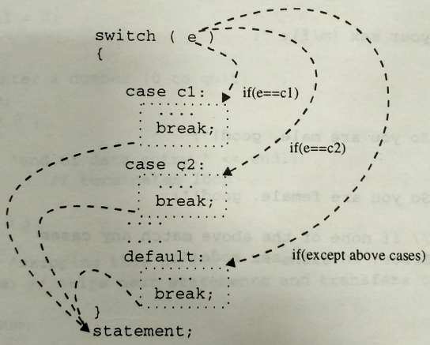

Slide 21
Rules for switch
Case labels must be constants or constant expressions
Case labels must be unique. No two labels should have same value
break statement transfers the control out of the switch statement
break is optional. Two or more case labels may belong to the same statements
default label is optional. If present, it will be executed when the expression does not find a matching case label
There can be at most one default label
default may be placed anywhere but usually placed at the end
Nesting of switch is possible
Notes:
21

Slide 22
Flow chart for switch statement
Entry
Switch expression
1
2
No match
block1
block2
Default
block
Statement- x

Slide 23
Calculation of grade using switch case
index=mark/10;
switch (index)
{ case 10:
  case 9:
  case 8: grade=‘A’;
  break;
  case 7:
  case 6:
  grade=‘B’;
  break;
  case 5:
  grade=‘C’
  break;
  case 4:
  grade=‘D’
  break;
  default: grade=‘F’;
  break;
} cout<<grade;
Notes:
23

Slide 24
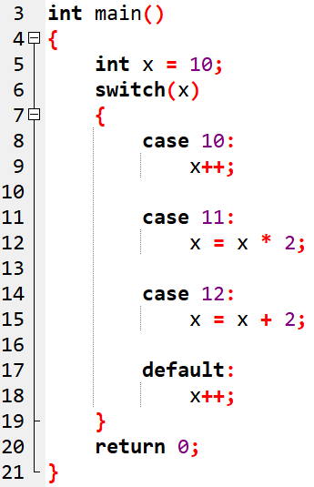
Ans: x = 25

Slide 25
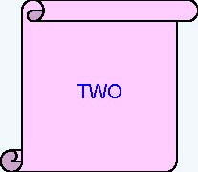
Predict the output -1
int iNum = 2;
switch(iNum){
case 1:
cout<<“ ONE”;
break;
case 2:
cout<<“ TWO”;
break;
case 3:
cout<<“ THREE”;
break;
default:
cout<<“INVALID”);
}
25

Slide 26
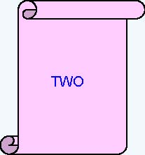
Predict the output -2
iNum = 2;
switch(iNum) {
default:
cout<<“ INVALID”);
case 1:
cout<<“ ONE”);
case 2:
cout<<“ TWO”);
break;
case 3:
cout<<“ THREE”);
}
26

Slide 27
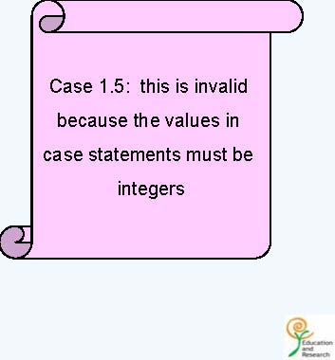
Predict the output -3
int iNum = 2;
switch(iNum) {
case 1.5:
cout<<“ ONE AND HALF”;
break;
case 2:
cout<<““TWO”;
case ‘A’ :
cout<<“ A character”;
}
27

Slide 28
Predict the output -4
const unsigned int iCountOfItems = 5;
switch ( iCountOfItems ) {
case iCountOfItems >=10 :
cout<<“ Enough Stock”;
break;
default :
cout<<“ Not enough stock”;
break;
}
Error: Relational Expressions cannot be used in switch statement
28

Slide 29
Predict the output -5
switch (iDepartmentCode){
case 110 : cout<<“HRD”;
case 115 : cout<<“IVS”;
case 125 : cout<<“ E&R”;
case 135 : cout<<“ CCD”;
}
• Assume iDepartmentCode is 115 and find the output
IVSE&RCCD
29

Slide 30

An example for switch case
char ch=‘a’;
switch(ch)
{
case ‘a’ : cout<<“ Vowel”; break;
case ‘e’ : cout<<“ Vowel”; break;
case ‘i’ : cout<<“ Vowel”; break;
case ‘o’ : cout<<“ Vowel”; break;
case ‘u’ : cout<<“ Vowel”; break;
default: cout<<“ Not a Vowel”;
}
char ch=‘a’;
switch(ch)
{
case ‘a’ :
case ‘e’ :
case ‘i’ :
case ‘o’ :
case ‘u’ :
cout<<“ Vowel”; break;
default :
cout<<“ Not a vowel”;
}
30

Slide 32
Loops & Decisions
Flow of control
Control statements – statements that cause jump

Slide 33
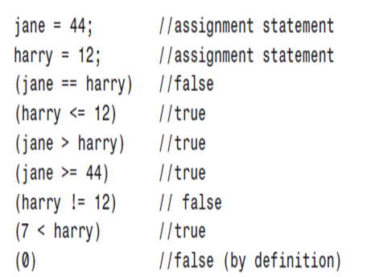
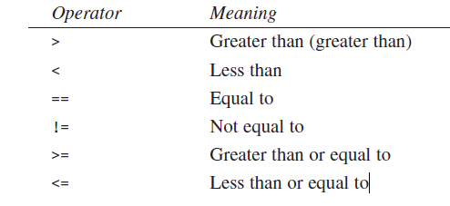


Relational Operators
C++ generates a 1 to indicate true, it assumes that any value other than 0 (such as –7 or 44) is true;
only 0 is false

Slide 34
Loops
Cause a section of your program to be repeated a certain number of times.
The repetition continues while a condition is true. When the condition becomes false, the loop ends and control passes to the statements following the loop.
Depending on nature of control variable:
  Counter-controlled loops (definite repetition loop, exact times)
  Sentinel-controlled loops (indefinite repetition loop, -1 or 99 or y)
Notes:
A sentinel controlled loop is the indefinite repetition loop as the number of repetitions is not known before the loop begins executing. A counter controlled loop is the definite repetition loop as the number of repetitions is known before the loop begins executing

Slide 35
Entry and exit controlled loop
Entry
Entry
Body of
The loop
Test
Condition
False
Increment statement
True
Test
Condition
True
Body of
The loop
False
while, for
do-while
35
Notes:
35

Slide 36
The for loop
  Fixed number of times
  The general form:
for (initialization; test condition; increment)
        {
        statements
        }

Slide 37
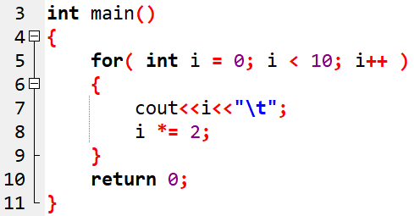

Example -1
OUTPUT:

Slide 38
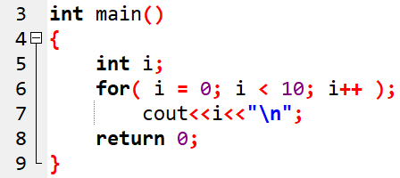
Example -2
OUTPUT:

Slide 39
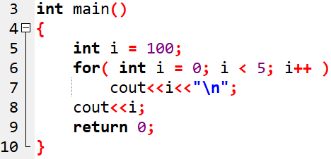

Example -3
OUTPUT:

Slide 40
The while loop
General format:
while (test condition)
{
body of the loop
}

Slide 41
Predict the output
unsigned int iCount = 1;
while (iCount<10);
{
cout<<iCount;
}
Because of this;

Slide 42
Problems to be tried
Find the sum of the digits of a number.
To count how many 1’s are present in the input binary number.

Slide 43
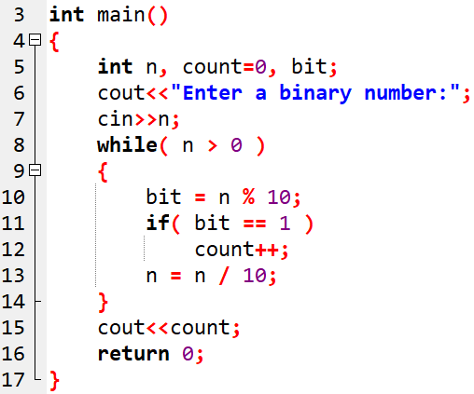

Example -4
OUTPUT:

Slide 44
Test our while loop
while( next < limit / 2 )
{
//body of loop
}
We want the division to be performed before the comparison?
Operator precedence -------> Arithmetic higher than Relational

Slide 45
Arithmetic Operators
Operator Meaning
+ Addition
- Subtraction or unary minus
* Multiplication
/ Division
% Modulo division
Integer division truncates any fractional part
Modulo division produces the remainder of an integer division
45
Notes:
45

Slide 46
The do loop
Guarantee that the loop body is executed at least once, no matter what the initial state of the test expression
General form:
do
{
body of the loop
}
while (test condition);

Slide 47
Nesting of loops
for ( i = 0; i < 5; i ++ )
{
statement-1;
for ( j = 1 ; j < 3 ; j++ )
{
statement-2;
}
}
// Executed 5 times
// Executed 10 times

Slide 48
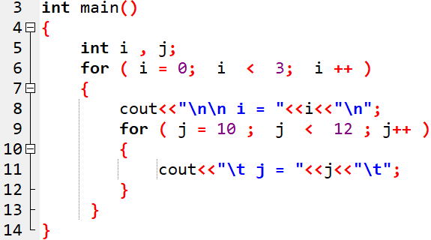
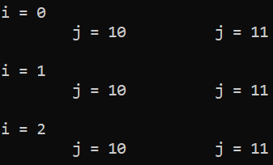
Example -5
OUTPUT:

Slide 49
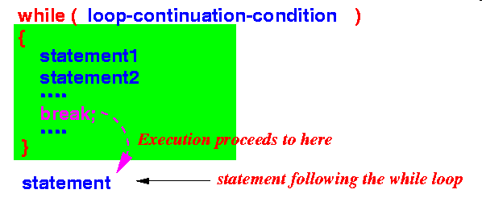
Jumping out of for loop
An early exit from a loop can be accomplished by using the break statement.
When the break statement is encountered inside a loop, the loop is immediately exited and the program continues with the statement immediately following the loop.
When the loops are nested , the break would only exit from the loop containing it. i.e. , the break will exit only a single loop.
Notes:
49

Slide 50
Exiting a loop with break statement
do
{…….
…………
if (condition)
break;
………
……….
} while(…);
…………..
while (……….)
{…….
…………
if (condition)
break;
………
……….
}
…………..
Exit
From
loop
Exit
From
loop
Notes:
50

Slide 51
Exiting a loop with break statements
for
{…….
…………
if (condition)
break;
………
……….
}
…………..
for (……….)
{ …….
for(……..)
{ ………
if (condition)
break;
………
}
……..
}
Exit
From
inner
loop
Exit
From
loop
Notes:
51

Slide 52
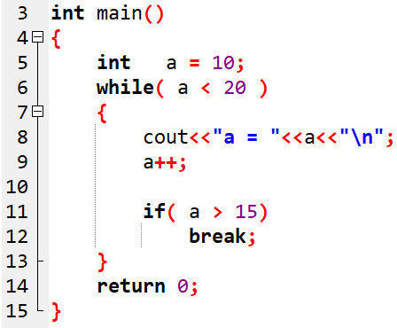

Example -6
OUTPUT:

Slide 53
Skipping a part of the loop
Skip a part of the body of the loop under certain conditions using continue statement.
As the name implies, causes the loop to be continued with next iteration, after skipping rest of the body of the loop.
In while and do loops, continue causes the control to go directly to the test-condition and then to continue the iteration process.
In for loop, the increment section of the loop is executed before the test condition is evaluated
Notes:
53

Slide 54
Skipping a part of the loop(contd.)
while (……….)
{ …….
  if (condition)
  continue;
……….
}
…………..
do
{…….
if (condition)
continue;
……….
} while(…);
…………..
Skipped part
Notes:
54

Slide 55
Skipping a part of the loop(contd.)
for ( initialization; test_condition; increment )
{…….
…………
if (condition)
continue;
……… // Skipped part
}
…………..
Notes:
55

Slide 56
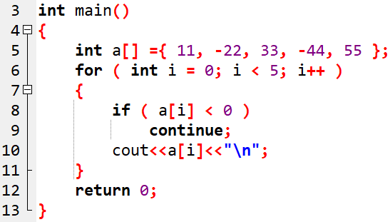
Example -7
OUTPUT:

