Slide 1
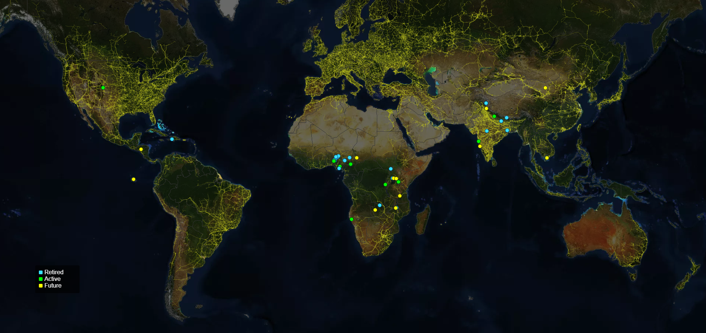
RGU
RGU
GRA
GHE
IITM
SSC
NEP
SCF
SES
The Americas___
Galapagos (Ecuador)
Haiti
Honduras
United States
CSA
SBI
HIS
IA
GVE
AGC
PLI
FGU
SNL
SNL
VHSS
NCTU
REIc
REIc
RSVSV
DCN
ADP
DCN
MAA
Asia___
Bangladesh
India
Nepal
Vietnam
BCF
Africa___
Burkina Faso
Cameroon
Kenya
Malawi
Namibia
Nigeria
South Sudan
Rwanda
Tanzania
Uganda
Zambia
HHE
MAA
LCS
RDO
LCS
WET
TBS
CEM

