Slide 1


Toward an XBRL Taxonomy for CAFRs
Marc D. Joffe
Center for Municipal Finance
http://www.munifinance.org
Data Transparency 2016 – September 28, 2016

Slide 2
What are CAFRs?
A CAFR – Comprehensive Annual Financial Report – is the state/local government equivalent of a company’s annual report. It is a set of audited financial statements
There are 90,000 sub-national governments in the US – about a third of these produce audit financials
Governments that borrow in the municipal bond market submit financial statements to the Municipal Securities Rulemaking Board’s EMMA system
Governments that receive more than $750,000 in federal funds annually must submit audited financials under the Single Audit Act of 1984 (in accordance with OMB Circular A-133)
In recent years, CAFRs have become easy to obtain but they are published in PDF format
Eight years after the SEC mandated company XBRL filings, there is no similar requirement for state and local governments, but that would change under HR 2477.

Slide 3

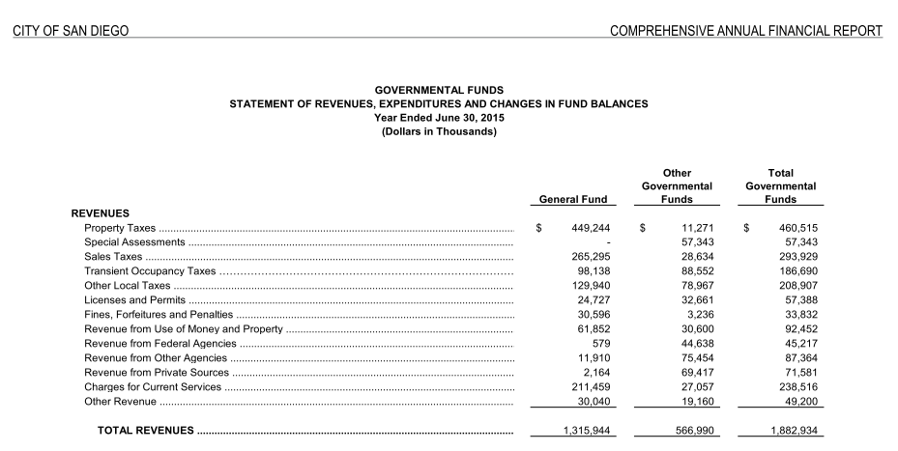
The PDF Status Quo

Slide 4
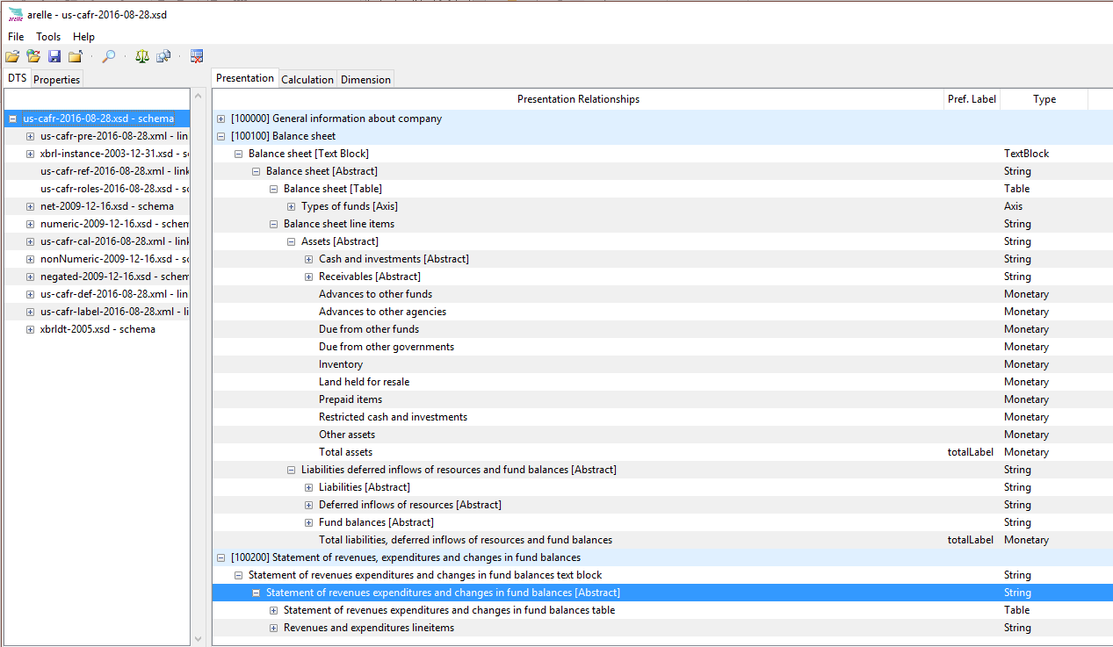
We’re working on an XBRL Taxonomy

Slide 5
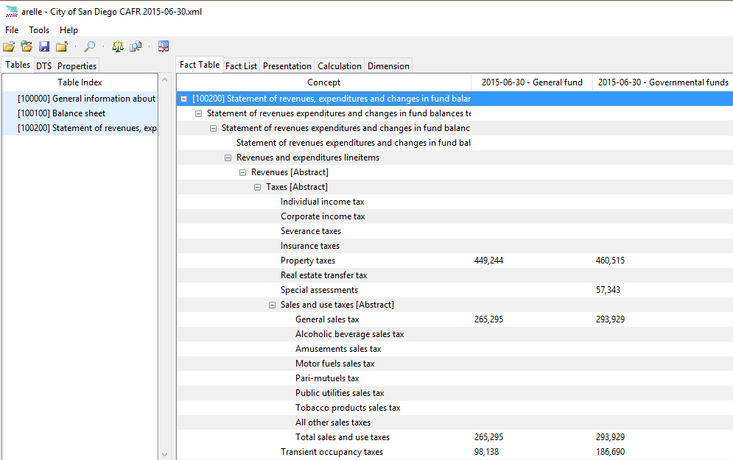
Instance Document for the City of San Diego

Slide 6
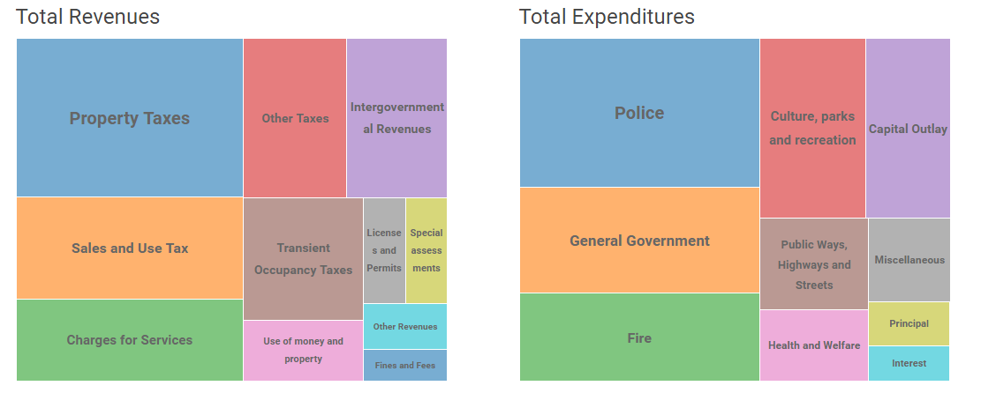
Benefits of a Taxonomy: Visualization
San Diego Governmental Fund Revenues and Expenditures, 2015
For data on this and other cities, see http://fiscal.municipalfinance.org/.

Slide 7
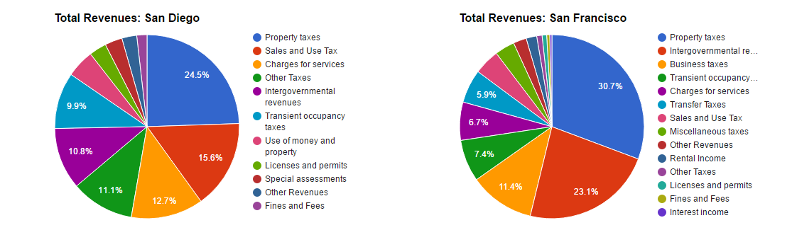
Benefits of a Taxonomy: Comparisons
San Diego vs. San Francisco Governmental Fund Revenues, 2015
For data on these and other cities, see http://fiscal.municipalfinance.org/.

Slide 8
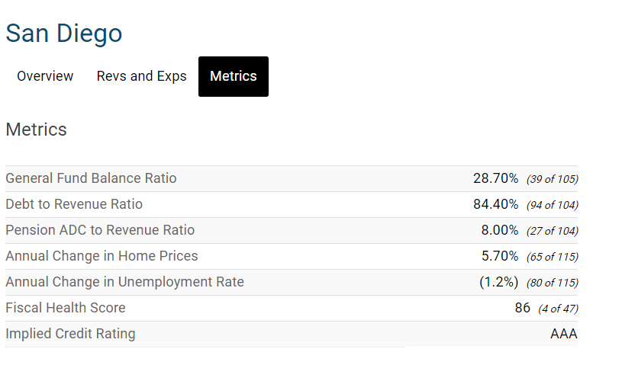
Benefits of a Taxonomy: Financial Analysis

Slide 9
Status
Northern Illinois and Workiva have an initial taxonomy for the two government-wide financial statements
CMF has a rough prototype for Governmental Funds financial statements
We plan to merge these two projects in October
We will need sponsorship to complete a credible taxonomy
Foundations, GASB, MSRB, States and the Federal Government can each play a role

Slide 10
Center for Government Studies - Northern Illinois University SAFFIRe Project Innovation for Local Government Financial Reporting
SAFFIRe - Semantic Aware Framework for Financial Information Reporting
SAFFIRe’s Vision
… a platform leveraging digital financial reporting technologies, that
increases the efficiency and effectiveness in preparing and utilizing
government and non-profit financial reports, and enhances
transparency and accountability of the information therein …
SAFFIRe’s Principal Goals
Single Government CAFR Reporting Taxonomy - defining common concepts for all levels and jurisdictions of State and Local Goverment
Collaboration among a broad base of stakeholders - to facilitate wide relevance and future voluntary utilization of the taxonomy
Future implementation of a managed public CAFR report repository
Notes:
The basis of our work began with the SAFFIRe project. SAFFIRe means we are a group passionate about developing a…
All of our sub projects are conducted with the premise that they support the overall vision of SAFFIRe which consists of…

Slide 11
Center for Government Studies - Northern Illinois University SAFFIRe Project Innovation for Local Government Financial Reporting
SAFFIRe Status
Draft US GAAP Government Taxonomy – including
400+ elements defined and GASB reviewed (in accordance with GASB Statement No. 76) for: Statement of Net Position and Statement of Activities
Additional elements identified for Fund financial statements: Expenditures and Changes in Fund Balances and Balance Sheet (currently being incorporated into taxonomy)
Encouragement, support and collaboration from stakeholders, including: standards and regulatory bodies, state and local government legislators and staff, financial reporting industry leaders, academia, small government accounting/audit firms.
Prototype CAFR XBRL reporting examples implemented using Wdesk®
Multiple statements tagged via US GAAP taxonomy extensions
Open-source demonstration CAFR instance document repository
Notes:
The basis of our work began with the SAFFIRe project. SAFFIRe means we are a group passionate about developing a…
All of our sub projects are conducted with the premise that they support the overall vision of SAFFIRe which consists of…

Slide 12
Center for Government Studies - Northern Illinois University SAFFIRe Project Innovation for Local Government Financial Reporting
The description spreadsheet of the draft US GAAP Government Taxonomy is available online for review and integration with XBRL tools, at:
http://www.govwiki.info/UGGT as of 2016-09-23.xlsx
Example municipality XBRL Instance document (includes two statements) at:
http://www.govwiki.info/Fulton 2015 CAFR UGGT-XBRL.zip
For additional information, feedback or interest in participation please contact Shannon Sohl, ssohl@niu.edu, 815.753.5851, or Timothy Randle, timothy@clientserversllc.com
Notes:
The basis of our work began with the SAFFIRe project. SAFFIRe means we are a group passionate about developing a…
All of our sub projects are conducted with the premise that they support the overall vision of SAFFIRe which consists of…

