Slide 1
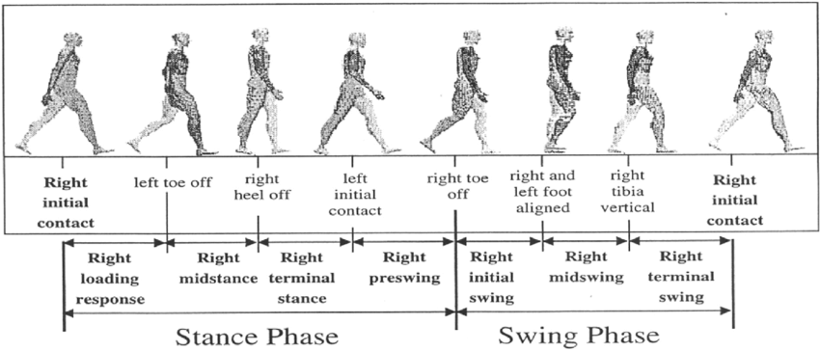
Description of the GaitPhase Database PPMI

Slide 2
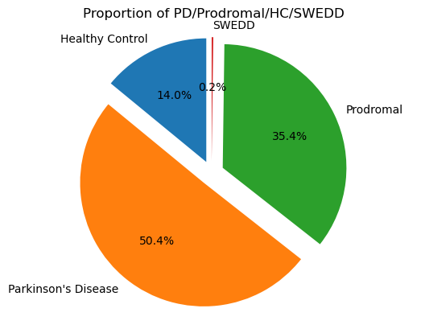
Data Observation and Cleaning
Number of Nan values :
PATNO 0
EVENT_ID 14
INFODT 0
COHORT 25
SP_U 15
RA_AMP_U 13
LA_AMP_U 13
RA_STD_U 13
LA_STD_U 13
SYM_U 13
R_JERK_U 13
L_JERK_U 13
ASA_U 13
ASYM_IND_U 13
TRA_U 13
T_AMP_U 13
CAD_U 13
STR_T_U 13
STR_CV_U 13
STEP_REG_U 13
STEP_SYM_U 13
JERK_T_U 13
SP__DT 19
RA_AMP_DT 19
LA_AMP_DT 19
RA_STD_DT 19
LA_STD_DT 19
SYM_DT 19
R_JERK_DT 19
L_JERK_DT 19
ASA_DT 19
ASYM_IND_DT 19
TRA_DT 19
T_AMP_DT 19
CAD_DT 19
STR_T_DT 19
STR_CV_DT 19
STEP_REG_DT 19
STEP_SYM_DT 19
JERK_T_DT 19
SW_VEL_OP 9
SW_PATH_OP 9
SW_FREQ_OP 9
SW_JERK_OP 9
SW_VEL_CL 13
SW_PATH_CL 13
SW_FREQ_CL 14
SW_JERK_CL 13
TUG1_DUR 5
TUG1_STEP_NUM 5
TUG1_STRAIGHT_DUR 5
TUG1_TURNS_DUR 5
TUG1_STEP_REG 5
TUG1_STEP_SYM 5
TUG2_DUR 12
TUG2_STEP_NUM 12
TUG2_STRAIGHT_DUR 12
TUG2_TURNS_DUR 12
TUG2_STEP_REG 12
TUG2_STEP_SYM 12
dtype: int64
Visualization of number in each cohort in total PPMI base

Slide 3
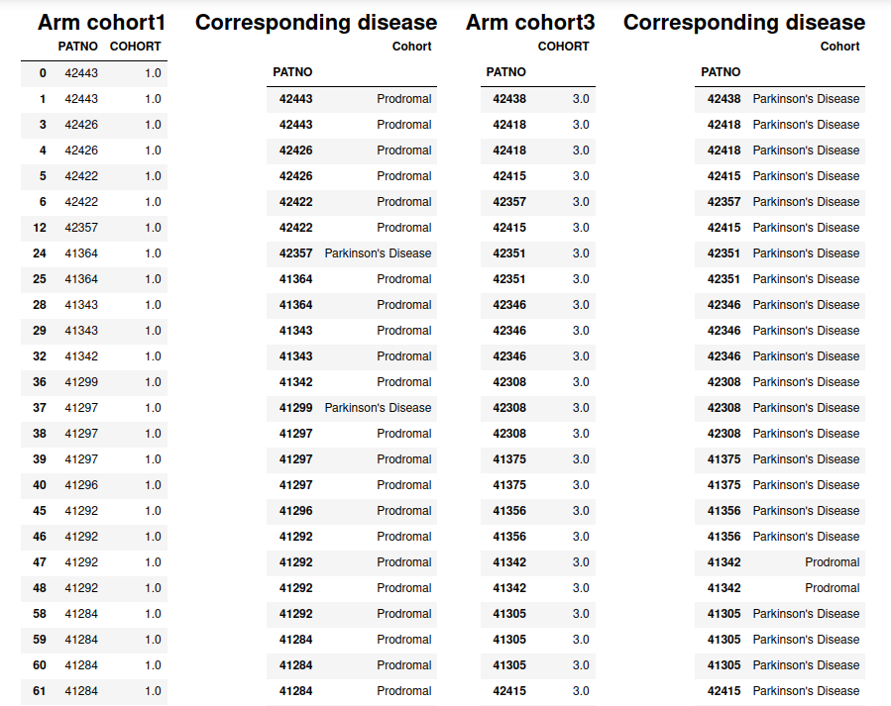
A quoi correspondent n°1/3 de cohort dans fichier ?
Arm cohort1
PATNO COHORT
0 42443 1.0
1 42443 1.0
3 42426 1.0
4 42426 1.0
5 42422 1.0
6 42422 1.0
12 42357 1.0
24 41364 1.0
25 41364 1.0
28 41343 1.0
29 41343 1.0
32 41342 1.0
36 41299 1.0
37 41297 1.0
38 41297 1.0
39 41297 1.0
40 41296 1.0
45 41292 1.0
46 41292 1.0
47 41292 1.0
48 41292 1.0
58 41284 1.0
59 41284 1.0
60 41284 1.0
61 41284 1.0
62 41284 1.0
63 41283 1.0
64 41283 1.0
65 41283 1.0
89 42012 1.0
90 42012 1.0
91 42011 1.0
93 42006 1.0
94 42006 1.0
95 42001 1.0
96 42000 1.0
97 41993 1.0
98 41992 1.0
99 41990 1.0
100 41990 1.0
104 41984 1.0
109 41562 1.0
110 41560 1.0
123 40587 1.0
124 40587 1.0
130 40567 1.0
139 42450 1.0
141 42445 1.0
143 41283 1.0
145 42444 1.0
146 42444 1.0
147 42444 1.0
148 42445 1.0
149 42446 1.0
150 42446 1.0
151 42446 1.0
155 42448 1.0
157 42450 1.0
158 42450 1.0
159 42450 1.0
160 42451 1.0
161 42452 1.0
165 42457 1.0
168 41307 1.0
169 41343 1.0
170 41364 1.0
173 42422 1.0
174 42426 1.0
177 42443 1.0
178 42444 1.0
179 42446 1.0
182 42001 1.0
183 42011 1.0
184 42012 1.0
Corresponding disease
Cohort
PATNO
42443 Prodromal
42443 Prodromal
42426 Prodromal
42426 Prodromal
42422 Prodromal
42422 Prodromal
42357 Parkinson's Disease
41364 Prodromal
41364 Prodromal
41343 Prodromal
41343 Prodromal
41342 Prodromal
41299 Parkinson's Disease
41297 Prodromal
41297 Prodromal
41297 Prodromal
41296 Prodromal
41292 Prodromal
41292 Prodromal
41292 Prodromal
41292 Prodromal
41284 Prodromal
41284 Prodromal
41284 Prodromal
41284 Prodromal
41284 Prodromal
41283 Prodromal
41283 Prodromal
41283 Prodromal
42012 Prodromal
42012 Prodromal
42011 Prodromal
42006 Prodromal
42006 Prodromal
42001 Prodromal
42000 Prodromal
41993 Prodromal
41992 Prodromal
41990 Prodromal
41990 Prodromal
41984 Prodromal
41562 Prodromal
41560 Prodromal
40587 Prodromal
40587 Prodromal
40567 Prodromal
42450 Prodromal
42445 Prodromal
41283 Prodromal
42444 Prodromal
42444 Prodromal
42444 Prodromal
42445 Prodromal
42446 Prodromal
42446 Prodromal
42446 Prodromal
42448 Parkinson's Disease
42450 Prodromal
42450 Prodromal
42450 Prodromal
42451 Parkinson's Disease
42452 Parkinson's Disease
42457 Prodromal
41307 Prodromal
41343 Prodromal
41364 Prodromal
42422 Prodromal
42426 Prodromal
42443 Prodromal
42444 Prodromal
42446 Prodromal
42001 Prodromal
42011 Prodromal
42012 Prodromal
Arm cohort3
COHORT
PATNO
42438 3.0
42418 3.0
42418 3.0
42415 3.0
42357 3.0
42415 3.0
42351 3.0
42351 3.0
42346 3.0
42346 3.0
42346 3.0
42308 3.0
42308 3.0
42308 3.0
41375 3.0
41375 3.0
41356 3.0
41356 3.0
41342 3.0
41342 3.0
41305 3.0
41305 3.0
41305 3.0
42415 3.0
41294 3.0
41294 3.0
41293 3.0
42351 3.0
41289 3.0
42429 3.0
41289 3.0
41288 3.0
41288 3.0
41287 3.0
41287 3.0
41285 3.0
41281 3.0
41281 3.0
41280 3.0
41280 3.0
41280 3.0
42035 3.0
42034 3.0
42014 3.0
42014 3.0
42009 3.0
41989 3.0
41989 3.0
41985 3.0
41568 3.0
41578 3.0
41568 3.0
41562 3.0
41508 3.0
41508 3.0
41420 3.0
41412 3.0
41410 3.0
41401 3.0
41400 3.0
41399 3.0
41384 3.0
41382 3.0
41382 3.0
41380 3.0
40586 3.0
40586 3.0
40585 3.0
40585 3.0
40578 3.0
40555 3.0
40553 3.0
40553 3.0
42455 3.0
41342 3.0
41288 3.0
42448 3.0
42351 3.0
41282 3.0
42447 3.0
42447 3.0
42447 3.0
42448 3.0
42453 3.0
42455 3.0
42456 3.0
41280 3.0
41281 3.0
42346 3.0
42415 3.0
42429 3.0
42438 3.0
42447 3.0
Corresponding disease
Cohort
PATNO
42438 Parkinson's Disease
42418 Parkinson's Disease
42418 Parkinson's Disease
42415 Parkinson's Disease
42357 Parkinson's Disease
42415 Parkinson's Disease
42351 Parkinson's Disease
42351 Parkinson's Disease
42346 Parkinson's Disease
42346 Parkinson's Disease
42346 Parkinson's Disease
42308 Parkinson's Disease
42308 Parkinson's Disease
42308 Parkinson's Disease
41375 Parkinson's Disease
41375 Parkinson's Disease
41356 Parkinson's Disease
41356 Parkinson's Disease
41342 Prodromal
41342 Prodromal
41305 Parkinson's Disease
41305 Parkinson's Disease
41305 Parkinson's Disease
42415 Parkinson's Disease
41294 Parkinson's Disease
41294 Parkinson's Disease
41293 Parkinson's Disease
42351 Parkinson's Disease
41289 Parkinson's Disease
42429 Parkinson's Disease
41289 Parkinson's Disease
41288 Parkinson's Disease
41288 Parkinson's Disease
41287 Parkinson's Disease
41287 Parkinson's Disease
41285 Parkinson's Disease
41281 Parkinson's Disease
41281 Parkinson's Disease
41280 Parkinson's Disease
41280 Parkinson's Disease
41280 Parkinson's Disease
42034 Parkinson's Disease
42014 Parkinson's Disease
42014 Parkinson's Disease
42009 Parkinson's Disease
41989 Parkinson's Disease
41989 Parkinson's Disease
41985 Parkinson's Disease
41568 Parkinson's Disease
41578 Parkinson's Disease
41568 Parkinson's Disease
41562 Prodromal
41508 Parkinson's Disease
41508 Parkinson's Disease
41420 Parkinson's Disease
41412 Parkinson's Disease
41410 Parkinson's Disease
41401 Parkinson's Disease
41400 Parkinson's Disease
41399 Parkinson's Disease
41384 Parkinson's Disease
41382 Parkinson's Disease
41382 Parkinson's Disease
41380 Parkinson's Disease
40586 Parkinson's Disease
40586 Parkinson's Disease
40585 Parkinson's Disease
40585 Parkinson's Disease
40578 Parkinson's Disease
40555 Parkinson's Disease
40553 Parkinson's Disease
40553 Parkinson's Disease
42455 Parkinson's Disease
41342 Prodromal
41288 Parkinson's Disease
42448 Parkinson's Disease
42351 Parkinson's Disease
41282 Parkinson's Disease
42447 Parkinson's Disease
42447 Parkinson's Disease
42447 Parkinson's Disease
42448 Parkinson's Disease
42453 Parkinson's Disease
42455 Parkinson's Disease
42456 Parkinson's Disease
41280 Parkinson's Disease
41281 Parkinson's Disease
42346 Parkinson's Disease
42415 Parkinson's Disease
42429 Parkinson's Disease
42438 Parkinson's Disease
42447 Parkinson's Disease
Conclusion :
The cohort 1 on the document corresponds to people in the Prodromal stage of Parkinson's disease (the stage at which individuals do not fulfill diagnostic criteria for PD ie, bradykinesia and at least 1 other motor sign)
The cohort 3 to patients with PD
PS : The exceptions of miss-classification are justified in the csv with a column named 'Comments'

Slide 4
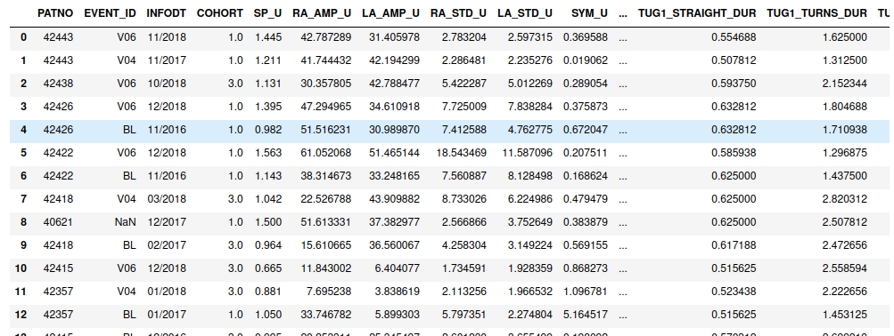
Attribution des Nan dans la colonne ‘COHORT’ du fichier arm swing

Slide 5
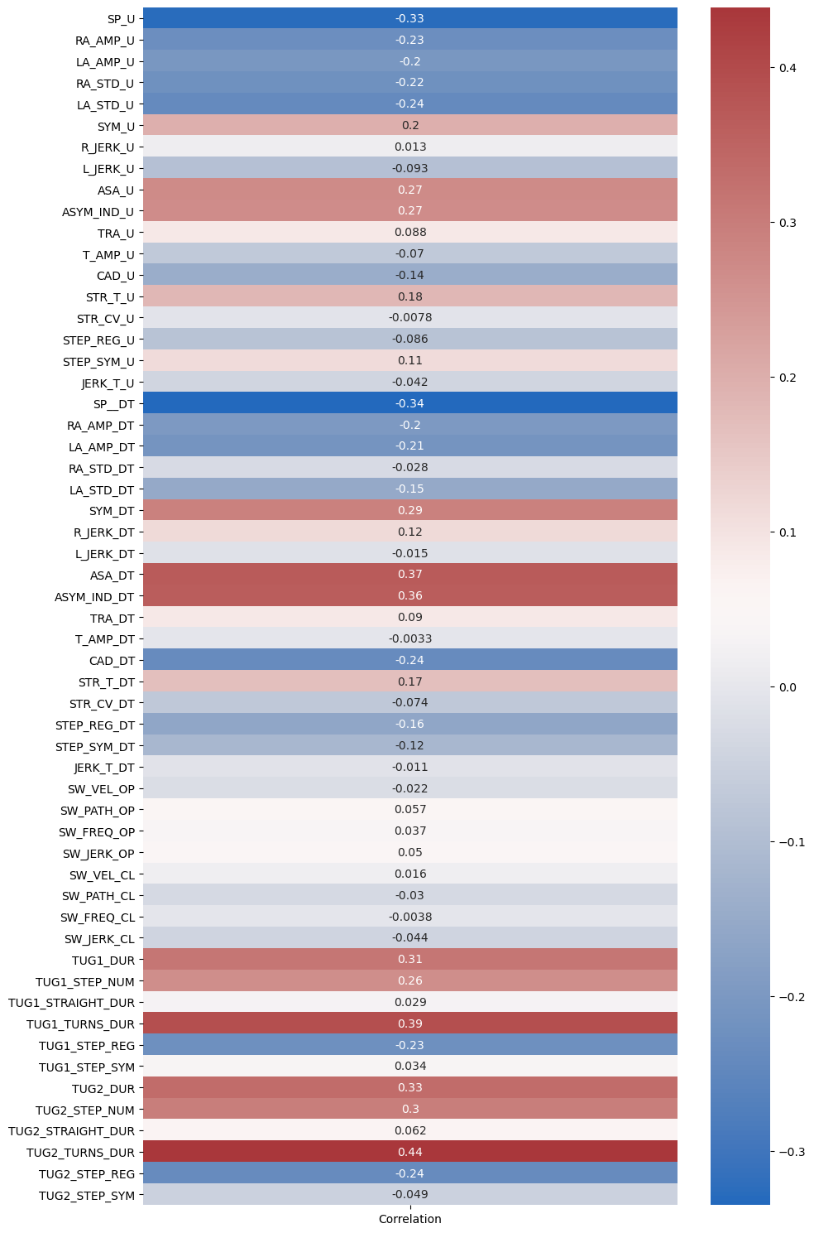
Correlation des données avec cohort

Slide 6
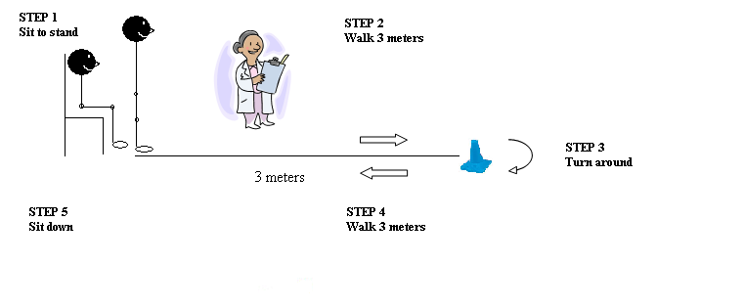
Test de classification avec XGBoost sur TUG2-TURNS-DUR
TUG 1 and 2 Average step duration during turns (sec)
Le TUG est un test de rendement physique général utilisé pour évaluer la mobilité, l’équilibre et le rendement locomoteur chez les personnes âgées avec des troubles d’équilibre. Plus spécifiquement, il évalue la capacité d’effectuer des tâches motrices séquentielles relatives aux capacités de marcher et de tourner
Method : voir doc
Accuracy: 58%
Très moyen mais
correlation init n’est
pas incroyable

Slide 7
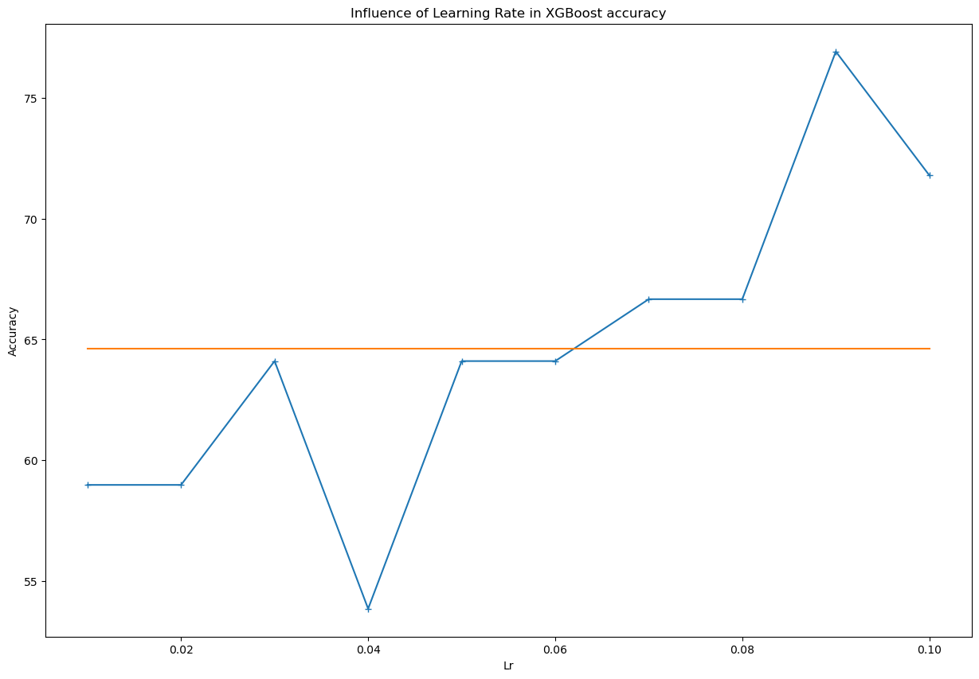
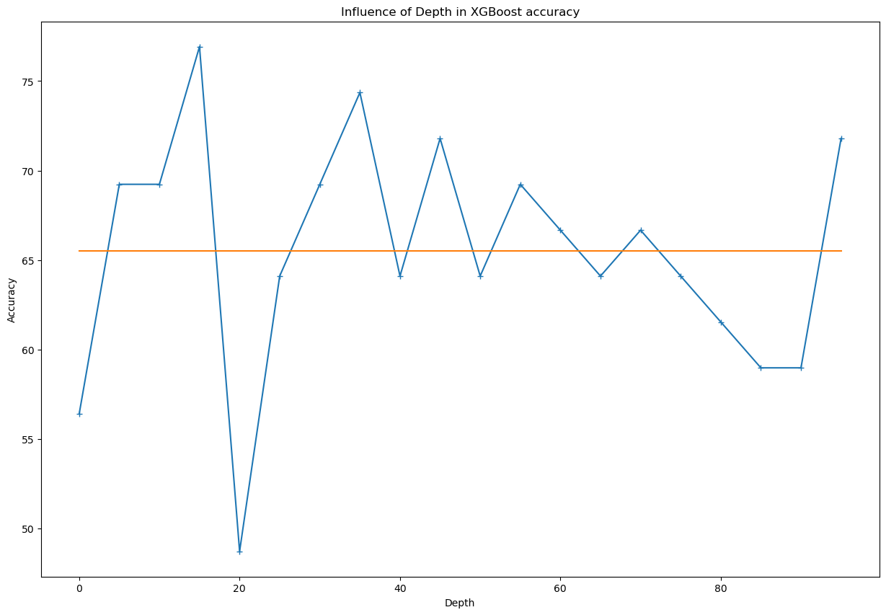
LR et Depth influence

Slide 8
Test de classification avec XGBoost sur toutes les mesures
Avec les mêmes hyperparamètres :
Pour lr = 0.01 et max_depth=100 et num_iter=5000 classification acceptable avec accuracy en moyenne à 70%

Slide 9
En cours et à venir
Combler Nan avec KNN
Utilisation XGBoost à approfondir et optimiser
Voir d’autres méthodes possibles pour ces mêmes données

