Slide 1

START
SETTINGS
QUIT

Slide 2

SETTINGS
Video
Audio
Setting1
N/A
Setting2
N/A
Setting3
N/A

Slide 3
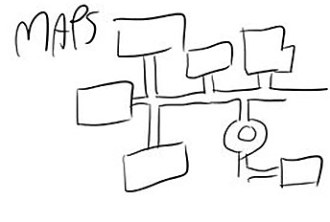

1

Slide 4
1
Stage 1
Highscore : -
Best time : -

Slide 5
(Locked)
1
Highscore : -
Best time : -

Slide 6
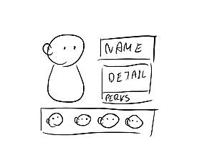

Charater 1
Detail
Perks

Slide 7
Charater 2
Detail
Perks

Slide 8
Charater 3
Detail
Perks

Slide 9
Charater 4
Detail
Perks

Slide 10
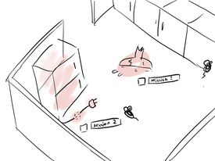

Slide 11
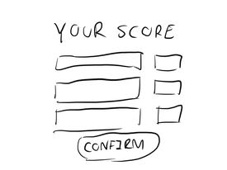

Slide 12
2
1

Slide 13
2
1
Stage 1
Highscore : -
Best time : -

Slide 14
2
Stage 2
1
Highscore : -
Best time : -

