Slide 1


Project 3 | Sunshine data + predictive analytics
Orthofix international

Slide 2
overview
Sunshine Act – government regulation
The Sunshine Act, a.k.a. the National Physician Payment Transparency Program (Open Payments), is a section of the Patient Protection and Affordable Care Act of 2010. It requires pharmaceutical and medical device companies report certain payments to the Federal government.
Pain Points with this data:
CMS Government open-sourced data site is very clunky and hard to navigate
Open-sourced data is not uniform and/or cleaned very well for analysis
Its hard for a user to get a quick answer re: physician payments
Our Solution:
Quick Check for a company to see what they paid a physician
For purposes of this MVP we selected Orthofix International with payment period of 2017
Over 3700 records of transactions

Slide 3
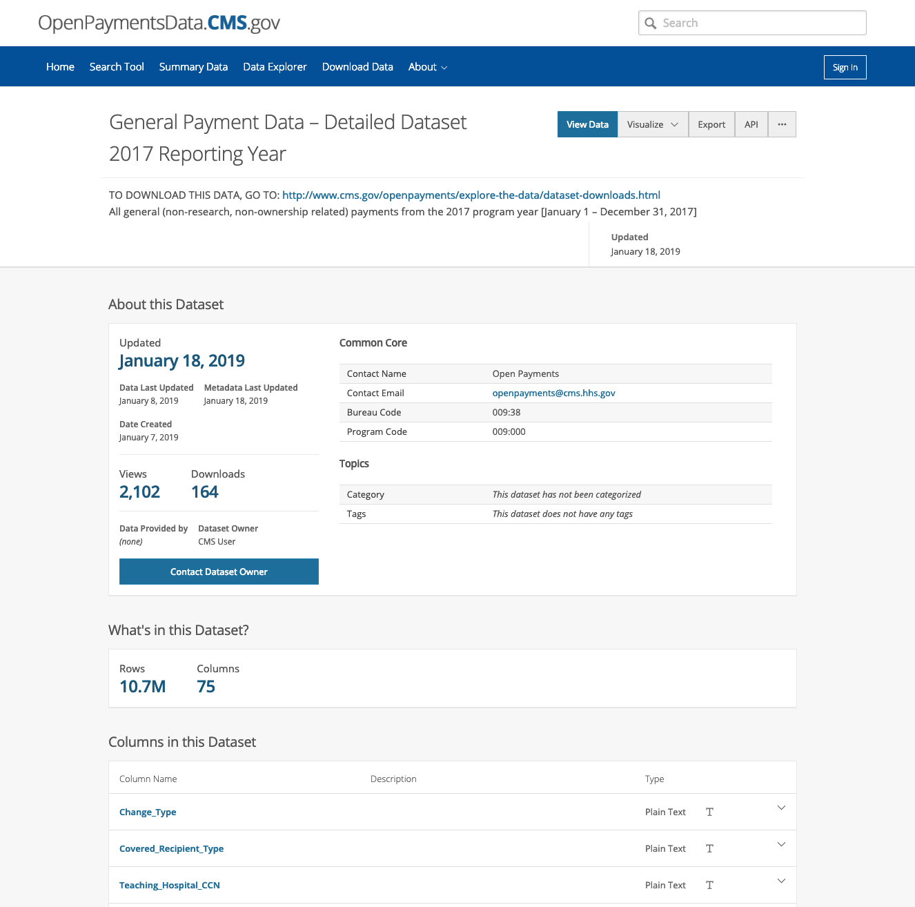
Data Sources
https://openpaymentsdata.cms.gov/dataset/General-Payment-Data-Detailed-Dataset-2017-Reporti/a3u6-h38p
CSV Export

Slide 4
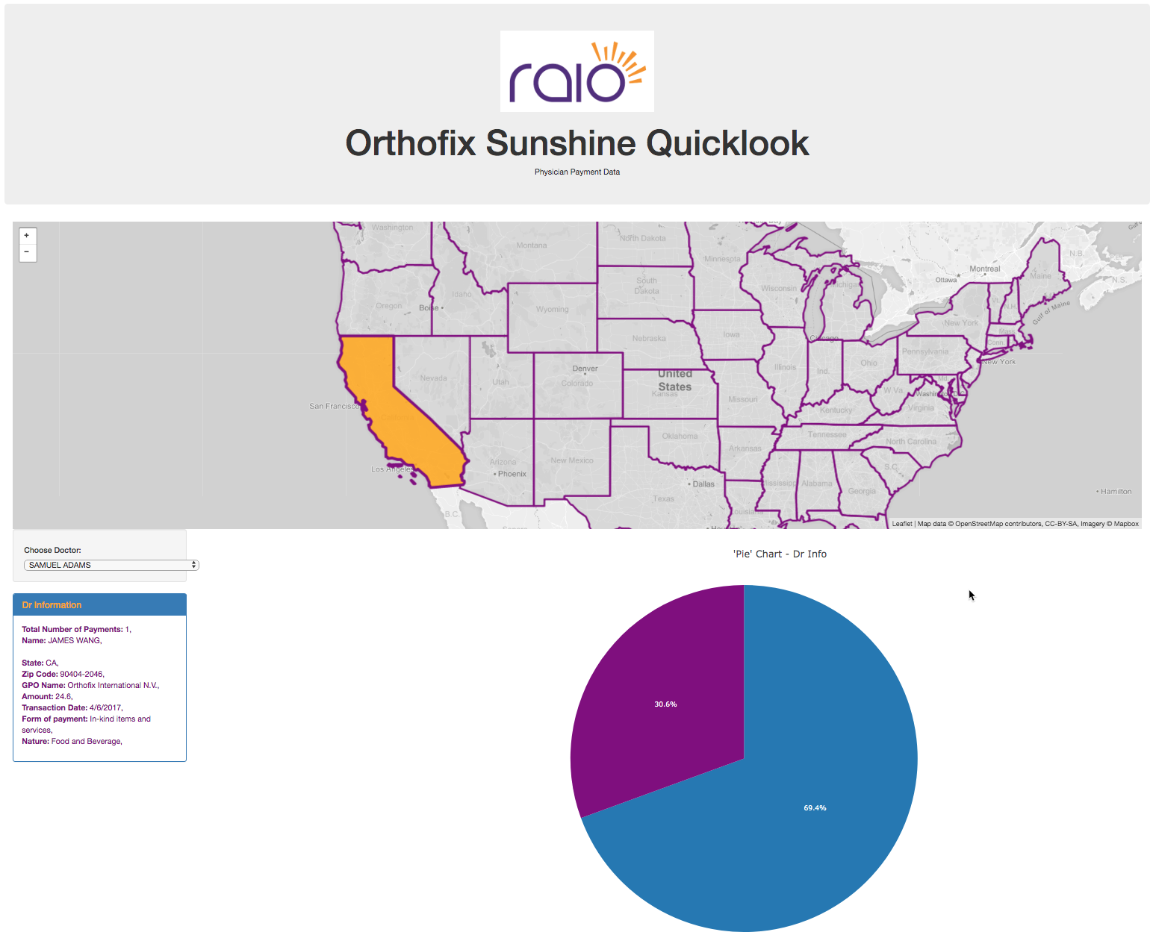
App
Preview

Slide 5
team roles
Mo
Time series regression
ETL
DB Set Up
Omar
Middle & Front-end
Flask App
Python Script
Pie Plot & table viz
Grant
Linear
Jupyter Notebook
Python, Matplot,

Slide 6
lessons learned & obstacles
Time & Resource constraints
Applying newly learned and underdeveloped skills

Slide 7
leveraged tech
Pandas - etl
SQL Server
R
Python
Matplot
SKlearn

Slide 8
Models

Slide 9
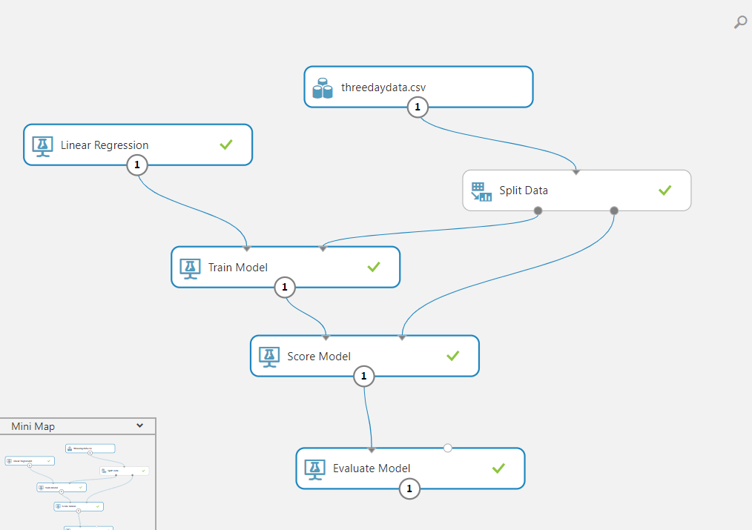
High-level approach

Slide 10
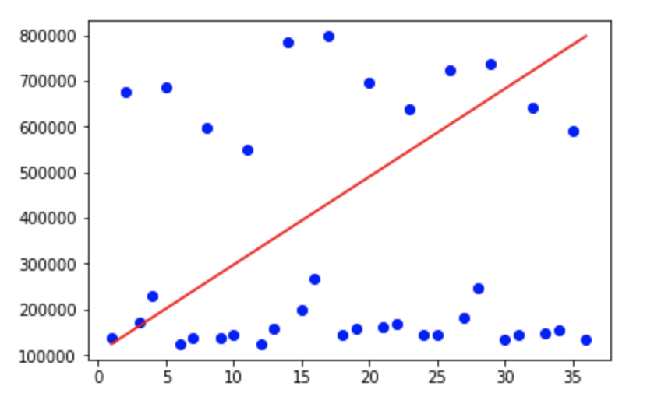
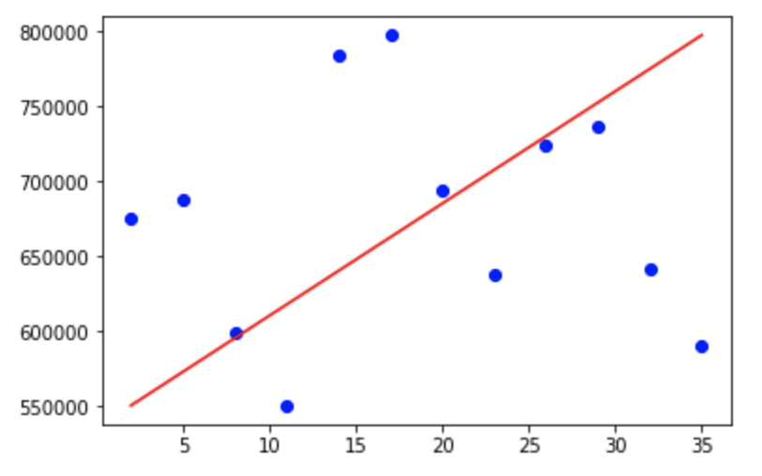
Approach 1: Linear Regression
Payment Analysis off all types of payments
Vs.
Payment Analysis of Royalties Payments
Conclusion: Not a good linear progression model for predicting spend on royalties alone.

Slide 11
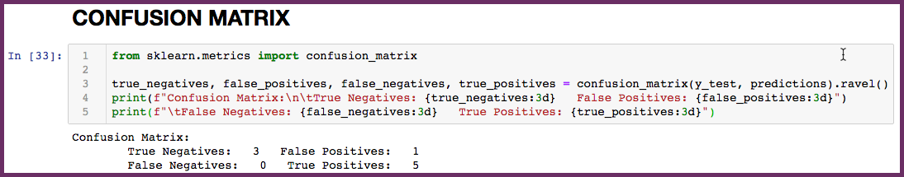

Approach 2: Logistic Regression
A regression model was developed to answer the following prediction:
Given a month, will the payment amounts increase or decrease?
The mean accuracy score on the test dataset was 0.88 = 88%
Conclusion: We were able to develop a model to predict whether or not the amount spent would increase/decrease w/ high accuracy …
but we believe this predictor alone is not enough to provide meaningful insight.

Slide 12
Approach 3: Time Series Arima
MA
AR
INT
Moving Average. A model that uses the dependency between an observation and a residual error from a moving average model applied to lagged observations.
Autoregression. A model that uses the dependent relationship between an observation and some number of lagged observations.
Integrated. The use of differencing of raw observations (e.g. subtracting an observation from an observation at the previous time step) in order to make the time series stationary.

Slide 13
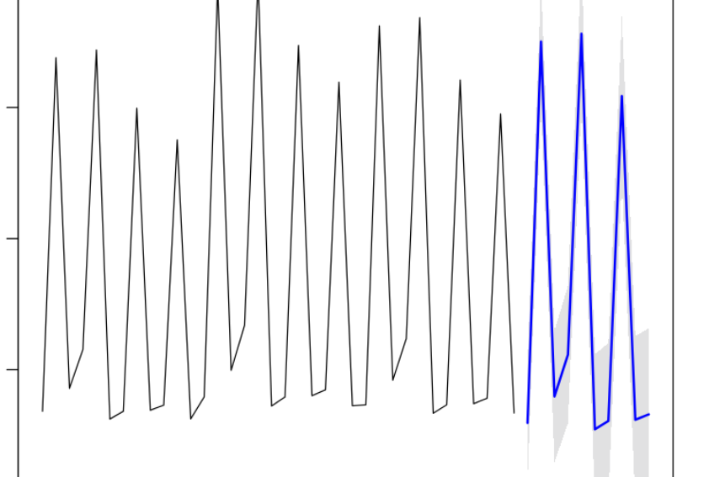
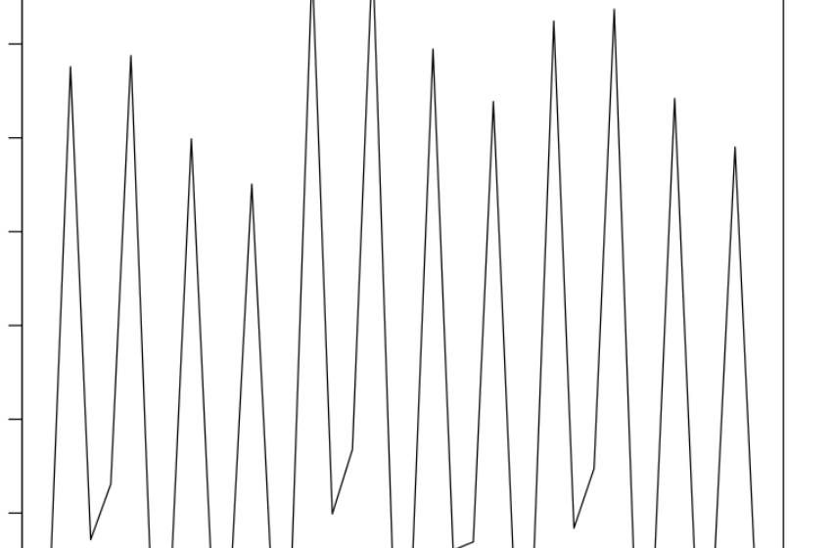
Approach 3: Continued
Look at the pattern and trend.
Blue line is the Projection

