Slide 1
22AIE401 · REINFORCEMENT LEARNING · AMRITA VISHWA VIDYAPEETHAM, AMRITAPURI
Why Nobody Drives the Shortest Route:
Learning Taxi Route Preferences with Maximum Entropy Inverse RL
Recovering interpretable driver preferences from real Porto taxi GPS trips on an OpenStreetMap road graph
3,000
11
0.682
93.7%
real map-matched taxi trips
interpretable reward features
edge F1 vs 0.636 for shortest path
top-1 junction accuracy
Notes:
Open with the hook: nobody drives the shortest route, so what are drivers optimising? We learn their hidden reward from real GPS data using Maximum Entropy Inverse RL. Headline: on 600 held-out Porto trips our model reaches edge F1 0.682 vs 0.636 for Dijkstra shortest path, and predicts the next road with 93.7% top-1 accuracy. We will be honest about where the gain is modest.

Slide 2
PROBLEM & MOTIVATION
Apps assume one metric; real drivers do not
The gap
Our task
▪ Shortest / fastest path one fixed metric, no driver comfort or habits
▪ Preferences are hidden drivers cannot articulate their own rules
▪ Inverse RL observe demonstrations, recover the reward that explains them
▪ Why it matters personalised navigation, realistic simulation, human-compatible autonomy
Given a road graph G and N map-matched trips D = {τ₁…τₙ}, find reward weights w that make the observed routes most likely:
w* = argmax_w Σᵢ log P(τᵢ | w, oᵢ, dᵢ) − λ‖w‖²
▪ Forward RL reward → policy
▪ Inverse RL (ours) demonstrations → reward
2
Notes:
Motivate. Shortest and fastest routes optimise one fixed number. Real taxi drivers trade off distance, turns, road familiarity. Those preferences are not written anywhere: that is why we need Inverse RL — observe behaviour, recover the reward.

Slide 3
LITERATURE REVIEW
Related work: from feature matching to deep IRL
Work | Venue | Idea | Limit for our setting
Ziebart et al. | AAAI 2008, Chicago | MaxEnt IRL on taxi GPS, linear reward | Private data, not reproducible
Ziebart et al. | UbiComp 2008, Seoul | Predict route, turn and destination with context | Private data; destination inference
Abbeel & Ng | ICML 2004, Banff | Feature-expectation matching (apprenticeship) | Mixture of policies; ambiguous
Wulfmeier et al. | NIPS 2015 Deep RL workshop | Neural-network reward in MaxEnt IRL | Less interpretable; grid worlds
Finn, Levine, Abbeel | ICML 2016, New York | Guided cost learning, sampled partition function | Sampling noise; continuous control
McFadden; Prato | Econometrics 1974; J. Choice Modelling 2009 | Logit over a route choice set | Needs choice-set generation
Dijkstra; Hart et al. | Numer. Math. 1959; IEEE SSC 1968 | Shortest path, fixed metric | No learning: our baseline
Newson & Krumm | ACM SIGSPATIAL 2009, Seattle | HMM map matching | Our preprocessing step
3
Notes:
Walk through the table quickly. Ziebart AAAI 2008 is our base method (MaxEnt IRL on Pittsburgh taxis, private data). Abbeel & Ng ICML 2004 is feature matching. Wulfmeier 2015 and Finn ICML 2016 are non-linear, sample-based extensions. McFadden logit is the econometric route-choice tradition; Dijkstra/A* is our baseline. Newson & Krumm is our map-matching. Venue details should be double-checked against the papers.

Slide 4
LITERATURE REVIEW
How this project differs from prior work
What we add
Where others are stronger
▪ Public, reproducible data Porto ECML/PKDD 2015 + OpenStreetMap + HMM map matching
▪ Edge-state MDP incoming edge as state keeps turn features Markov
▪ Identifiable features reference levels, per-step cost, goal direction, edge familiarity
▪ Exact gradients soft value iteration, no sampling noise
▪ Honest evaluation bootstrap CIs, paired tests, 5-fold CV, ablations
▪ Explainable demo per-feature "why this route"
▪ Ziebart (AAAI 2008) original method, much larger road network
▪ Ziebart (UbiComp 2008) infers an unknown destination, uses context
▪ Wulfmeier (2015) non-linear rewards
▪ Finn et al. (ICML 2016) scales to continuous control
▪ Logit models standard errors on parameters
▪ We do not claim a new algorithm
4
Notes:
Stress honesty: this is not a new algorithm. The contribution is an open, reproducible, statistically careful study on public data, with an identifiable feature set including goal direction and familiarity, plus an explainable demo. Say where others are stronger: Ziebart has a larger network, Wulfmeier more expressive rewards, Finn continuous control.

Slide 5
MDP FORMULATION
Our MDP: the course grid-world, translated to roads
Course example (3×4 grid)
 | Course grid-world | Our road MDP
S | Grid cell | Incoming directed edge (6,784) + fixed destination d
A | Up/down/left/right | Outgoing roads at the junction (2–4)
P | 0.6 / 0.2 / 0.2 slip | Deterministic, P = 1 (randomness is in the policy)
R | −0.5 per step, ±2 | R(e,e′) = wᵀφ(e,e′), w unknown: learned by IRL
Terminals | +2 goal, −2 pit | + destination (V = 0) − dead end (V = −∞, never chosen)
γ | 1 | 1, finite horizon H = 80
V, π | V = R + max Σ P V′ | V(e) = log Σ exp[R + V(e′)], π = exp(Q − V)
−0.5
−0.5
−2
−0.5
−0.5
−0.5
−0.5
−0.5
−0.5
−0.5
+2
0.6 forward, 0.2 slip each side
step reward −0.5, terminals ±2
solved by value iteration (max)
5
Notes:
Use the course notes as the anchor: tuple S, A, P, R, gamma; terminal states plus and minus 2 in the grid. Ours: state is the incoming edge which fixes node and heading; actions are outgoing roads; transitions are deterministic; reward is w transpose phi, unknown and learned; gamma one with horizon 80. Positive terminal = destination, negative terminal = dead ends (value minus infinity, never chosen).

Slide 6
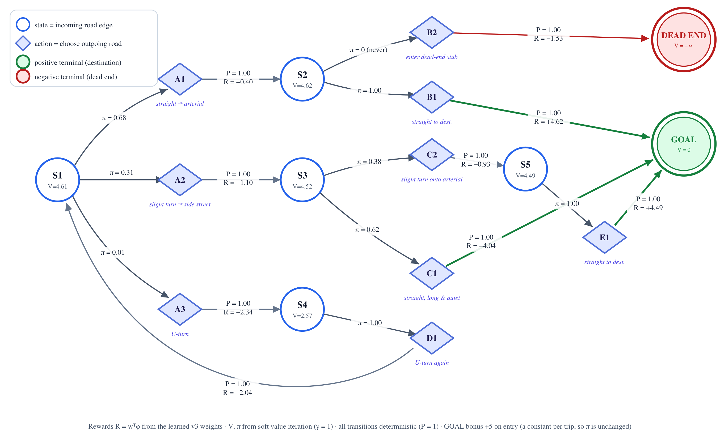
MDP FORMULATION
Worked example: states, actions, terminals
6
Notes:
Read the diagram left to right. Circles are states (incoming road edges), diamonds are actions (choose an outgoing road), arrows from diamonds carry P=1 and the reward. Green double circle is the destination: the positive terminal. Red is a dead end: the negative terminal with value minus infinity so the policy never enters it. At S1 the model prefers the straight arterial (0.68), sometimes the side street (0.31), almost never the U-turn (0.01). The +5 goal bonus is a constant per trip, so the policy is unchanged. Toy topology; the weights are the real learned ones.

Slide 7
METHOD
The reward: 11 interpretable features
What it tells us
▪ Sharp turns / U-turns strongest penalty (−1.46)
▪ Familiar edges strongest bonus (+0.87): drivers use roads other taxis use
▪ Per-step cost −0.67 prefers fewer segments
▪ Slight turns −0.52, straight is the reference
▪ Away from goal −0.29, goal-directed
▪ Identifiable reference levels + step constant fix v1 collinearity
7
Notes:
These are the learned weights from the final v3 model (single split). Sharp turns are strongly avoided, familiar edges strongly preferred, hop cost and slight turns penalised, moving away from the goal penalised. Note length and travel time are correlated (0.81), so read those two together; the earlier feature set was unidentifiable because of collinear one-hots, which we fixed with reference levels and a per-step constant.

Slide 8
METHOD
Maximum Entropy IRL with exact soft value iteration
1
Backward pass
2
Forward pass
3
Gradient
4
L-BFGS-B
Soft value iteration
V(e) = log Σ exp[R + V(e′)]
Q, π = exp(Q − V)
Expected state-visit
frequencies under π
→ E_π[φ]
∇ = E_π[φ] − φ_expert + λw
(exact, no sampling)
Update w, repeat
(~25–35 iterations)
▪ Trajectory probability P(τ|w) = exp(wᵀφ(τ)) / Z
▪ Route prediction Viterbi/Dijkstra on V(e) − Q(e,e′)
▪ Calibration extra length penalty α chosen on a validation slice, never on test
▪ Why exact small discrete MDP, so DP replaces sampling
▪ Verified finite-difference gradient test, relative error ~1e-8
▪ Cost ~13 min per fold on 8 CPU cores
8
Notes:
Outer loop: L-BFGS on weights w. Inner loop per destination: backward pass is soft value iteration, giving V and Q — dynamic programming control. Forward pass computes expected state visitation — dynamic programming prediction. Gradient is expected minus expert feature counts plus L2. Exact because the MDP is small, discrete and deterministic, no sampling. Then the most likely route is extracted with Viterbi/Dijkstra on V minus Q. Training about 13 minutes per CV fold on CPU.

Slide 9
METHOD
Data pipeline: from taxi GPS to road edges
Porto taxi GPS
HMM map matching
Edge sequences
MaxEnt IRL
Routes + demo
ECML/PKDD 2015
central bbox filter
→
7,528 tried
3,000 matched (40%)
→
5–75 edges per trip
with context
→
11 features
exact gradients
→
evaluation, API,
explainable dashboard
6,784
3,000
2,040 / 360 / 600
600
directed edges
matched trips
fit / val / test per fold
held-out test trips
3,367 nodes, central Porto
of 7,528 attempted
5-fold cross-validation
single-split CIs use these
Edge familiarity = log(1 + #trips through the edge) from an independent pool of map-matched trips, disjoint from train, validation and test.
Map-matching errors are treated as ground truth (a limitation).
9
Notes:
Porto ECML/PKDD 2015 taxi dataset, 1.7M raw trips; we filtered to central Porto and map-matched with an HMM (Leuven MapMatching): only 40% of attempted trips matched, 3,000 used. Graph from OSM, 3,367 nodes, 6,784 directed edges. Be upfront: matching errors are treated as ground truth. Familiarity counts come from a separate disjoint pool of trips to avoid leakage.

Slide 10
EXPERIMENTAL SETUP
Baselines and metrics
Baselines
Metrics
▪ Dijkstra-Shortest minimise length
▪ Dijkstra-Fastest minimise free-flow time
▪ Myopic classifier per-junction logistic regression, no destination
▪ Pop-Shortest shortest path discounted by edge popularity
▪ Edge F1 / Jaccard overlap of predicted and driven edges
▪ Path length ratio detects loops or shortcuts
▪ Top-1 / Top-3 accuracy next-road prediction at each junction
▪ Log-likelihood / trip NLL how well the model explains held-out trips
▪ Evidence 95% bootstrap CIs, paired Wilcoxon tests, 5-fold CV
10
Notes:
Four baselines. Dijkstra shortest is the strong one on taxi data. Pop-Shortest is a popularity-discounted shortest path — a simple non-IRL baseline that turned out to tie us in cross-validation, which we report honestly. Metrics: edge Jaccard and F1 for route overlap; top-k junction accuracy and log-likelihood for the probabilistic model; bootstrap CIs and paired Wilcoxon tests.

Slide 11
RESULTS
Results: learned routes beat the shortest path
0.682
Edge F1 (IRL-v3)
95% CI 0.657–0.708
+0.046
93.7%
vs Shortest
Top-1 acc.
paired p = 2.7e-5
Top-3: 99.9%
Trip NLL 5.46 (v1: 6.12)
Log-likelihood −0.155 per step
Path length ratio 0.91 vs 0.88 for shortest
11
Notes:
Single split, 600 held-out Porto trips. Calibrated IRL v3 gets edge F1 0.682 (95% CI 0.657-0.708) against 0.636 for Dijkstra shortest; paired p = 2.7e-5. Raw v3 without calibration is 0.659 (p = 0.06). Fastest is 0.454, myopic 0.162. Also point out the v1 original features lost to shortest (0.611) — that is why we redesigned the features.

Slide 12
RESULTS
Cross-validation: the gain holds, but a baseline ties
Method | Edge F1 | Jaccard
Dijkstra-Fastest | 0.478 ± 0.009 | 0.379 ± 0.008
Dijkstra-Shortest | 0.630 ± 0.003 | 0.538 ± 0.003
IRL-v3 (raw) | 0.655 ± 0.008 | 0.572 ± 0.010
IRL-v3 (calibrated) | 0.669 ± 0.010 | 0.588 ± 0.011
Pop-Shortest | 0.671 ± 0.007 | 0.594 ± 0.005
Honest takeaway
IRL beats shortest path by ~0.04 F1, but Pop-Shortest matches it. Our value: a calibrated route distribution with readable weights.
Mean ± std over 5 folds (one seed). Calibration = extra length penalty α chosen on validation data.
12
Notes:
5-fold CV, mean over folds. IRL v3 calibrated 0.669 plus or minus 0.010 versus Dijkstra shortest 0.630 plus or minus 0.003. But Pop-Shortest, a simple popularity-weighted shortest path, scores 0.671 — it ties us. So the honest reading: much of the improvement comes from the familiarity signal, and IRL's added value is a calibrated probabilistic route model with interpretable weights, not a higher F1.

Slide 13
RESULTS
What made the model work: feature-set progression
Model | Trip NLL ↓ | Top-1
v1 | 6.12 | 92.7%
v2 | 6.06 | 92.9%
v3 | 5.46 | 93.7%
▪ v1 original features lost to Dijkstra (0.611 vs 0.636, p = 0.029)
▪ v2 identifiable parameterisation + goal direction
▪ v3 + edge familiarity: biggest likelihood gain
13
Notes:
This is a real ablation of the modelling choices. v1 original features lost to Dijkstra. v2 made the parameterisation identifiable and added goal-direction; the likelihood improved only slightly. Calibration with a length penalty lifted F1. v3 added edge familiarity, which gave the largest likelihood gain — NLL 6.06 to 5.46 — and the best F1.

Slide 14
RESULTS
Ablations: familiarity and turns matter most
Turn features: likelihood collapses (NLL +1.78) but F1 rises, because validation picked a larger length penalty (α = 1.0). Overlap and likelihood disagree here. Single split, one seed: the F1 95% CI is about ±0.025.
14
Notes:
Five feature-group ablations, each retrained from scratch on the same 600 test trips. Removing familiarity costs the most F1 (-0.034) and NLL (+0.60). Removing turn features collapses the likelihood (NLL +1.78) yet F1 slightly rises: validation chose a bigger length penalty for that model; route overlap and likelihood disagree there. Goal direction and road class add almost nothing. Caveat: single split, one seed; F1 CI is about plus or minus 0.025, so only familiarity clearly exceeds noise; NLL is the cleaner signal.

Slide 15
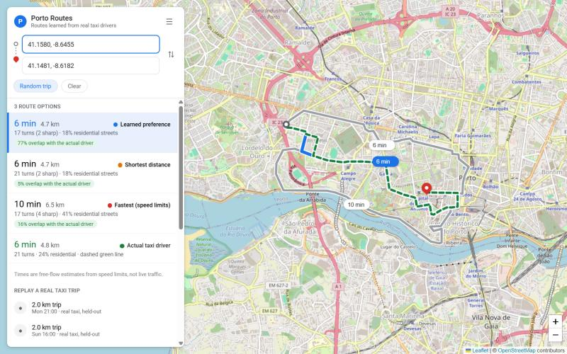
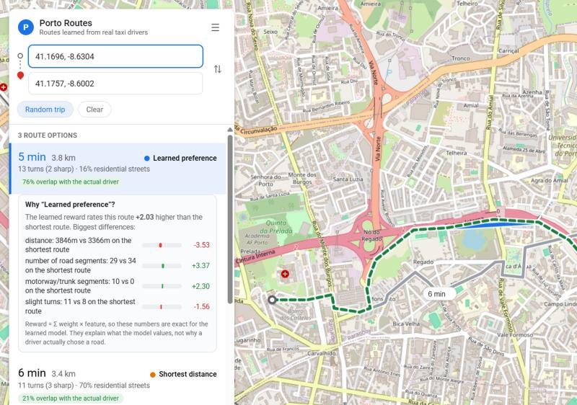
DEMO
Live demo: compare routes and ask "why this route?"
Run it
python run_api.py
open http://localhost:5000
Uses the v3 model and
validation-tuned α
▪ Compare learned vs shortest vs fastest vs the real driver
▪ Search type street names (offline, from the OSM graph) or click the map
▪ Explain exact per-feature contributions, since R = Σ weight × feature
▪ Replay held-out real taxi trips, with overlap % to the driver
15
Notes:
Demo script: open localhost:5000. Click Random trip or type a street name like Avenida da Boavista as start and Rua da Ribeira Negra as destination. Four routes appear: learned, shortest, fastest, and the real driver (dashed green). Click the learned route to open the Why panel: the reward is linear, so each feature's contribution is exact — e.g. fewer segments, motorway use and slight turns. Caveat: this explains the model, not the driver's intent. Names come from the OSM graph; landmark search would need an external geocoder.

Slide 16
DISCUSSION
Limitations and honest takeaways
Modest margin
Single seed, one city
Linear, single reward
IRL beats shortest by ~0.04 F1; a popularity-weighted shortest path ties it in CV.
Fold variation reported; seed variation and other cities not measured.
No feature interactions, one w for every driver and time of day.
Map-matching noise
Static network
Model-level explanations
Only 40% of trips matched; errors are treated as ground truth.
No congestion or time-of-day in the state; free-flow times only.
They show what the reward values, not why a driver chose a road.
16
Notes:
Be upfront: modest gain over strong baselines, popularity baseline ties us, single seed, one city, one reward for all drivers, map matching noise. The deck's value is a reproducible, interpretable benchmark and a clear picture of what drives route choice.

Slide 17
WRAP-UP
Conclusion and future work
What we showed
Future work
▪ Real data 3,000 Porto taxi trips, HMM map-matched
▪ Edge-state MDP exact MaxEnt IRL, 11 interpretable features
▪ F1 0.682 vs 0.636 significant (p = 2.7e-5), CV 0.669 vs 0.630
▪ Drivers prefer familiar roads, few turns, goal-directed moves
▪ Open demo explainable route comparison
▪ More seeds and sample-size curves
▪ Context-aware reward time of day, driver clusters
▪ Non-linear reward neural features, keep explanations
▪ Other cities and larger graphs
▪ Unknown destination infer it from a partial trip
▪ Forward RL use the learned reward for navigation or AV policy training
17
Notes:
Summarise in three sentences: we learned an interpretable reward from real taxi data; it beats shortest path significantly but modestly and is tied by a popularity baseline; the main value is the exact, reproducible, explainable pipeline. Future: seeds and sample curves, nonlinear/context rewards, more cities, unknown destination.

Slide 18
APPENDIX
References
[1] B. D. Ziebart, A. Maas, J. A. Bagnell, A. K. Dey, "Maximum entropy inverse reinforcement learning," AAAI, 2008, pp. 1433–1438.
[2] B. D. Ziebart, A. Maas, A. K. Dey, J. A. Bagnell, "Navigate like a cabbie: probabilistic reasoning from observed context-aware behavior," UbiComp, 2008.
[3] A. Y. Ng, S. J. Russell, "Algorithms for inverse reinforcement learning," ICML, 2000, pp. 663–670.
[4] P. Abbeel, A. Y. Ng, "Apprenticeship learning via inverse reinforcement learning," ICML, 2004.
[5] M. Wulfmeier, P. Ondruska, I. Posner, "Maximum entropy deep inverse reinforcement learning," arXiv:1507.04888, 2015.
[6] C. Finn, S. Levine, P. Abbeel, "Guided cost learning: deep inverse optimal control via policy optimization," ICML, 2016.
[7] D. McFadden, "Conditional logit analysis of qualitative choice behavior," Frontiers in Econometrics, 1974.
[8] P. Newson, J. Krumm, "Hidden Markov map matching through noise and sparseness," ACM SIGSPATIAL GIS, 2009.
[9] L. Moreira-Matias et al., "Predicting taxi–passenger demand using streaming data," IEEE Trans. ITS, 14(3), 2013.
[10] G. Boeing, "OSMnx: new methods for acquiring, constructing, analyzing, and visualizing complex street networks," Comput. Environ. Urban Syst., 65, 2017.
18
Notes:
Verify venue and page details against the originals before final submission.

