Slide 1


Abstractions for Creating, Synchronizing and Coordinating Threads

Slide 2
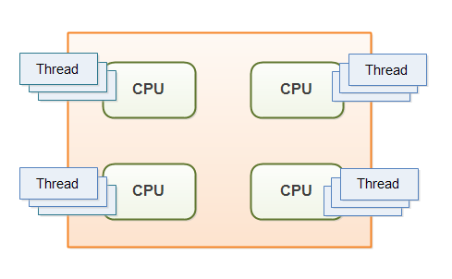
What is concurrency?

Slide 3
Languages used for programming concurrency
Language Kind | Language
Visual | Scratch
Procedural | C
Object-based | Python, Java

Slide 4
Requirements
Integration with object-based programming
Coverage of concepts provided by JAVA language
Focus on performance and programmability

Slide 5
AUTONOMOUS INTERACTING OBJECTS IN MOTION
An abstraction-independent explanation
Layered explanations
Layered worked-examples
Layered student exercises

Slide 6
Introducing concurrency and object-programming
Real-life Analogies
Prerequisite Free
Demonstrating benefits of Object-based Programming
Programmability and Performance
Synchronization Illustration
Coordination Illustration
Concurrency Visualization

Slide 7

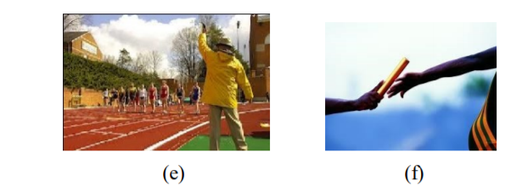
Analogies

Slide 8
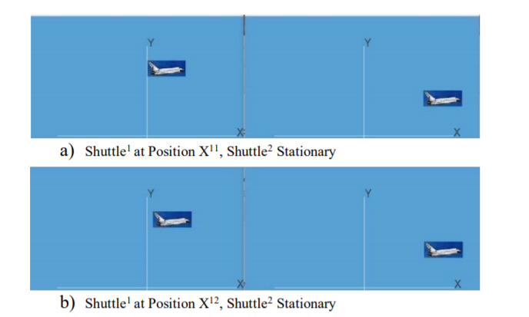
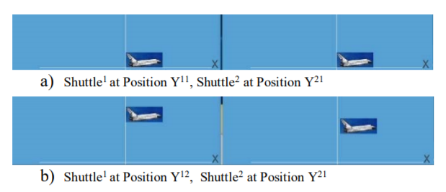
Examples

Slide 9



