Slide 1
Comparison between Dynamic Web Scripting Languages

Slide 2

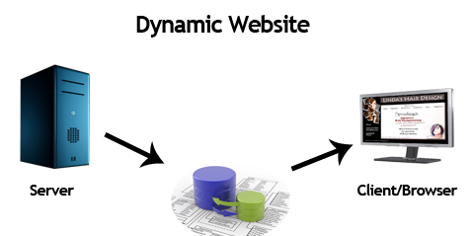
What is Dynamic Web Programming?

Slide 3



Dynamic Web Scripting Languages

Slide 4

How was it in the beginning?
HTML, which stands for Hyper Text Markup Language is a text and image formatting markup language to format WEB pages.
It was proposed by Tim Berners-Lee in 1992

Slide 5

Common Gateway Interface
CGI is an interface specification for web servers to execute programs like console applications running on a server that generates WEB pages dynamically.

Slide 6

Hypertext Preprocessor
PHP is a general-purpose scripting language especially suited to web development.
Stands for "Hypertext Preprocessor." PHP is an HTML-embedded Web scripting language.
Developed in 1995 by Rasmus Lerdorf.

Slide 7
JavaServer Pages
Jakarta Server Pages (JSP; formerly JavaServer Pages) is a collection of technologies that helps software developers create dynamically generated web pages based on HTML, XML, SOAP, or other document types.
Released in 1999 by Sun Microsystems.

Slide 8

Active Server Page
ASP.NET is an open-source, server-side web-application framework designed for web development to produce dynamic web pages.
Stands for Active Server Page. Released in 2002.

Slide 9
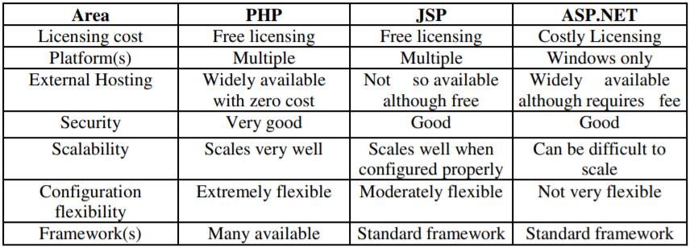
Brief Comparison

Slide 10
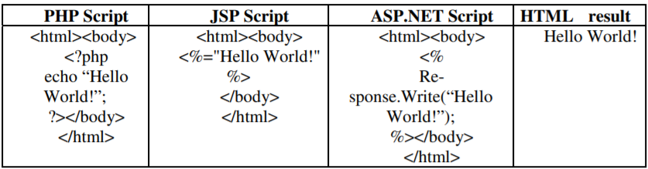
Examples of scripts

Slide 11

Client-Server Architecture

Slide 12
Experiments and Analysis
Finding the factorial of 100
Determining whether a random word having 1 million characters is a palindrome or not
Sorting a list of 1 million random integers using merge sort
Running Dijkstra’s algorithm on a graph with 1000 nodes and 5000 edges

Slide 13
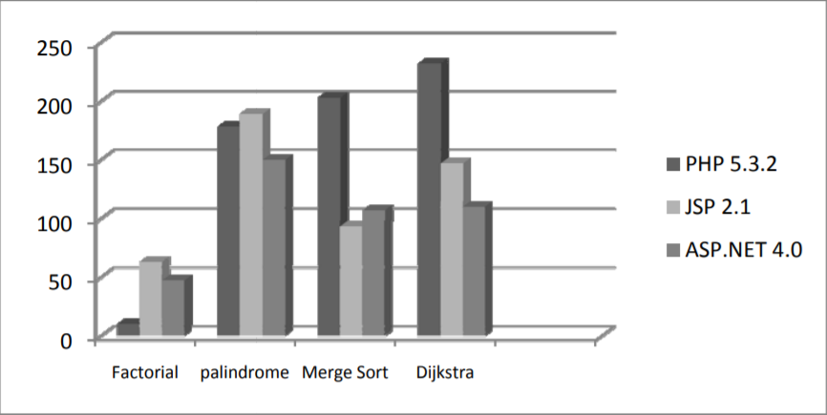

Slide 14
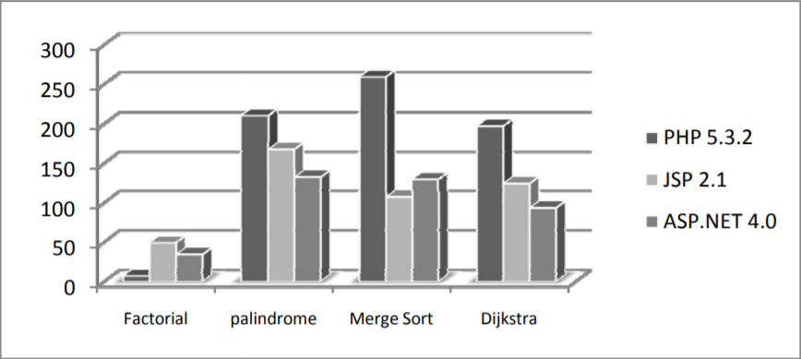

Slide 15
Summarizing comparisons
Problems pertaining to String manipulations
ASP.NET
Dijkstra’s algorithm
ASP.NET
Numerical calculations
PHP
Merge sort
JSP

