Slide 1
Real-Time Communication with SignalR

Slide 2
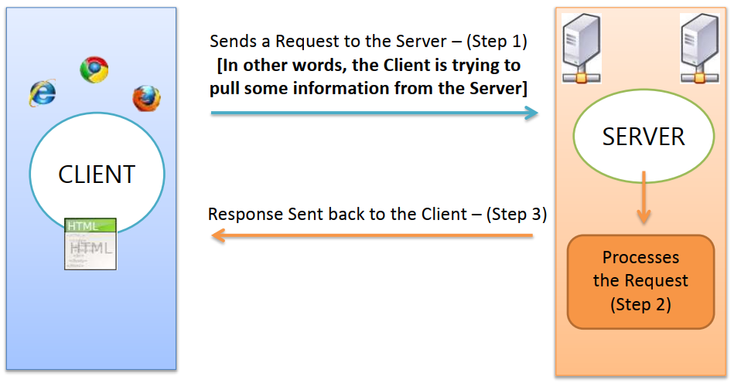
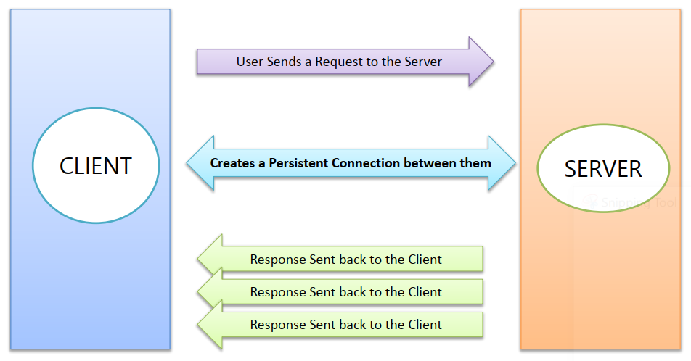
Real Time Web Applications - 1
Real Time Web Applications
Traditional Web Approach

Slide 3
Real Time Web Applications - 2
“Real Time” means an immediate response being sent by the Server to the Client.
Real Time is “Pushing” instead of “Pulling”
Push Technology is completely different from Pull Technology. Its about getting told what’s new, instead of asking for what’s new!

Slide 4
Introducing SignalR
SignalR is a library from Microsoft that offers real-time web development for ASP.NET applications.
SignalR is primarily used by applications that require push notifications from server to client (applications such as chat, stock market, gaming, and dashboards).
SignalR solves the problem by providing a persistent connection between the client and the server. SignalR uses the Hubs API to push notifications from server to client, and it supports multiple channels such as WebSocket, server-sent events, and long polling.
Notes:
signalR là thư viện open-source thêm chức năng real-time cho web
Được sử dụng bỏi các ứng dụng cần đẩy thông tin từ server về client
SignalR cung cấp 1 kết nối liên tục giữa server và client, sử dung Hubs API để đẩy noti
Tự động chọn method tốt nhất trong 3 method websockets, server-sent events và long polling trong khả năng của máy chủ và khách

Slide 5
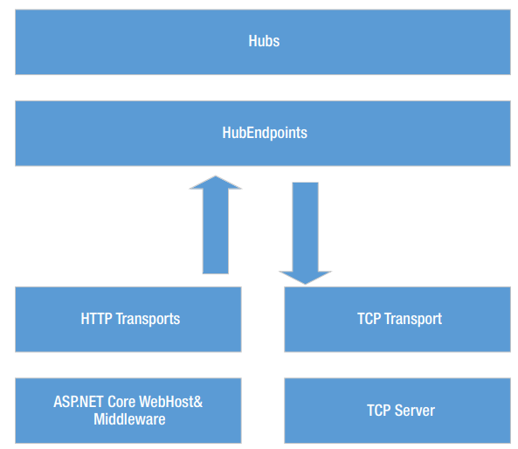
SignalR high-level architecture
The ASP.NET Core SignalR high-level architecture

Slide 6
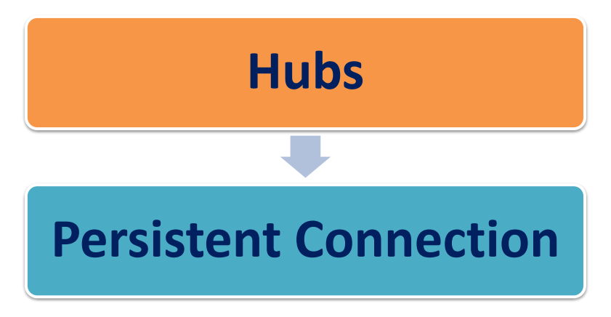
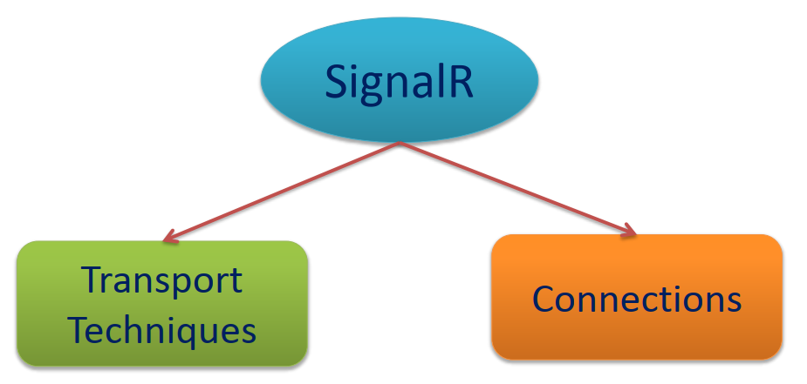
SignalR Connections
“SignalR supports "server push" functionality, in which server code can call out to client code in the browser using Remote Procedure Calls (RPC), rather than the request-response model common on the web today.

Slide 7
Hubs - 1
SignalR uses hubs to communicate between clients and servers.
A hub is a high-level pipeline that allows a client and server to call methods on each other.
SignalR provides two built-in hub protocols:
a text protocol based on JSON
a binary protocol based on MessagePack
Notes:
Hub là đường truyền cao cấp cho phép máy chủ và khách gọi phương thức lẫn nhau.
SignalR cung cấp 2 giao thức built-in là Json và messagePack

Slide 8
Hubs - 2
MessagePack generally creates smaller messages compared to JSON.
Older browsers must support XHR level 2 to provide MessagePack protocol support.
Hubs call client-side code by sending messages that contain the name and parameters of the client-side method.
Objects sent as method parameters are deserialized using the configured protocol.
The client tries to match the name to a method in the client-side code.
When the client finds a match, it calls the method and passes to it the deserialized parameter data.
Notes:
Hub gọi phương thức ở máy khách bằng cách gửi message chưa tên và tham số của phương thức
Objects được gửi như tham số của hàm sẽ được giải mã bằng giao thức đã được cấu hình
Deserialized đổi object từ byte sang đối tượng hóa có thể sử dụng được bởi ứng dụng
Khi khách tìm được 1 match, máy khách sẽ gọi hàm kèm theo tham số đã được gửi

Slide 9
Simple Chat with SignalR

Slide 10
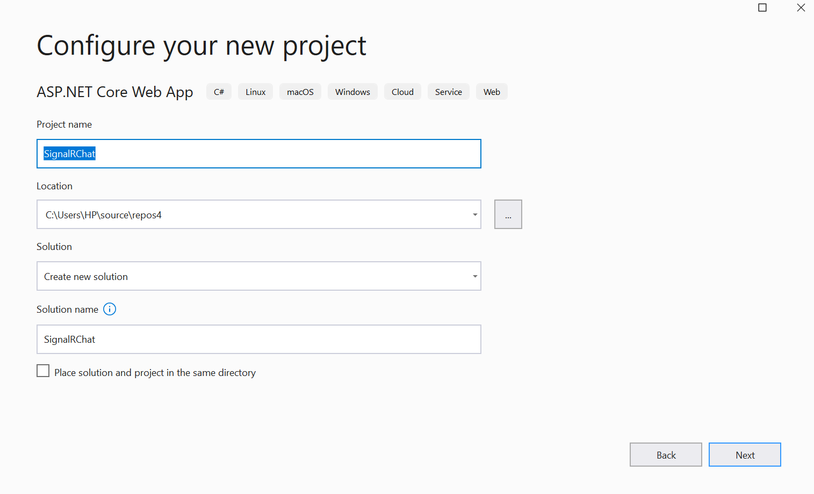
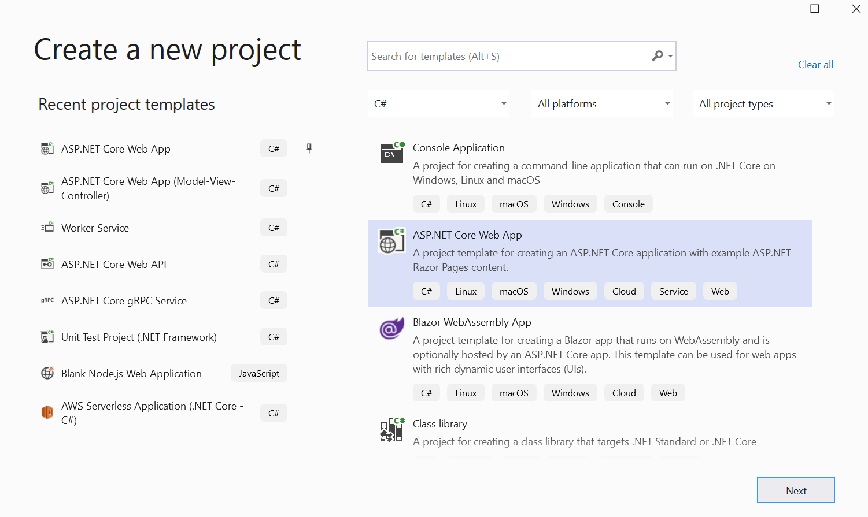
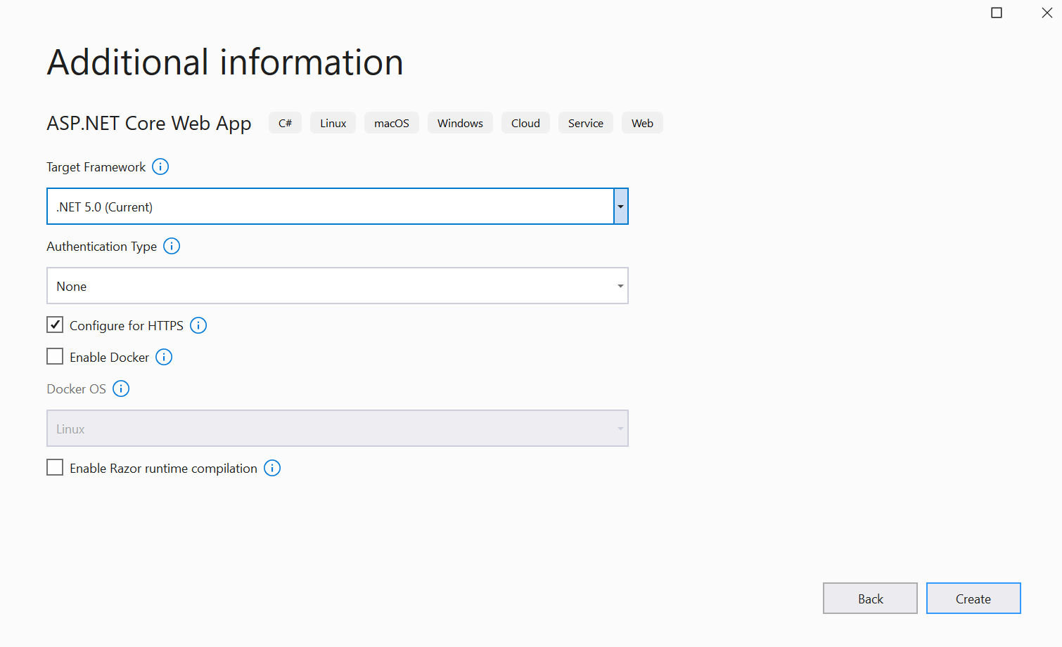
Step 1. Create a web project.

Slide 11
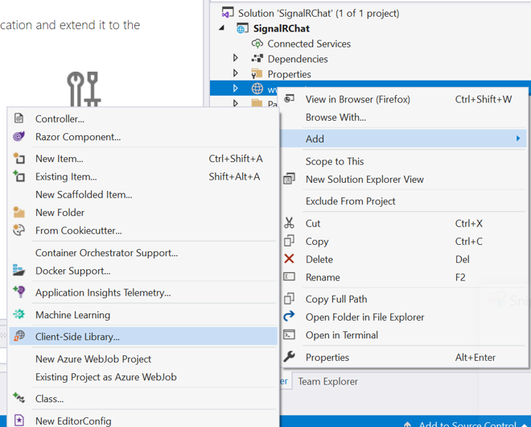
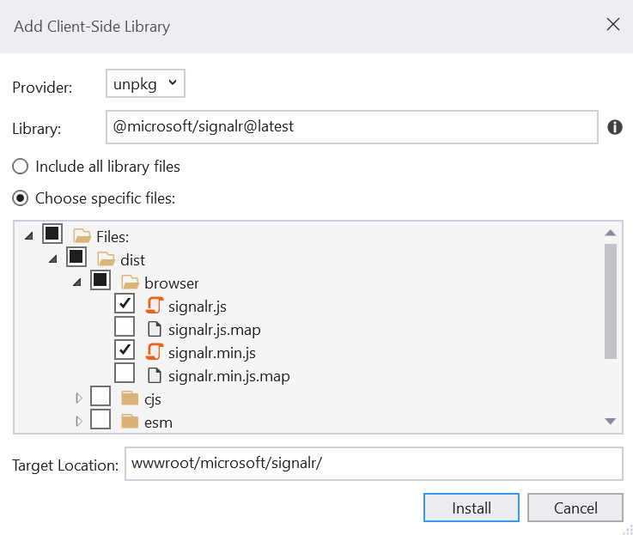
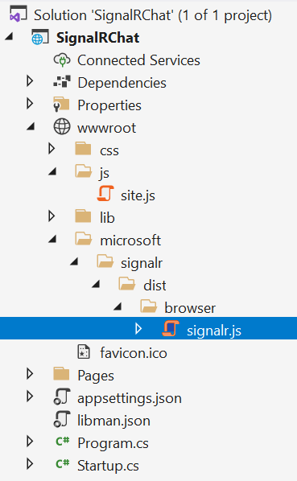
Step 2. Add the SignalR client library.

Slide 12
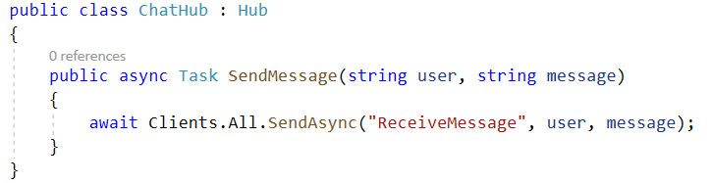
Step 3. Create a SignalR hub.
A hub is a class that serves as a high-level pipeline that handles client-server communication.
Create a ChatHub.cs
The ChatHub class inherits from the SignalR Hub class. The Hub class manages connections, groups, and messaging.
The SendMessage method can be called by a connected client to send a message to all clients.

Slide 13
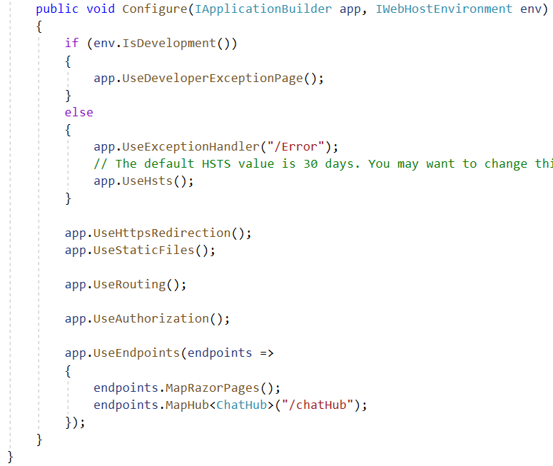
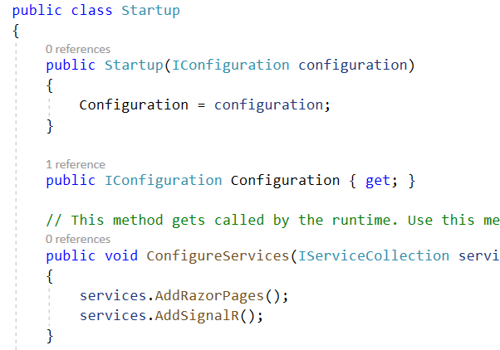
Step 4. Configure the project to use SignalR.
The SignalR server must be configured to pass SignalR requests to SignalR.

Slide 14
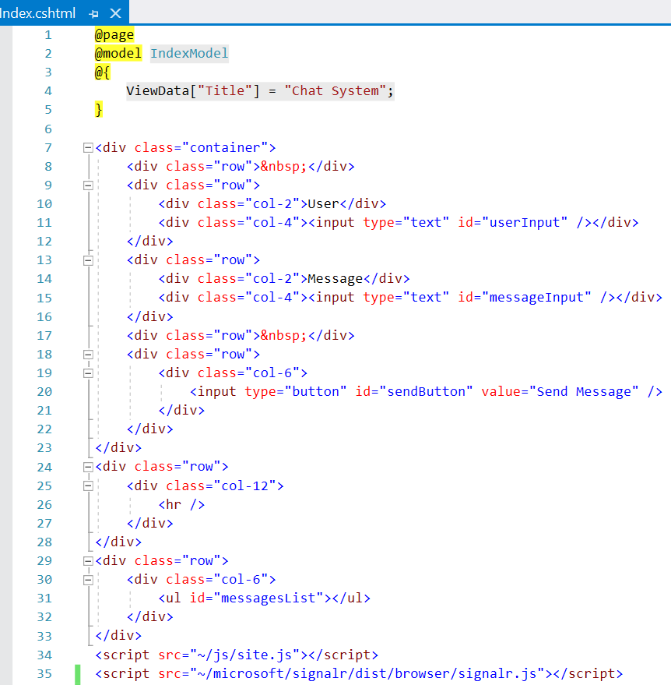
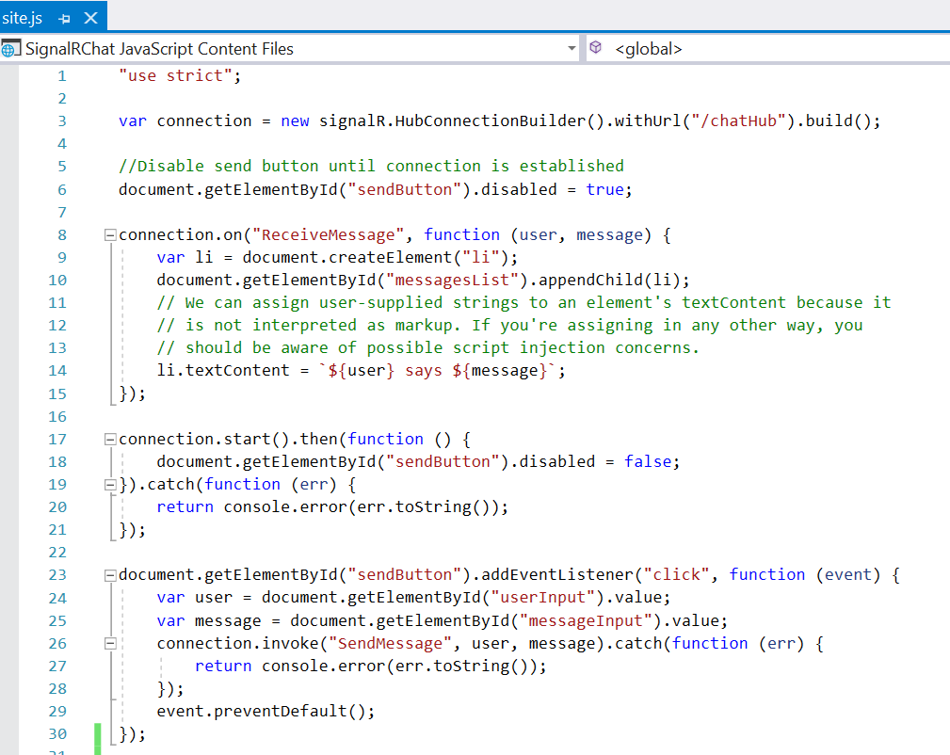
Step 5. Add code that sends messages
Add code that sends messages from any client to all connected clients

Slide 15
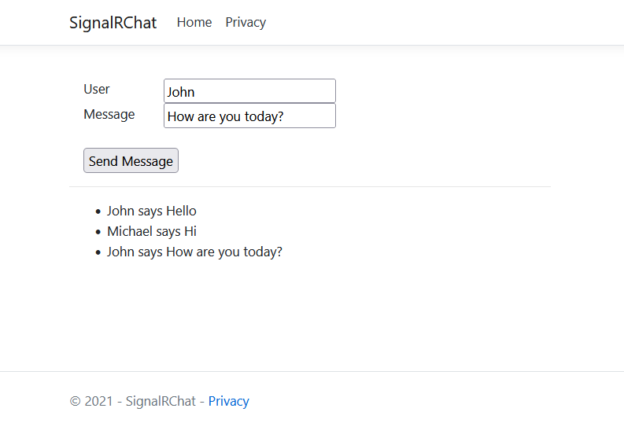
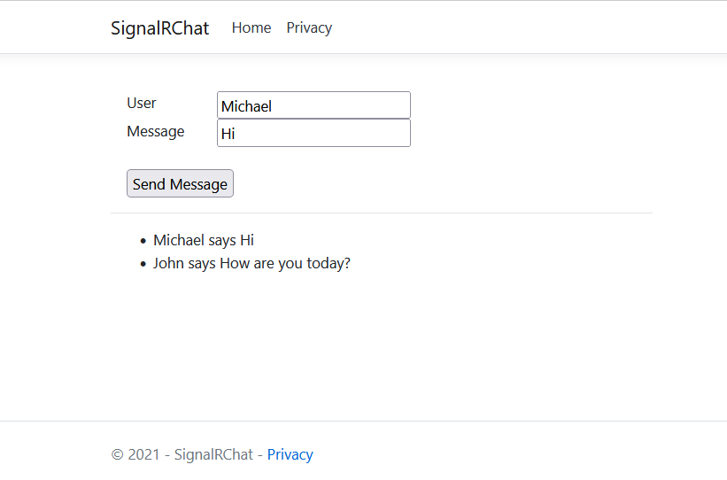
Step 6. Run application

