Slide 1
Neural Network Arena: Comparing Machine Learning Models using Long-Term Dependency and Physical System Time Series Benchmarks
Student: Hannes Brantner Direct Supervisor: Dr. Ramin Hasani Faculty Supervisor: Prof. Radu Grosu

Slide 2
Contents
Benchmarks (long-term dependency and physical system)
Models (RNN and Transformer architecture)
Results

Slide 3
quick overview on parameter optimization
each benchmark provides an input vector time series x_{n} (regularly sampled) and an expected output vector y_{truth}
each model can be understood as a parameterized function f_{θ}
the prediction of a model y_{est} is given by f_{θ}(x_{n})
the loss function L is an error measure between y_{truth} and y_{est}
taking the derivative of L(y_{truth}, y_{est}) shows how to update parameters

Slide 4
Activity Benchmark (physical system)
benchmark input: 64 subsequent measurement vectors from four inertial sensors worn on a person’s arms and feet
model output: output vector of size 7 where each vector entry stands for a category, the higher the value the more likely the category
benchmark output: classification of the person’s activity at the end of the input time series given as a single value from 0 to 6 (category index)
Loss function: sparse categorical crossentropy from logits
sample: [0,0,0,1,4.3,1.8,0.9],… → 3 (means walking)

Slide 5
Add Benchmark (long-term dependency)
benchmark input: 100 vectors of length 2 containing a value and a marker, only one value is marked in the first and second half of the sequence, values are taken uniformly from [0,1)
model output: output vector of size 1 which should contain the sum of the two marked values
benchmark output: output vector of size 1 which is exactly the sum of the two marked entries
Loss function: mean squared error
sample: …,[0.5,1],[0.3,0],…,[0.4,1],[0.1,0],… → 0.9

Slide 6
Walker Benchmark (physical system)
benchmark input: 64 subsequent state vectors of size 17 of a physics simulation where inputs are provided by a policy trained on the Walker2d-v2 OpenAI gym (MuJoCo physics engine)
model output: output vector of size 17 which represents the next state of the physics simulation
benchmark output: output vector of size 17 which is the exact next state of the physics simulation
Loss function: mean squared error
sample: [1.03,2.04,…],… → [0.46,0.95,…]

Slide 7
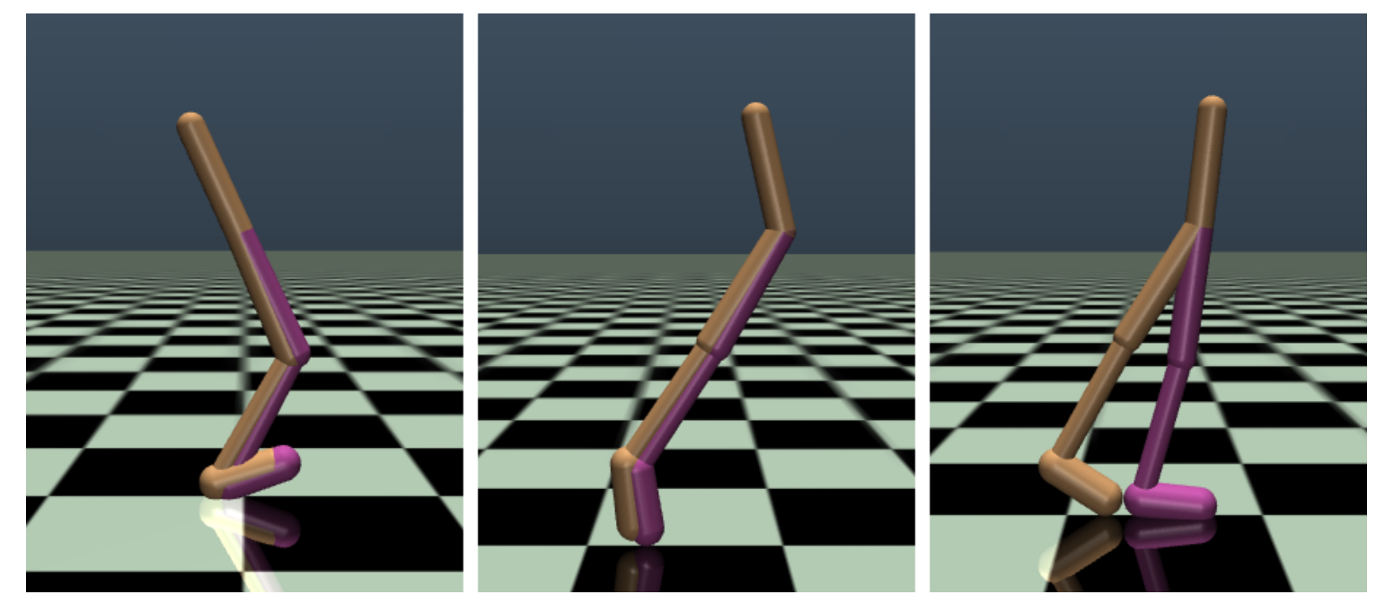

Slide 8
Memory Benchmark (long-term dependency)
benchmark input: 102 vectors of size 1, at the beginning a category index from 0 to 9, then 100 filler symbols (10), then the marker symbol 0
model output: output vector of size 10 where each vector entry stands for a category, the higher the value the more likely the category
benchmark output: category index at the beginning of the time series
Loss function: sparse categorical crossentropy from logits
sample: [5,10,…,10,0] → 5 (recall the correct category)

Slide 9
MNIST Benchmark (long-term dependency)
benchmark input: 98 vectors of size 8, which are image chunks of vectorized 28x28 MNIST images
model output: output vector of size 10 where each vector entry stands for a category (or digit in this case), the higher the value the more likely the category
benchmark output: correct category index or digit of the image
Loss function: sparse categorical crossentropy from logits
sample: [0,…,255,…],… → 3 (picture represents digit 3)

Slide 10
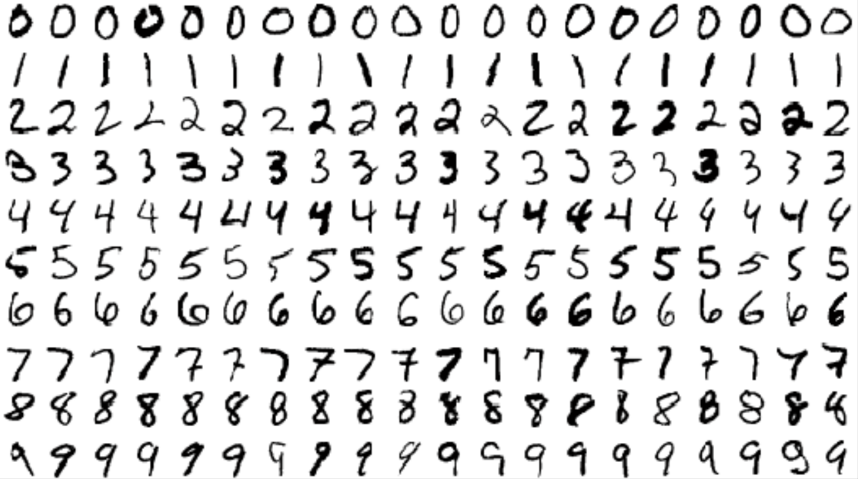

Slide 11
Cell Benchmark (long-term dependency)
benchmark input: 384 input vectors of size 2, which are a concatenation of 3 sparse activation sequences of length 128
model output: 384 output vectors of size 2 attempting to store the sparse activations
benchmark output: 384 output vectors of size 2 with stored sparse activations
Loss function: mean squared error
sample: [1,0],[0,0],…,[0,1],[0,0],… → [1,0],[1,0],…,[0,1],[0,1],…

Slide 12
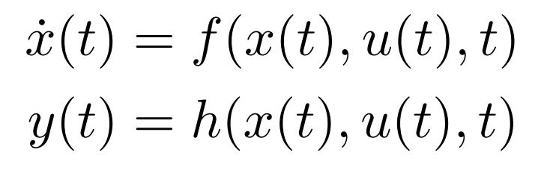
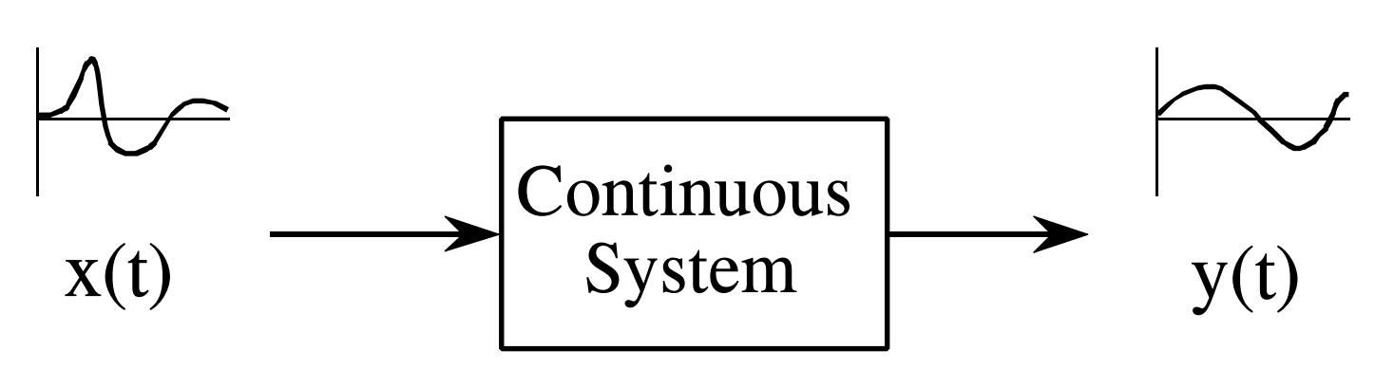
continuous-time RNN architectures (analogy)

Slide 13
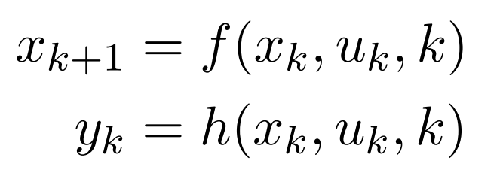
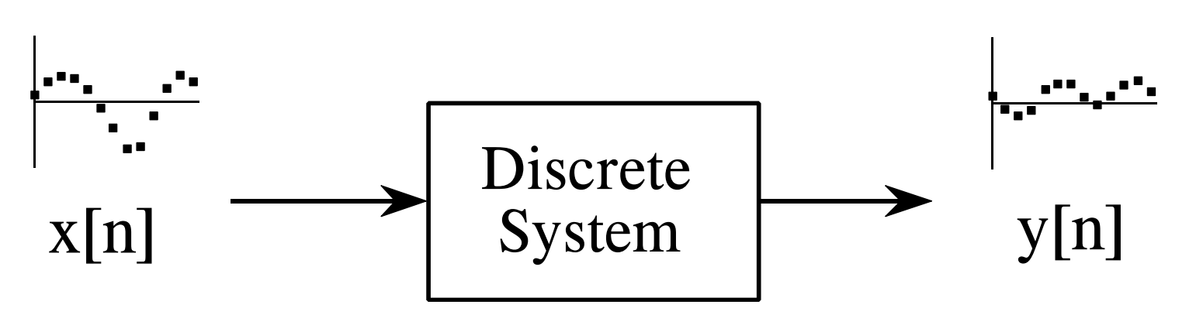
discrete-time RNN architectures (analogy)

Slide 14
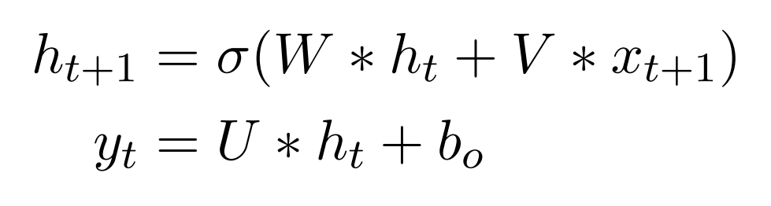
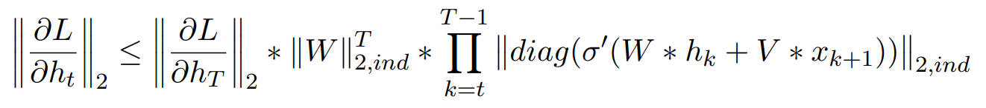
RNN – capturing long-term dependencies
T >> t:

Slide 15
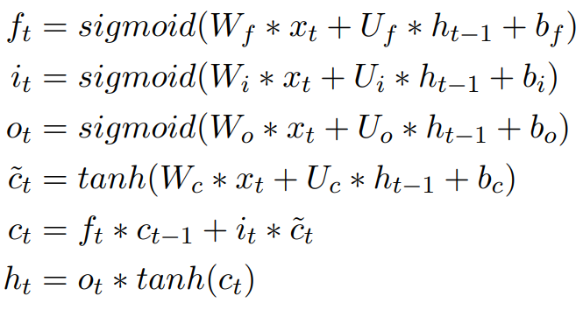
LSTM (Long Short-Term Memory)

Slide 16
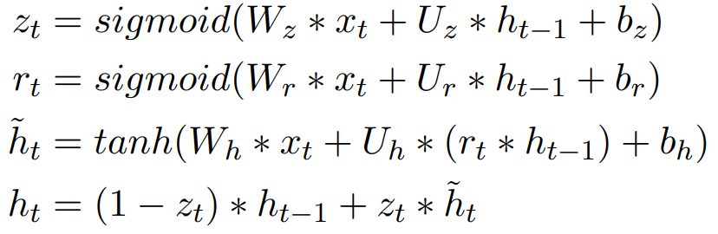
GRU (Gated Recurrent Unit)

Slide 17
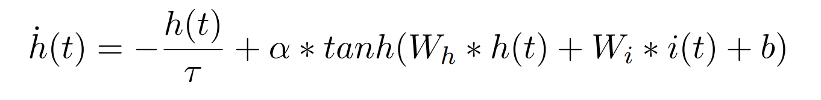
CT-RNN

Slide 18
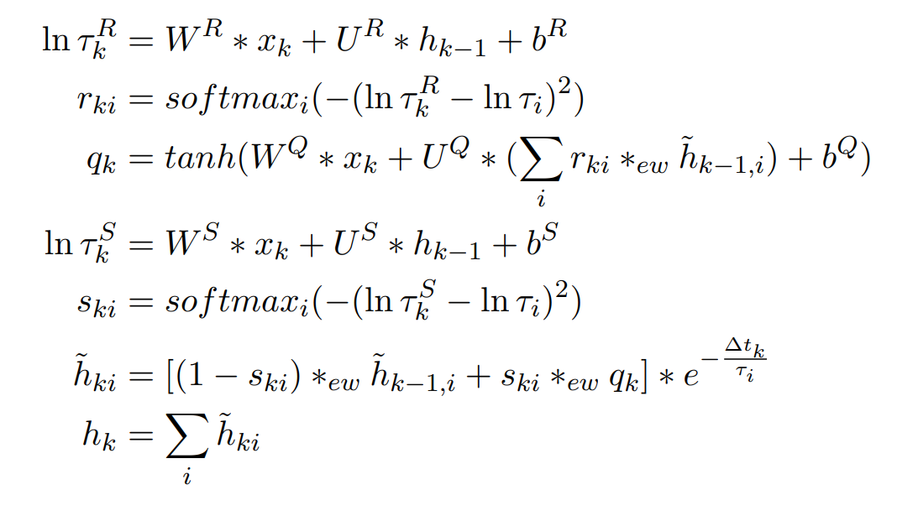
CT-GRU

Slide 19
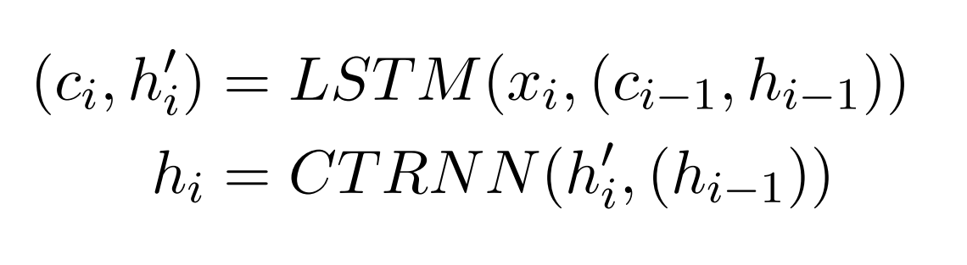
ODE-LSTM

Slide 20
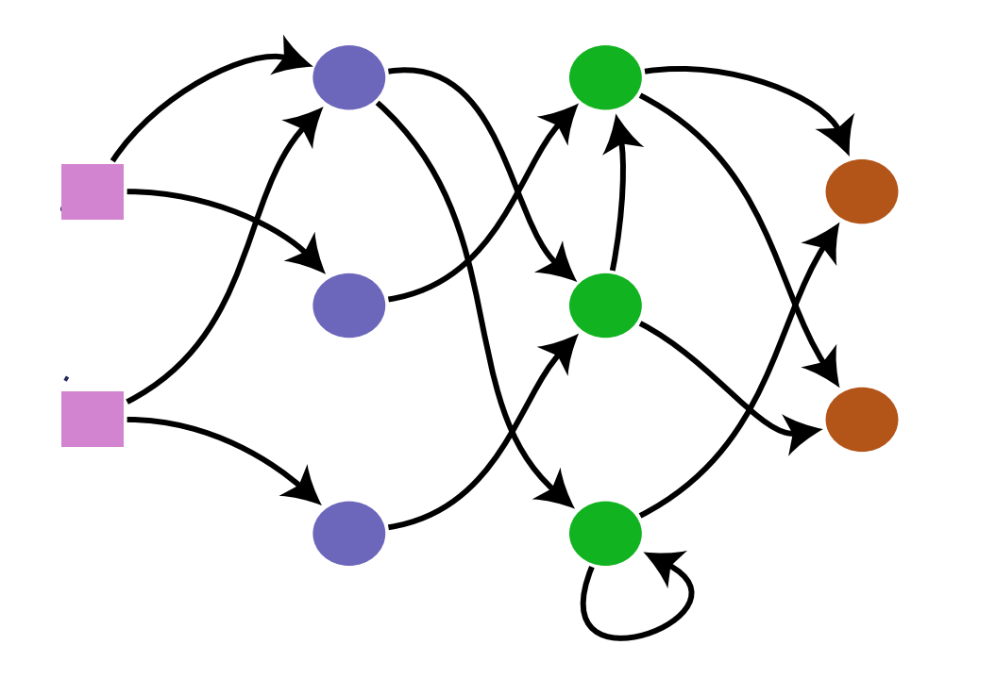
NCP (Neural Circuit Policies)

Slide 21
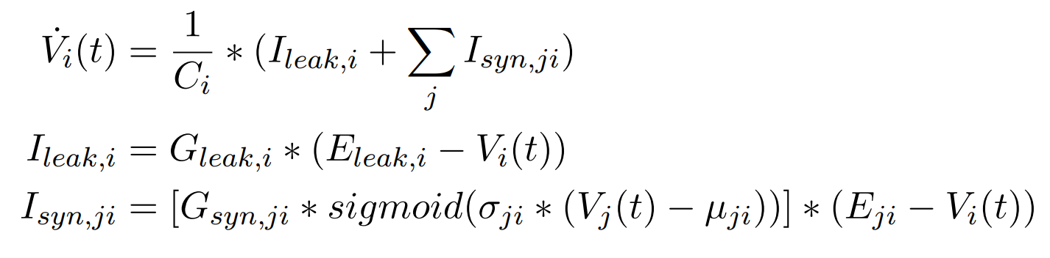
NCP (Neural Circuit Policies)

Slide 22
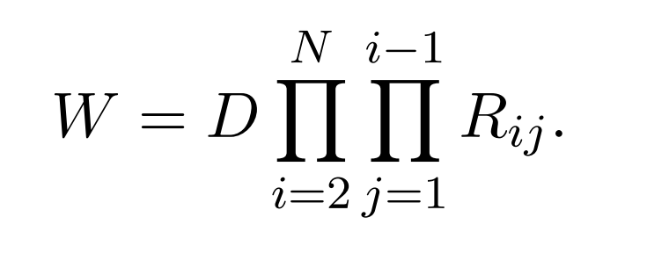
Unitary RNN

Slide 23
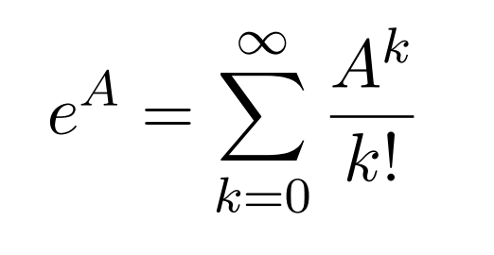
Matrix Exponential Unitary RNN (new)

Slide 24
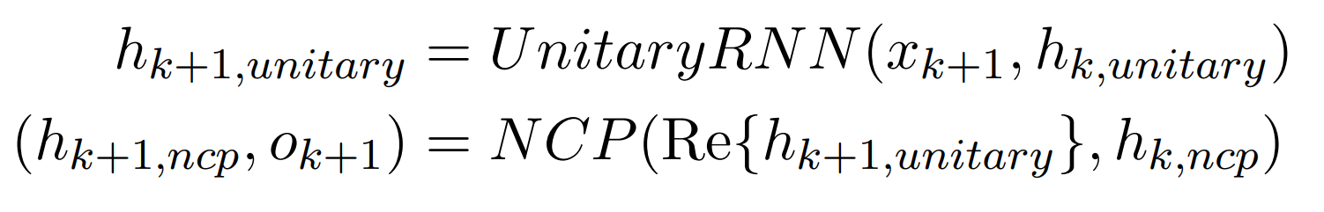
Unitary NCP (new)

Slide 25
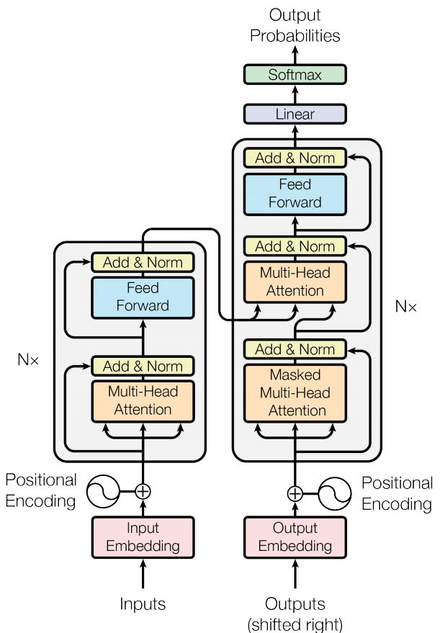
Transformer

Slide 26
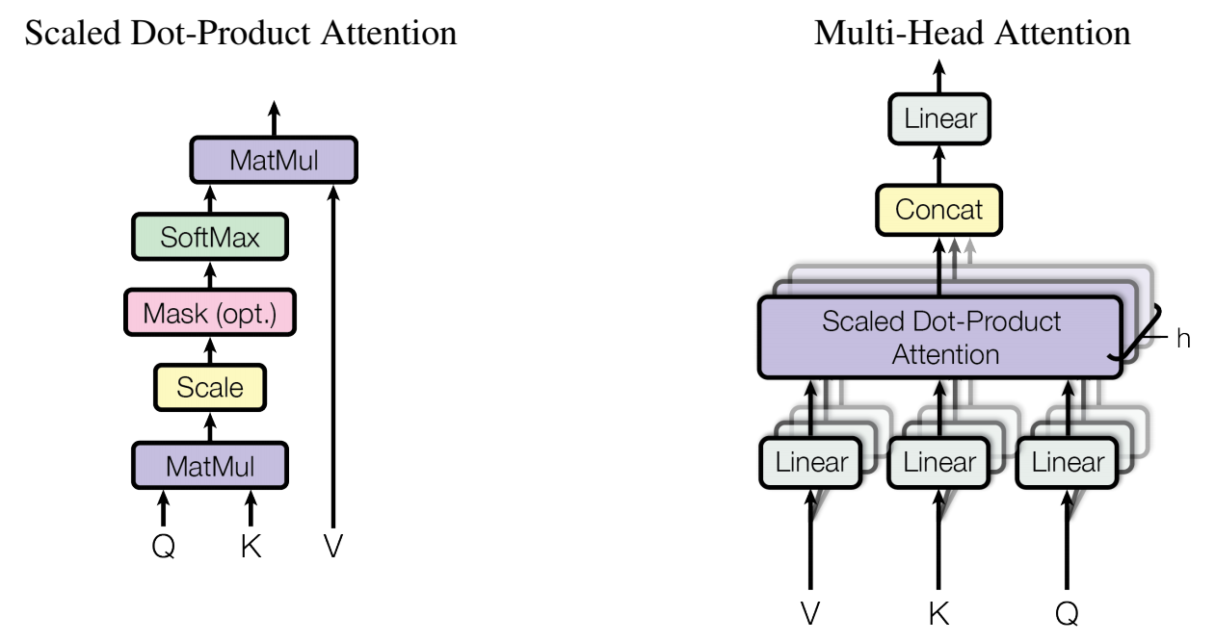
Transformer

Slide 27
Recurrent Network Augmented Transformer (new)
instead of simply adding the weighted value vectors together in the scaled dot-product attention, an LSTM is used to aggregate them

Slide 28
Recurrent Network Attention Transformer (new)
instead of using scaled dot-product attention, a Unitary RNN together with recurrent network attention is used to
only queries and values are used
attention mechanism provides a new representation for each query
Example: inputs are query vectors: q1, q2 and value vectors: v1, v2, v3 the output of the attention mechanism for q1 is the final output of the RNN after feeding the sequence: (q1,v1), (q1,v2), (q1,v3).
more heads are implemented by using different RNNs for each head

Slide 29
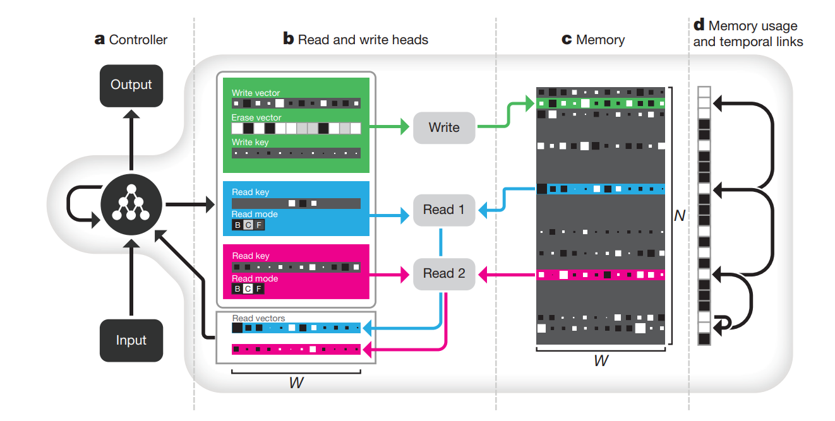
DNC (Differentiable Neural Computer)

Slide 30
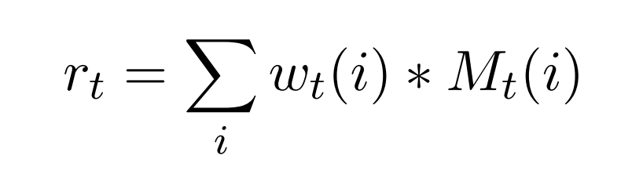
DNC – writing and reading from memory

Slide 31
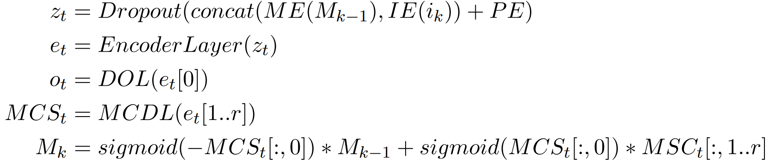
Memory Augmented Transformer (new)

Slide 32
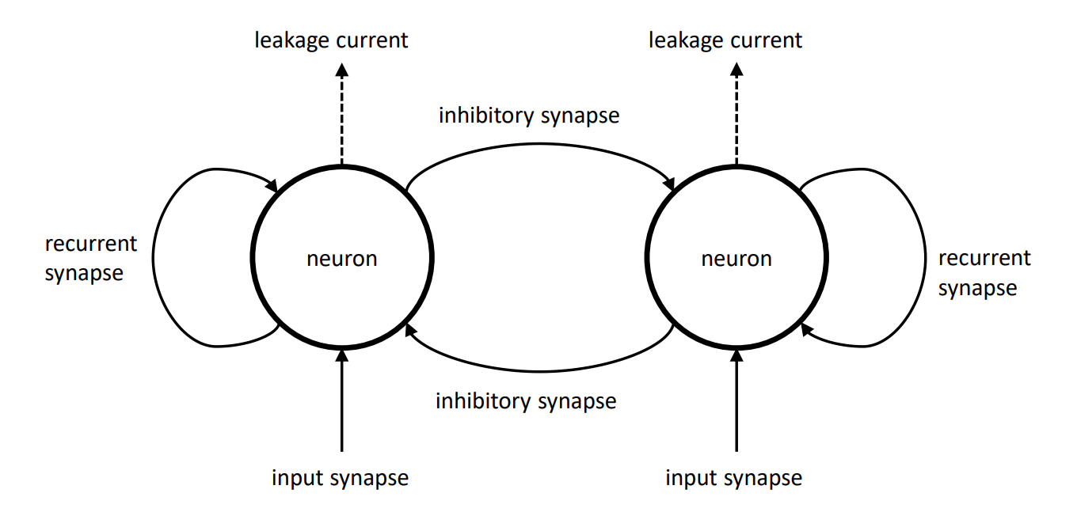
Memory Cell (new)

Slide 33
Results – remarks
all models featured roughly 20000 trainable parameters
models with less parameters due to complex model function:
Unitary RNN
NCP
Unitary NCP
Recurrent Network Augmented Transformer
Recurrent Network Attention Transformer
all experiments were repeated three times

Slide 34
Activity Benchmark
model | training duration total | test sparse categorical crossentropy
transformer | 657.964 ± 94.372 | 0.178 ± 0.022
gru | 548.685 ± 97.925 | 0.209 ± 0.065
ct_gru | 1289.666 ± 303.182 | 0.223 ± 0.040
differentiable_neural_computer | 4425.337 ± 929.309 | 0.229 ± 0.046
ode_lstm | 1127.534 ± 168.389 | 0.235 ± 0.021
lstm | 561.106 ± 56.684 | 0.245 ± 0.039
memory_augmented_transformer | 6745.386 ± 1335.496 | 0.257 ± 0.024
matrix_exponential_unitary_rnn | 4206.879 ± 917.213 | 0.336 ± 0.047
recurrent_network_augmented_transformer | 4240.549 ± 859.176 | 0.373 ± 0.016
recurrent_network_attention_transformer | 6245.701 ± 669.365 | 0.410 ± 0.019
ct_rnn | 5310.323 ± 909.814 | 0.510 ± 0.074
unitary_rnn | 6280.606 ± 1197.117 | 0.522 ± 0.030
unitary_ncp | 4386.633 ± 973.768 | 0.573 ± 0.046
neural_circuit_policies | 6353.197 ± 3362.551 | 1.088 ± 0.434

Slide 35
Add Benchmark
model | training duration total | test mean squared error
transformer | 421.042 ± 62.125 | 0.000 ± 0.000
recurrent_network_augmented_transformer | 3369.947 ± 238.022 | 0.000 ± 0.000
gru | 423.332 ± 52.080 | 0.001 ± 0.000
ct_gru | 983.703 ± 123.086 | 0.001 ± 0.000
recurrent_network_attention_transformer | 10433.169 ± 3205.297 | 0.002 ± 0.002
differentiable_neural_computer | 6138.672 ± 4012.017 | 0.007 ± 0.011
ct_rnn | 9904.616 ± 1578.008 | 0.019 ± 0.003
matrix_exponential_unitary_rnn | 5956.370 ± 1220.646 | 0.022 ± 0.032
lstm | 589.247 ± 181.783 | 0.066 ± 0.085
unitary_rnn | 9694.727 ± 2483.450 | 0.094 ± 0.076
unitary_ncp | 3283.152 ± 1513.217 | 0.106 ± 0.092
memory_augmented_transformer | 3802.347 ± 1303.816 | 0.122 ± 0.083
neural_circuit_policies | 1007.356 ± 252.374 | 0.166 ± 0.001
ode_lstm | 748.046 ± 108.977 | 0.167 ± 0.002

Slide 36
Walker Benchmark
model | training duration total | test mean squared error
ode_lstm | 1479.639 ± 82.601 | 1.159 ± 0.067
ct_rnn | 7284.599 ± 661.406 | 1.205 ± 0.040
memory_augmented_transformer | 8482.406 ± 397.415 | 1.213 ± 0.060
differentiable_neural_computer | 5224.531 ± 263.850 | 1.330 ± 0.027
gru | 574.551 ± 24.867 | 1.339 ± 0.025
lstm | 775.982 ± 51.555 | 1.363 ± 0.040
ct_gru | 1298.792 ± 146.468 | 1.526 ± 0.031
transformer | 1548.471 ± 218.343 | 1.599 ± 0.156
unitary_rnn | 9231.787 ± 589.190 | 1.622 ± 0.030
recurrent_network_augmented_transformer | 5438.420 ± 330.703 | 2.207 ± 0.059
recurrent_network_attention_transformer | 6955.163 ± 1436.109 | 2.490 ± 0.469
matrix_exponential_unitary_rnn | 3896.433 ± 2610.319 | 3.180 ± 1.406
unitary_ncp | 8292.842 ± 1105.148 | 3.438 ± 0.296
neural_circuit_policies | 8099.388 ± 2507.014 | 4.850 ± 0.128

Slide 37
Memory Benchmark
model | training duration total | test sparse categorical crossentropy
unitary_rnn | 3576.441 ± 293.414 | 0.000 ± 0.000
recurrent_network_attention_transformer | 5265.193 ± 2737.636 | 0.008 ± 0.009
matrix_exponential_unitary_rnn | 11178.496 ± 4789.471 | 0.062 ± 0.042
unitary_ncp | 4478.233 ± 3554.849 | 0.205 ± 0.338
recurrent_network_augmented_transformer | 4819.569 ± 1163.124 | 0.205 ± 0.355
ct_gru | 1183.943 ± 850.848 | 0.321 ± 0.422
transformer | 641.340 ± 214.464 | 0.362 ± 0.627
gru | 419.598 ± 197.926 | 0.768 ± 1.329
differentiable_neural_computer | 1971.082 ± 744.754 | 1.534 ± 1.328
memory_augmented_transformer | 3457.429 ± 653.695 | 2.303 ± 0.000
lstm | 231.764 ± 52.835 | 2.303 ± 0.000
neural_circuit_policies | 1750.867 ± 515.520 | 2.303 ± 0.000
ct_rnn | 2709.544 ± 224.245 | 2.303 ± 0.000
ode_lstm | 563.901 ± 89.358 | 2.303 ± 0.001

Slide 38
MNIST Benchmark
model | training duration total | test sparse categorical crossentropy
differentiable_neural_computer | 4695.074 ± 571.804 | 0.201 ± 0.025
gru | 882.416 ± 132.625 | 0.221 ± 0.015
lstm | 695.434 ± 63.874 | 0.285 ± 0.018
recurrent_network_attention_transformer | 11926.374 ± 3235.949 | 0.354 ± 0.070
unitary_rnn | 6211.725 ± 2629.199 | 0.365 ± 0.050
ode_lstm | 1063.088 ± 74.767 | 0.372 ± 0.069
ct_gru | 2287.787 ± 474.193 | 0.588 ± 0.038
transformer | 1097.666 ± 75.003 | 0.654 ± 0.082
matrix_exponential_unitary_rnn | 5700.014 ± 1943.402 | 0.712 ± 0.215
recurrent_network_augmented_transformer | 9250.855 ± 4071.886 | 0.754 ± 0.130
ct_rnn | 5741.032 ± 2668.638 | 1.164 ± 0.026
memory_augmented_transformer | 3896.794 ± 2556.562 | 1.313 ± 0.112
neural_circuit_policies | 7386.977 ± 723.096 | 1.624 ± 0.168
unitary_ncp | 1590.662 ± 966.124 | 1.876 ± 0.319

Slide 39
Cell Benchmark
model | training duration total | test mean squared error
memory_cell | 631.731 ± 7.779 | 0.000 ± 0.000

