Slide 1
Neural Network Arena: Investigating Long-Term Dependencies in Deep Models
Student: Hannes Brantner Direct Supervisor: Dr. Ramin Hasani Faculty Supervisor: Prof. Radu Grosu

Slide 2
Problem Statement
Implement a selection of state-of-the-art sequence models as well as possible improvements and newly introduced sequence models
Design and implement a reusable benchmark suite that tests the models for their capabilities to capture long-term dependencies and to model physical systems
Thoroughful comparison of all models using this benchmark suite
Proof-of-concept design and implementation of a continuous-time memory cell architecture based on LTC networks

Slide 3
Explanation of Terms
input vector sequence
sequence model (parameterizable function)
output vector (or output vector sequence)
a benchmark suite is a collection of benchmarks, a benchmark is a collection of expected input-output pairs
capture long-term dependencies: [[5],[6],[13],[2],[11], …] → [5]
model physical systems: e.g.: model the scalar output of an electrical circuit given the history of the scalar inputs
LTC networks: biologically inspired neuron model interconnected with synapses

Slide 4
Gradient Descent
A benchmark is a collection of input-output pairs, where the input is denoted as x and the output is denoted as y
The model applies its function to the input x which yields ŷ
The loss function L measures the error between y and ŷ
The loss function derivative with respect to the model parameters gives hints on how to update the parameters
The loss surface is the loss function plotted for all model parameter values

Slide 5
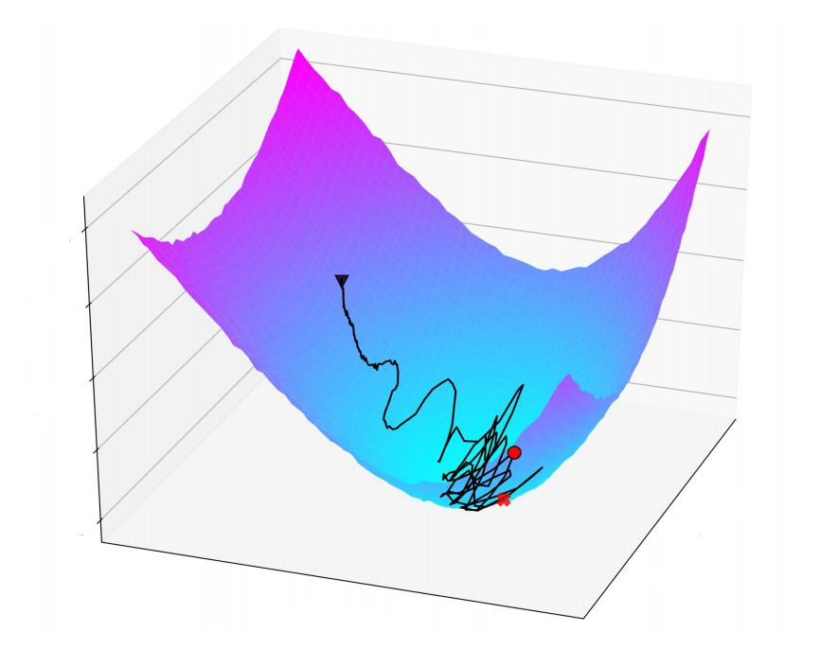
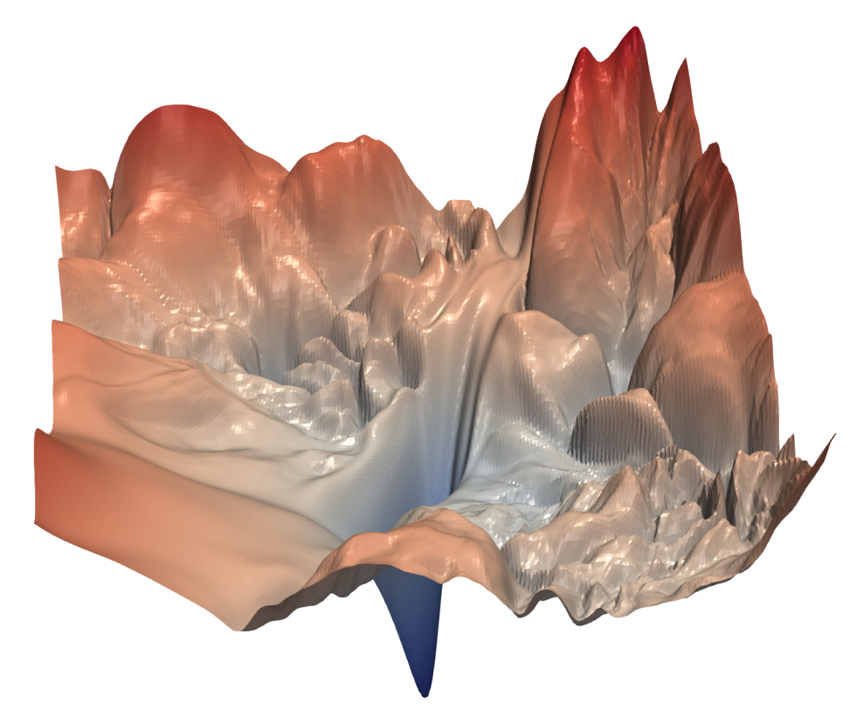
Loss Surface Examples
smooth loss surface
rugged loss surface

Slide 6
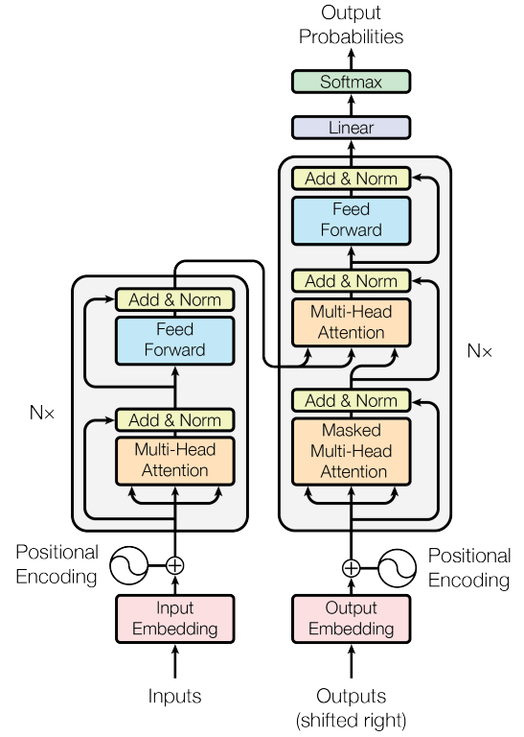

Used Sequence Model Families
RNN (Recurrent Neural Network) architecture
Transformer architecture

Slide 7
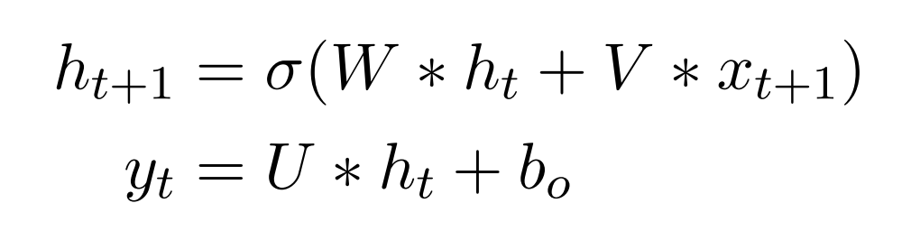
RNN architecture
RNN architecture model function
loss function gradient norm inequality for T>t

Slide 8
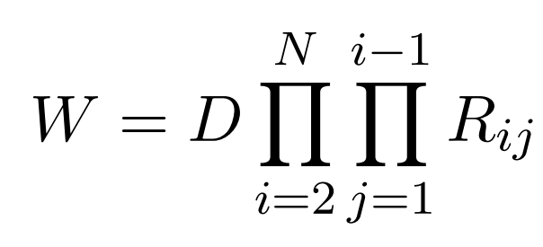
Unitary Matrix Parametrization (SOA)
… first step
… second step
… third step

Slide 9
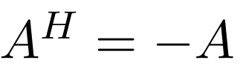
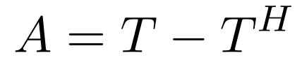
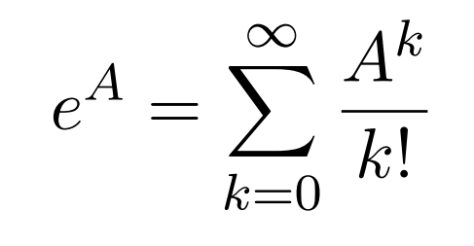

Unitary Matrix Parametrization (my approach)
… first step
… second step
… third step

Slide 10
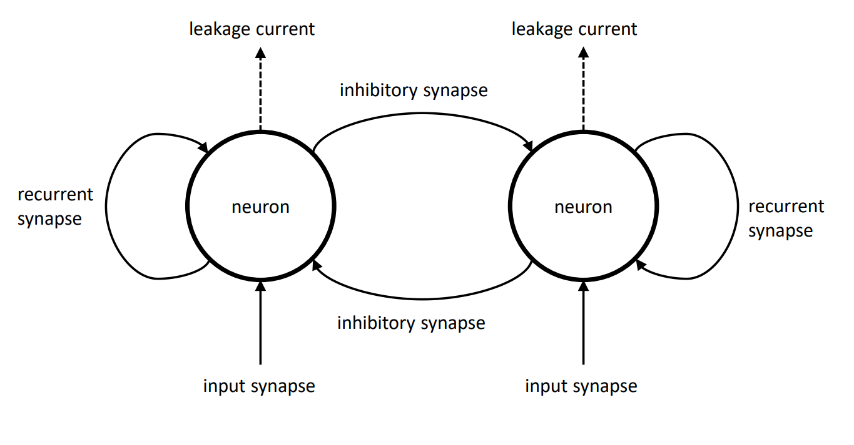
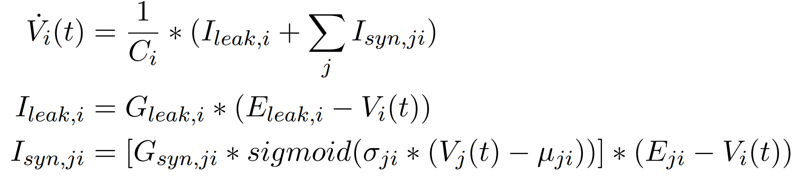
Memory Cell Architecture
LTC network model function
Memory Cell Architecture

Slide 11
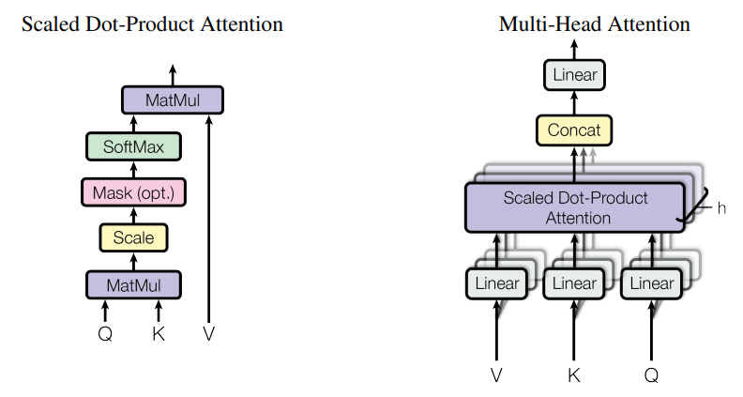
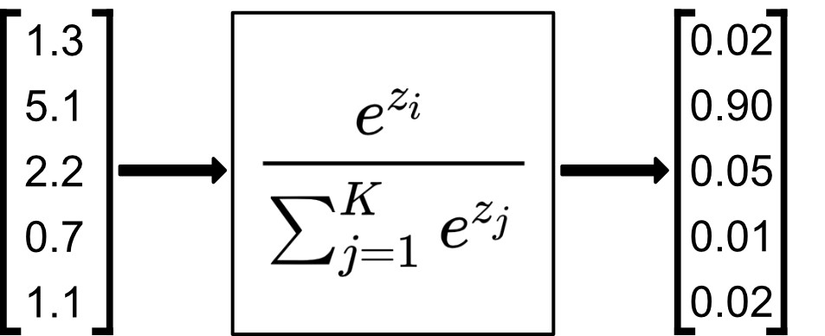
Transformer Architecture
Transformer architecture
softmax function

Slide 12
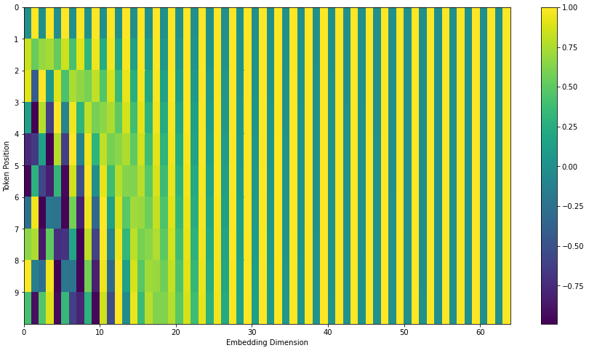
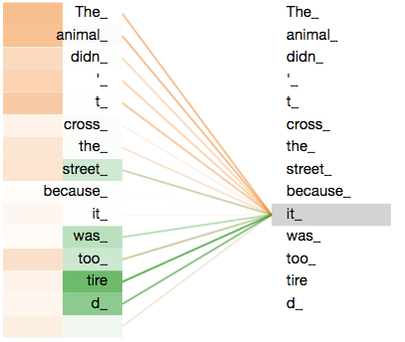
Transformer Architecture
attention weights
positional encoding

Slide 13
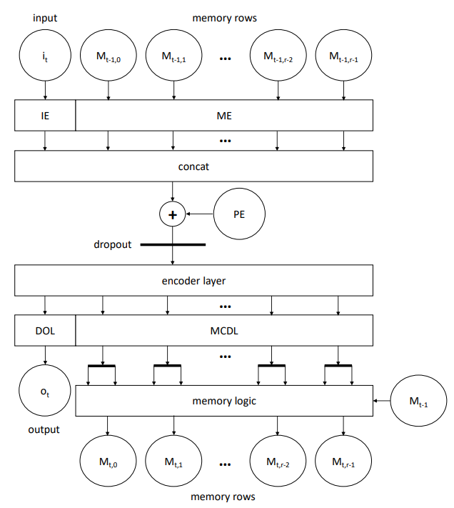
Memory Augmented Transformer

Slide 14
Benchmarks
Activity Benchmark - human activity classification of inertial sensor measurement data sequences
Add Benchmark - adding up two marked numbers in a very long number sequence
Walker Benchmark - predict the next state of a physics simulation given a sequence of previous simulation states
Memory Benchmark - store a seen category exactly and recall it after seeing a sequence of irrelevant filler symbols
MNIST Benchmark - digit classification using a sequence of MNIST handwritten digit image chunks
Cell Benchmark - validates if sparse activations are correctly stored in the time-continuous memory cell architecture

Slide 15
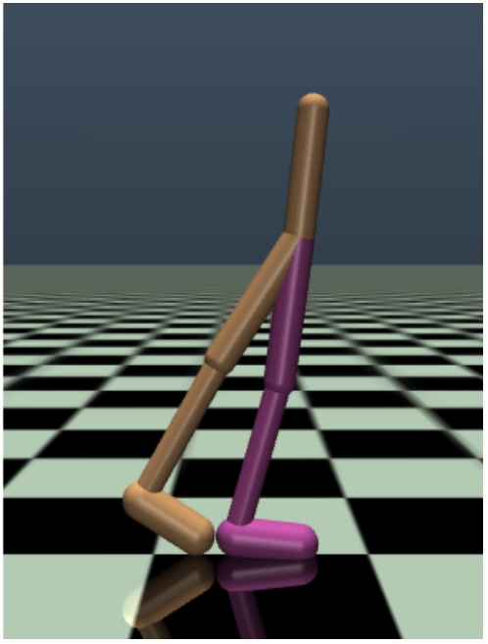
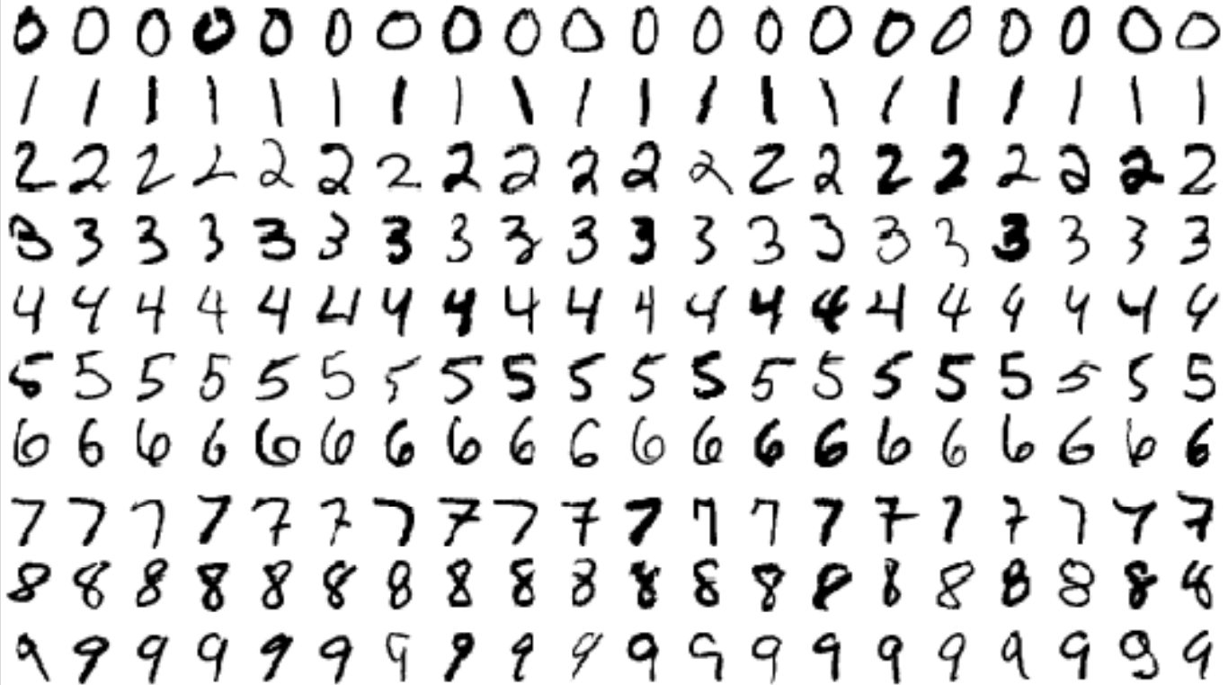
Benchmark Visualizations
MNIST handwritten digits
physics simulation

Slide 16
Results – Unitary RNNs (N=3)
model | trainable parameters | training duration total [s] | training duration per epoch [s] | epochs | test mean squared error
matrix_exponential_unitary_rnn | 17409 | 5956.370 ± 1220.646 | 115.400 ± 11.578 | 51.333 ± 6.028 | 0.022 ± 0.032
unitary_rnn | 2929 | 9694.727 ± 2483.450 | 278.442 ± 11.350 | 35.000 ± 9.849 | 0.094 ± 0.076
Add Benchmark
model | trainable parameters | training duration total [s] | training duration per epoch [s] | epochs | test sparse categorical crossentropy | test sparse categorical accuracy
unitary_rnn | 3834 | 3576.441 ± 293.414 | 282.500 ± 2.493 | 12.667 ± 1.155 | 0.000 ± 0.000 | 1.000 ± 0.000
matrix_exponential_unitary_rnn | 19466 | 11178.496 ± 4789.471 | 110.305 ± 3.039 | 102.000 ± 45.033 | 0.062 ± 0.042 | 1.000 ± 0.000
Memory Benchmark

Slide 17
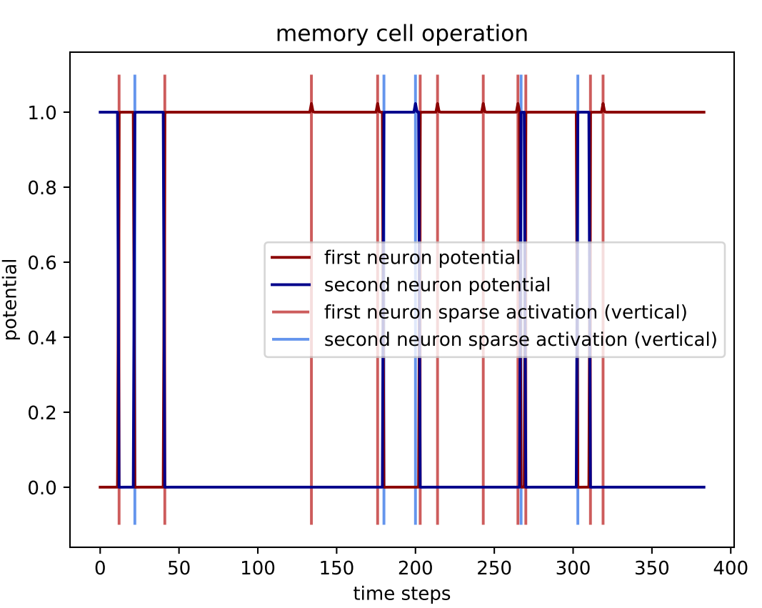
Results – Memory Cell Architecture
Memory Cell Architecture

Slide 18
Results – Transformer Architecture (N=3)
model | trainable parameters | training duration total [s] | training duration per epoch [s] | epochs | test sparse categorical crossentropy | test sparse categorical accuracy
unitary_rnn | 3834 | 3576.441 ± 293.414 | 282.500 ± 2.493 | 12.667 ± 1.155 | 0.000 ± 0.000 | 1.000 ± 0.000
transformer | 22170 | 641.340 ± 214.464 | 31.795 ± 1.909 | 20.000 ± 6.000 | 0.362 ± 0.627 | 0.832 ± 0.290
Memory Benchmark
model | trainable parameters | training duration total [s] | training duration per epoch [s] | epochs | test sparse categorical crossentropy | test sparse categorical accuracy
differentiable_neural_computer | 27039 | 4695.074 ± 571.804 | 148.336 ± 0.894 | 31.667 ± 4.041 | 0.201 ± 0.025 | 0.940 ± 0.006
transformer | 22282 | 1097.666 ± 75.003 | 29.961 ± 0.477 | 36.667 ± 3.055 | 0.654 ± 0.082 | 0.769 ± 0.037
MNIST Benchmark

Slide 19
Results – Memory Augmented Transformer (N=3)
model | trainable parameters | training duration total [s] | training duration per epoch [s] | epochs | test mean squared error
differentiable_neural_computer | 24774 | 6138.672 ± 4012.017 | 152.861 ± 2.424 | 40.333 ± 26.858 | 0.007 ± 0.011
memory_augmented_transformer | 18066 | 3802.347 ± 1303.816 | 283.514 ± 8.116 | 13.333 ± 4.163 | 0.122 ± 0.083
Add Benchmark
model | trainable parameters | training duration total [s] | training duration per epoch [s] | epochs | test mean squared error
memory_augmented_transformer | 19074 | 8482.406 ± 397.415 | 187.573 ± 15.380 | 45.333 ± 2.517 | 1.213 ± 0.060
differentiable_neural_computer | 29910 | 5224.531 ± 263.850 | 101.772 ± 0.303 | 51.333 ± 2.517 | 1.330 ± 0.027
Walker Benchmark

Slide 20
Results – Tables (N=3)
model | trainable parameters | training duration total | training duration per epoch | epochs | test sparse categorical crossentropy | test sparse categorical accuracy
transformer | 22167 | 657.964 ± 94.372 | 19.973 ± 0.446 | 33.000 ± 5.196 | 0.178 ± 0.022 | 0.937 ± 0.010
gru | 21927 | 548.685 ± 97.925 | 13.752 ± 0.277 | 40.000 ± 7.810 | 0.209 ± 0.065 | 0.929 ± 0.021
ct_gru | 21991 | 1289.666 ± 303.182 | 31.936 ± 0.483 | 40.333 ± 9.074 | 0.223 ± 0.040 | 0.922 ± 0.014
differentiable_neural_computer | 26540 | 4425.337 ± 929.309 | 102.129 ± 1.515 | 43.333 ± 9.018 | 0.229 ± 0.046 | 0.915 ± 0.017
ode_lstm | 27207 | 1127.534 ± 168.389 | 29.398 ± 0.503 | 38.333 ± 5.508 | 0.235 ± 0.021 | 0.914 ± 0.009
lstm | 18887 | 561.106 ± 56.684 | 13.786 ± 0.216 | 40.667 ± 3.512 | 0.245 ± 0.039 | 0.909 ± 0.013
memory_augmented_transformer | 18424 | 6745.386 ± 1335.496 | 186.745 ± 6.089 | 36.000 ± 6.000 | 0.257 ± 0.024 | 0.911 ± 0.008
matrix_exponential_unitary_rnn | 20231 | 4206.879 ± 917.213 | 72.567 ± 2.383 | 58.000 ± 12.490 | 0.336 ± 0.047 | 0.883 ± 0.015
recurrent_network_augmented_transformer | 3871 | 4240.549 ± 859.176 | 95.246 ± 4.026 | 44.333 ± 7.095 | 0.373 ± 0.016 | 0.868 ± 0.010
recurrent_network_attention_transformer | 2491 | 6245.701 ± 669.365 | 170.609 ± 4.495 | 36.667 ± 4.619 | 0.410 ± 0.019 | 0.852 ± 0.007
ct_rnn | 18439 | 5310.323 ± 909.814 | 123.450 ± 0.472 | 43.000 ± 7.211 | 0.510 ± 0.074 | 0.810 ± 0.029
unitary_rnn | 4983 | 6280.606 ± 1197.117 | 176.368 ± 2.639 | 35.667 ± 7.234 | 0.522 ± 0.030 | 0.808 ± 0.014
unitary_ncp | 3579 | 4386.633 ± 973.768 | 104.291 ± 1.551 | 42.000 ± 8.888 | 0.573 ± 0.046 | 0.801 ± 0.032
neural_circuit_policies | 2857 | 6353.197 ± 3362.551 | 126.264 ± 0.247 | 50.333 ± 26.652 | 1.088 ± 0.434 | 0.603 ± 0.197
Activity Benchmark

Slide 21
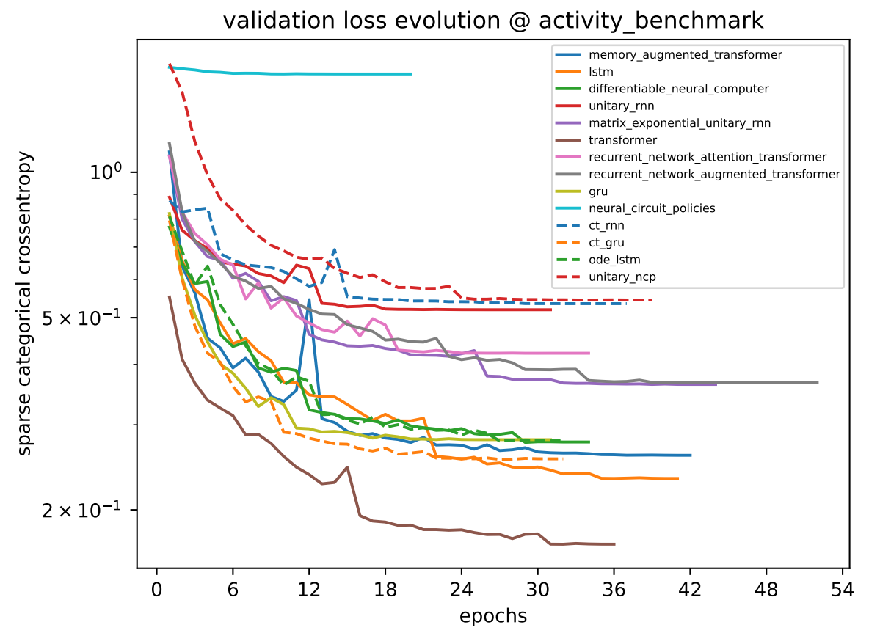
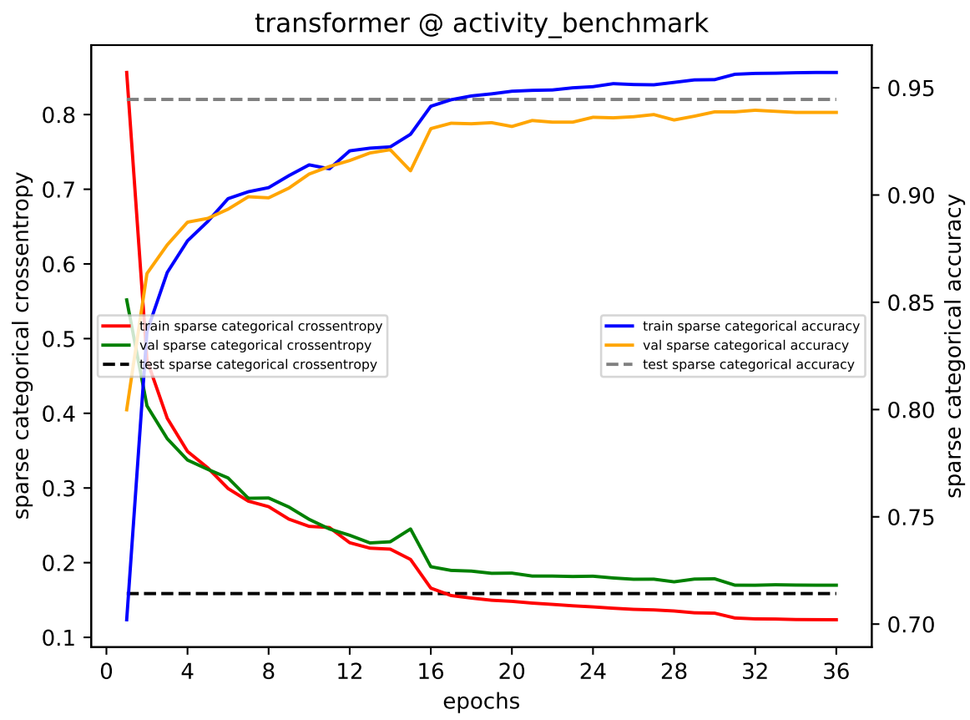
Results – Plots

Slide 22
Future Work
better hyperparameter space exploration (including trying out different batch sizes, optimizers and learning rates)
explore initialization strategies for the Matrix Exponential Unitary RNN and the Memory Augmented Transformer
simplification/approximation of the LTC network model function is desired
improve the Transformer model to incorporate positional information more effectively
improve Memory Augmented Transformer model function to make the training more stable

