Slide 1
Capturing Long-Term Dependencies in Neural Regulatory Networks
Faculty Supervisor: Univ.-Prof. Dr.rer.nat. Radu Grosu
Direct Supervisor: Dr. Ramin Hasani
Hannes Brantner

Slide 2
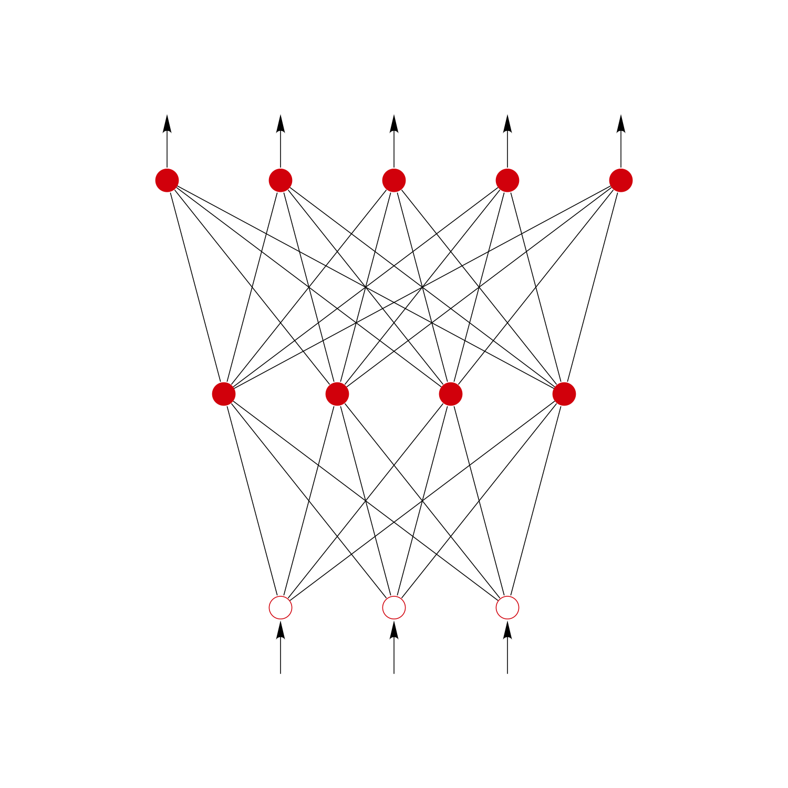
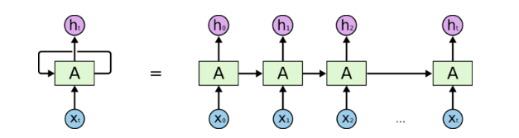
sequence modelling
ht+1 = fp(xt+1, ht)
yt+1 = op(ht+1)
y = fp(x)
feed-forward neural network
recurrent neural network (RNN)

Slide 3

scalar loss function - L(p)
gradient descent step - ∀i: pi -= lr * ∂L/∂pi(p)

Slide 4
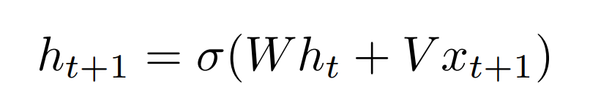
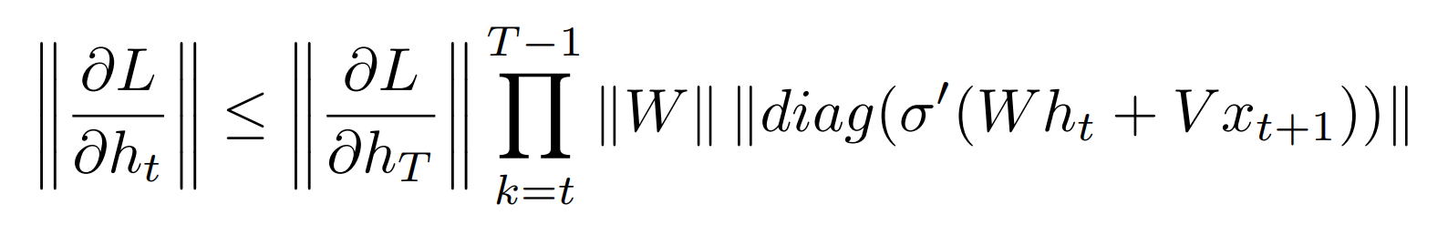
next state equation
for T >> t:
1 for σ(x) = max(0, x)

Slide 5
Unitary RNN
Unitary RNNs ensure that ||W|| = 1

Slide 6
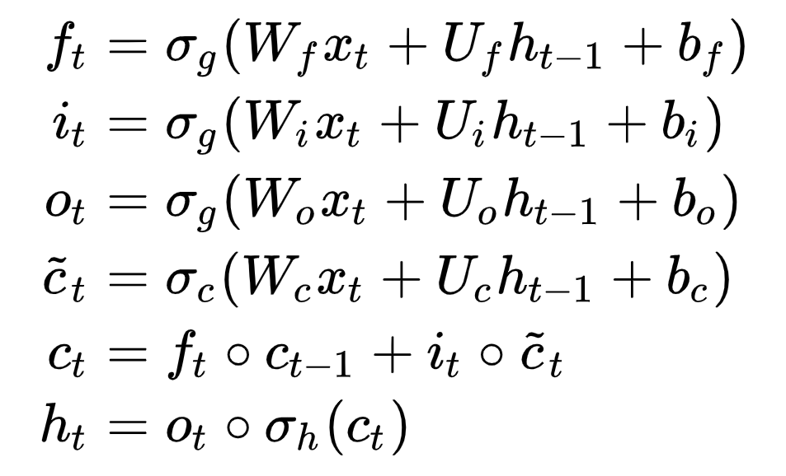
LSTM

Slide 7
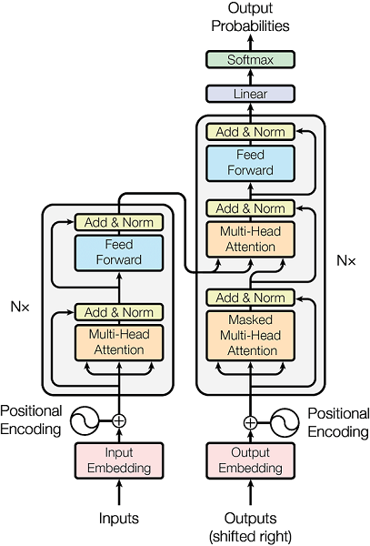
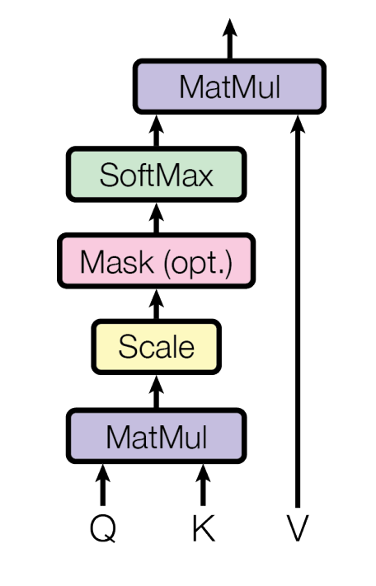
Transformer

Slide 8
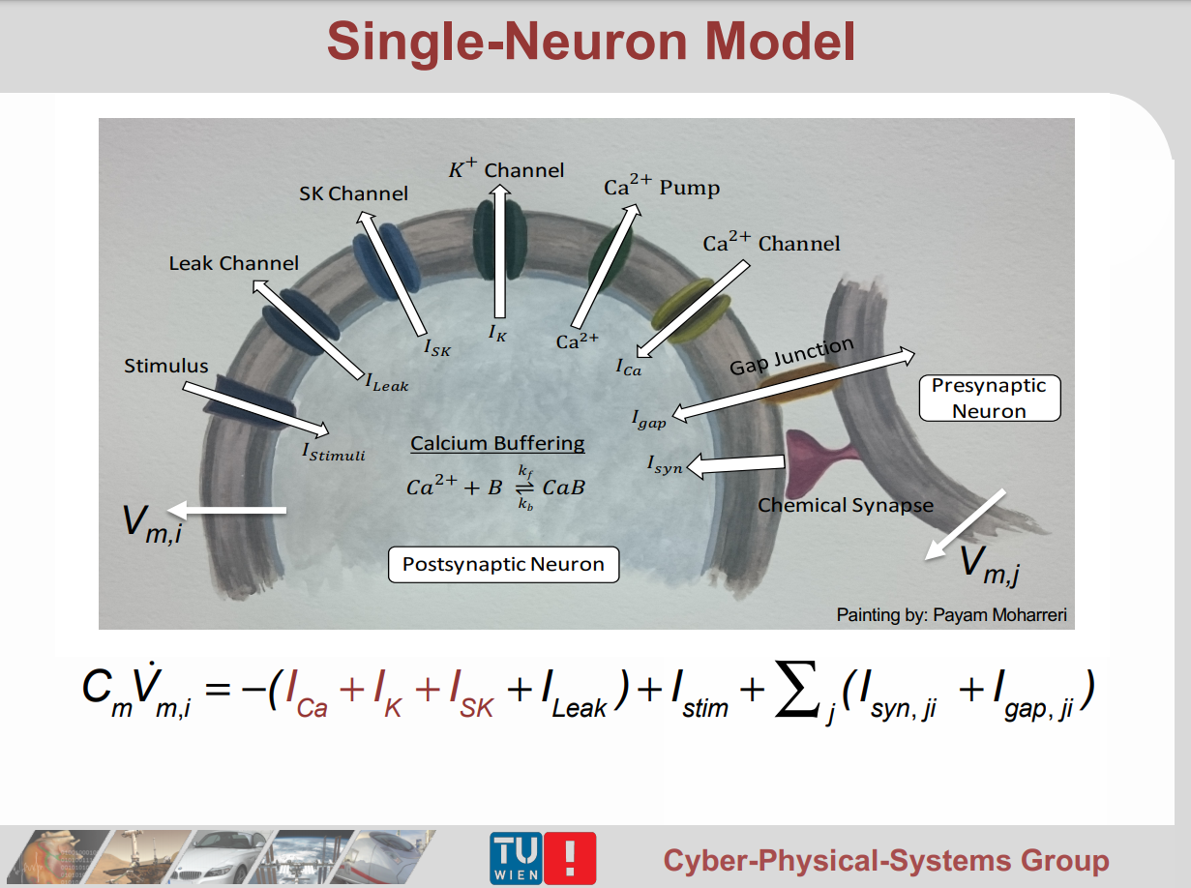

Slide 9
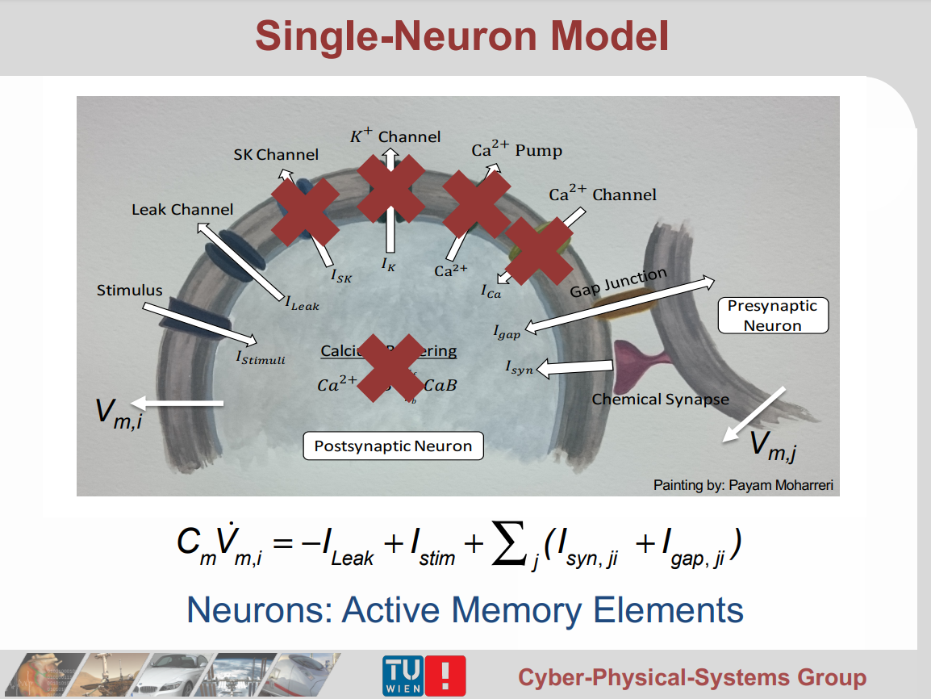

Slide 10
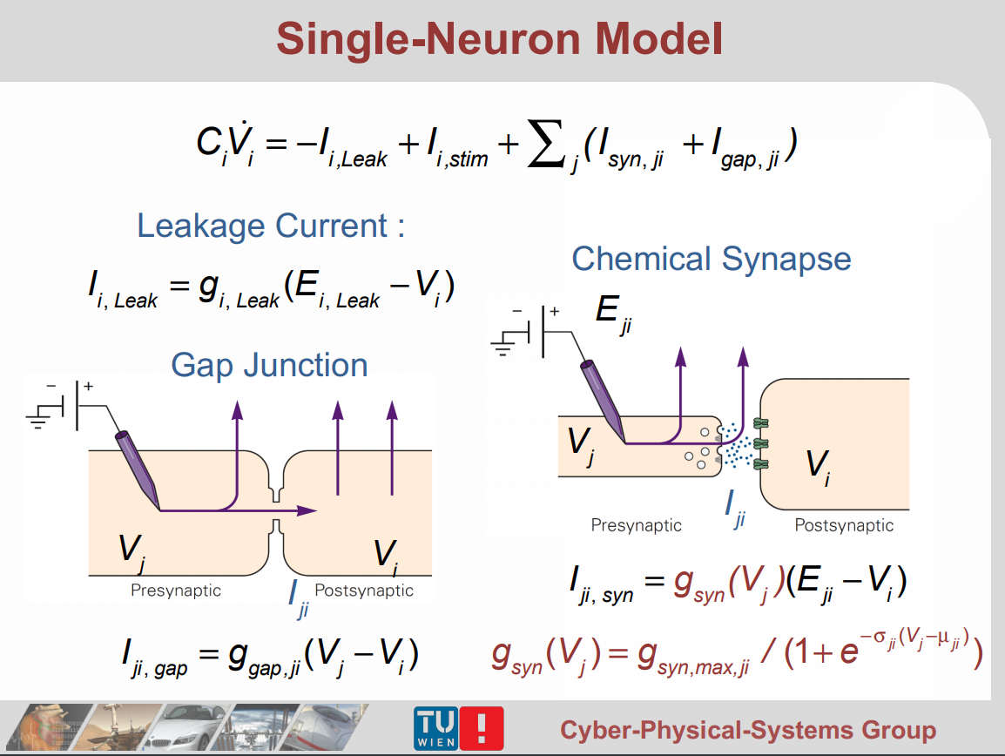

Slide 12
memory cell
output is potential of one neuron
after affine transformation
inhibitory syn.
Neuron_0
Neuron_1
excitatory syn.
excitatory syn.
inhibitory syn.
input after affine transformation
same input after affine transformation

Slide 13
memory layer
vector output
output transformation – has access to all memory states
scalar outputs
memory cell
memory cell
memory cell
memory cell
scalar inputs
input transformation – has access to all memory states
vector input

Slide 14
experiments - memory cell
only two inputs to cell: 1 or 0
input sparsely coded: if no input present, both cells receive 0 current
gmax*sigmoid(sigma*(Vpre-µ)) * (E - Vpost)
A 1 as input to a neuron should lead to a large positive current
A 0 as input to a neuron should lead to a large negative current
synapse that ensures potential difference
Synapses between neurons should deliver a positive current from 0 to 1 and a negative current from 1 to 0
Neuron_0
initial pot.: 0
Neuron_1
initial pot.:1
synapse that ensures potential difference
positive input: x (over synaptic activation)
positive input: 1-x (over synaptic activation)

Slide 15
Sign of current is only set via E – Vpost
Same synapse needs to deliver these currents (for the input case):
- negative current if 0 at input and Vpost=1
- positive current if 1 at input and Vpost=0
Same synapse needs to deliver these currents (for the potential difference case):
- negative current if self potential is 1 and Vpost=0
- positive current if self potential is 0 and Vpost=1
E-0 < 0 and E-1 > 0
no solution!
E-0 < 0 and E-1 > 0
no solution!

