Slide 1
Capturing Long-Term Dependencies in Neural Regulatory Networks
Faculty Supervisor: Univ.-Prof. Dr.rer.nat. Radu Grosu
Direct Supervisor: Dr. Ramin Hasani
Hannes Brantner

Slide 2
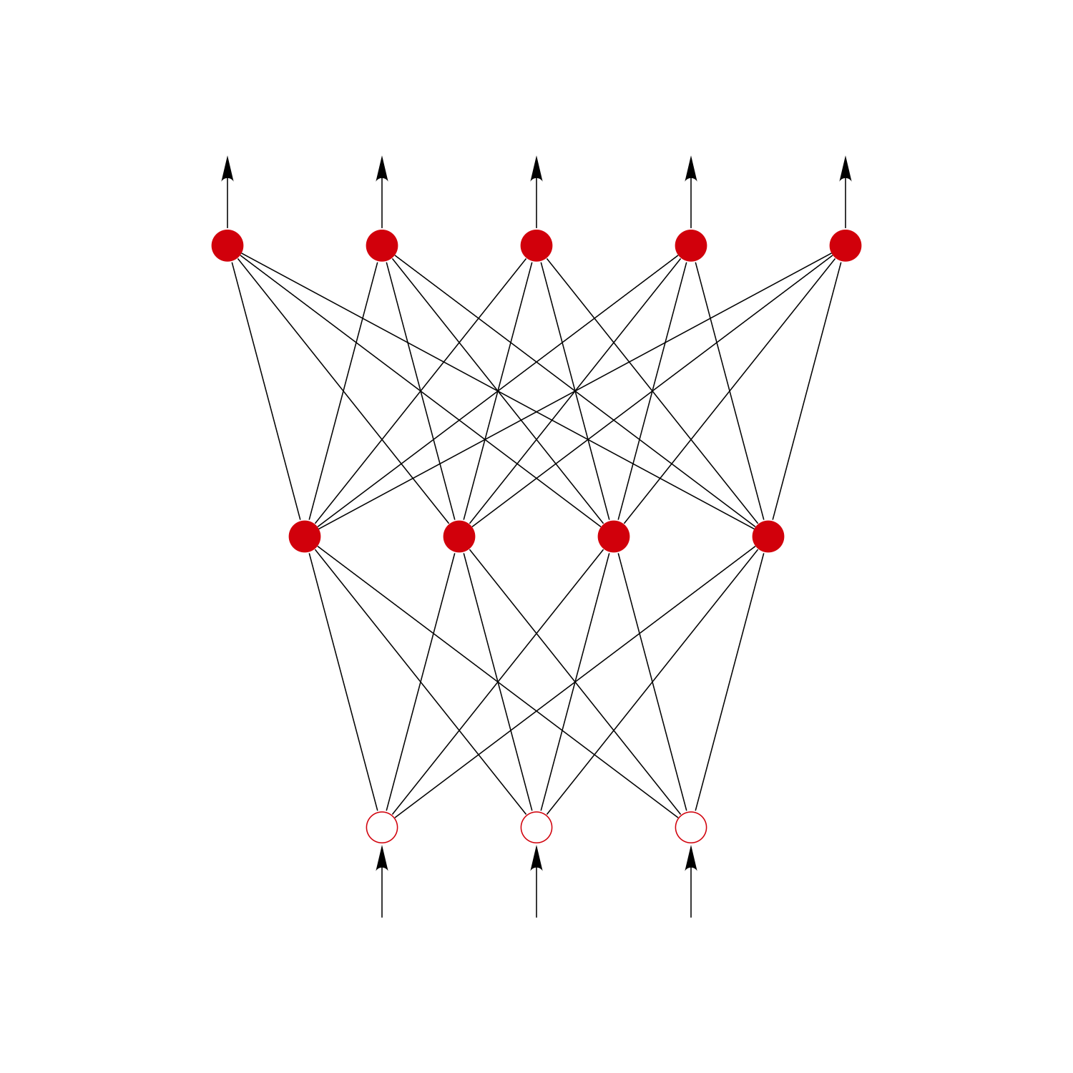
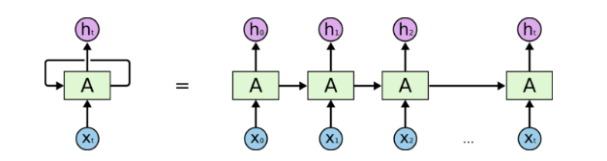
sequence modelling
ht+1 = fp(xt+1, ht)
yt+1 = op(ht+1)
y = fp(x)
feed-forward neural network
recurrent neural network (RNN)

Slide 3
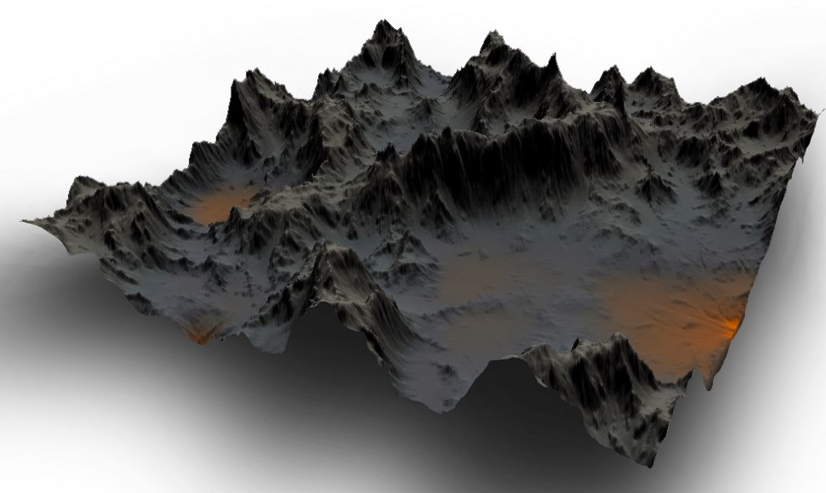
scalar loss function - L(p)
gradient descent step - ∀i: pi -= lr * ∂L/∂pi(p)

Slide 4
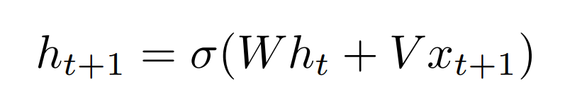
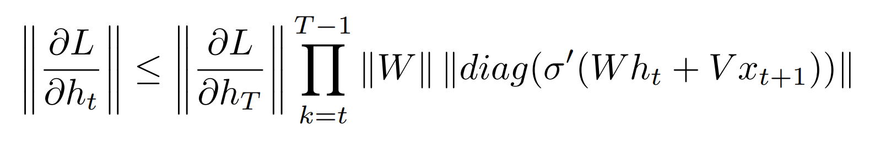
next state equation
for T >> t:
1 for σ(x) = max(0, x)

Slide 5
Unitary RNN
Unitary RNNs ensure that ||W|| = 1

Slide 6
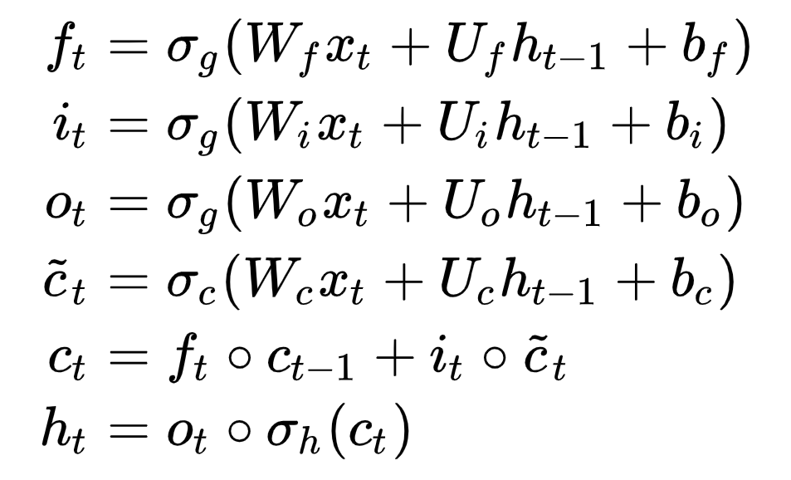
LSTM

Slide 7
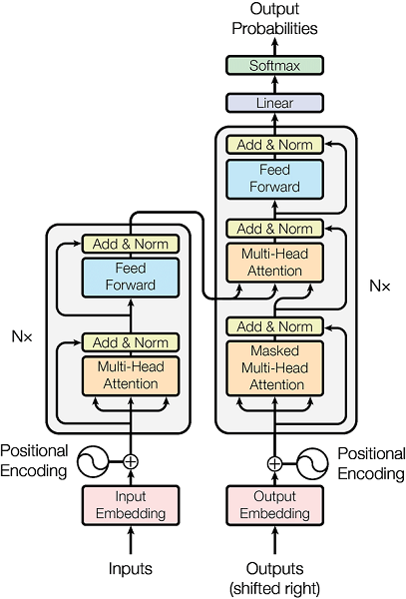
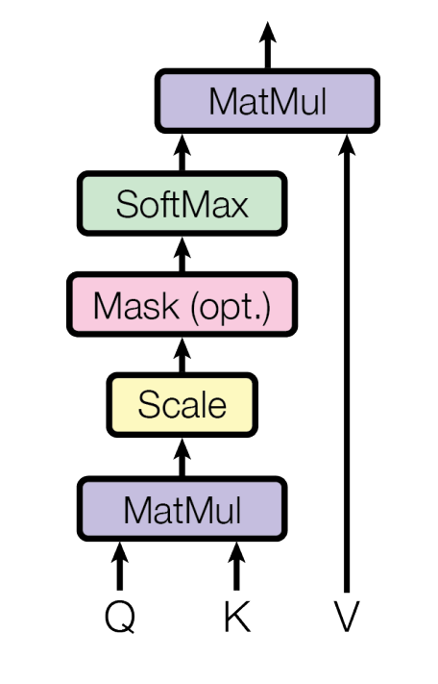
Transformer

Slide 8
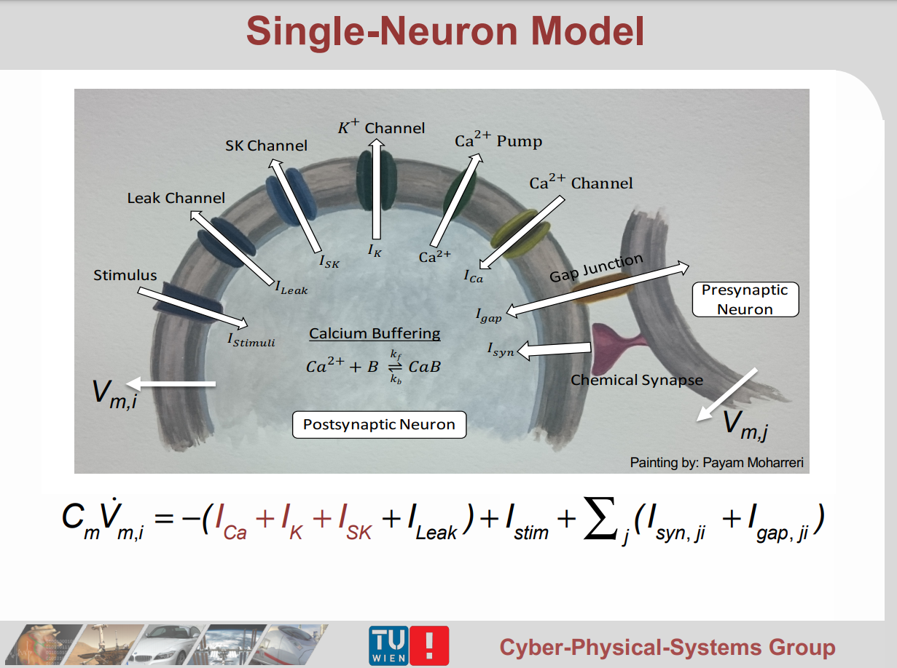

Slide 9
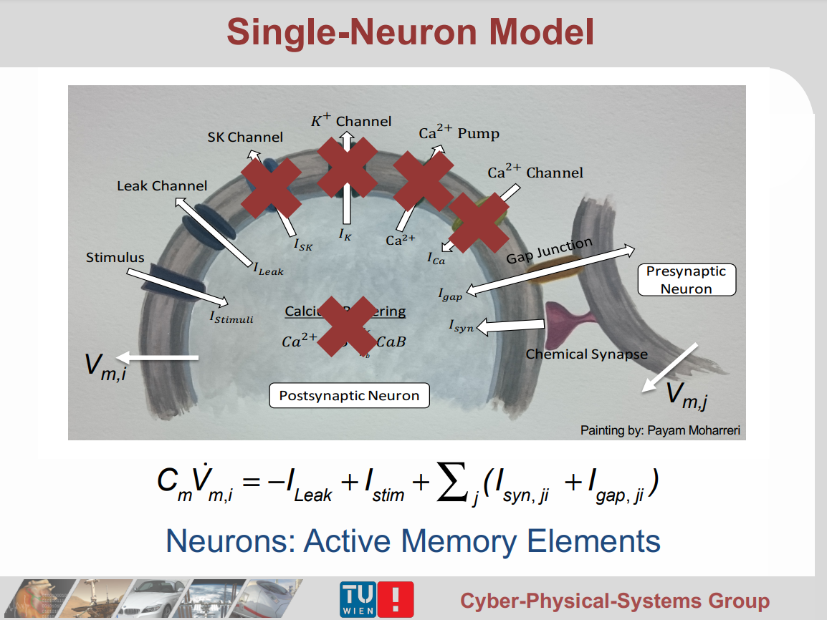

Slide 10
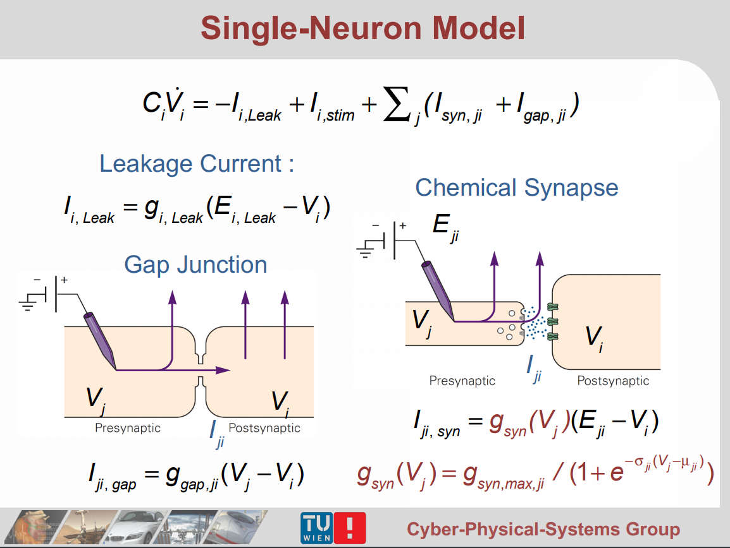

Slide 12
memory cell
output is potential of one neuron
after affine transformation
inhibitory syn.
Neuron_0
Neuron_1
excitatory syn.
excitatory syn.
inhibitory syn.
input after affine transformation
same input after affine transformation

Slide 13
memory layer
vector output
output transformation – has access to all memory states
scalar outputs
memory cell
memory cell
memory cell
memory cell
scalar inputs
input transformation – has access to all memory states
vector input

