Slide 1
OpcUaServerWrapper

Slide 2

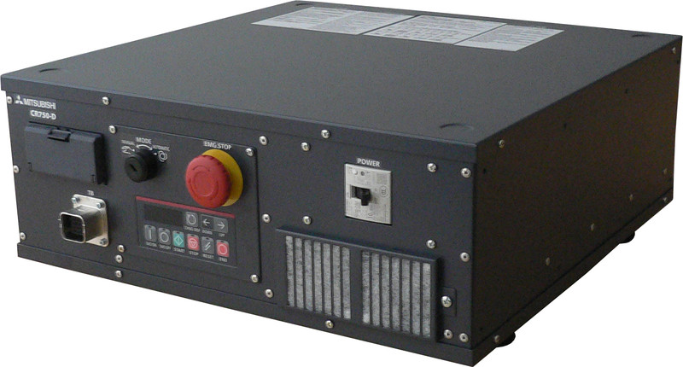
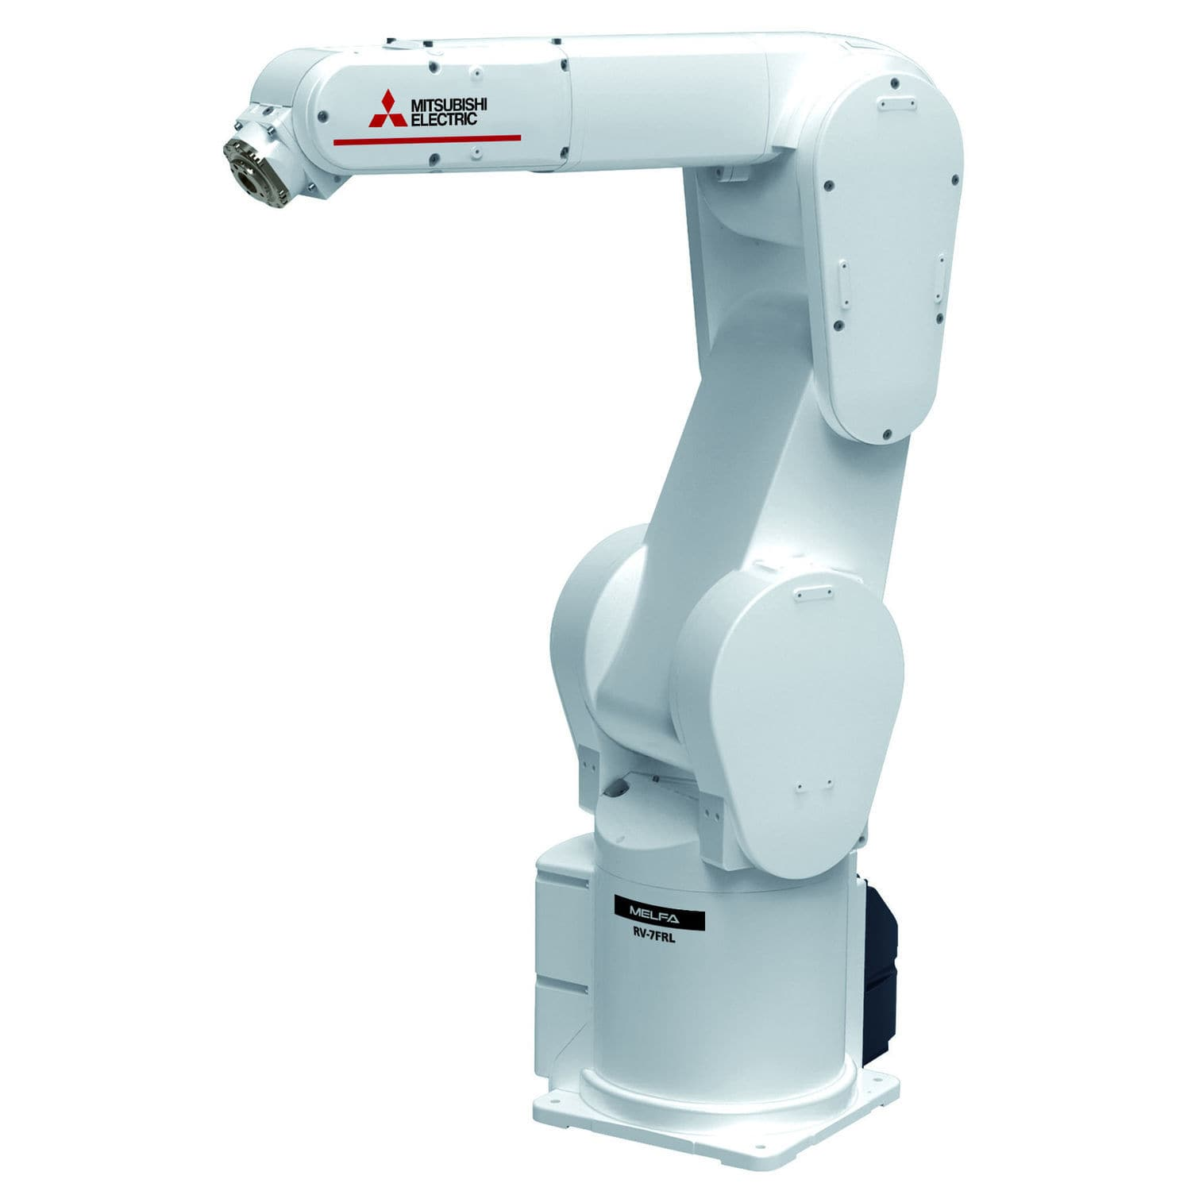
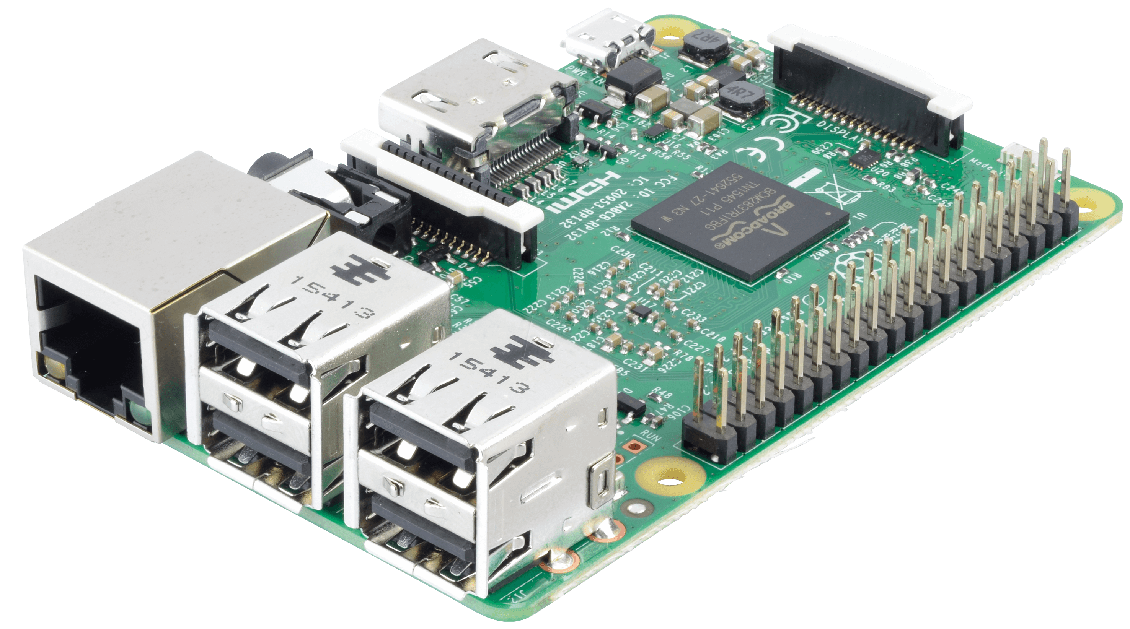
Client
Controller
CN2
OPC UA
Telnet
runs our software
Server
Robot

Slide 3
Telnet example (ASCII encoding)
‘1;1;TIME’
response info
‘QoK04-02-0917:54:32’
OR
response status
‘QeR4220000’
error code

Slide 4
our software is hosted on a public GitHub repo
git clone https://github.com/Oidlichtnwoada/OpcUaServerWrapper.git

Slide 5


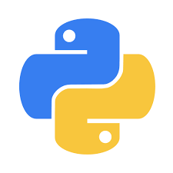
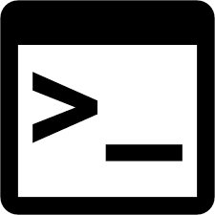
OpcUaServerWrapper.git
opcua.service
run at startup
1. git pull
2. execute Python script
update_repository_and_start_server.sh
startserver.py

Slide 6
… communicates with Controller …
telnetclient.py
… runs forever …
execute Python script
startserver.py
opcuaserver.py
receive res from controller
Request
send cmds to controller
Response
generate Telnet command(s)
return processed controller response
PC
robotcontrollerclient.py

Slide 7
used open-source Python OPC UA library
git clone https://github.com/FreeOpcUa/python-opcua.git

Slide 8
OPC UA method name | NodeId | Description
ReadInput(Index) | ns=4;i=1067 | reads the input sensor with the corresponding Index
WriteOutput(Index, Value) | ns=4;i=1111 | writes Value to the actuator with the corresponding Index
Move(X,Y,Z,A,B,C) | ns=4;i=1137 | move to position (X,Y,Z) with rotation (A,B,C)
OpenGripper() | ns=4;i=1131 | open the gripper attached to the robot
CloseGripper() | ns=4;i=1134 | close the gripper attached to the robot
GetErrorLog(NumErrorLogs) | ns=4;i=1140 | returns the most recent NumErrorLogs errors
ResetError() | ns=4;i=1108 | resets the current error present in the controller

Slide 9
Code Walkthrough

Slide 10
Live Demo

