Slide 1
AI-Matching-Tool
Hannes Brantner

Slide 2
Model Architecture
Job Requirement Extraction
Job Requirement Matching Part 1
Job Requirement Matching Part 2
Output File
Configuration Part 1
Configuration Part 2

Slide 3
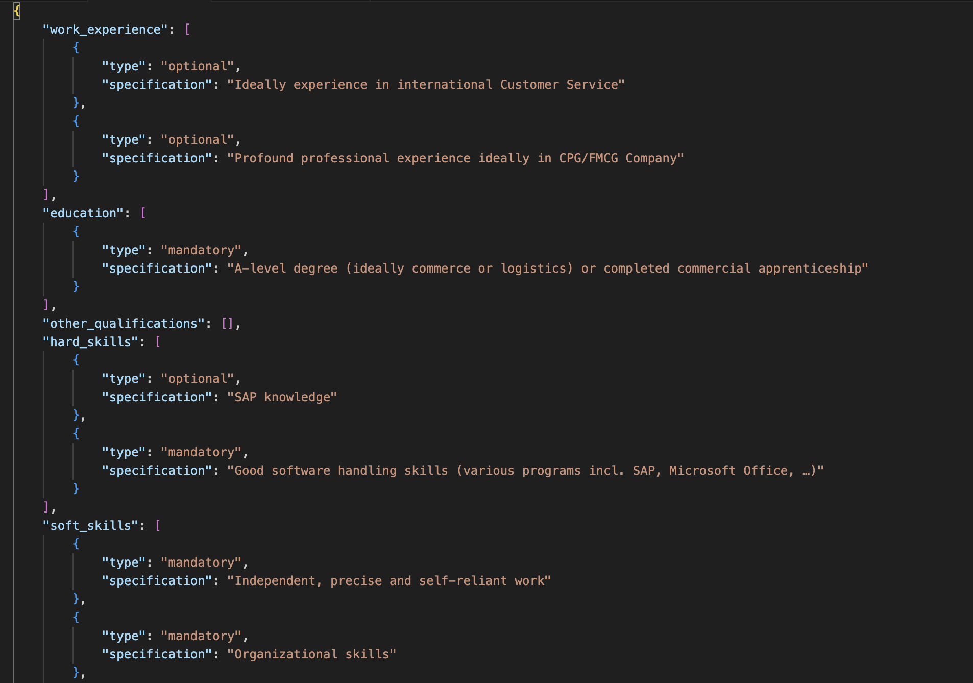



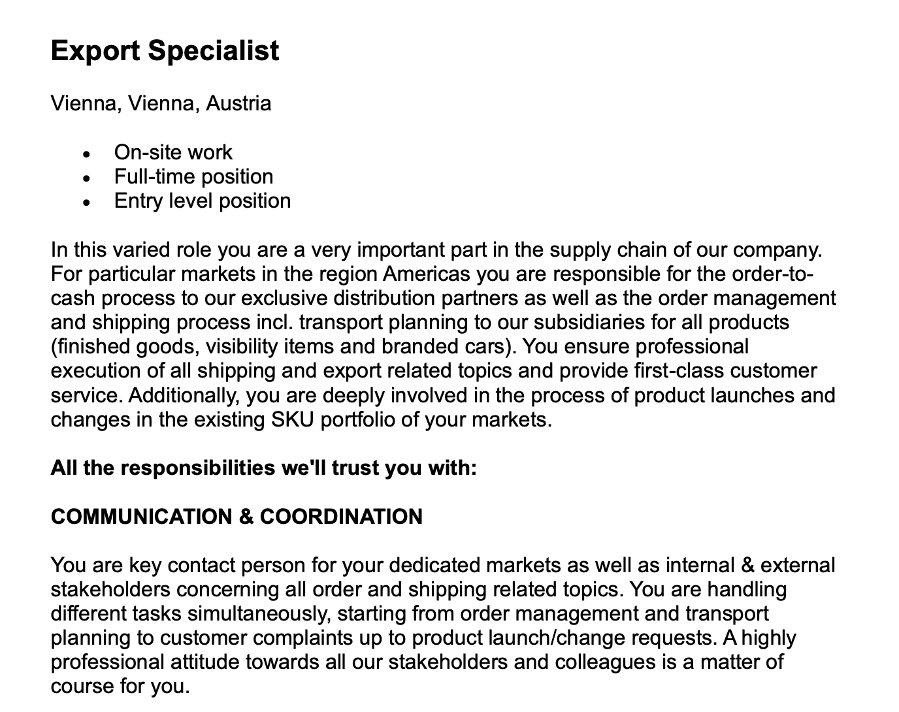
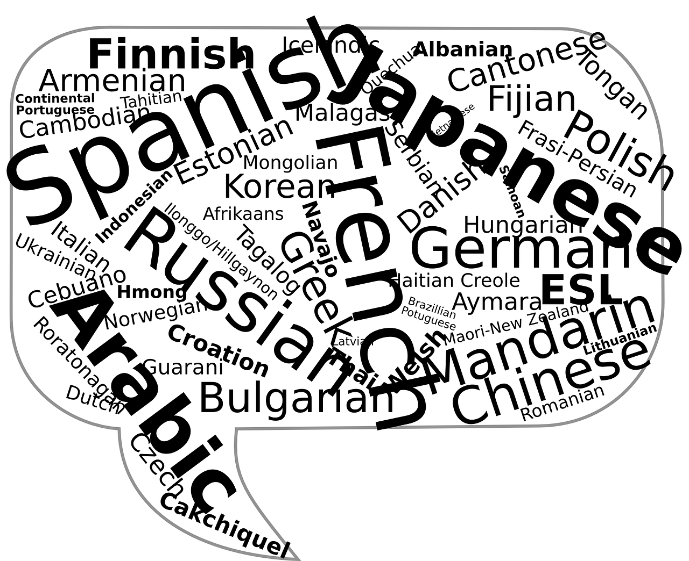
Job Requirement Extraction
Model

Slide 4
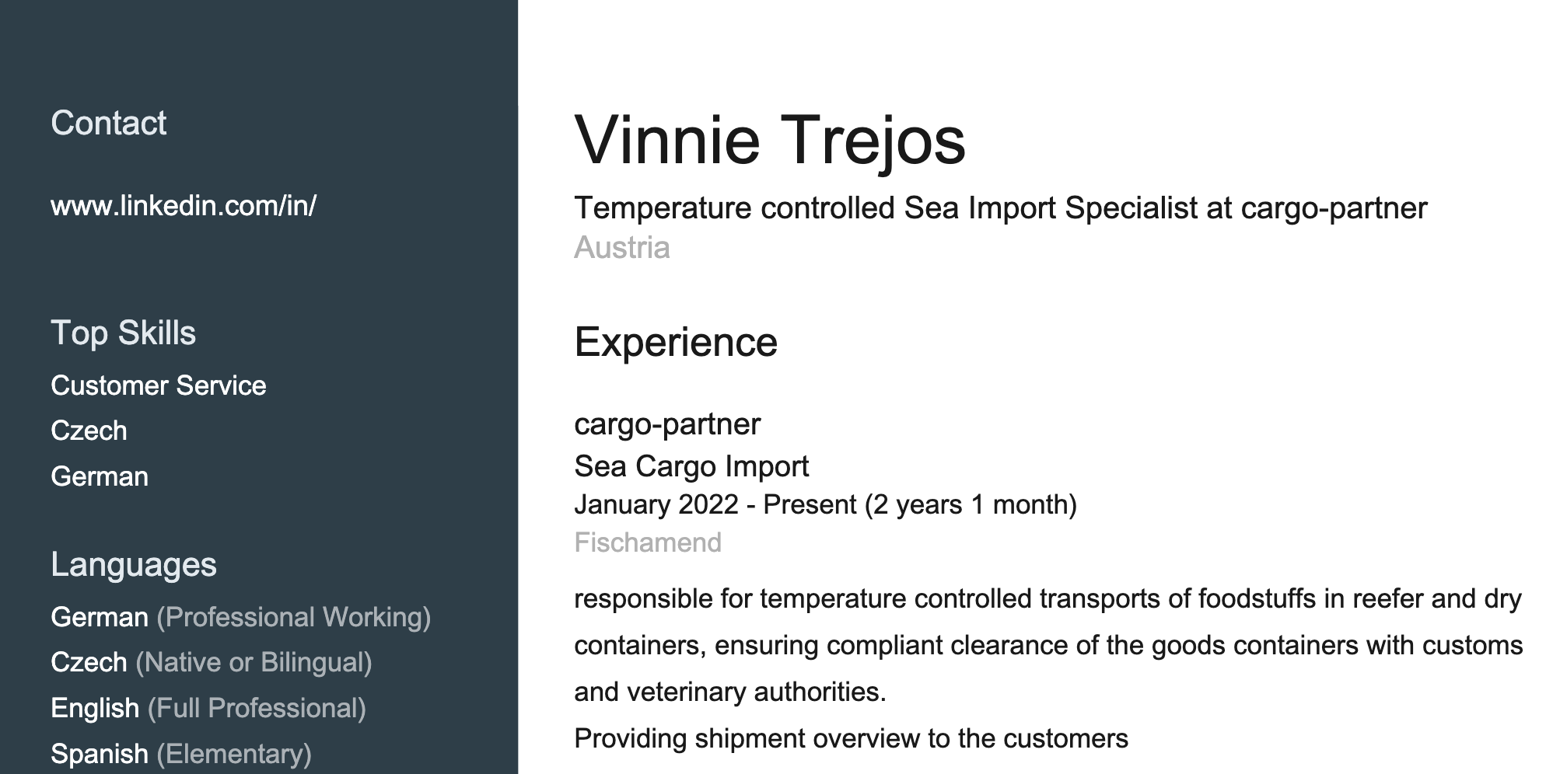
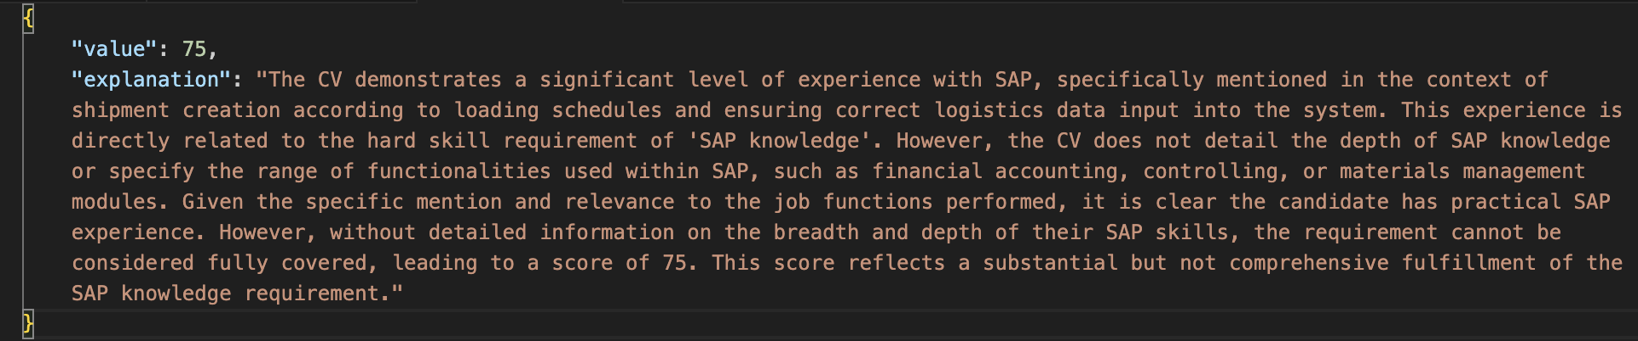
Job Requirement Matching Part 1
Model
+
+

Slide 5
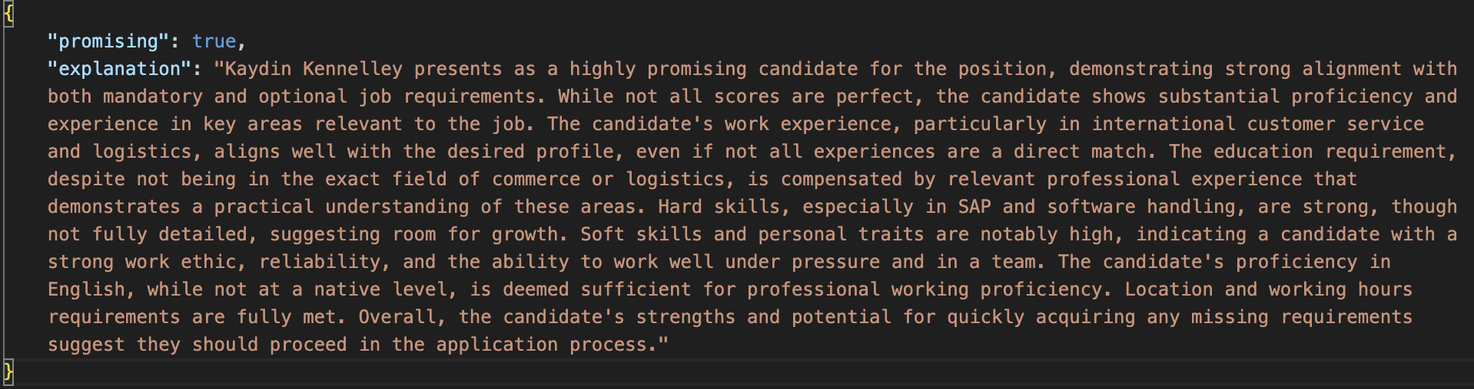

Job Requirement Matching Part 2
+
Model
Calculation
Score: 80/100
“promising”: yes/no

Slide 6
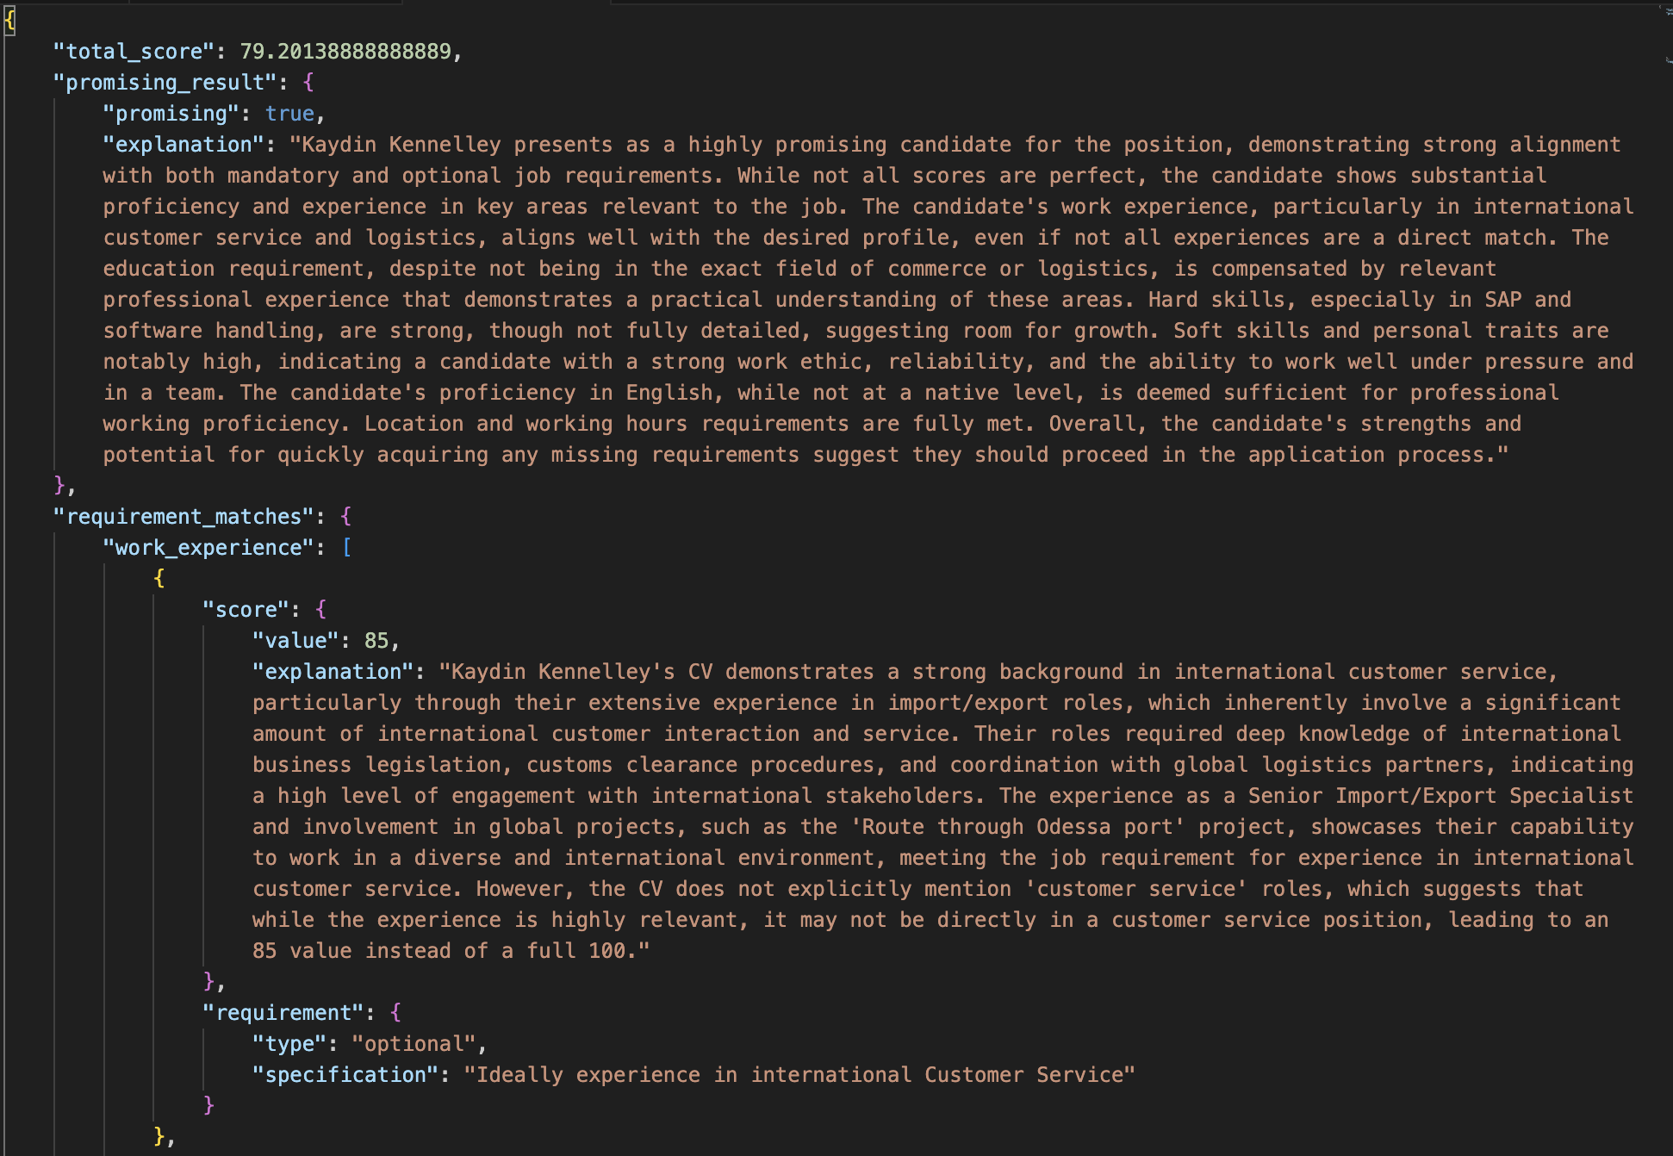
Output File

Slide 7

Configuration Part 1

Slide 8
Configuration Part 2
Work Experience
Education
Other Qualifications
Hard Skills
Soft Skills
Specific Knowledge
Personal Traits
Languages
Travel
Location
Working Hours
Physical Ability

