Slide 1
Efficient Self-Verification: Understanding LaSeR for LLM Reasoning
Unifying Reasoning and Verification via Last-Token Self-Rewarding
Hannes Brantner

Slide 2
Outline
Introduction: The Evolution of LLM Training (SFT → RLVR)
Problem Statement: The Test-Time Verification Gap
Methodology: LaSeR (Reinforcement Learning with Last-Token Self-Rewarding)
Theoretical Framework: Deriving the Closed-Form Solution
Experimental Results: Accuracy and Efficiency Gains
Critical Analysis: Strengths and Limitations
Conclusion: Towards Efficient System 2 Reasoning

Slide 3
Introduction:
The Evolution of Reasoning
Supervised Fine-Tuning (SFT): The foundation of instruction following, but lacks deliberate reasoning incentives.
RLHF (Reinforcement Learning from Human Feedback): Aligns models with human preference, yet suffers from subjective reward signals.
RLVR (RL with Verifiable Rewards) [3]:
  Current SOTA (e.g., DeepSeek-R1 [2], OpenAI o1) utilizes ground-truth outcomes (math/code) to incentivize "System 2" reasoning chains.
  Mechanism: Rewards reasoning paths based on final answer consistency.
The Next Frontier: How do we maintain this rigorous verification when ground truth is absent (i.e., at inference time)?

Slide 4
How does RLVR work?
System Message: “Wrap the final answer in <ANSWER>...</ANSWER> tags.”
Question: “What is 4 * 3?”
Verifiable Answer: “12”
Sampled Rollouts:
  Answer 1: “4 groups of 3 is equivalent to 4 + 4 + 4, which equals 12. <ANSWER>12</ANSWER>” - CORRECT (Reward: 1)
  Answer 2: “The numbers are 4 and 3. Adding them together gives 4 + 3 = 7. <ANSWER>7</ANSWER>” - INCORRECT (Reward: 0)
  Answer 3: “4 times 3 is a standard multiplication fact. The result is 14. <ANSWER>14</ANSWER>” - INCORRECT (Reward: 0)
  Answer 4: “If you combine the digits 4 and 3, you get the number 43. <ANSWER>43</ANSWER>” - INCORRECT (Reward: 0)
Policy Update: Update the LLM model weights to maximize the likelihood of the correct reasoning path (Answer 1) relative to the incorrect paths.

Slide 5
Problem Statement:
The Test-Time Blind Spot
The Constraint: Standard RLVR relies on ground-truth labels which are unavailable during deployment.
Current Inefficient Solutions:
  External Verifiers: Training separate Reward Models (ORMs/PRMs) is computationally expensive and parameter-heavy.
  Sequential Self-Verification: Asking the model to "double-check" its answer requires a second generation pass, doubling inference costs.
Research Question: Can we unify reasoning and verification within a single policy model at almost zero additional cost?

Slide 6
Methodology:
LaSeR Overview
Core Concept: LaSeR (Reinforcement Learning with Last-Token Self-Rewarding).
Mechanism:
  The model predicts a specific "verification token" (e.g., <vision_start>) immediately after the solution.
  The log-probability of this token serves as the self-rewarding score.
Implementation:
  Augments standard RLVR loss with a Mean Squared Error (MSE) loss.
  Aligns the last-token probability with the true verifier reward during training.
Efficiency: Requires only one additional token inference per generation.

Slide 7
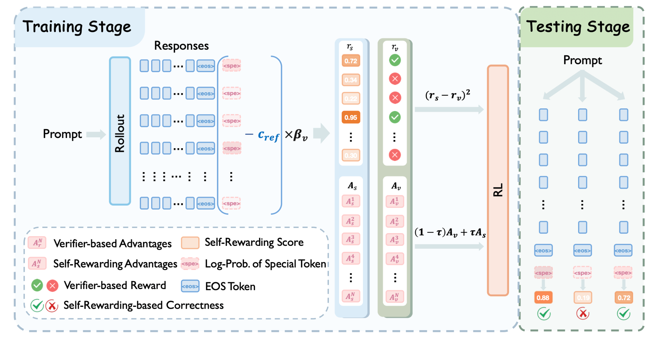
LaSeR Methodology [1]

Slide 8
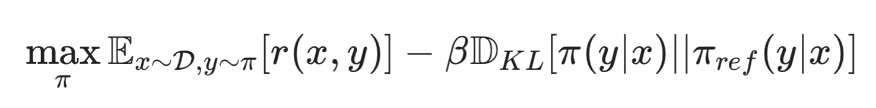
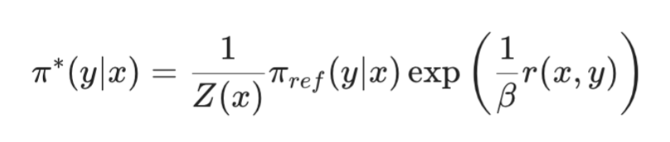
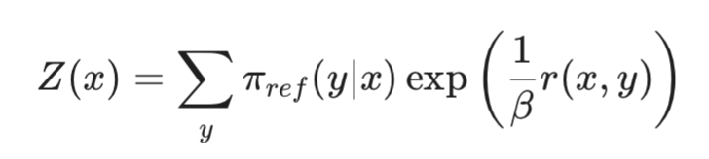
Theoretical Framework:
The Derivation
RL Objective For Post-Training [4]:
Closed-Form Optimal Policy:
Solve Equation For The Reward: on the next slide!
(also conditioning on verification token is added)

Slide 9
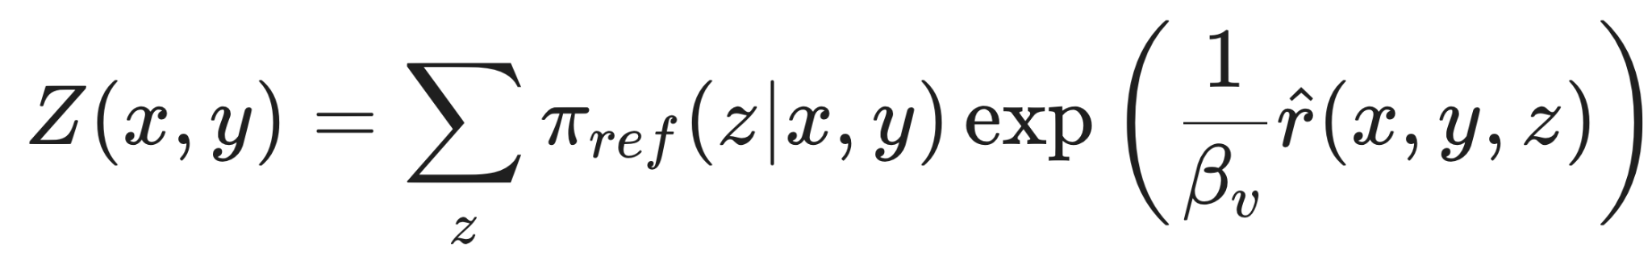
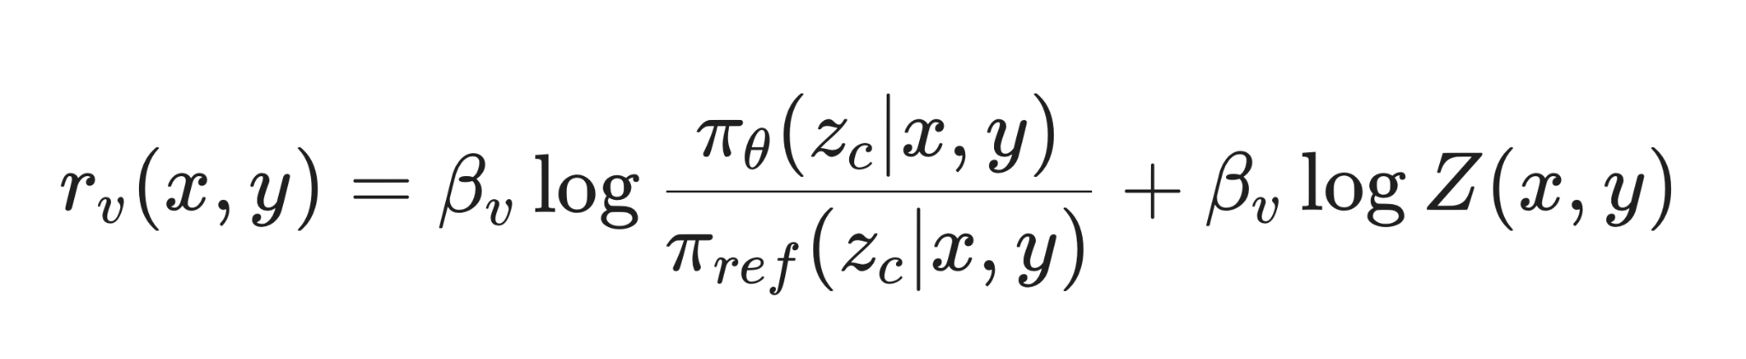


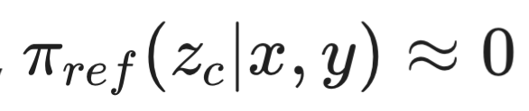
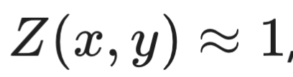
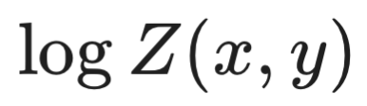
Theoretical Framework:
The Derivation
Closed-Form Solution [4]:
  Where is the verification token and is the reference model.
The Simplification:
  For unused special tokens, (negligible probability).
  Therefore, the partition function , allowing the term to be discarded.
Result: The reasoning reward is directly equivalent to the scaled log-probability ratio of the last token.

Slide 10
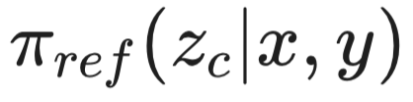
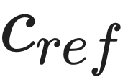


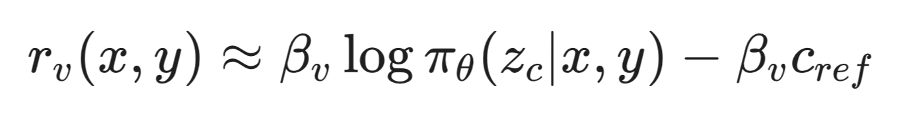
Practical Optimization Techniques
Reference Log-Probability as Constant:
  Empirical analysis shows is effectively constant ( ) across inputs.
  Benefit: Eliminates the need for a forward pass through the reference model during self-rewarding
Self-Rewarding-based Advantages (SWA):
  Integrates the continuous self-rewarding score into the RL advantage estimation.
  Formula: ​ (blends verifier and self-reward advantages, e.g. 10% self-reward signal and 90% external verifier signal).
  Benefit: Provides dense signals to smooth out sparse binary rewards.
Loss Re-Weighting: Balances correct/incorrect class distribution to prevent mode collapse.
Final Shortened Formula ( = 0.1):

Slide 11
Advantages: Why LaSeR?
Computational Efficiency:
  Replaces separate reward models (e.g., 72B parameters) with a single token check.
  Avoids the 2x latency penalty of sequential self-verification.
Performance:
  Reasoning: Outperforms standard GRPO (e.g., Open-Reasoner-Zero-7B: 45.5% vs 45.0% average accuracy).
  Verification: Achieves ~78% F1 score in self-verification, matching state-of-the-art external verifiers with a much higher parameter count.
Inference Scaling: Enables effective weighted majority voting at test time without external tools.

Slide 12
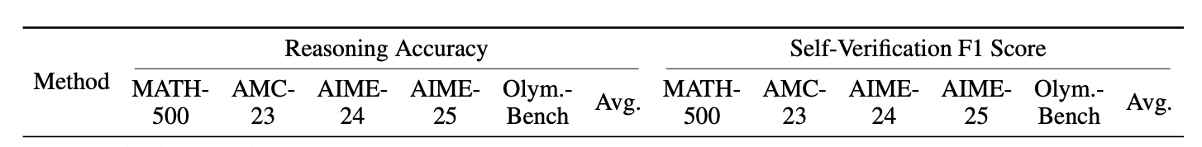
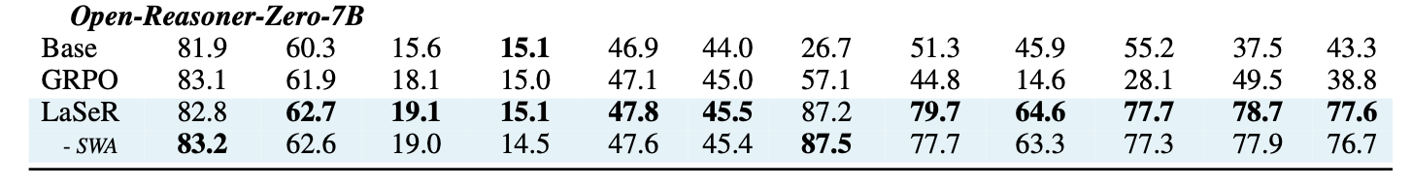
Reasoning and Self-Verification [1]

Slide 13
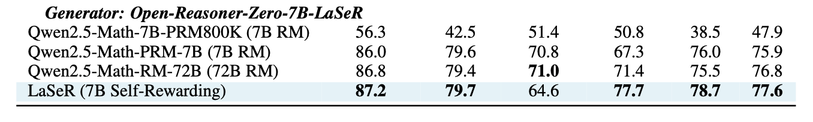
External Reward Model Comp. [1]
Self-Verification F1 Score

Slide 14
Experimental Results
Benchmarks: MATH500, AMC23, AIME24, AIME25, OlympiadBench.
Used Base Model Architectures: LLaMA-3.2 (3B) and Qwen-2.5 (7B).
Key Findings:
  LaSeR consistently yields higher Pass@1 accuracy than baselines.
  Self-verification capability remains robust even on difficult datasets (e.g., AIME25) where reasoning accuracy is low.
  "Token Hijacking" (using <vision_start>) successfully encodes semantic correctness without disrupting generation.

Slide 15
Critical Analysis & Limitations
Generalization Gap:
  Highly effective in deterministic domains (Math).
  Performance degrades in general reasoning (e.g., MMLU-Pro) due to noisy training verifiers and subjective ground truth.
Prompt Sensitivity: The mechanism is sensitive to the specific prompt templates used to trigger the verification state.
Aggregation Heuristic: Reliance on the last token assumes the model can aggregate all prior reasoning uncertainty into a single step, which may be susceptible to length bias in complex chains.
Non-Standard Mechanism: Additional token generation step after the “EOS” token is non-standard.

Slide 16
Conclusion & Outlook
Summary: LaSeR theoretically and empirically proves that LLMs can act as their own verifiers by utilizing the probability distribution of the final token.
Impact: Unifies generation and verification into a single, compute-optimal workflow.
Future Directions:
  Extending "Last-Token" verification to "Step-by-Step" (PRM) verification for finer granularity (e.g. could be further broken down to generating the self-reward signal at each token generation step).
  Improving generalization to non-STEM domains.
  Removing the dependence on the single additional forward pass after the “EOS” token.

Slide 17
References
[1] Yang, W., et al. (2025). LaSeR: Reinforcement Learning with Last-Token Self-Rewarding. arXiv:2510.14943v1.
[2] Guo, D., et al. (2025). DeepSeek-R1: Incentivizing reasoning capability in LLMs via reinforcement learning.
[3] He, Z., et al. (2025). DeepMath-103K: A large-scale, challenging, decontaminated, and verifiable mathematical dataset.
[4] Rafailov, R., et al. (2023). Direct preference optimization: Your language model is secretly a reward model.

