Slide 1
Ch 2 Database System Concepts and Architecture
29.6.2026
Lecture 1

Slide 2
Database System Architecture
Database architecture refers to the overall design and structure of a Database Management System (DBMS).
It defines how data is stored, managed, and accessed by users and applications.
In the past, DBMSs were monolithic systems where all functions were integrated into one software package.
Modern DBMSs use Client/Server, Distributed, and Cloud architectures.
Client/Server Architecture
A Client/Server architecture divides the system into two parts:
Client: The client interacts with users.
Functions:
User Interface (UI)
Forms
Applications
Mobile Apps

Slide 3

Server: The server manages the database.
Functions:
Data Storage
Query Processing
Security
Example: Student Registration System
Student fills registration form (Client)
Database stores information (Server)
Data Model
A Data Model is a collection of concepts used to describe Data, Relationships, Constraints.
It provides a way to organize and represent data.
Example: Student and Course relationship
Student
Enroll
Course

Slide 4
Schema and Instance
Schema
Schema is the structure or blueprint of a database.
Example: STUDENT(SID, Name, Major)
Schema rarely changes.
Instance
Instance is the actual data stored in the database at a particular time.
Example
SID | Name
S1 | Aung Aung
S2 | Su Su

Slide 5
Three-Schema Architecture
The three-Schema Architecture divides the database into three levels:
External Level
Conceptual Level
Internal Level
Purpose:
Data Independence
Security
Multiple User Views
External Level: The External Level shows only the data required by a particular user.
Example: Teacher View
StudentID Name Grade

Slide 6
The internal level has an internal schema, which describes the physical storage structure of the database.
The internal schema uses a physical data model and describes the complete details of data storage and access paths for the database.
Note: Internal Level: Describes how data is physically stored.
Example: Files, Indexes, Storage Blocks
The conceptual level has a conceptual schema, which describes the structure of the whole database for a community of users.
The conceptual schema hides the details of physical storage structures and concentrates on describing entities, data types, relationships, user operations, and constraints.
Usually, a representational data model is used to describe the conceptual schema when a database system is implemented.
This implementation conceptual schema is often based on a conceptual schema design in a high-level data model.
Note: Conceptual Level: Represents the entire logical structure of the database.
Example: STUDENT, COURSE, ENROLLMENT

Slide 7
The external or view level includes a number of external schemas or user views.
Each external schema describes the part of the database that a particular user group is interested in and hides the rest of the database from that user group.
As in the previous level, each external schema is typically implemented using a representational data model, possibly based on an external schema design in a high-level conceptual data model.
Data Independence
Data Independence means changes at one level do not affect higher levels.
1. Logical Data Independence
Changes in database structure do not affect user views.
Example: Adding Email column
Student(SID, Name, Email)
2. Physical Data Independence
Changes in storage do not affect database structure.
Example: Hard Disk → SSD
Applications continue working.

Slide 8
2.3 Database Languages and Interfaces
2.3.1 DBMS Languages
DDL (Data Definition Language): Used to define database structure.
It specifies Tables, Attributes, Relationships and Constraints
Commands: CREATE, ALTER, DROP
Example
CREATE TABLE Student( StudentID INT PRIMARY KEY, Name VARCHAR(50), Major VARCHAR(30) );
This defines the logical structure.

Slide 9
After the database schema has been created (using DDL) and the database has been filled with data, users need a way to work with that data.
The Data Manipulation Language (DML) is the language used to:
Retrieve data
Insert new data
Update existing data
Delete data
Commands: INSERT, UPDATE, DELETE
Example:
INSERT INTO Student
VALUES (1,'Aung Aung','CS');
Retrieve Data (SELECT)
Retrieve means getting data from the database.
SELECT *
FROM Student;

Slide 10
2.3.2 DBMS Interfaces
What is a DBMS Interface?
A DBMS Interface is the medium through which users communicate with the database.
Different users need different interfaces depending on their knowledge and tasks.
Types of DBMS Interfaces
1. Menu-Based Interface
A menu-based interface provides users with lists of options (menus).
Users simply choose options instead of typing SQL commands.
Example:
ATM machine menus
Website navigation menus
Online shopping categories
Main Menu
1. Search Student
2. Add Student
3. Delete Student
4. Exit
Advantages
Easy for beginners
No need to remember SQL syntax

Slide 11
2. Apps for Mobile Devices
Many organizations provide mobile apps so users can access their databases.
Examples:
Banking apps
Hotel reservation apps
Insurance apps
4. Graphical User Interface (GUI)
GUI allows users to interact with the database through graphical elements such as:
Windows
Icons
Buttons
Diagrams
3. Forms-Based Interface
Users enter information into forms.
The DBMS processes the entered data.
Advantages
Very easy for non-technical users
Reduces typing errors

Slide 12
5. Natural Language Interface
Users ask questions in ordinary language.
The system translates the question into a database query.
Example:
Show all Computer Science students.
Advantages
No SQL knowledge required
Easy for everyone
6. Keyword-Based Database Search
Works like a search engine.
Users type keywords instead of SQL.
Example: type Aung Aung
The system searches matching records.
7. Speech Input and Output
Users speak instead of typing.
The system converts speech into queries and can also answer using speech.
Example
"What is my account balance?"

Slide 13
8. Interfaces for Parametric Users
Parametric users perform the same tasks repeatedly.
The interface provides shortcut buttons or function keys.
Examples:
Bank tellers
Cashiers
Ticket counter staff
9. Interfaces for DBA
The Database Administrator (DBA) uses special interfaces with administrative privileges.
Examples:
Create user accounts
Grant permissions
Modify schema
Backup database
Reorganize storage

Slide 14
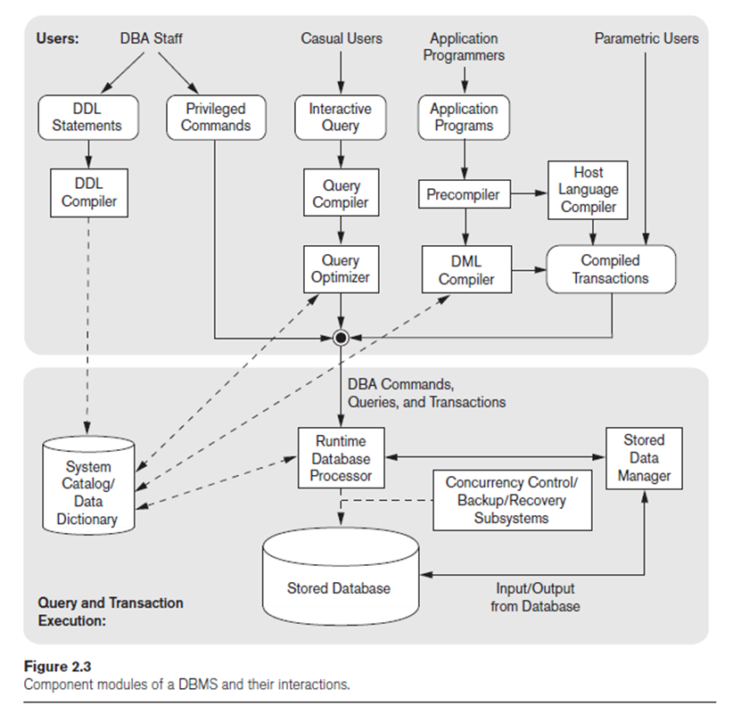
2.4 The Database System Environment
What is Database System Environment?
A Database System Environment is the complete environment in which a DBMS operates.
It includes:
Users
DBMS software modules
Operating System (OS)
Database
System Catalog (Data Dictionary)
Top part is User Side.
Bottom part is DBMS Internal Processing.

Slide 15
DBA → DDL Compiler → System Catalog
Casual User → Query Compiler → Query Optimizer → Runtime Database Processor
Application Programmer → Precompiler → DML Compiler + Host Language Compiler → Compiled Transaction → Runtime Database Processor
Runtime Database Processor → Stored Data Manager → Stored Database

