Slide 1

NAYPYITAW STATE POLYTECHNIC UNIVERSITY(NSPU)
Department of Computational Mathematics Academic Year 2025-2026
Engineering Mathematics IV
(Fourier Analysis and Complex Analysis)
(EM-4012)
Daw Soe Sanda Aye
Associate Professor
Email:soesandaraye1986@gmail.com

Slide 2
Contents;
Exponential Function
Trigonometric and Hyperbolic Functions
Objectives,
To understand Exponential Function
To understand Trigonometric and Hyperbolic Functions
To apply problems by Theory
To solve problems by Theory

Slide 3
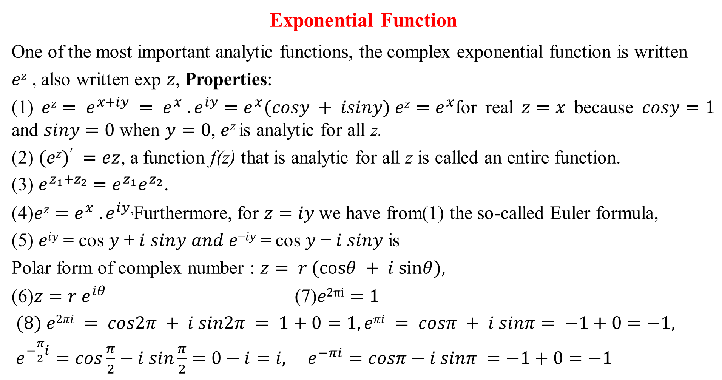
Exponential Function
One of the most important analytic functions, the complex exponential function is written
𝑒^{𝑧} , also written exp 𝑧, Properties:
(1) $ez= e^{x+iy} = e^{x} . e^{iy}=e^{x}(cosy + isiny) ez=e^{x}$for real $z=x$ because $cosy=1$ and $siny=0$ when $y=0$, 𝑒^{𝑧} is analytic for all z.
(2) $(ez)′ =ez$, a function f(z) that is analytic for all z is called an entire function.
(3) $e^{z_{1}+z_{2}}$ $=e^{z_{1}}e^{z_{2}}$.
(4)$ez=e^{x} . e^{iy}$,Furthermore, for $z=iy$we have from(1) the so-called Euler formula,
(5) 𝑒^{𝑖𝑦} = cos 𝑦 + 𝑖 𝑠𝑖𝑛𝑦 𝑎𝑛𝑑 𝑒^{−𝑖𝑦} = cos 𝑦 − 𝑖 𝑠𝑖𝑛𝑦 is
Polar form of complex number : $z= r (cosθ + i sinθ),$
(6)$z=r e^{iθ}$ (7)$e2πi=1$
$(8) e2πi = cos2π + i sin2π = 1+0=1, eπi = cosπ + i sinπ= −1+0=−1,$
$e^{−\frac{π}{2}i}=cos\frac{π}{2}−i sin\frac{π}{2}=0−i=i, e^{−πi}=cosπ−i sinπ =−1+0=−1$

Slide 4

$(9)\left|e^{iy}\right|=\left|cos y + i siny\right|=\sqrt{\cos^{2}y+\sin^{2}y}=1$
$(10) \left|e^{z}\right|=\left|e^{x+iy}\right|=\left|e^{x}.e^{iy}\right|=\left|e^{x}\right|\left|e^{iy}\right|= e^{x}, arg⁡e^{z} = y ± 2nπ (n = 0,1,2, … )$. $\left(11\right)e^{z}≠ 0 for all z, \left(12\right)e^{z+2πi}= ez for all z,. (13) −π<y≤$
This infinite strip is called a fundamental region of 𝑒^{z} .
Example 1. Function Values. Solution of Functions
Compute 𝑒^{1.4−0.6𝑖} , $\left|e^{1.4−0.6i}\right|$ 𝑎𝑛𝑑 𝐴𝑟𝑔 𝑒^{1.4−0.6𝑖} .
Solution:
𝑒^{1.4−0.6𝑖}$=e1.4$.$e^{−0.6i}$
$$=e1.4 (cos0.6 − isin0.6) , = e1.4 cos0.6 − ie1.4 sin0.6 ,= 3.35− i2.29$$
$\left|e^{1.4−0.6i}\right|=\left|e^{1.4}. e^{−0.6}\right|=\left|e^{1.4}\right|=e1.4=4.055 ,Arg\text{e}\text{1.4−0.6}\text{i}= −0.6$
Compute 𝑒^{2+𝑖}, 𝑒^{4-𝑖}
Solution: $e^{2+i}=e2 (cos1 + isin1), e^{4−i}$= 𝑒⁴ (cos1 – i sin 1), =𝑒²(cos1+𝑖𝑠𝑖𝑛1)
𝑒⁴ (cos1 – i sin 1) ,$=\text{e}\text{2}$ 𝑒⁴ (cos² 1+ sin² 1)= 𝑒⁶

Slide 5
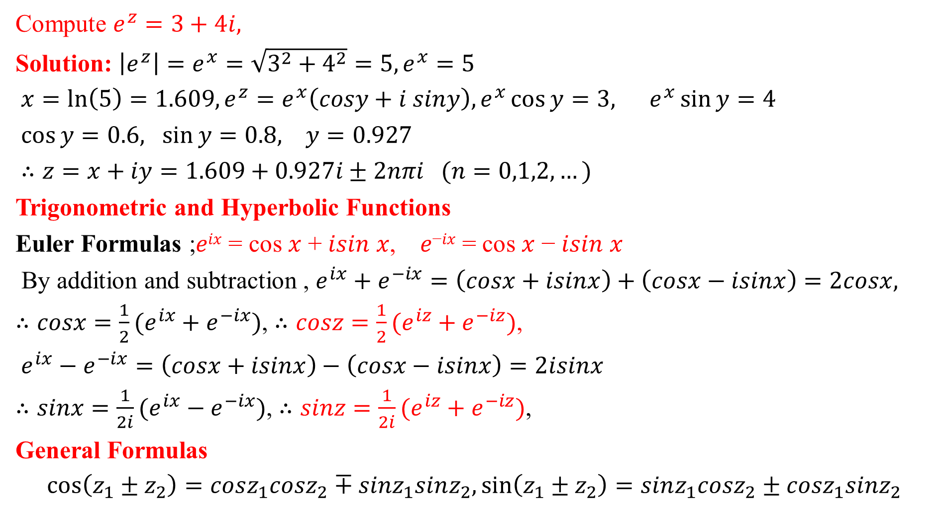
Compute $e^{z}=3+4i,$
Solution: $\left|e^{z}\right|=e^{x}=\sqrt{3^{2}+4^{2}}=5, e^{x}=5$
$x=\ln\left(5\right)=1.609, e^{z}=e^{x}\left(cosy+i siny\right), e^{x}\cos{y}=3, e^{x}\sin{y=4}$
$\cos{y=0.6, \sin{y=0.8, y=0.927}}$
$∴z=x+iy=1.609+0.927i±2nπi (n=0,1,2,…)$
Trigonometric and Hyperbolic Functions
Euler Formulas ;𝑒^{𝑖𝑥} = cos 𝑥 + 𝑖𝑠𝑖𝑛 𝑥, 𝑒^{−𝑖𝑥} = cos 𝑥 − 𝑖𝑠𝑖𝑛 𝑥
By addition and subtraction , $e^{ix}+e^{−ix}=\left(cosx+isinx\right)+\left(cosx−isinx\right)=2cosx,$
$∴cosx=\frac{1}{2}(e^{ix}+e^{−ix})$, $∴cosz=\frac{1}{2}(e^{iz}+e^{−iz})$,
$e^{ix}−e^{−ix}=\left(cosx+isinx\right)−\left(cosx−isinx\right)=2isinx$
$∴sinx=\frac{1}{2i}(e^{ix}−e^{−ix})$, $∴sinz=\frac{1}{2i}(e^{iz}+e^{−iz})$,
General Formulas
$$\cos\left(z_{1}±z_{2}\right)=cosz_{1}cosz_{2}∓sinz_{1}sinz_{2},\sin\left(z_{1}±z_{2}\right)=sinz_{1}cosz_{2}±{cosz}_{1}sinz_{2}$$

Slide 6
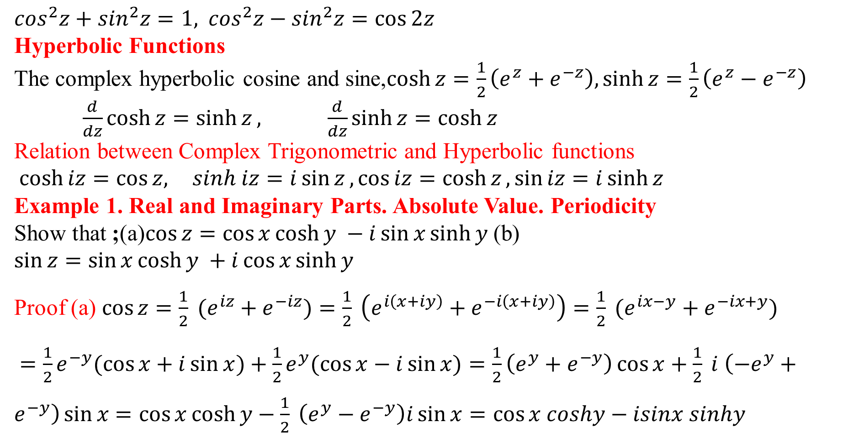
$\cos^{2}z+\sin^{2}z=1,$ $\cos^{2}z−\sin^{2}z=\cos{2z}$
Hyperbolic Functions
The complex hyperbolic cosine and sine,$\cosh{z}=\frac{1}{2}\left(e^{z}+e^{−z}\right), \sinh{z}=\frac{1}{2}\left(e^{z}−e^{−z}\right)$
$\frac{d}{dz}\cosh{z}=\sinh{z}, \frac{d}{dz}\sinh{z}=\cosh{z}$
Relation between Complex Trigonometric and Hyperbolic functions
$\cosh{iz}=\cos{z, } sinh iz=i\sin{z}, \cos{iz}=\cosh{z}, \sin{iz}=i\sinh{z}$
Example 1. Real and Imaginary Parts. Absolute Value. Periodicity
Show that ;(a)$\cos{z=\cos{x\cosh{y }−i\sin{x\sinh{y }}}}$(b) $\sin{z=\sin{x\cosh{y }+i\cos{x\sinh{y}}}}$
Proof (a) $\cos{z=\frac{1}{2} (e^{iz}+e^{−iz})}=\frac{1}{2} \left(e^{i\left(x+iy\right)}+e^{−i\left(x+iy\right)}\right)=\frac{1}{2} (e^{ix−y}+e^{−ix+y})$
$=\frac{1}{2}e^{−y}(\cos{x+i\sin{x})}+\frac{1}{2}e^{y}(\cos{x−i\sin{x)}}=\frac{1}{2}\left(e^{y}+e^{−y}\right)\cos{x}+\frac{1}{2} i \left(−e^{y}+e^{−y}\right)\sin{x}$ $=\cos{x\cosh{y−\frac{1}{2} \left(e^{y}−e^{−y}\right)i\sin{x}}}=\cos{x coshy−isinx sinhy}$

Slide 7

Proof (b): $\sin{z=\frac{1}{2i} \left(e^{iz}−e^{−iz}\right)=\frac{1}{2i} \left(e^{i(x+iy)}−e^{−i(x+iy)}\right)=\frac{1}{2i} \left(e^{ix−y}−e^{−ix+y}\right)}$
$=\frac{1}{2i} \left(e^{ix}. e^{−y}−e^{−ix}.e^{y}\right)$ $=\frac{1}{2i} \left(e^{−y}(\cos{x+i\sin{x})}−e^{y}(\cos{x−i\sin{x}}\right))$
= $\frac{1}{2i} \left(e^{−y}−e^{y}\right)\cos{x}+\frac{1}{2} \left(e^{y}+e^{−y}\right)\sin{x}$
$=\frac{1}{2i}\left(−1\right)\left(e^{y}−e^{−y}\right)\cos{x+\sin{x\cosh{y}}}$
= $\frac{1}{2i} \left(i^{2}\right)\left(e^{y}−e^{−y}\right)\cos{x+\sin{x\cosh{y}}}=i\cos{x\sinh{y+\sin{x\cosh{y}}}}$
= $\sin{x\cosh{y+i\cos{x\sinh{y}}}}$
Example 2. Solution of Equations. Zeros of $cosz$ and $sinz$
Solve (a) $cos⁡z =5$(which has no real solution!) ,(b) $cos⁡z =0$(c)$sin⁡z = 0.$
Solution : (a) $e^{2iz}−10e^{iz}+1=0$from (1) by multiplication by $e^{iz}$ .
This is a quadratic equation in $e^{iz}$, with solutions (rounded off to 3 decimals)

Slide 8
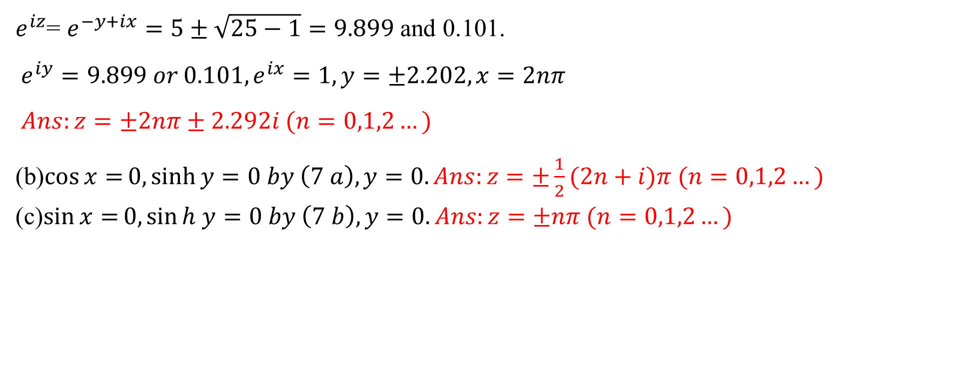
$e^{iz}$= $e^{−y+ix}=5±\sqrt{25−1}=9.899$ and 0.101.
$e^{iy}=9.899 or 0.101,e^{ix}=1,y=±2.202,x=2nπ$
$Ans:z=±2nπ±2.292i (n=0,1,2…)$
(b)$\cos{x=}0,\sinh{y}=0 by \left(7 a\right),y=0. Ans:z=±\frac{1}{2}(2n+i)π (n=0,1,2…)$
(c)$\sin{x=}0,\sin{h y}=0 by \left(7 b\right),y=0. Ans:z=±nπ (n=0,1,2…)$

Slide 9
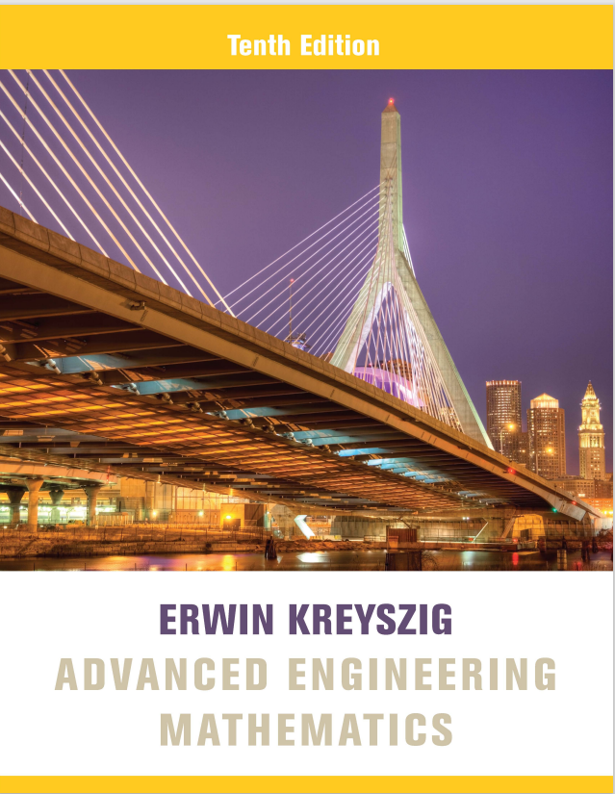
Reference Book
Advanced Engineering Mathematics, Erwin Kreyszig, $10^{th}$ Edition
Thank you

