Slide 1
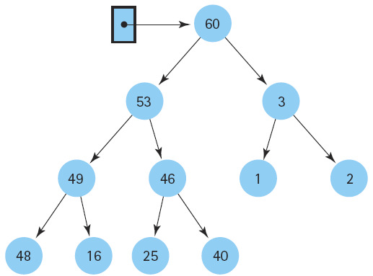
Data Structure and
Algorithm I

Slide 2
Class Outlines
Basic course information
  Course No.
    CEIT 4041
  Course Title
    Data Structures and Algorithms
  Textbook and materials
    Data Structure and Algorithm Analysis by Clifford A. Shaffer
Course Structure
Class Schedules
Grading Policy
Course Outcomes

Slide 3
Course Structure
Semester Four
  Chapter 1 (Data Structures and Algorithms)
  Chapter 3 (Algorithm Analysis)
  Chapter 4 (Lists, Stacks, and Queues)
  Chapter 5 (Binary Trees)
  Chapter 7 (Internal Sorting)
  Chapter 9 (Searching)
  Chapter 10 (Indexing)

Slide 4
Schedule of Classes
No | Topic | Week
1 | Introduction, Data Structures and Algorithms | Week 1
2 | Data Structures and Algorithms | Week 2
3 | Practical / Tutorial | Week 3
4 | Algorithm Analysis | Week 4
5 | Lists, Stacks, and Queues | Week 5
6 | Lists, Stacks, and Queues | Week 6
7 | Practical / Tutorial | Week 7
8 | Binary Trees | Week 8
9 | Binary Trees | Week 9
10 | Indexing | Week 10
11 | Practical / Tutorial | Week 11
12 | Internal Sorting | Week 12
13 | Internal Sorting | Week 13
14 | Searching | Week 14
15 | Practical / Tutorial | Week 15

Slide 5
Grading Policy
Exam → 70%
Practical / Tutorial / Assignment → 30%

Slide 6
Course Outcomes
CO-1 (Analyze the fundamental data structures for representing data)
CO-2 (Design appropriate data structures for solving computing problems)
CO-3 (Evaluate the space and time efficiency of data organization and algorithms)
CO-4 (Develop the abstract data types for various data structures in C++ programming)

Slide 7
